Slide 1

Semantic Web
Group 2: Ramiro Lopez Cento, Marco Ciccale and Guillermo Izquierdo

Slide 2
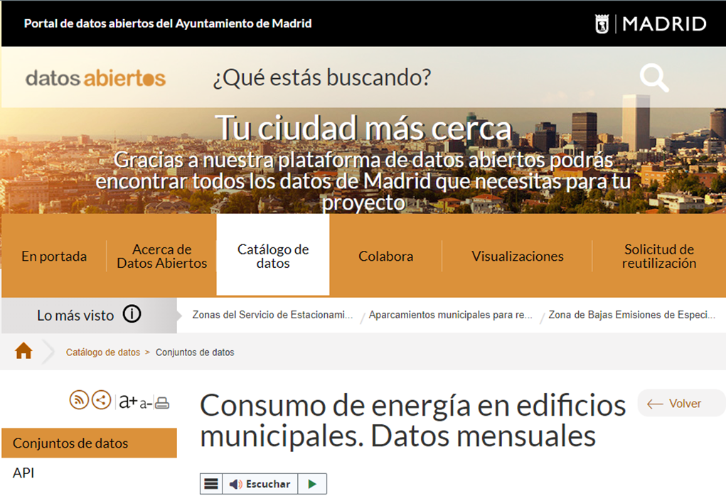
HO1 – Dataset selection
Dataset Requirements
Aplication Requirements

Slide 3
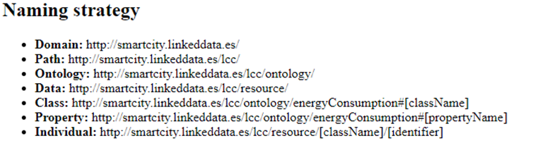
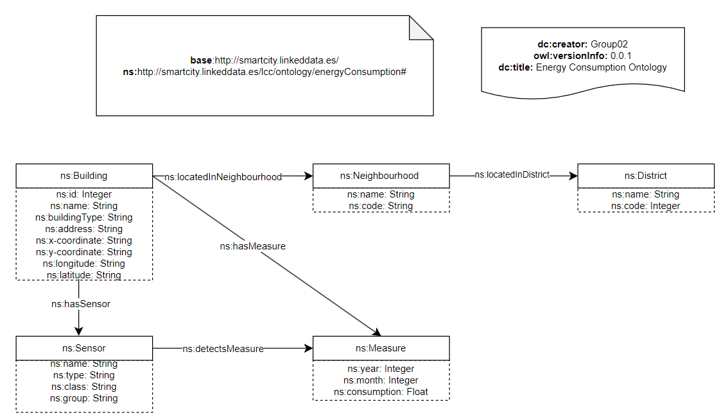

HO2 – Analyze dataset, define RNS and develop lightweight ontology
ontology.ttl

Slide 4



HO3 – OpenRefine: Cleaning Data
updated_dataset.csv
dataset.csv
history.json

Slide 5




HO4 – Transform Data to RDF
MATEY
YARRRML
RML
morph
Knowledge Graph
updated_dataset.csv

Slide 6
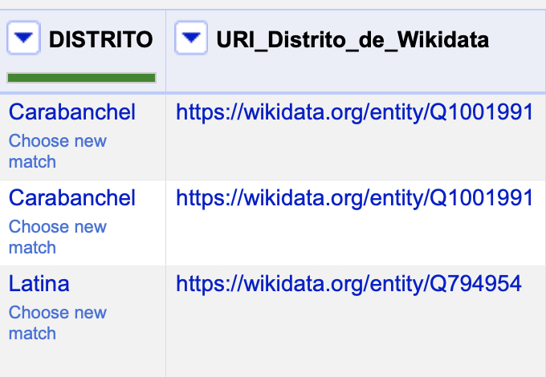
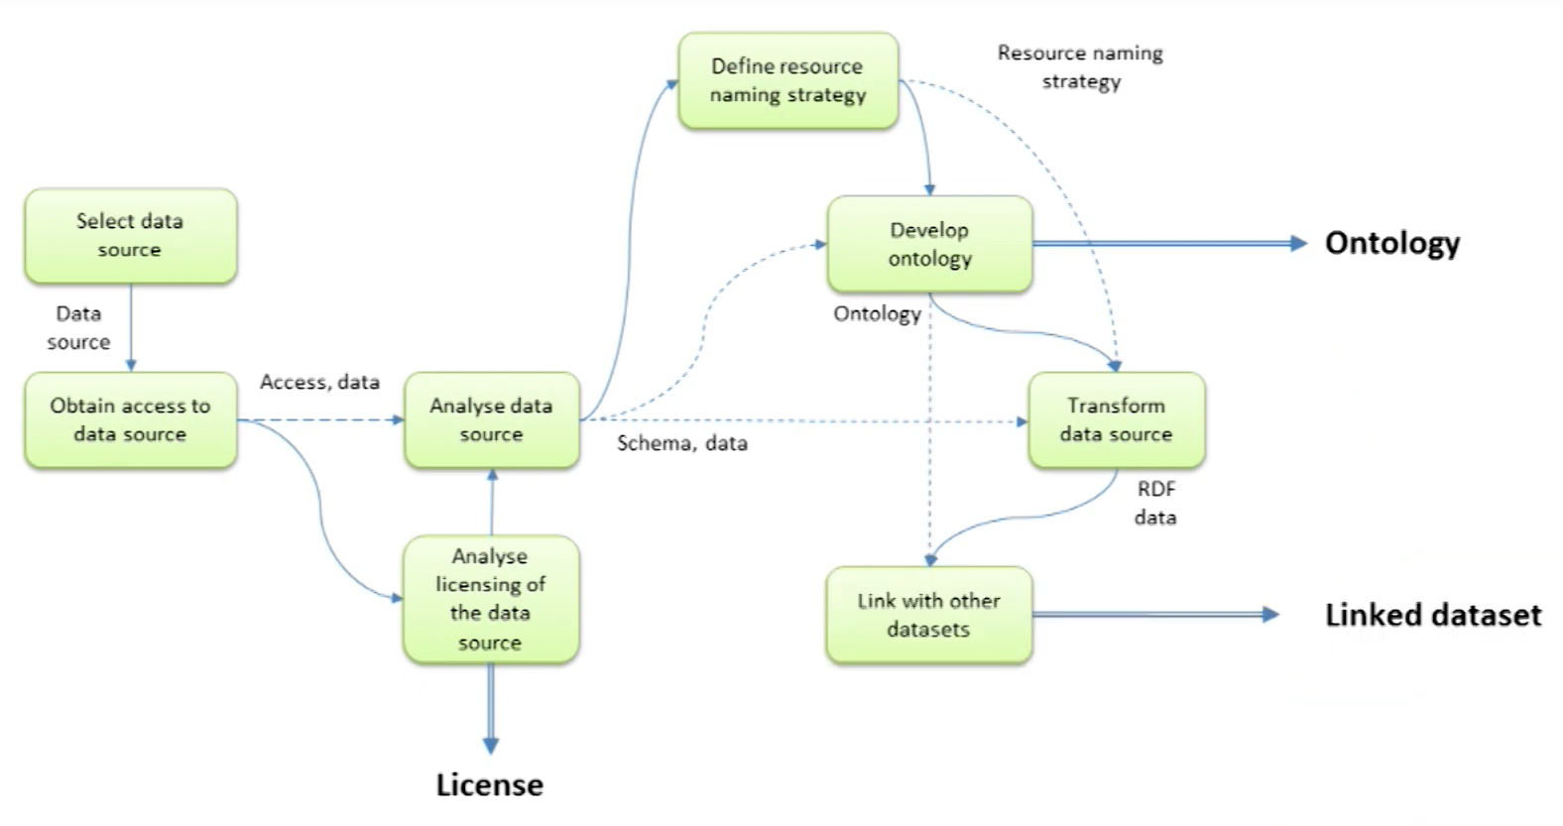
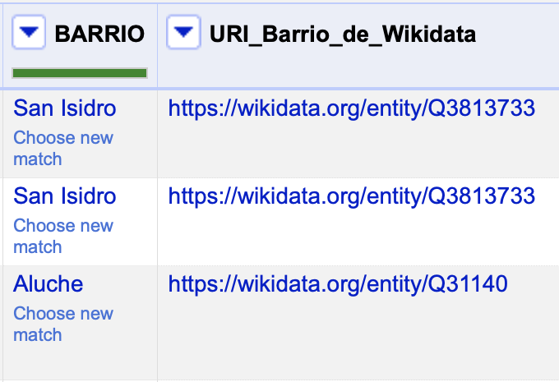
HO5 – WikiData Linking
Reconciliation Services

Slide 7
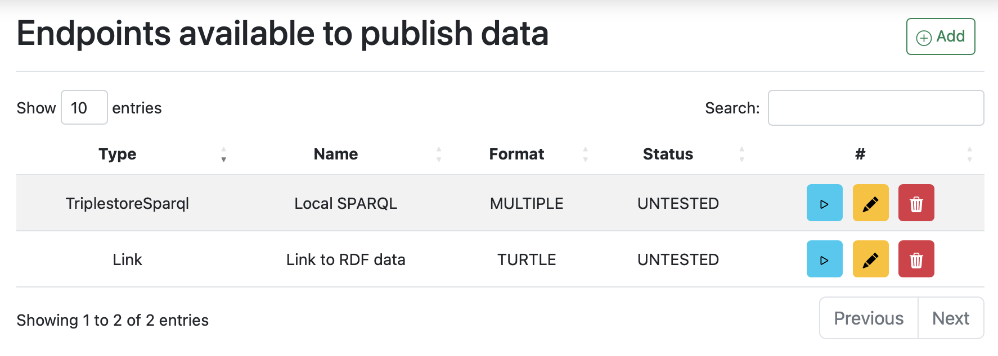
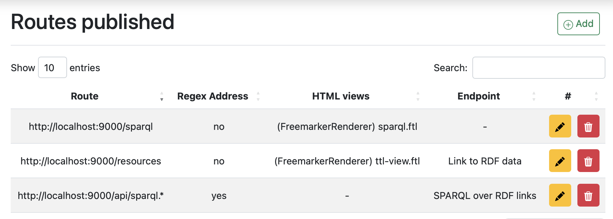
HO-Publish Linked Data (Helio)
Knowledge Graph

Slide 8
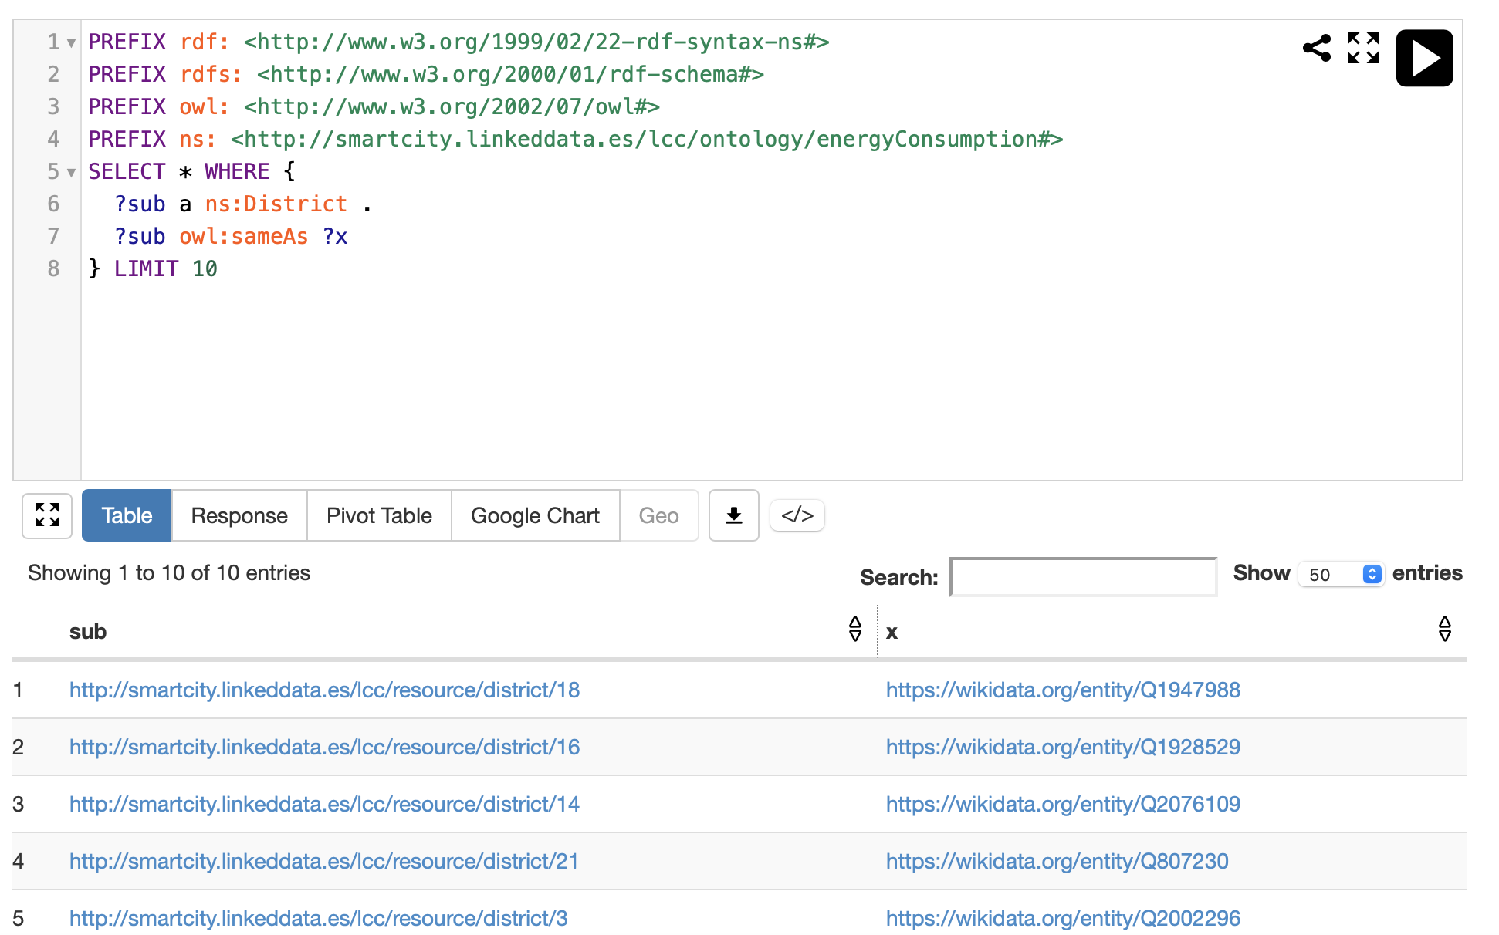
SParQL result:

Slide 9
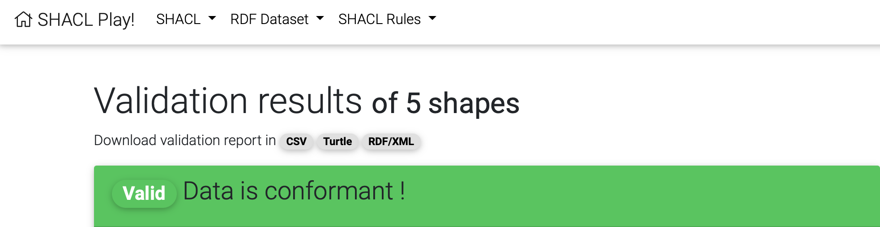
HO-SHACL Validation
Create shapes inferred from ontology (Astrea)
Report validation

Slide 10

App Demo

