Slide 1
WEB-007 JavaScript
ver. 1.0

Slide 2
WEB-007 JavaScript
jQuery
ver. 1.0

Slide 3
jQuery
jQuery overview
jQuery DOM selectors
DOM manipulations
CSS manipulations
Use jQuery for creating event handlers
Using jQuery to create effects

Slide 4
Overview
What is jQuery
is a JavaScript library
it's free and open source
started by John Resig, an american software engineer

Slide 5
Overview
What jQuery does
finds elements
reads and changes HTML content
reads and changes CSS
creates new elements
deletes existing elements
listens to user events (click, mouse move, key press)
animates content
sends and receives data over network
jQuery does this CONSISTENTLY, for all browsers

Slide 6
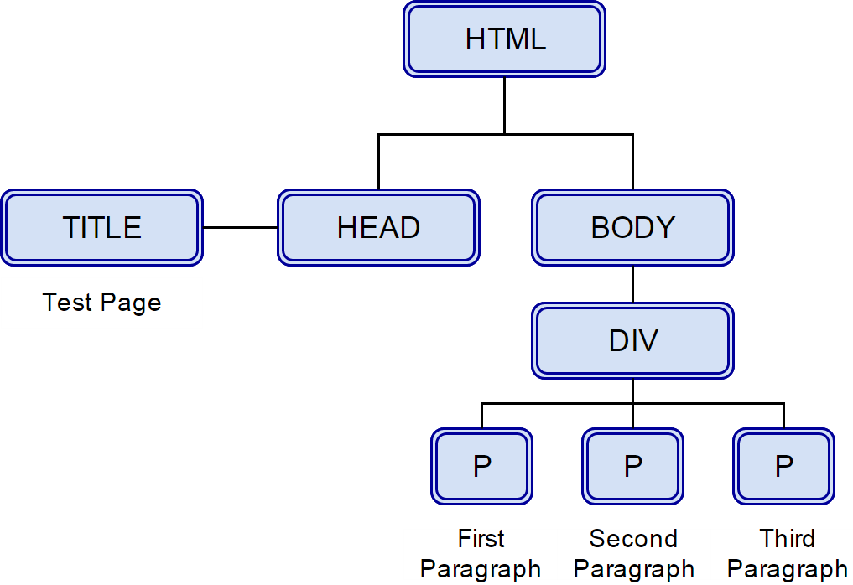
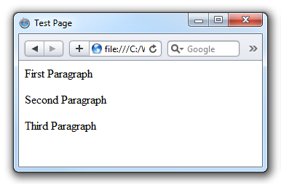
HTML page and its DOM
<html> <head> <title>Test Page</title> </head> <body> <div id="myDiv"> <p class="myClass">First Paragraph</p> <p>Second Paragraph</p> <p>Third Paragraph</p> </div> </body> </html>

Slide 7
jQuery DOM selectors
// div element (selected by id) var myDiv = $("#myDiv") // first paragraph (selected by class) var myParagraph = $("p.myClass") // last paragraph var myDiv = $("#myDiv:last-child") // all paragraphs in div elements var myDiv = $("div > p") // second paragraph var myDiv = $("p:contains('Second')") // first and third paragraphs var myDiv = $("div > p:odd")

Slide 8
HTML page and its DOM
<html> <head> <title>Test Page</title> </head> <body> <div id="myDiv"> <p class="myClass">First Paragraph</p> <p>Second Paragraph</p> <p>Third Paragraph</p> </div> </body> </html>
var myParagraph = $("p.myClass")

Slide 9
HTML page and its DOM
<html> <head> <title>Test Page</title> </head> <body> <div id="myDiv"> <p class="myClass">First Paragraph</p> <p>Second Paragraph</p> <p>Third Paragraph</p> </div> </body> </html>
var myDiv = $("#myDiv")

Slide 10
HTML page and its DOM
<html> <head> <title>Test Page</title> </head> <body> <div id="myDiv"> <p class="myClass">First Paragraph</p> <p>Second Paragraph</p> <p>Third Paragraph</p> </div> </body> </html>
var myParagraphs = $("p")

Slide 11
HTML page and its DOM
<html> <head> <title>Test Page</title> </head> <body> <div id="myDiv"> <p class="myClass">First Paragraph</p> <p>Second Paragraph</p> <p>Third Paragraph</p> </div> </body> </html>
var secondParagraph = $("p[value*=Second]");

Slide 12
jQuery selector
Selector | Selecting...
$("p") | by type (all paragraphs)
$("#some_id") | by ID
$(".some_class") | by class
$("input[type=radio]") | by attribute (radio input types)
$("input[name!=submit]") | inverted attribute
$("input[value^=test]") | begins with string
$("input[value$=test]") | ends with string
$("input[value~=test]") | if contains the word
$("input[value*=test]") | if contains a string
$("input:checked") | by checked

Slide 13
jQuery selector
Selector | Selecting...
$("button:disabled") | by disabled
$("button:enabled") | by enabled
$("div:empty") | by empty (all empty divs)
$("li:even") | by even elements
$("li:odd") | by odd elements
$(".some_class:first") | first element
$(".some_class:last") | last element
$(".some_class:first-child") | first child
$(".some_class:last-child") | last child
$("p:contains('text')") | by text inside

Slide 14
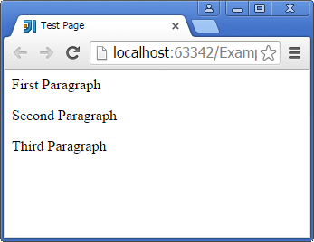
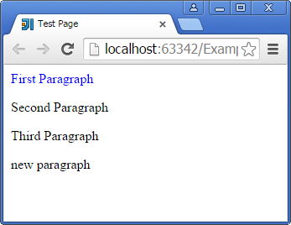
DOM manipulations
jQuery: Examples
$("#myP").css("color", "blue"); // makes text blue p = document.createElement("p");// creates new P element in memory $(p).html('new paragraph'); // sets text in new paragraph in memory $("#myDiv").append(p); // adds new paragraph to a div element
Before
After

Slide 15
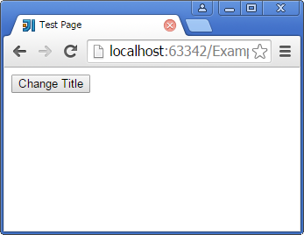
DOM manipulations
DOM: Examples
<button onclick="javascript: changeTitle()">Change Title</button> <script type="application/javascript"> function changeTitle() { document.title = "New Pretty Title!" } </script>

Slide 16
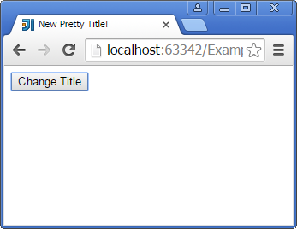
DOM manipulations
DOM: Examples
<button onclick="javascript: changeTitle()">Change Title</button> <script type="application/javascript"> function changeTitle() { document.title = "New Pretty Title!" } </script>

Slide 17
DOM Insertion, Around
Function | Result
.unwrap() | Remove the parents of the set of matched elements from the DOM, leaving the matched elements in their place
.wrap() | Wrap an HTML structure around each element in the set of matched elements
.wrapAll() | Wrap an HTML structure around all elements in the set of matched elements
.wrapInner() | Wrap an HTML structure around the content of each element in the set of matched elements

Slide 18
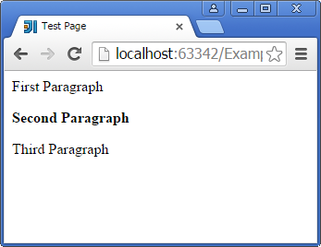
DOM Insertion, Around
<html> <head> <title>Test Page</title></head> <body> <div id="myDiv"> <p>First Paragraph</p> <p id="second">Second Paragraph</p> <p>Third Paragraph</p> </div> </body> </html>
jQuery:
$("p#second").wrapInner("<b></b>");

Slide 19
DOM Insertion, Outside
Function | Result
.after() | Insert content, specified by the parameter, after each element in the set of matched elements
.before() | Insert content, specified by the parameter, before each element in the set of matched elements
.insertAfter() | Insert every element in the set of matched elements after the target
.insertBefore() | Insert every element in the set of matched elements before the target

Slide 20
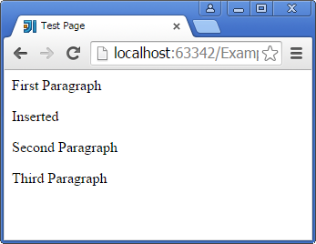
DOM Insertion, Outside
<html> <head> <title>Test Page</title></head> <body> <div id="myDiv"> <p>First Paragraph</p> <p id="second">Second Paragraph</p> <p>Third Paragraph</p> </div> </body> </html>
jQuery:
$("p#second").before("<p>Inserted</p>");

Slide 21
DOM Removal
Function | Result
.detach() | Remove the set of matched elements from the DOM
.empty() | Remove all child nodes of the set of matched elements from the DOM
.remove() | Remove the set of matched elements from the DOM

Slide 22
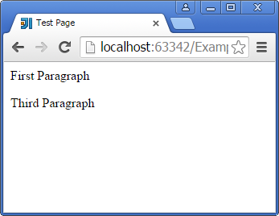
DOM Removal
<html> <head> <title>Test Page</title></head> <body> <div id="myDiv"> <p>First Paragraph</p> <p id="second">Second Paragraph</p> <p>Third Paragraph</p> </div> </body> </html>
jQuery:
$("p#second").remove();

Slide 23
DOM Replacement
Function | Result
.replaceAll() | Replace each target element with the set of matched elements
.replaceWith() | Replace each element in the set of matched elements with the provided new content and return the set of elements that was removed.

Slide 24
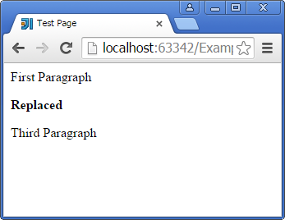
DOM Replacement
<html> <head> <title>Test Page</title></head> <body> <div id="myDiv"> <p>First Paragraph</p> <p id="second">Second Paragraph</p> <p>Third Paragraph</p> </div> </body> </html>
jQuery:
$("p#second").
replaceWith("<b>Replaced</b>");

Slide 25
CSS manipulations
Function | Result
.addClass() | Add the specified class(es) to each of the set of matched elements
.hasClass() | Determine whether any of the matched elements are assigned the given class
.removeClass() | Remove a single class, multiple classes, or all classes from each element in the set of matched elements
.toggleClass() | Add or remove one or more classes from each element in the set of matched elements, depending on either the class’s presence or the value of the switch argument

Slide 26
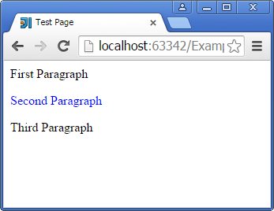
Class Attribute
<html> <head> <title>Test Page</title> <style>.blue { color: blue; }</style> </head> <body> <div id="myDiv"> <p>First Paragraph</p> <p id="second">Second Paragraph</p> <p>Third Paragraph</p> </div> </body> </html>
jQuery:
$("p#second").addClass("blue");

Slide 27
Manipulate functions: General Attributes
Function | Result
.attr() | Get the value of an attribute for the first element in the set of matched elements or set one or more attributes for every matched element
.prop() | Get the value of a property for the first element in the set of matched elements or set one or more properties for every matched element
.removeAttr() | Remove an attribute from each element in the set of matched elements
.removeProp() | Remove a property for the set of matched elements

Slide 28
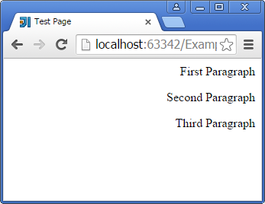
Manipulate functions: General Attributes
<html> <head> <title>Test Page</title></head> <body> <div id="myDiv"> <p>First Paragraph</p> <p id="second">Second Paragraph</p> <p>Third Paragraph</p> </div> </body> </html>
jQuery:
$("div#myDiv").attr("align", "right");

Slide 29
Style Properties
Function | Result
.css() | Get the value of a style property for the first element in the set of matched elements or set one or more CSS properties for every matched element
.height() | Get the current computed height for the first element in the set of matched elements or set the height of every matched element
.width() | Get the current computed width for the first element in the set of matched elements or set the width of every matched element
.innerHeight() | Get the current computed inner height (including padding but not border) for the first element in the set of matched elements or set the inner height of every matched element
.innerWidth() | Get the current computed inner width (including padding but not border) for the first element in the set of matched elements or set the inner width of every matched element

Slide 30
Style Properties
Function | Result
.offset() | Get the current coordinates of the first element, or set the coordinates of every element, in the set of matched elements, relative to the document
.outerHeight() | Get the current computed height for the first element in the set of matched elements, including padding, border, and optionally margin. Returns a number (without “px”) representation of the value or null if called on an empty set of elements
.outerWidth() | Get the current computed width for the first element in the set of matched elements, including padding and border
.position() | Get the current coordinates of the first element in the set of matched elements, relative to the offset parent
.scrollLeft() | Get the current horizontal position of the scroll bar for the first element in the set of matched elements or set the horizontal position of the scroll bar for every matched element
.scrollTop() | Get the current vertical position of the scroll bar for the first element in the set of matched elements or set the vertical position of the scroll bar for every matched element

Slide 31
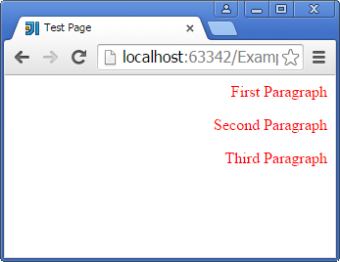
Style Properties
<html> <head> <title>Test Page</title></head> <body> <div id="myDiv"> <p>First Paragraph</p> <p id="second">Second Paragraph</p> <p>Third Paragraph</p> </div> </body> </html>
jQuery:
$("p").css("color", "red");

Slide 32
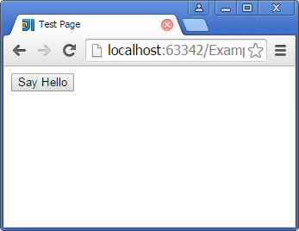
Use jQuery for creating event handlers
<button id="myButton">Say Hello</button>
<script> $("#myButton").click(function (e) { alert("Hello, World!") }); </script>

Slide 33
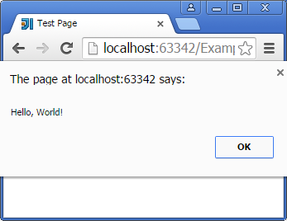
Use jQuery for creating event handlers
<button id="myButton">Say Hello</button>
<script> $("#myButton").click(function (e) { alert("Hello, World!") }); </script>

Slide 34
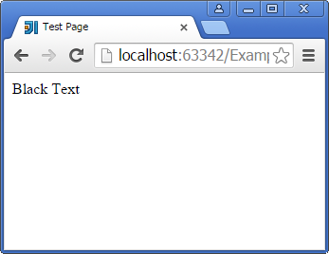
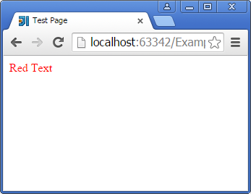

Use jQuery for creating event handlers
<p id="paragraph">Black Text</p>
<script> $("#paragraph").hover(function(e) { $("#paragraph").html("Red Text").css('color', 'red') }); </script>

Slide 35
Browser Events
Function | Result
.resize() | Bind an event handler to the “resize” JavaScript event, or trigger that event on an element
.scroll() | Bind an event handler to the “scroll” JavaScript event, or trigger that event on an element

Slide 36
Document Loading Events
Function | Result
.load() | Bind an event handler to the “load” JavaScript event
.ready() | Specify a function to execute when the DOM is fully loaded
.unload() | Bind an event handler to the “unload” JavaScript event

Slide 37
Form Events
Function | Result
.blur() | Bind an event handler to the “blur” JavaScript event, or trigger that event on an element
.change() | Bind an event handler to the “change” JavaScript event, or trigger that event on an element
.focus() | Bind an event handler to the “focus” JavaScript event, or trigger that event on an element
.focusin() | Bind an event handler to the “focusin” event
.select() | Bind an event handler to the “select” JavaScript event, or trigger that event on an element
.submit() | Bind an event handler to the “submit” JavaScript event, or trigger that event on an element

Slide 38
Keyboard Events
Function | Result
.focusout() | Bind an event handler to the “focusout” JavaScript event
.keydown() | Bind an event handler to the “keydown” JavaScript event, or trigger that event on an element
.keypress() | Bind an event handler to the “keypress” JavaScript event, or trigger that event on an element
.keyup() | Bind an event handler to the “keyup” JavaScript event, or trigger that event on an element

Slide 39
Mouse Events
Function | Result
.click() | Bind an event handler to the “click” JavaScript event
.dblclick() | Bind an event handler to the “dblclick” JavaScript event
.hover() | Bind one or two handlers to the matched elements, to be executed when the mouse pointer enters and leaves the elements
.mousedown() | Bind an event handler to the “mousedown” JavaScript event
.mousemove() | Bind an event handler to the “mousemove” JavaScript event
.mouseout() | Bind an event handler to the “mouseout” JavaScript event
.mouseover() | Bind an event handler to the “mouseover” JavaScript event
.mouseup() | Bind an event handler to the “mouseup” JavaScript event

Slide 40
Using jQuery to create effects
Animate allows creating animation effects on any numeric CSS property
Can animate: width, height, border, position left or right, border left or right, border size, transparency, font size
Example:
http://jsfiddle.net/vaysman/2r0r293u/
http://jsfiddle.net/vaysman/8totmzju/

Slide 41
Animation functions
Function | Result
.animate() | Perform a custom animation of a set of CSS properties.
.fadeIn() | Display the matched elements by fading them to opaque
.fadeOut() | Hide the matched elements by fading them to transparent.
.fadeTo() | Adjust the opacity of the matched elements.
.fadeToggle() | Display or hide the matched elements by animating their opacity.
.hide() | Hide the matched elements.
.show() | Display the matched elements.
.toggle() | Display or hide the matched elements.
.slideDown() | Display the matched elements with a sliding motion.
.slideUp() | Hide the matched elements with a sliding motion.
.slideToggle() | Display or hide the matched elements with a sliding motion.

Slide 42
jQuery
jQuery overview
jQuery DOM selectors
DOM manipulations
CSS manipulations
Use jQuery for creating event handlers
Using jQuery to create effects

