Slide 1
WEB-007 JavaScript
ver. 1.0

Slide 2
WEB-007 JavaScript
Events
ver. 1.0

Slide 3
Events
Events-driven development
Attach event handlers
Browsers events
Document loading events
Form events
Keyboard events
Mouse events

Slide 4
Events-driven development
Notes:
Client-side JavaScript programs use an asynchronous event-driven programming model
In this style of programming, the web browser generates an event whenever something interesting happens to the document or browser or to some element or object associated with it
For example, the web browser generates an event when it finishes loading a document, when the user moves the mouse over a hyperlink, or when the user strikes a key on the keyboard
If a JavaScript application cares about a particular type of event, it can register one or more functions to be invoked when events of that type occur

Slide 5
Events-driven development
<table id="outside"> <tr><td id="t1">one</td></tr> <tr><td id="t2">two</td></tr> </table>
// Function to change the content of t2 function modifyText() { var t2 = document.getElementById("t2"); if (t2.firstChild.nodeValue == "three") { t2.firstChild.nodeValue = "two"; } else { t2.firstChild.nodeValue = "three"; } } // add event listener to table var el = document.getElementById("outside"); el.addEventListener("click", modifyText, false);
Notes:
An event handler or event listener is a function that handles or responds to an event
Applications register their event handler functions with the web browser, specifying an event type and an event target
When an event of the specified type occurs on the specified target, the browser invokes the handler
When event handlers are invoked for an object, we sometimes say that the browser has “fired”, “triggered”, or “dispatched” the event
An event object is an object that is associated with a particular event and contains details about that event

Slide 6
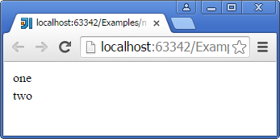
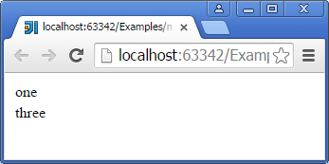

Events-driven development
Click

Slide 7
Events-driven development
<div id="test"></div>
document.getElementById("test").addEventListener("click", function( event ) { // display the current click count inside the clicked div event.target.innerHTML = "click count: " + event.detail; }, false);

Slide 8
Event object
Property | Description
bubbles | A boolean indicating whether the event bubbles up through the DOM or not
cancelable | A boolean indicating whether the event is cancelable
defaultPrevented | Indicates whether or not event.preventDefault() has been called on the event
currentTarget | A reference to the currently registered target for the event
target | A reference to the target to which the event was originally dispatched
type | The name of the event (case-insensitive)
Notes:
Event objects are passed as an argument to the event handler function
All event objects have a type property that specifies the event type and a target property that specifies the event target
Each event type defines a set of properties for its associated event object.
For example, the object associated with a mouse event includes the coordinates of the mouse pointer, and the object associated with a keyboard event contains details about the key that was pressed and the modifier keys that were held down

Slide 9
Event object
Method | Description
preventDefault() | Cancels the event (if it is cancelable)
stopImmediatePropagation() | For this particular event, no other listener will be called. Neither those attached on the same element, nor those attached on elements which will be traversed later (in capture phase, for instance)
stopPropagation() | Stops the propagation of events further along in the DOM
Notes:
Event objects are passed as an argument to the event handler function
All event objects have a type property that specifies the event type and a target property that specifies the event target
Each event type defines a set of properties for its associated event object.
For example, the object associated with a mouse event includes the coordinates of the mouse pointer, and the object associated with a keyboard event contains details about the key that was pressed and the modifier keys that were held down

Slide 10
Attach event handlers
Older way to register event listeners
// Pass a function reference — do not add '()' after it,
// which would call the function! el.onclick = modifyText; // Using a function expression element.onclick = function() { // ... function logic ... };
<p onclick="paragraphClicked(this);">Paragraph</p> <script> function paragraphClicked(that) { // accessing to event object using global scope window.event.target.innerHTML = "Hello"; that.innerHTML = "Hello"; } </script>
Notes:
There are two basic ways to register event handlers:
The first, from the early days of the Web, is to set a property on the object or document element that is the event target
The second, newer and more general, technique is to pass the handler to a method of the object or element
You can set an event handler property in JavaScript code, or for document elements, you can set the corresponding attribute directly in HTML
For handler registration by method invocation, there is a standard method, named addEventListener(), that is supported by all browsers except IE8 and before, and a different method, named attach Event() , for all versions of IE before IE9

Slide 11
Attach event handlers
By convention, event handler properties have names that consist of the word “on” followed by the event name: onclick, onchange, onload, onmouseover, and so on
// Set the onload property of the Window object to a function. // The function is the event handler: it is invoked when the document loads. window.onload = function() { // Look up a <form> element var elt = document.getElementById("shipping_address"); // Register an event handler function that will be invoked right // before the form is submitted. elt.onsubmit = function() { return validate(this); } }
Notes:
The event handler properties of a document element can also be set as attributes on the corresponding HTML tag
The attribute value should be a string of JavaScript code. That code should be the body of the event handler function, not a complete function declaration. That is, your HTML event handler code should not be surrounded by curly braces and prefixed with the function keyword
A common style in client-side programming involves keeping HTML content separate from JavaScript behavior. Programmers who follow this discipline shun (or at least avoid) HTML event handler attributes, since they directly mix JavaScript and HTML

Slide 12
Handler return value
For event handlers registered as properties the return value of an event handler tells the browser that it should or should not perform the default action associated with the event
<a href="http://google.com" id="link">Don't go to Google</a> <script> document.getElementById("link").onclick = cancelHandler; function cancelHandler(event) { return false; // cancel the default action associated with the event } </script>
Notes:
In browsers that support addEventListener(), you can also cancel the default action for an event by invoking the preventDefault()

Slide 13
Attach event handlers
The new way to register event listeners
document.getElementById("myBtn").addEventListener("click", myFunction); function myFunction() { document.getElementById("demo").innerHTML = "Hello World"; } // using anonymous function document.getElementById("myBtn").addEventListener("click", function() { myFunction(); });
Notes:
addEventListener() takes three arguments
The first is the event type for which the handler is being registered. The event type (or name) is a string and it should not include the “on” prefix that is used when setting event handler properties.
The second argument to addEventListener() is the function that should be invoked when the specified type of event occurs.
The final argument to addEventListener() is a boolean value. Normally, you’ll pass false for this argument. If you pass true instead, your function is registered as a capturing event handler and is invoked at a different phase of event dispatch.
Internet Explorer, prior to IE9, does not support addEventListener() and remove Event Listener() . In IE5 and later, it defines similar methods attachEvent() and detachEvent()
The attachEvent() and detachEvent() methods work like addEventListener() and removeEventListener(), with the following exceptions:
Since the IE event model does not support event capturing, attachEvent() and detachEvent() expect only two arguments: the event type and the handler function
The first argument to the IE methods is an event handler property name, with the “on” prefix, rather than the unprefixed event type. For example, pass “onclick” to attachEvent() where you would pass “click” to addEventListener()
attachEvent() allows the same event handler function to be registered more than once. When an event of the specified type occurs, the registered function will be invoked as many times as it was registered

Slide 14
Attach event handlers
<button id="mybutton">Click me</button> <script> var b = document.getElementById("mybutton");
// onclick b.onclick = function () { alert("Thanks for clicking me!"); };
// but click b.addEventListener("click", function () { alert("Thanks again!"); }, false); </script>

Slide 15
Remove event handlers
// Attach an event handler to <div> document.getElementById("myDIV").addEventListener("click", myFunction); // Remove the event handler from <div> document.getElementById("myDIV").removeEventListener("clic", myFunction);

Slide 16
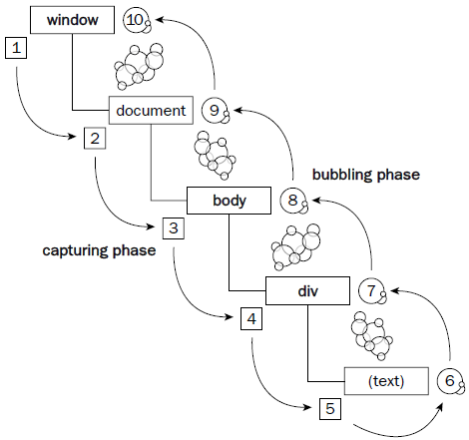
Bubbling and Capturing
Clicking the span is actually a click on every element in this page
The events bubble from the bottom of the DOM tree to the top
<body> <div> Text </div> </body>

Slide 17
Bubbling and Capturing
<div id="div1"> <div id="div2"> <p id="para">Text</p> </div> </div> <script> function sayDiv1(event) { console.log("div1"); } function sayDiv2(event) { console.log("div2"); } function sayPara(event) { console.log("para"); event.stopPropagation(); } document.getElementById("div1").addEventListener("click", sayDiv1, true); document.getElementById("div2").addEventListener("click", sayDiv2); document.getElementById("para").addEventListener("click", sayPara); </script>

Slide 18
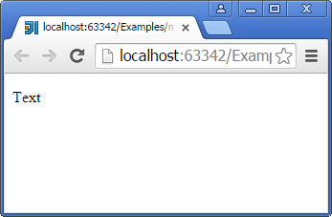
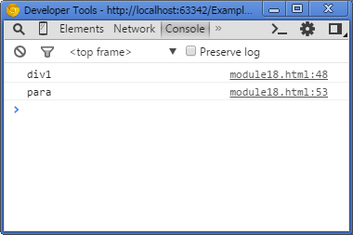
Bubbling and Capturing
Click

Slide 19
Browsers events
Some event types are directed at the browser as a whole, rather than at any particular document element
In JavaScript, handlers for these events are registered on the Window object. In HTML, we place them on the <body> tag, but the browser registers them on the Window

Slide 20
Browsers events
Event Handler | Description
onload | The browser have finished loading document
onunload | The document is being unloaded
beforeunload | The window, the document and its resources are about to be unloaded
onpageshow | A session history entry is being traversed to
onpagehide | A session history entry is being traversed from
onpopstate | The active history entry changes between two history entries for the same document
onhashchange | A window's hash changes
onafterprint | The user prints or aborts a print dialog
onbeforeprint | The document is about to be printed or previewed for printing
ononline | The browser has gained access to the network
onoffline | The browser has lost access to the network

Slide 21
Browsers events
Event Handler | Description
onfocus | The document has received focus
onblur | The document has lost focus
onresize | The document view has been resized
onmessage | A message has been received
onerror | An error occurs when loading a document or an image
onstorage | A Web Storage area is updated
onundo | The document performs an undo
onredo | The document performs a redo

Slide 22
Browser events
<body onload="checkCookies()"> <script> function checkCookies() { var text = ""; if (navigator.cookieEnabled == true) { text = "Cookies are enabled."; } else { text = "Cookies are not enabled."; } document.getElementById("demo").innerHTML = text; } </script>

Slide 23
Browser events
<button onclick="changePart()">Try it</button> <p id="demo"></p> <script> // Using the location.hash property to change the anchor part function changePart() { location.hash = "hash"; var x = location.hash; document.getElementById("demo").innerHTML = "The hash is now: " + x; } window.onhashchange = logHash; function logHash() { console.log("The hash part has changed!"); } </script>

Slide 24
Form events
Form element | Event handler | Description and events
Buttons, Submit, Reset | onclick | The user clicks on an element
Checkbox, Radio buttons, Input, List box, Textarea | onchange | The content of a form element, the selection, or the checked state have changed
All elements | onfocus | An element gets focus
All elements | onblur | An element loses focus
form | onsubmit | A form is submitted
form | onreset | A form is reset

Slide 25
Form events
<form name="myForm3" onsubmit="return validateForm()"> First name: <input type="text" name="fname"> <input type="submit" value="Submit"> </form> <script> function validateForm() { var x = document.forms["myForm3"]["fname"].value; if (x == null || x == "") { alert("First name must be filled out"); return false; } } </script>

Slide 26
Form events
Server name: <input type="text" name="server" id="server"> <script> document.getElementById("server").addEventListener("change", function(event) { get(event.target.value); }); function get(server) { // request something from server console.log(server); } </script>

Slide 27
Keyboard events
Event | Description
keydown | A key is pressed down
keyup | A key is released
keypress | A key is pressed down and that key normally produces a character value
Notes:
The keydown and keyup events are fired when the user presses or releases a key on the keyboard
They are generated for modifier keys, function keys, and alphanumeric keys
If the user holds the key down long enough for it to begin repeating, there will be multiple keydown events before the keyup event arrives
The event object associated with these events has a numeric keyCode property that specifies which key was pressed.

Slide 28
Keyboard events
Property | Description
char | The character value of the key
key | The key value of the key represented by the event
charCode | The Unicode reference number of the key; this attribute is used only by the keypress event (deprecated)
keyCode | A system and implementation dependent numerical code identifying the unmodified value of the pressed key (deprecated)
ctrlKey | true if the control key was down when the event was fired
shiftKey | true if the shift key was down when the event was fired
altKey | true if the alt key was down when the event was fired
metaKey | true if the meta key was down when the event was fired
Notes:
Specific property of Keyboard eventFor keys that generate printable characters, the keyCode is generally the Unicode encoding of the primary character that appears on the key
Letter keys always generate uppercase keyCode values, regardless of the state of the Shift key
Number keys always generate keyCode values for the digit that appears on the key, even if you are holding down Shift in order to type a punctuation character
For nonprinting keys, the keyCode property will be some other value. These keyCode values have never been standardized, but reasonable cross-browser compatibility is possible
you should use char and key instead, if available.

Slide 29
Keyboard events
<input type="text" id="demo" onkeydown="keydownFunc()" onkeyup="keyupFunc()"> <script> function keydownFunc() { document.getElementById("demo").style.backgroundColor = "red"; } function keyupFunc() { document.getElementById("demo").style.backgroundColor = "green"; } </script>

Slide 30
Keyboard events
<input type="text" id="demo3"> <script> document.getElementById("demo3").addEventListener("keypress", myFunction); function myFunction(event) { var color = "white"; switch (event.keyCode) { case 114: color = "red"; break; case 103: color = "green"; break; case 98: color = "blue"; break; default: color = "white"; } document.getElementById("demo3").style.backgroundColor = color; } </script>
Notes:
Del key does nothing

Slide 31
Mouse events
Type | Description
click | A higher-level event fired when the user presses and releases a mouse button or otherwise “activates” an element
dblclick | Fired when the user double-clicks the mouse
contextmenu | A cancelable event fired when a contextmenu is about to be popped up. Current browsers display context menus on right mouse clicks, so this event can also be used like the click event
mousedown | Fired when the user presses a mouse button
mouseup | Fired when the user releases a mouse button
mousemove | Fired when the user moves the mouse

Slide 32
Mouse events
Type | Description
mouseover | Fired when the mouse enters an element
mouseout | Fired when the mouse leaves an element
mouseenter | Like “mouseover”, but does not bubble
mouseleave | Like “mouseout”, but does not bubble

Slide 33
MouseEvent
Property | Description
screenX | The X coordinate of the mouse pointer in global (screen) coordinates
screenY | The Y coordinate of the mouse pointer in global (screen) coordinates
clientX | The X coordinate of the mouse pointer in local (DOM content) coordinates
clientY | The Y coordinate of the mouse pointer in local (DOM content) coordinates
button | The button number that was pressed when the mouse event was fired: Left button=0, middle button=1 (if present), right button=2
ctrlKey, shiftKey, altKey, metaKey | Same as in KeyboardEvent
Notes:
The object passed to mouse event handlers has clientX and clientY properties that specify the coordinates of the mouse pointer relative to the containing window
The altKey, ctrlKey, metaKey, and shiftKey properties specify whether various keyboard modifier keys were held down when the event occurred
The button property specifies which mouse button, if any, was held down when the event occurred

Slide 34
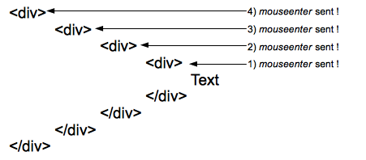
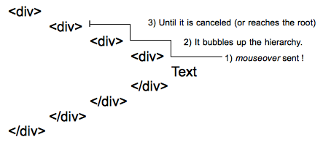
mouseenter & mouseover
mouseenter
mouseover
Notes:
One mouseenter event is sent to each element of the hierarchy when entering them. Here 4 events are sent to the four elements of the hierarchy when the pointer reaches the text.
One single mouseover event is sent to the deepest element of the DOM tree, then it bubbles up the hierarchy until it is canceled by a handler or reaches the root.

Slide 35
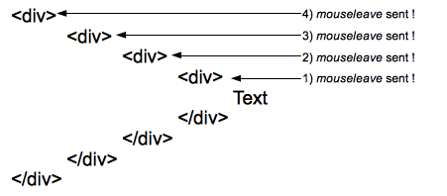

mouseleave & mouseout
mouseleave
mouseout

Slide 36
Mouse events
<div id="enter" style="border: solid"> <h3 id="demo4">mouseenter</h3> <h3>Mouse over me</h3> </div> <div id="over" style="border: solid"> <h3 id="demo5">mouseover</h3> <h3>Mouse over me</h3> </div>

Slide 37
Mouse events
demo4 = document.getElementById("demo4"); demo5 = document.getElementById("demo5"); document.getElementById("enter").addEventListener("mouseenter", mouseEnter); document.getElementById("enter").addEventListener("mouseleave", mouseLeave); document.getElementById("over").addEventListener("mouseover", mouseOver); document.getElementById("over").addEventListener("mouseout", mouseOut); function mouseEnter() { blink(demo4, "red", "black"); } function mouseLeave() { blink(demo4, "yellow", "black"); } function mouseOver() { blink(demo5, "red", "black"); } function mouseOut() { blink(demo5, "yellow", "black"); } var working = false; function blink(el, color1, color2) { if(!working) { working = true; el.style.color = color1; setTimeout(function () { el.style.color = color2; working = false; }, 500) } }
Notes:
When mouse moving inside first div it blink once
When mouse moving inside second div it blink regulary

Slide 38
Events
Events-driven development
Attach event handlers
Browsers events
Document loading events
Form events
Keyboard events
Mouse events

