Slide 1
WEB-007 JavaScript
ver. 1.0

Slide 2
WEB-007 JavaScript
JavaScript introduction
ver. 1.0

Slide 3
JavaScript introduction
JavaScript versions
Client-side JavaScript
JavaScript usage examples
JavaScript popularity

Slide 4
JavaScript versions
Designed by Brendan Eich
Developed by Netscape Communications Corporation, Mozilla Foundation
Mocha -> LiveScript -> JavaScript
Appeared in Netscape Navigator 2.0B3 in 1995
In November 1996, Netscape submitted JavaScript to Ecma International

Slide 5
JavaScript versions
Standardized version named ECMAScript
In June 1997, Ecma International published the first edition of the ECMA-262 specification
ECMAScript standard is 5.1, released in June 2011
ECMAScript 6.0 release date is June 2015
ECMAScript 5.0 supported by all modern browsers
http://kangax.github.io/compat-table/es5/

Slide 6
Client-side JavaScript
Client-side JavaScript – JavaScript engine inside browser
Client-side JavaScript combines the functionality of a language with a built-in DOM model defined by the browser. It allows you to create very dynamic pages and to create a desktop like interfaces

Slide 7
Client-side JavaScript
Example of Client-side JavaScript
<!DOCTYPE html> <html> <head lang="en"> <meta charset="UTF-8"> <title></title> </head> <body> <script> var fact = 1; for (var i = 1; i < 10; i++) { fact = fact * i; document.write(i + "! = " + fact + "<br>"); } </script> </body> </html>

Slide 8
JavaScript usage examples
Google JavaScript engine V8
Version 0.2.5 in September 2008
Version 3.31.1 in November 2014
Mozilla Foundation SpiderMonkey
Java 8 SE includes JS engine (Nashorn)
The Unity game engine (modified version of JS)
Node.js

Slide 9
JavaScript popularity
Diagrams from http://langpop.com/

Slide 10
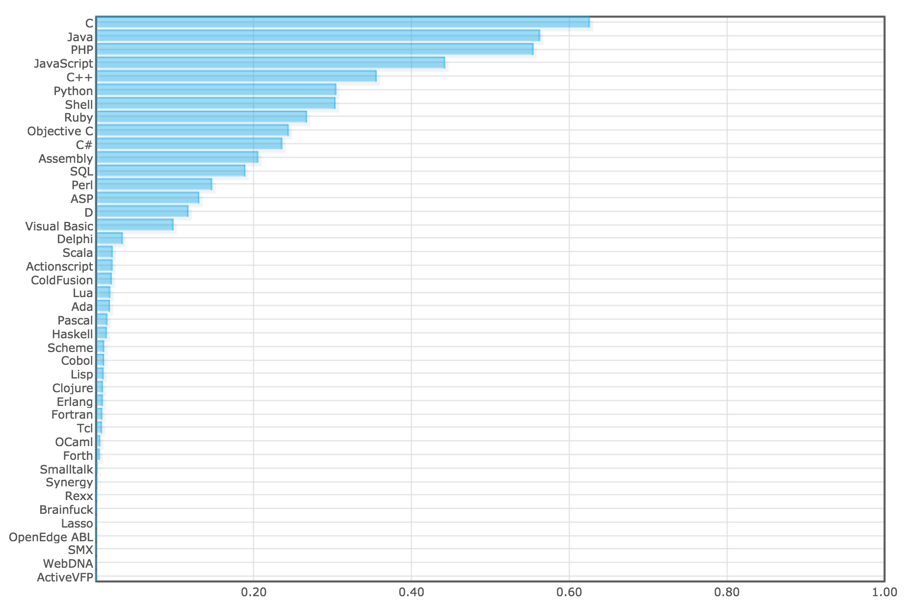
Normalized Comparison

Slide 11
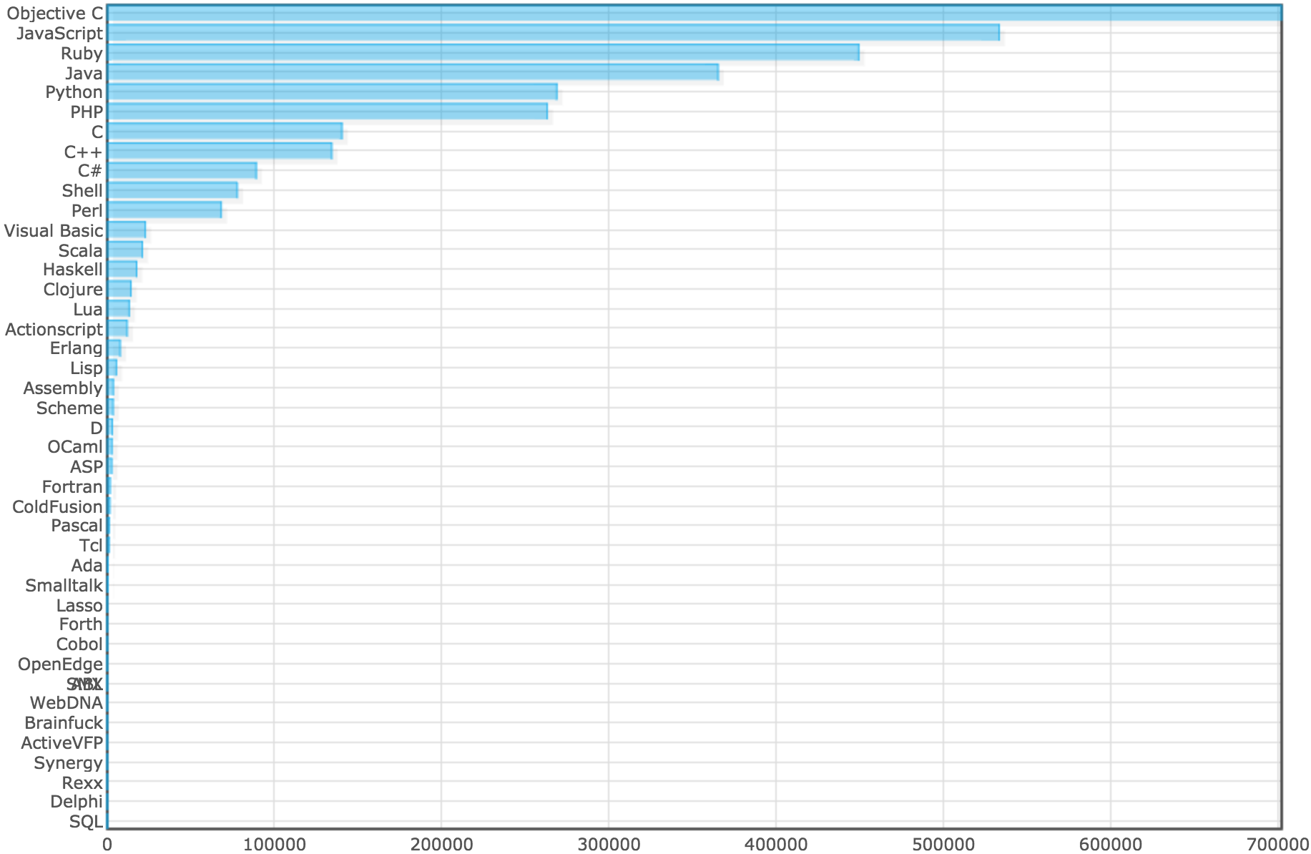
Github repositories

Slide 12
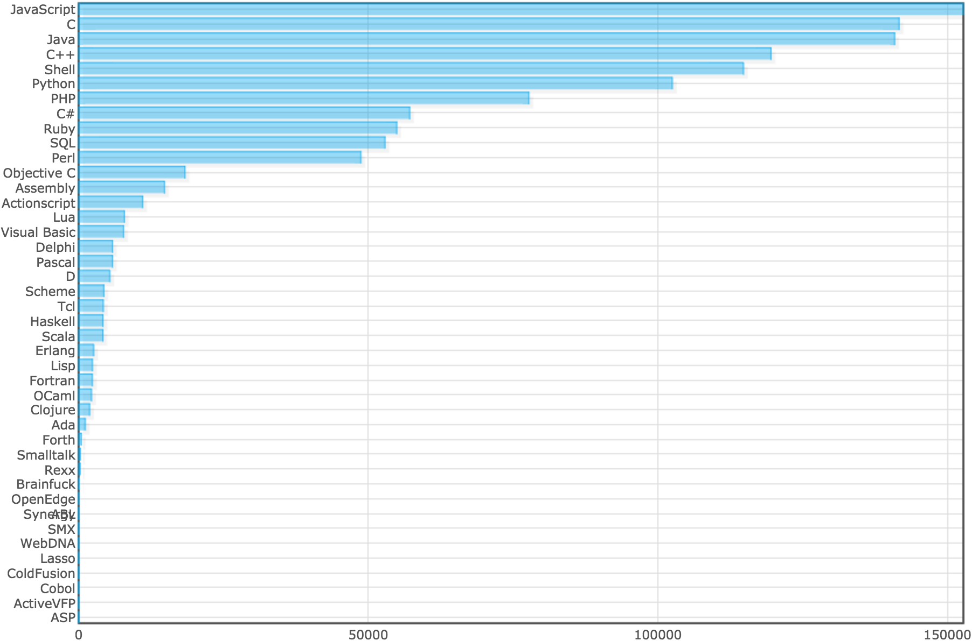
Ohloh
Notes:
number of people committing code in a particular language

Slide 13
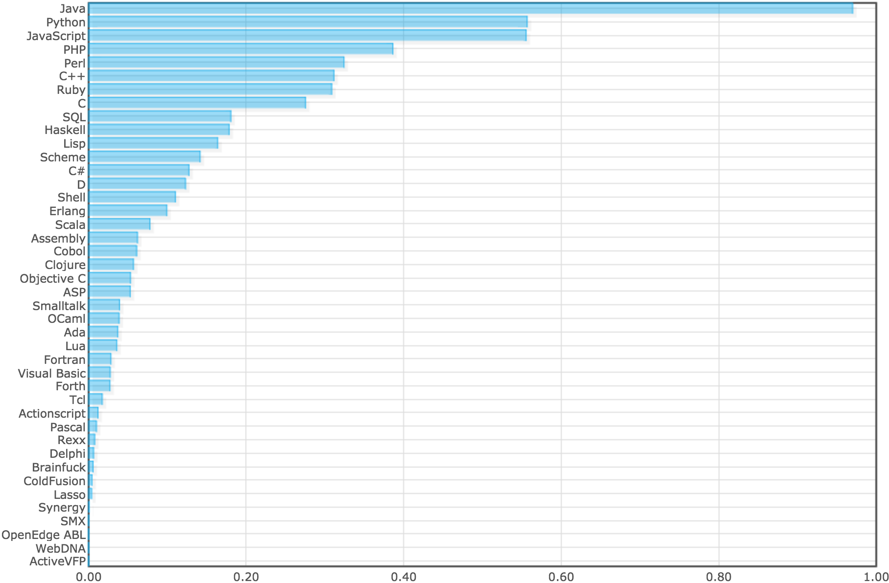
Normalized Discussion Site
Notes:
Lambda The Ultimate
Slashdot
Reddit

Slide 14
JavaScript introduction
JavaScript versions
Client-side JavaScript
JavaScript usage examples
JavaScript popularity

