Slide 1
WEB-007 JavaScript
ver. 1.0

Slide 2
WEB-007 JavaScript
Document Object Model
ver. 1.0

Slide 3
Document Object Model
DOM
DOM Level 3
Universal tree representation
HTML implementation of DOM
DOM compatibility in browsers
Selecting Document Elements
Document modification
innerHTML property

Slide 4
DOM
The Document Object Model, or DOM, is the fundamental API for representing and manipulating the content of HTML and XML documents
The nested elements of an HTML or XML document are represented in the DOM as a tree of objects
The tree representation of an HTML document contains nodes representing HTML tags or elements, such as <body> and <p>, and nodes representing strings of text
The DOM itself is not a part of the JavaScript language

Slide 5
Sample HTML
<html> <head> <title>Sample Document</title> </head> <body> <h1>An HTML Document</h1> <p>This is a <i>simple</i> document.</p> </body> </html>

Slide 6
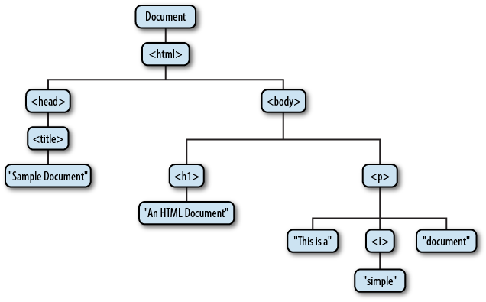
The DOM representation

Slide 7
DOM
The node directly above a node is the parent of that node
The nodes one level directly below another node are the children of that node
Nodes at the same level, and with the same parent, are siblings
The set of nodes any number of levels below another node are the descendants of that node
And the parent, grandparent, and all other nodes above a node are the ancestors of that node

Slide 8
DOM Level 3
DOM Level 3 was published in April 2004
http://www.w3.org/DOM/
https://developer.mozilla.org/en-US/docs/Web/API/Document_Object_Model
DOM Level 3 includes 6 specifications:
DOM Level 3 Core
DOM Level 3 Load and Save
DOM Level 3 Xpath
DOM Level 3 Views and Formatting
DOM Level 3 Requirements
DOM Level 3 Validation

Slide 9
The DOM representation

Slide 10
Universal tree representation
At the root of the tree is the Document node that represents the entire document
The nodes that represent HTML elements are Element nodes
The nodes that represent text are Text nodes
Document, Element, and Text are subclasses of Node
Document and Element are the two most important DOM classes

Slide 11
Node
Method/Property | Description
childNodes | Returns NodeList containing all the children of this node
firstChild | Returns a Node representing the first direct child node of the node, or null if the node has no child
lastChild | Returns a Node representing the last direct child node of the node, or null if the node has no child
nextSibling | Returns a Node representing the next node in the tree, or null if there isn't such node
nodeName | Returns a DOMString containing the name of the Node
parentNode | Returns a Node that is the parent of this node
textContent | Is a DOMString representing the textual content of an element and all its descendants
appendChild() | Insert a Node as the last child node of this element
removeChild() | Removes a child node from the current element, which must be a child of the current node.

Slide 12
Node type
Property nodeType returns an unsigned short representing the type of the node. Possible values are:
Name | Value
ELEMENT_NODE | 1
TEXT_NODE | 3
COMMENT_NODE | 8
DOCUMENT_NODE | 9
DOCUMENT_TYPE_NODE | 10

Slide 13
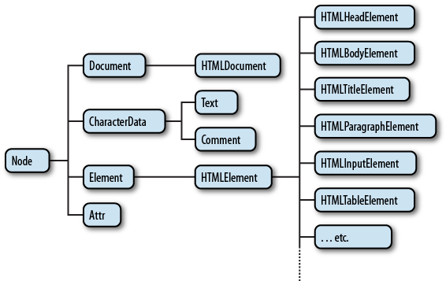
HTML implementation of DOM

Slide 14
HTML implementation of DOM
There are many subtypes of HTMLElement that represent specific types of HTML elements
A document containing HTML is described using the HTMLDocument class
HTMLDocument extends Document

Slide 15
HTMLDocument
Method / Property | Description
getElementById() | Returns the element that has the ID attribute with the specified value
getElementsByTagName() | Returns a NodeList containing all elements with the specified tagname
getElementsByClassName() | Returns a NodeList containing all elements with the specified class name
forms | Returns a collection of all the forms in the document
links | Returns a collection of all the links in the document
title | Sets or returns the title of the document
URL | Returns the full URL of the document
domain | Returns the domain name of the server that loaded the document

Slide 16
HTMLElement
HTMLElement extends Element
HTMLElement contains several important properties: id, className, lang, style, title
For each of HTML tag there is a corresponding subclass of the HTMLElement
Some subclasses contain methods for working with them:
submit() and reset() for HTMLFormElement

Slide 17
DOM compatibility in browsers
http://www.quirksmode.org/dom/html/
http://www.webbrowsercompatibility.com/
http://caniuse.com/

Slide 18
Selecting Document Elements
Most client-side JavaScript programs work by somehow manipulating one or more document elements
When these programs start, they can use the global variable document to refer to the Document object
In order to manipulate elements of the document, however, they must somehow obtain or select the Element objects that refer to those document elements

Slide 19
Selecting Document Elements
The DOM defines a number of ways to select elements; you can query a document for an element or elements:
with a specified id attribute
with a specified name attribute
with the specified tag name
with the specified CSS class or classes
matching the specified CSS selector

Slide 20
Selecting Elements By ID
Any HTML element can have an id attribute
The value of this attribute must be unique within the document — no two elements in the same document can have the same ID
var section1 = document.getElementById("section1");

Slide 21
Selecting Elements by Name
The HTML name attribute was originally intended to assign names to form elements, and the value of this attribute is used when form data is submitted to a server
The name assigns a name to an element
The value of a name attribute does not have to be unique
var radiobuttons = document.getElementsByName("favorite_color");

Slide 22
Selecting Elements by Type
You can select all HTML elements of a specified type (or tag name) using the getElementsByTagName() method of the Document object
var spans = document.getElementsByTagName("span"); var firstpara = document.getElementsByTagName("p")[0];

Slide 23
Document modification
You can create new Element nodes with the createElement() method of the Document object
Once you have a new node, you can insert it into the document with the Node methods appendChild() or insertBefore()
The removeChild() method removes a node from the document tree
The Element type also defines get Attribute() and setAttribute() methods that you can use to query and set HTML attributes
// Create a <script> element
var s = document.createElement("script");
var headline = document.getElementById("headline"); headline.setAttribute("align", "center");

Slide 24
innerHTML property
innerHTML was introduced in IE4
Reading the innerHTML property of an Element returns the content of that element as a string of markup
Setting this property on an element invokes the web browser’s parser and replaces the element’s current content with a parsed representation of the new string

Slide 25
Example
<html> <head> <title>Test Page</title> </head> <body> <div id="myDiv"> <p id="myP">First Paragraph</p> <p>Second Paragraph</p> <p>Third Paragraph</p> </div> </body> </html>

Slide 26
Example
var myP = document.getElementById("myP") // first paragraph myP.style.color = 'blue' // makes text blue
// creates new P element in memory p = document.createElement("p")
// sets text in new paragraph in memory p.innerHTML = 'new paragraph'
// adds new paragraph to a div element document.getElementById("myDiv").appendChild(p)

Slide 27
Document Object Model
DOM
DOM Level 3
Universal tree representation
HTML implementation of DOM
DOM compatibility in browsers
Selecting Document Elements
Document modification
innerHTML property

