Slide 1
WEB-007 JavaScript
ver. 1.0

Slide 2
WEB-007 JavaScript
CSS
ver. 1.0

Slide 3
CSS
CSS introduction
Positioning
z-index
The CSS Box Model
Element Display and Visibility
Partial Visibility: overflow and clip
Style management with JavaScript
CSS Animations
Enabling and Disabling Stylesheets

Slide 4
CSS introduction
Current standard is CSS level 2 revision 1
Cascading Style Sheets (CSS) is a standard for specifying the visual presentation of HTML documents
CSS is intended for use by graphic designers: it allows a designer to precisely specify fonts, colors, margins, indentation, borders, and even the position of document elements
CSS is also of interest to client-side JavaScript programmers because CSS styles can be scripted
There are many variables in the visual display of an HTML document: fonts, colors, spacing, and so on

Slide 5
CSS introduction
The CSS standard enumerates these variables and calls them style properties. CSS defines properties that specify fonts, colors, margins, borders, background images, text alignment, element size, and element position
To define the visual appearance of HTML elements, we specify the value of CSS properties
There are two ways to associate a set of CSS property values with the HTML elements whose presentation they define
setting the style attribute of an individual HTML element
to separate CSS styles from individual HTML elements and define them in a stylesheet

Slide 6
CSS introduction
Recall that the C in CSS stands for “cascading.” This term indicates that the style rules that apply to any given element in a document can come from a “cascade” of different sources:
The web browser’s default stylesheet
The document’s stylesheets
The style attribute of individual HTML elements
Styles from the style attribute override styles from stylesheets
The basic element of a CSS stylesheet is a style rule, which consists of a selector followed by a set of CSS properties and their values, enclosed in curly braces

Slide 7
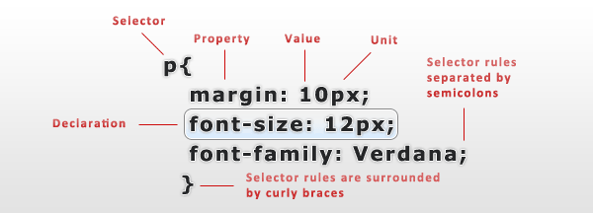
Structure

Slide 8
Selectors
Selectors are used to declare which part of the markup a style applies to by matching tags and attributes in the markup itself
Selectors may apply to:
all elements of a specific type, e.g. the second level headers h2
elements specified by attribute, in particular:
id: an identifier unique to the document
class: an identifier that groups multiple elements in a document
elements depending on how they are placed relative to others in the document tree

Slide 9
Selectors
Pattern | Description | Example
E | an element of type E | h2
E F | an F element descendant of an E element | div p
* | any element | *
E#myid | an E element with ID equal to "myid" | p#myP
E.info | an E element whose class is “info" | div.Container
E > F | an F element child of an E element | ul > li
E + F | an F element immediately preceded by an E element | image + p
E[foo] | an E element with a "foo" attribute | p[align]
E[foo="bar"] | an E element whose "foo" attribute value is exactly equal to "bar" | p[align=“left”]

Slide 10
Example
<!DOCTYPE html> <html> <head lang="en"> <meta charset="UTF-8"> <title>Test Document</title> <style> body { margin-left: 30px; margin-right: 15px; background-color: #ffffff } p { font-size: 24px; } </style> </head> <body> <p>Testing, testing</p> </body> </html>

Slide 11
Properties
Property | Description
position | Specifies the type of positioning applied to an element
top, left | Specify the position of the top and left edges of an element
bottom, right | Specify the position of the bottom and right edges of an element
width, height | Specify the size of an element
z-index | Specifies the “stacking order” of an element relative to any overlapping elements; defines a third dimension of element positioning
display | Specifies how and whether an element is displayed
visibility | Specifies whether an element is visible
clip | Defines a “clipping region” for an element; only portions of the element within this region are displayed
overflow | Specifies what to do if an element is bigger than the space allotted for it

Slide 12
Properties
Property | Description
margin, border, padding | Specify spacing and borders for an element
background | Specifies the background color or image of an element
opacity | Specifies how opaque (or translucent) an element is.

Slide 13
Example
<!DOCTYPE html> <html> <head lang="en"> <meta charset="UTF-8"> <title>Test Document</title> <link rel="stylesheet" href="mystyles.css" type="text/css"> </head> <body> <p>Testing, testing</p> </body> </html>

Slide 14
Example
p { /* the selector "p" matches all <p> elements */ text-indent: .5in; /* indent the first line by .5 inches */ } .warning { /* Any element with class="warning" */ background-color: yellow; /* gets a yellow background */ border: solid black 5px; /* and a big black border */ }

Slide 15
Positioning and Visibility
The CSS position property specifies the type of positioning applied to an element. Here are the four possible values for this property:
static
absolute
fixed
relative

Slide 16
Position
static
The default. Use this value if you need to turn positioning off explicitly
absolute
The element's position is fixed relative to a parent element. Only a parent that is itself positioned with relative, fixed or absolute will do. You can make any parent element suitable by specifying position: relative; for it without specifying any shift
fixed
The element's position is fixed. Specify the element's position relative to the document window. Even if the rest of the document scrolls, the element remains fixed

Slide 17
Position
relative
The element's position is shifted relative to its normal position. Use this to shift an element by a specified amount. You can sometimes use the element's margin to achieve the same effect

Slide 18
z-index
The z-index property defines a kind of third dimension: it allows you to specify the stacking order of elements and indicate which of two or more overlapping elements is drawn on top of the others
The z-index property is an integer. The default value is zero, but you may specify positive or negative values
When two or more elements overlap, they are drawn in order from lowest to highest z-index; the element with the highest z-index appears on top of all the others
If overlapping elements have the same z-index, they are drawn in the order in which they appear in the document so that the last overlapping element appears on top

Slide 19
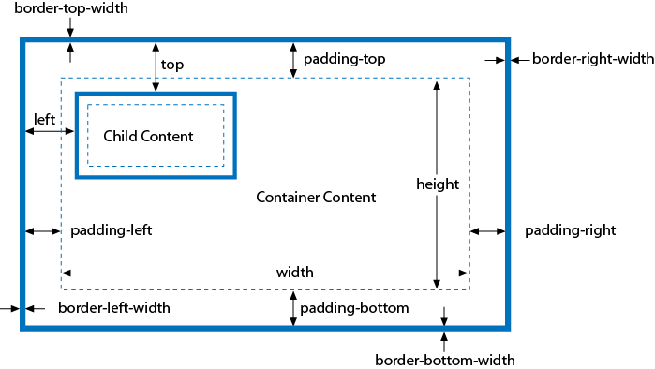
The CSS Box Model
An absolutely positioned element nested inside a positioned container element

Slide 20
Element Display and Visibility
Two CSS properties affect the visibility of a document element: visibility and display
The visibility property is simple: when the property is set to the value hidden, the element is not shown; when it is set to the value visible, the element is shown
The display property is more general and is used to specify the type of display an item receives. It specifies whether an element is a block element, an inline element, a list item, or so on
When display is set to none, however, the affected element is not displayed, or even laid out, at all.

Slide 21
Element Display and Visibility
The difference between the visibility and display style properties has to do with their effect on elements that use static or relative positioning
Setting visibility to hidden makes the element invisible but reserves space for it in the document layout
If an element’s display property is set to none, however, no space is allocated for it in the document layout

Slide 22
Partial Visibility: overflow and clip
The overflow and clip properties allow you to display only part of an element
The overflow property specifies what happens when the content of an element exceeds the size specified (with the width and height style properties, for example) for the element
The allowed values and their meanings for this property are as follows:
visible
hidden
scroll
auto

Slide 23
Partial Visibility: overflow and clip
The value of the clip property specifies the clipping region for the element
The top, right, bottom, and left values specify the boundaries of the clipping rectangle relative to the upper-left corner of the element’s box
clip: rect(top right bottom left);

Slide 24
Style management with JavaScript
The most straightforward way to script CSS is to alter the style attribute of individual document elements
Like most HTML attributes, style is also a property of the Element object, and you can manipulate it in JavaScript
The style property is unusual, however: its value is not a string, but a CSSStyleDeclaration object
The JavaScript properties of this style object represent the CSS properties specified by the HTML style attribute
var e = document.getElementById("id"); e.style.fontSize = "24pt"; e.style.fontWeight = "bold"; e.style.color = "blue”;

Slide 25
Style management with JavaScript
Many CSS style properties, such as font-size, contain hyphens in their names. In JavaScript, a hyphen is interpreted as a minus sign
If a CSS property name contains one or more hyphens, the CSSStyleDeclaration property name is formed by removing the hyphens and capitalizing the letter immediately following each hyphen
Remember that all values must be specified as strings
Remember that all the positioning properties require units
e.style.left = 300; // Incorrect: this is a number, not a string e.style.left = "300"; // Incorrect: the units are missing e.style.left = "300px"; // Correct

Slide 26
Style management with JavaScript
An alternative to scripting individual CSS styles through the inline style property is to script the value of the HTML class attribute
Changing an element’s class changes the set of stylesheet selectors that apply to the element and can cause multiple CSS properties to change at the same time
function grabAttention(e) { e.className = "attention"; } function releaseAttention(e) { e.className = ""; }

Slide 27
CSS Animations
One of the most common uses of scripted CSS is to produce animated visual effects
This can be achieved by using setTimeout() or setInterval() to repeatedly invoke a function that alters the inline style of an element
The CSS3 Transitions module defines a way to specify animated effects in stylesheets, obviating the need for any scripting
.fadeable { transition: opacity .5s ease-in }

Slide 28
Enabling and Disabling Stylesheets
The simplest stylesheet scripting technique is also the most portable and robust
<style> elements, <link> elements, and CSSStyleSheet objects all define a disabled property that you can query and set in JavaScript
If the disabled property is true, then the stylesheet is disabled and is ignored by the browser.

Slide 29
CSS
CSS introduction
Positioning
z-index
The CSS Box Model
Element Display and Visibility
Partial Visibility: overflow and clip
Style management with JavaScript
CSS Animations
Enabling and Disabling Stylesheets

