Slide 1
WEB-007 JavaScript
ver. 1.0

Slide 2
WEB-007 JavaScript
HTTP Protocol
ver. 1.0

Slide 3
HTTP Protocol
Web server
Methods
HTTP protocol status codes

Slide 4
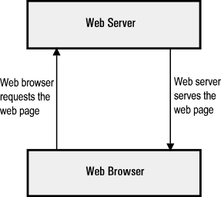
Web server
Server is a running instance of an application (software) capable of accepting requests from the client and giving responses accordingly
Servers operate within a client-server architecture

Slide 5
Web server
Apache (Apache HTTP Server) – cross-platform free web server
IIS (Internet Information Services) – web server created by Microsoft for use with Windows family
Nginx (engine-x) – open source HTTP and reverse proxy server
Tomcat (Apache Tomcat) – most popular Java server

Slide 6
HTTP Protocol
HyperText Transfer Protocol
Works like «request-response»
Contains information about requested resource (page, file, image)
Contains some information about sender (browser version, preferred encoding etc.)
Contains information about HTTP method, i.e. requested action

Slide 7
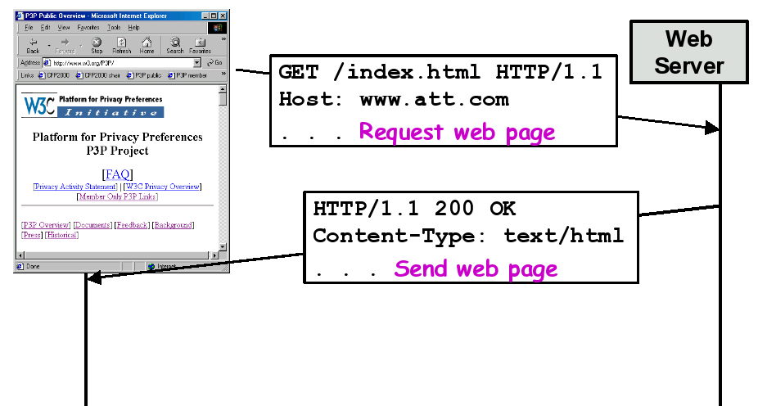
HTTP Protocol

Slide 8
Methods
GET – requests a representation of the specified resource. Data are sent as URL variables and limited (2 – 8 kb)
/path/resource?param1=value1&param2=value2
POST – requests data sending. Data are sent in request body and have no size limit
/path/resource

Slide 9
Methods
OPTIONS – returns the HTTP methods that the server supports for the specified URL
HEAD – asks for the response identical to the one that would correspond to a GET request, but without the response body
PUT – Requests that the enclosed entity be stored under the supplied URI
PATCH – Applies partial modifications to a resource
DELETE – Deletes the specified resource
TRACE – Echoes back the received request
CONNECT – Converts the request connection to a transparent TCP/IP tunnel

Slide 10
HTTP protocol status codes
HTTP always returns status code in response
Status code – main information about results of request processing
200 – OK
500 – Internal Server Error
403 – Forbidden
404 – Not Found
405 – Method Not Allowed

Slide 11
HTTP Protocol
Web server
Methods
HTTP protocol status codes

