Slide 1
WEB-007 JavaScript
ver. 1.0

Slide 2
WEB-007 JavaScript
JavaScript tools
ver. 1.0

Slide 3
JavaScript tools
Debugging JavaScript
Code compressors
Testing JavaScript application

Slide 4
Debugging JavaScript
The Chrome Developer Tools (DevTools for short), are a set of web authoring and debugging tools built into Google Chrome
The DevTools provide web developers deep access into the internals of the browser and their web application
Use the DevTools to efficiently track down layout issues, set JavaScript breakpoints, and get insights for code optimization

Slide 5
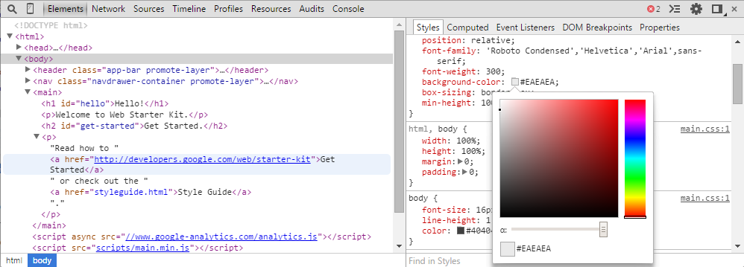
The DevTools window

Slide 6
DevTools
The Elements panel lets you see everything in one DOM tree, and allows inspection and on-the-fly editing of DOM elements
The JavaScript Console provides two primary functions for developers testing web pages and applications. It is a place to:
Log diagnostic information in the development process
A shell prompt which can be used to interact with the document and DevTools
The Sources panel lets you debug your JavaScript code. It provides a graphical interface to the V8 debugger

Slide 7
The Sources panel
The Sources panel lets you see all the scripts that are part of the inspected page
Standard controls to pause, resume, and step through code are provided below the panel selection icons
Add and remove breakpoints
Interact with paused breakpoints

Slide 8
Tips
Normally, you activate debugging in your browser with F12, and select "Console" in the debugger menu
You can use console.log() to display JavaScript values in the debugger window
The debugger keyword stops the execution of JavaScript, and calls (if available) the debugging function

Slide 9
Code compressors
Compress JavaScript code
Making JavaScript download and run faster
YUI Compressor
http://yui.github.io/yuicompressor/
Google Closure Compiler
https://developers.google.com/closure/compiler/
https://closure-compiler.appspot.com/home

Slide 10
Testing JavaScript application
There is many different libraries for testing
QUnit
https://qunitjs.com/
Jasmine
http://jasmine.github.io/
Protractor
http://angular.github.io/protractor/#/
Karma
http://karma-runner.github.io/

Slide 11
QUnit
QUnit is a powerful, easy-to-use JavaScript unit testing framework
It's used by the jQuery, jQuery UI and jQuery Mobile projects and is capable of testing any generic JavaScript code, including itself!
QUnit.test( "hello test", function( assert ) { assert.ok( 1 == "1", "Passed!" ); });

Slide 12
JavaScript tools
Debugging JavaScript
Code compressors
Testing JavaScript application

