Slide 1
SMART TALKS 185: Machine Learning
Machine Learning Models as Services in Docker
Andrii Shchur
anshc@smart-it.com

Slide 2

Andrii Shchur
Data science engineer
Education:
Kyiv National Economic University named after Vadym Hetman, Institute Information Technologies in Economics,
Master's degree — «System analysis»
Microsoft Certified Solutions Associate - Machine Learning
Microsoft Certified Solutions Expert - Data Management and Analytics
Experience:
Sales analyst (internship) – SC Adidas Ukraine
Planning department intern – Danone
Analyst – P&G
Analyst – Henkel
Data science engineer – SMART business

Slide 3
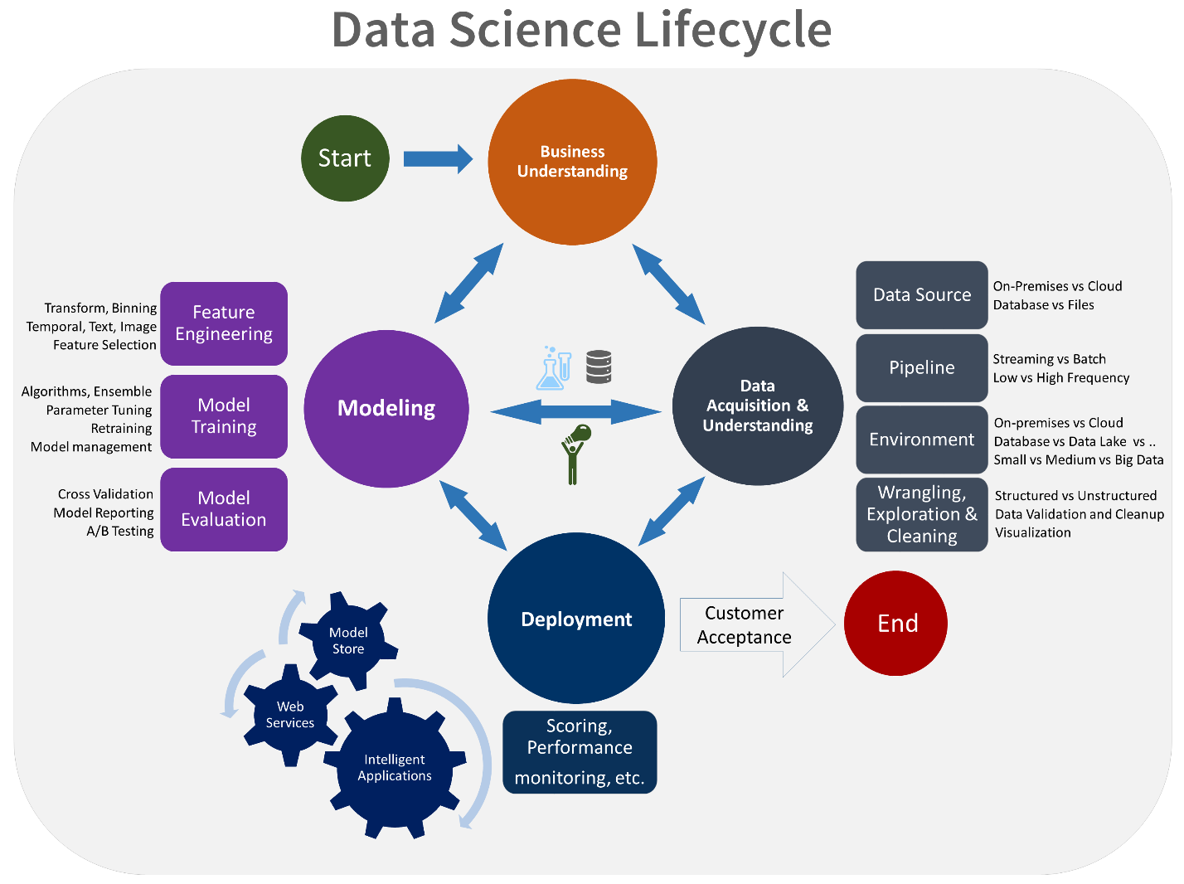
Team data science process

Slide 4
Deployment
One of the most critical but often overlooked aspects of the Machine Learning process is operationalization of Machine Learning models.
Operationalization of Machine Learning models includes the below areas.
Deployment of Model
Model Scoring/Serving
Collect metrics/failures
Monitor Model Performance
Analyze results and errors
Retrain Model

Slide 5
Deployment
Depending on the business requirements, predictions are made either in real time or on a batch basis. The interface enables the model to be easily consumed from various applications, such as:
Online websites
Spreadsheets
Dashboards
Line-of-business applications
Back-end applications

Slide 6





Demos
Dashboard – R and Shiny
Web service – R and Plumber
Web service – Python and Flask

Slide 7

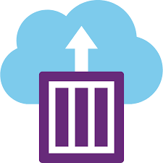
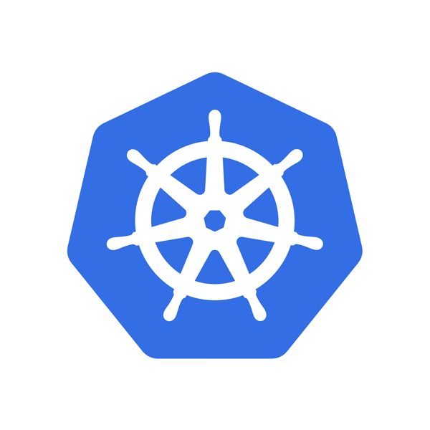
Docker in Azure
Azure Container Registry
Azure Container Registry allows you to build, store, and manage images for all types of container deployments.
Azure Container Instances
Azure Container Instances offers the fastest and simplest way to run a container in Azure, without having to provision any virtual machines and without having to adopt a higher-level service.
Azure Kubernetes Service
Azure Kubernetes Service makes it simple to deploy a managed Kubernetes cluster in Azure. AKS reduces the complexity and operational overhead of managing Kubernetes by offloading much of that responsibility to Azure.

Slide 8
Docker command
CMD
Build New Docker Image
docker build -t image_name .
Log in to docker hub
docker login --username=yourhubusername
Check the image ID using
docker images
Tag image
docker tag img_id docker_hub_repositories:image_name
Push image to the repository
docker push docker_hub_repositories
AZURE CLI
Import to ACR
az acr import --name myregistry --source docker.io/library/hello-world:latest --image hello-world:latest
Deploy to ACI
az container create -g MyResourceGroup --name myapp --image myimage:latest --cpu 1 --memory 1

Slide 9
Dashboard
Shiny is an R package that makes it easy to build interactive web applications (apps) straight from R.
Must things in shiny app code
User Interface (UI) :It controls the layout and appearance of various widgets on the web page. Every shiny app requires a user interfacewhich is controlled by ui script.
Server : It contains the instructions that your computer needs when the user interacts with the app.

Slide 10
DEMO

Slide 11
Web service – R and Plumber
The plumber package for R makes it easy to expose existing R code as a webservice via an API.
You take an existing R script and make it accessible with plumber by simply adding a few lines of comments.
you define the output or endpoint
you can add additional annotation to customize your input, output and other functionalities of your API
you can define every input parameter that will go into your function
every such annotation will begin with either #' or #*

Slide 12
DEMO

Slide 13
Web service – Python and Flask
Flask is a web application framework written in Python. Web Application Framework or simply Web Framework represents a collection of libraries and modules that enables a web application developer to write applications without having to bother about low-level details such as protocols, thread management etc.
Must things in to create Flask app
model.py
server.py
request.py

Slide 14
DEMO

Slide 15
Links
Azure Container Registry
https://docs.microsoft.com/en-us/azure/container-registry/
Azure Container Instances
https://azure.microsoft.com/en-us/services/container-instances/
Azure Kubernetes Service
https://azure.microsoft.com/en-in/services/kubernetes-service/
Plumber
https://www.rplumber.io/
Flask
http://flask.pocoo.org/
Docker
https://docs.docker.com/

