Slide 1
Enterprise business PR and marketing oriented improvements driven with AMP (Accelerated Mobile Pages) HTML framework for mobile front-end web development
Tech for business research
May 2020

Slide 2




Authors and knowledge base
Svitlana Samko
https://www.linkedin.com/in/svitlana-samko/
My most beneficial skill: I like to learn the business from the inside. Only so one can be sure that we build the right product in the right way at any stage of the development process.
Key skills and work experience used as a base for current research
GDG Dublin - January 2020 - AMP Workshop (Fellyph Cintra, James Osborne)
Certified Google AdWords specialists 2008-2016
Certified Google Analytics specialists 2009-2014
Marketing experts in Google AdWords Agencies 2010-2014
Enterprise PR and marketing 2006-2012
15+ years in web and mobile development
300+ delivered web and mobile start-up projects
Andrii Stepura
https://www.linkedin.com/in/andriistepura/
My most beneficial skill: Imagination to think like a stakeholder. Every piece of software starts from an idea. The first written code lines are just half of the delivery of that idea.

Slide 3
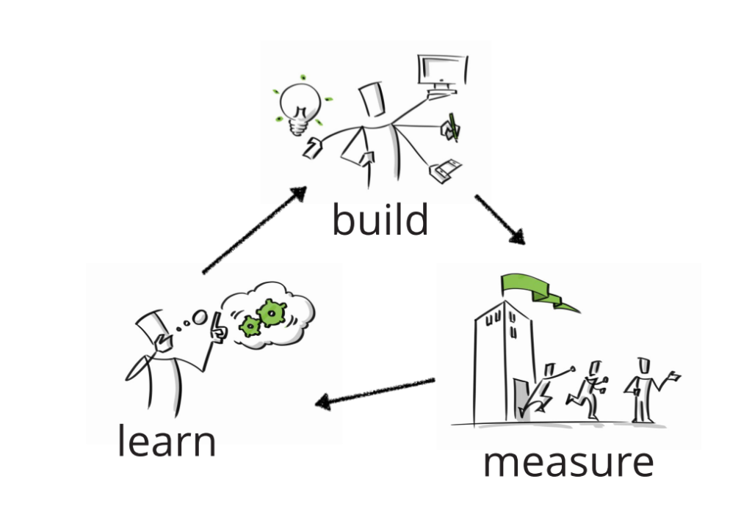
Build-Measure-Learn approach
Presentation format: Lean Startup methodology loop
http://www.bpesec.com/2017/03/31/gamifying-lean-startup/

Slide 4
Content
0. Measure
- Audience (Business/Tech) : AMP / Google SEO / AdWords skills
1. Learn
- Google search traffic
- Mobile devices trends
- Google SEO & AdWords definitions
- Web pages front-end technical optimization
- Web pages quality and usability impact
- Actual search results examples
2. Build
- AMP (Accelerated Mobile Pages) HTML framework introduction
- Knowledge source and references
3. Measure
- Presentation usefulness for audience

Slide 5
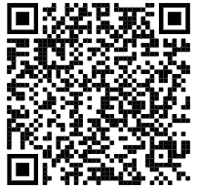

Audience measurement
!
Please, submit this form:
short link:
w2b.kz/amp052020
or:
https://forms.gle/QsGyBodhLZ3EKwqD8

Slide 6
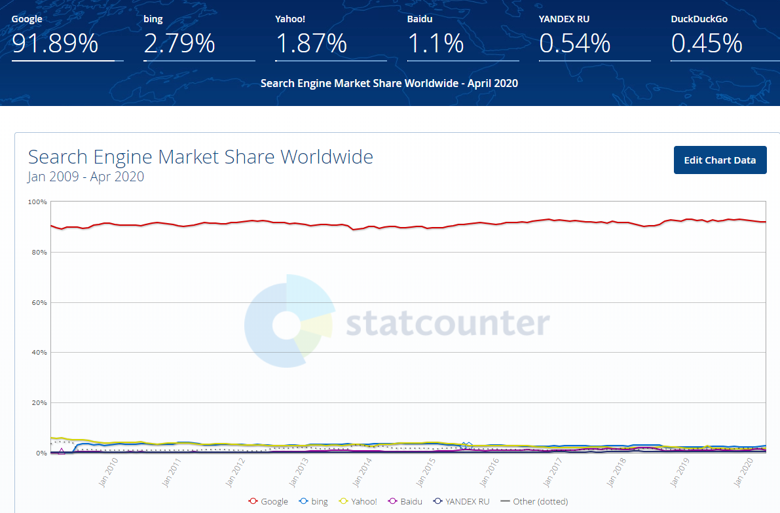

Google search traffic
Why Google?
Google was chosen as a search engine for this research because...
Data by https://gs.statcounter.com/search-engine-market-share#monthly-200901-202004

Slide 7
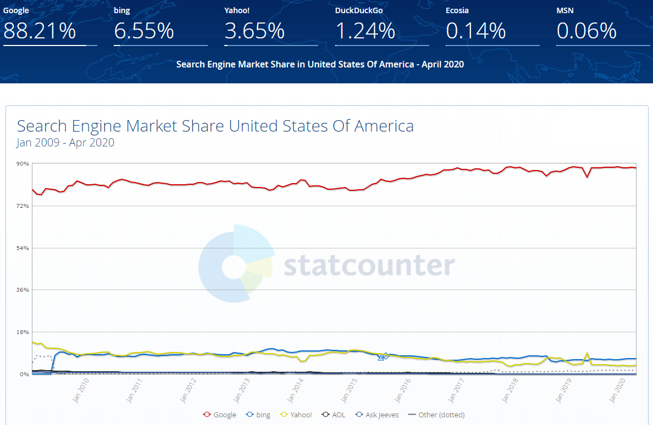
Google search traffic (USA)
Data by https://gs.statcounter.com/search-engine-market-share#monthly-200901-202004

Slide 8
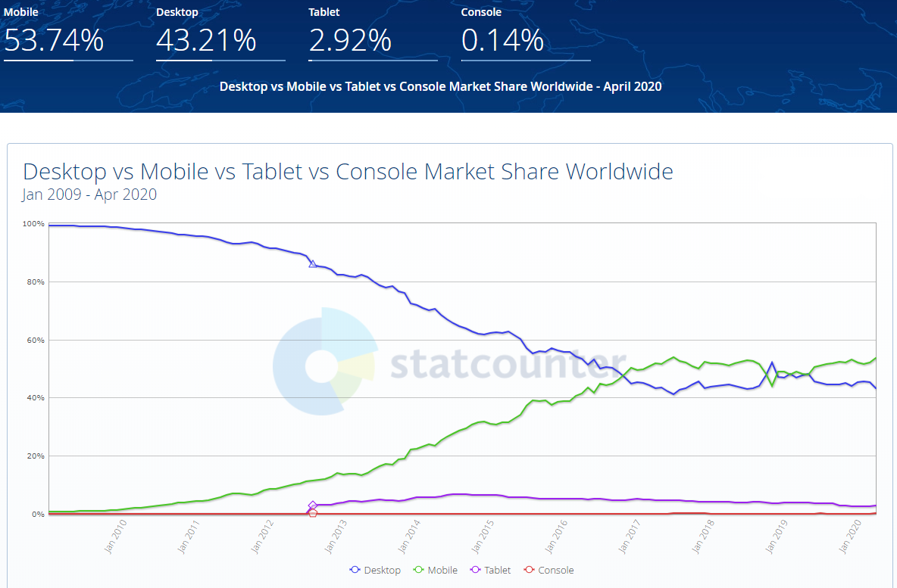
Mobile devices trends
Why mobile?
Mobile traffic is important for your business because...
Data by https://gs.statcounter.com/search-engine-market-share#monthly-200901-202004

Slide 9
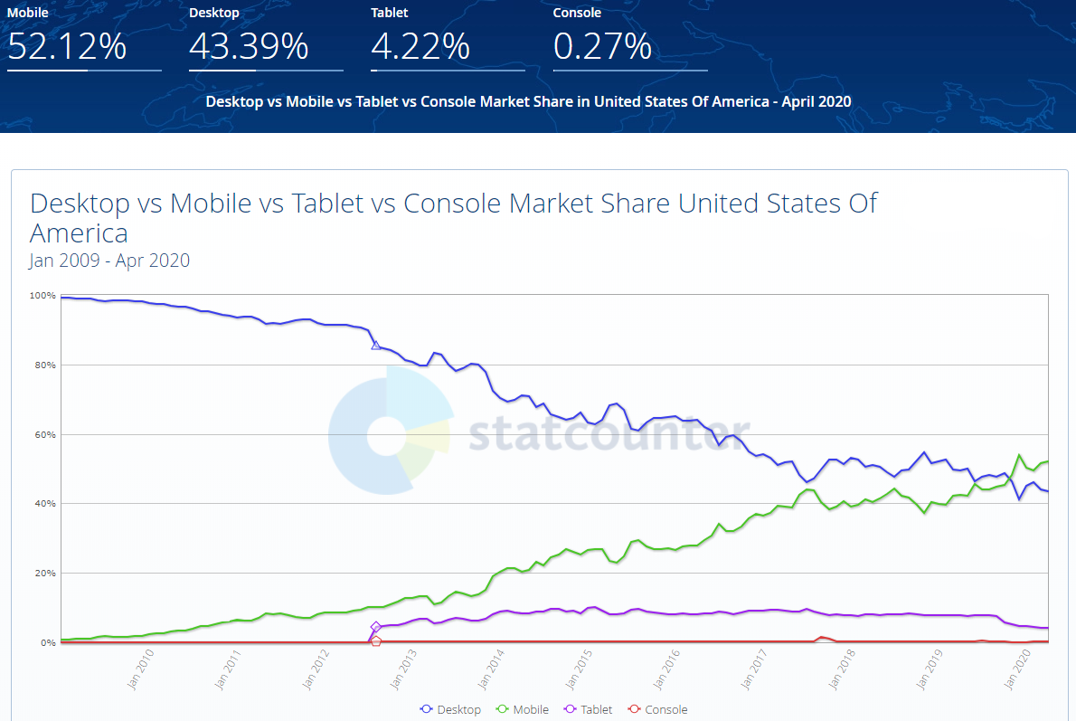
Mobile devices trends (USA)
Data by https://gs.statcounter.com/search-engine-market-share#monthly-200901-202004

Slide 10
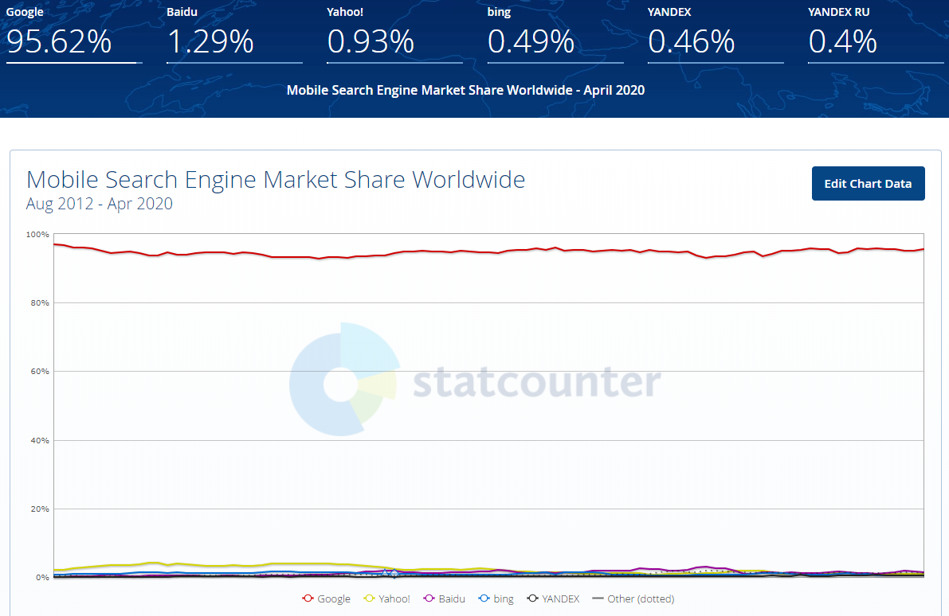
SE trends for mobile users
Data by https://gs.statcounter.com/search-engine-market-share#monthly-200901-202004

Slide 11
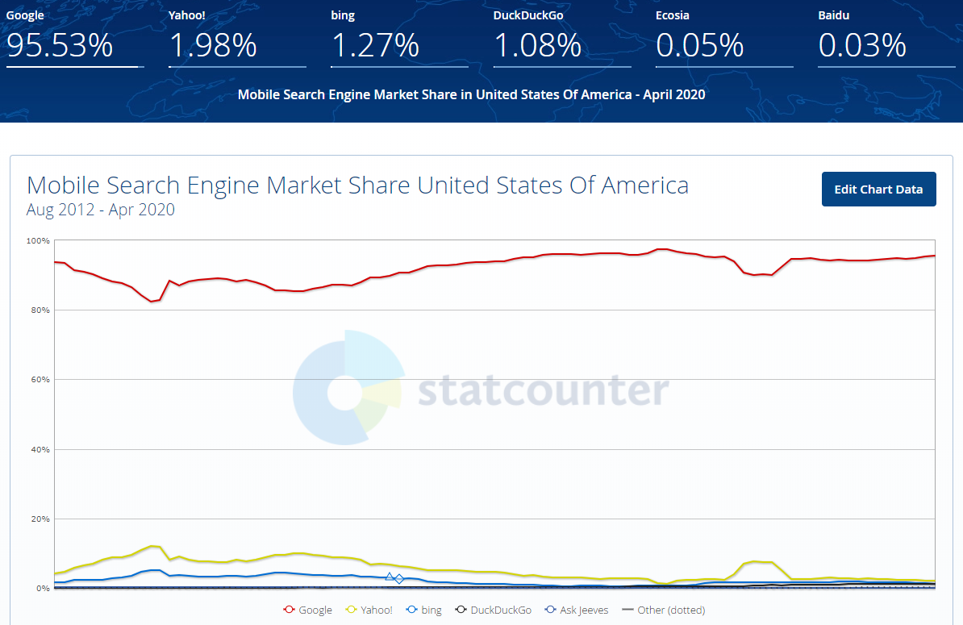
SE trends for mobile users (USA)
Data by https://gs.statcounter.com/search-engine-market-share#monthly-200901-202004

Slide 12
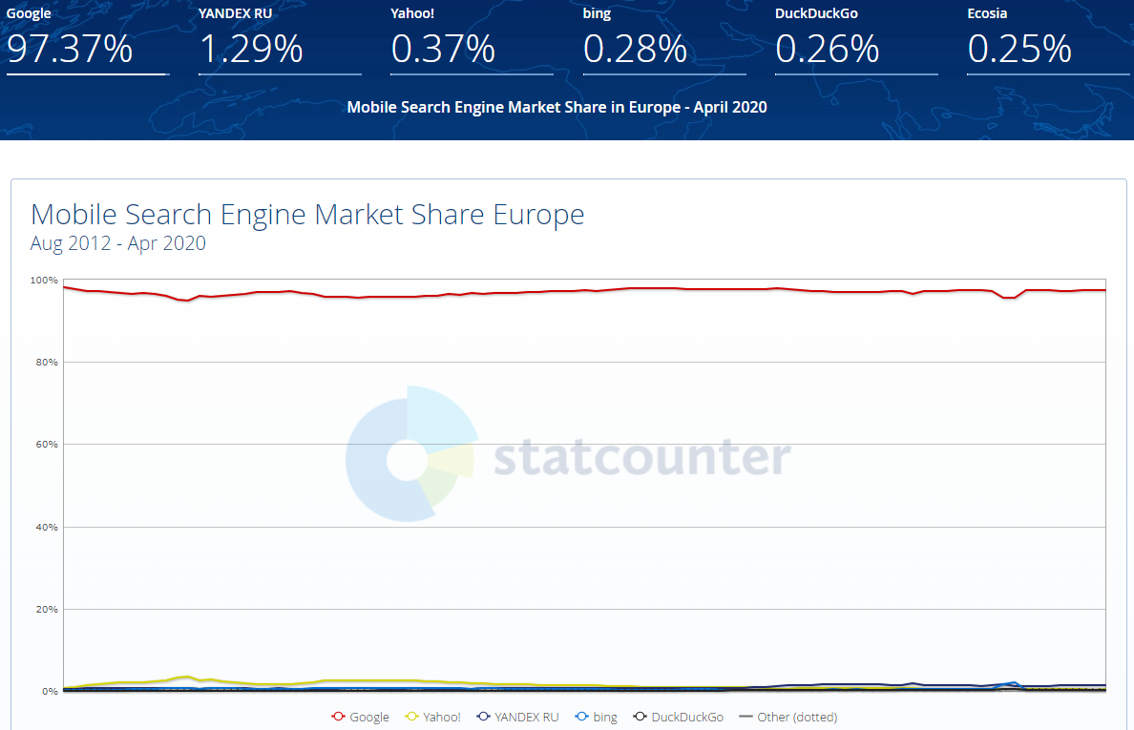
SE trends for mobile users (Europe)
Data by https://gs.statcounter.com/search-engine-market-share#monthly-200901-202004

Slide 13
Google SEO and common terms
SEO - Search Engine Optimization
is about helping search engines understand and present content.
SERP - Stands for “search engine results page”
Ranking - Ordering search results by relevance to the query.
White hat - Search engine optimization practices that comply with Google’s quality guidelines.
https://support.google.com/webmasters/answer/7451184 & https://moz.com/beginners-guide-to-seo/seo-glossary

Slide 14
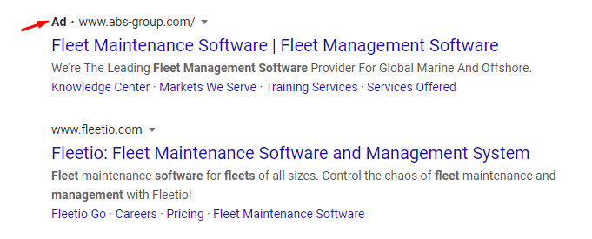
Google AdWords definitions
AdWords (Google Ads) –
Google Ads is an online advertising platform developed by Google, where advertisers pay to display brief advertisements, service offerings, product listings, video content, and generate mobile application installs within the Google ad network to web users.
https://en.wikipedia.org/wiki/Google_Ads

Slide 15

Front-end technical optimization
Make your site mobile-friendly
The world is mobile today. Most people are searching on Google using a mobile device. The desktop version of a site might be difficult to view and use on a mobile device. As a result, having a mobile ready site is critical to your online presence. In fact, starting in late 2016, Google has begun experiments to primarily use the mobile version of a site's content for ranking, parsing structured data, and generating snippets.
https://support.google.com/webmasters/answer/7451184?hl=en&ref_topic=9460495

Slide 16
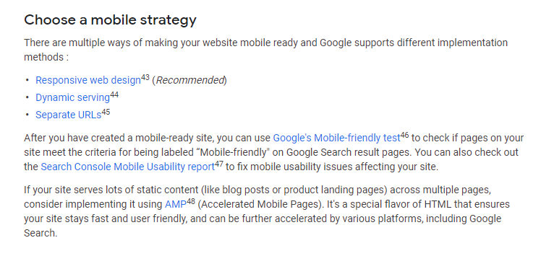
Front-end technical optimization
https://support.google.com/webmasters/answer/7451184?hl=en&ref_topic=9460495

Slide 17

Quality and usability impact
“algorithms to promote more usable pages over less usable ones, all other things being equal”
by Google “How Search algorithms work”
https://www.google.com/search/howsearchworks/algorithms/

Slide 18
Quality and usability impact (AdWords)
According to our experience in result of technical front-end and server-side improvements price per click in Google AdWords marketing companies was reduced, as an example from 4.26 USD to 1.38 USD for the same requests and targeting audience sources with the higher average positions.

Slide 19
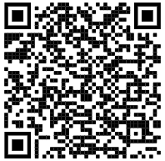
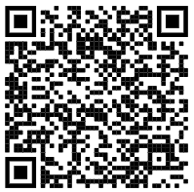
Actual search results examples
Test 1 - “fleet management software”
(USA, mobile, 16 May 2020)
Website A
Website B
URL
https://www.geotab.com/fleet-management-software/
https://www.verizonconnect.com/
Position
7th
15th
Page
Speed Insights
(Mobile)
44/100
34/100
https://developers.google.com/speed/pagespeed/insights/?url=https%3A%2F%2Fwww.geotab.com%2Ffleet-management-software%2F&tab=mobile
https://developers.google.com/speed/pagespeed/insights/?url=https%3A%2F%2Fwww.verizonconnect.com%2F&tab=mobile
https://www.google.com/search?q=fleet+management+software&sclient=mobile-gws-wiz-serp

Slide 20
Actual search results examples
Test 2 - “how to reduce fleet fuel costs”
(Ireland, mobile vs desktop, 16 May 2020)
Website A
Website B
URL
https://www.verizonconnect.com/ie/resources/article/how-to-reduce-fleet-fuel-costs/
https://blog.fossnational.com/reduce-fuel-costs
Desktop
- Position
- Quality
2nd
97/100
https://developers.google.com/speed/pagespeed/insights/?url=https%3A%2F%2Fwww.verizonconnect.com%2Fie%2Fresources%2Farticle%2Fhow-to-reduce-fleet-fuel-costs%2F&tab=desktop
7th
88/100
https://developers.google.com/speed/pagespeed/insights/?url=https%3A%2F%2Fblog.fossnational.com%2Freduce-fuel-costs&tab=desktop
Mobile
- Position
- Quality
It looks like an abnormality, but...
2nd
51/100
https://developers.google.com/speed/pagespeed/insights/?url=https%3A%2F%2Fwww.verizonconnect.com%2Fie%2Fresources%2Farticle%2Fhow-to-reduce-fleet-fuel-costs%2F&tab=mobile
1st
37/100
https://developers.google.com/speed/pagespeed/insights/?url=https%3A%2F%2Fblog.fossnational.com%2Freduce-fuel-costs&tab=mobile
https://www.google.com/search?q=how+to+reduce+fleet+fuel+costs

Slide 21
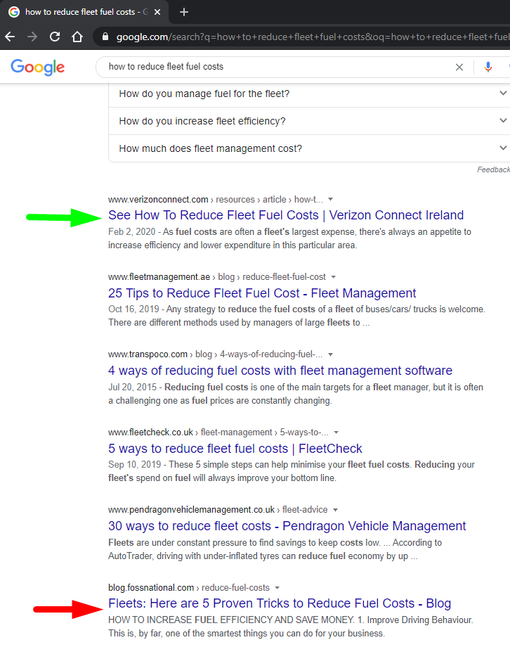
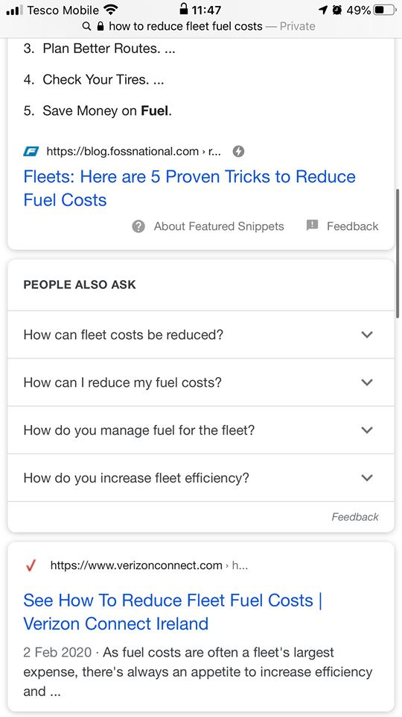
Actual search results examples
Desktop vs mobile SERP

Slide 22
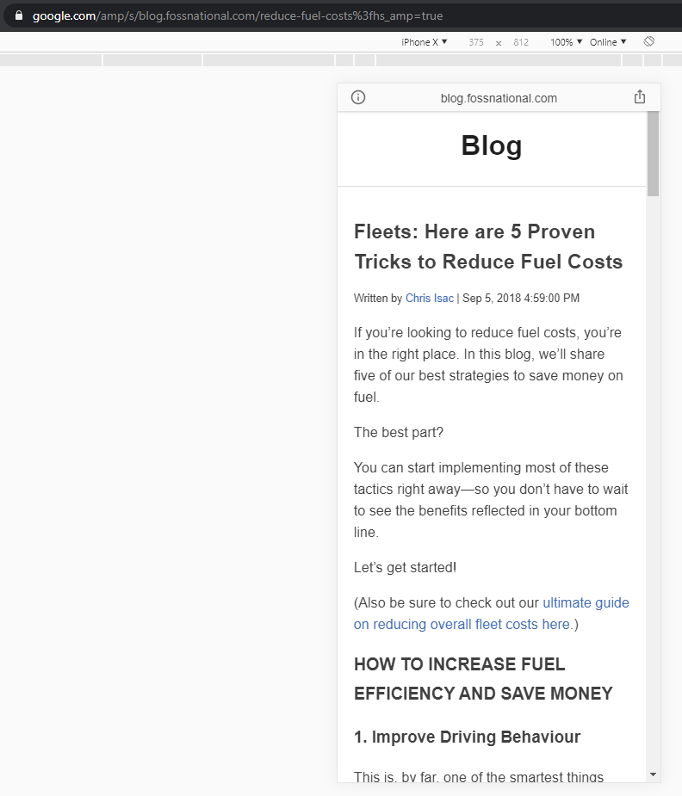
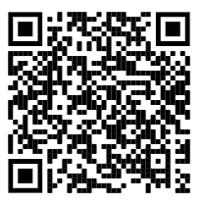
AMP search result
https://www.google.com/amp/s/blog.fossnational.com/reduce-fuel-costs%3fhs_amp=true

Slide 23
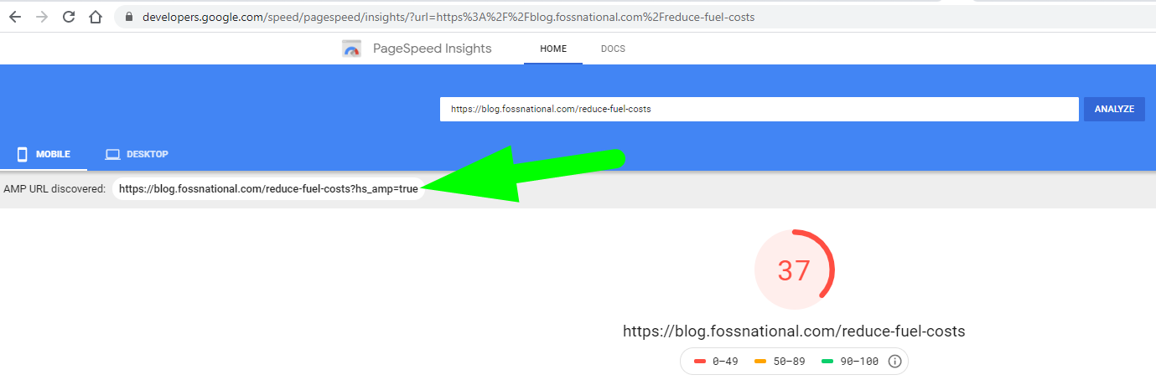
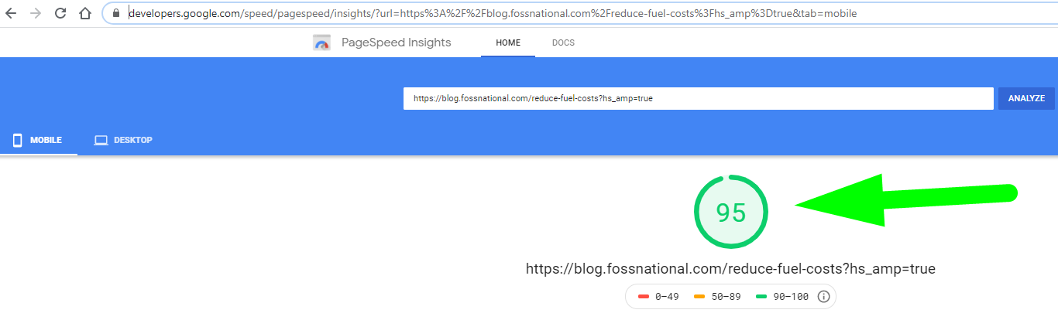
AMP search result
https://developers.google.com/speed/pagespeed/insights/?url=https%3A%2F%2Fblog.fossnational.com%2Freduce-fuel-costs
https://developers.google.com/speed/pagespeed/insights/?url=https%3A%2F%2Fblog.fossnational.com%2Freduce-fuel-costs%3Fhs_amp%3Dtrue&tab=mobile

Slide 24


AMP introduction
Acronym for Accelerated Mobile Pages - “diet HTML” designed to make the viewing experience lightning fast for mobile visitors.
It was originally created by Google as a competitor to Facebook Instant Articles and Apple News. AMP is optimised for mobile web browsing and intended to help webpages load faster. AMP pages may be cached by a CDN, such as Microsoft Bing or Cloudflare's AMP caches, which allows pages to be served more quickly.
https://en.wikipedia.org/wiki/Accelerated_Mobile_Pages & https://moz.com/beginners-guide-to-seo/seo-glossary

Slide 25

AMP introduction
https://amp.dev/about/websites/
Thunder ⚡ Lightning bolt symbol can be used in HTML AMP markup
<!doctype html>
<html amp>
or
<!doctype html>
<html ⚡>

Slide 26


AMP introduction
AMP Boilerplate Generator
https://amp.dev/boilerplate/
AMP Components
https://amp.dev/documentation/components/

Slide 27
Knowledge source and references
Beginner Course - https://glitch.com/~nosy-leech
Intermediate Course - https://glitch.com/~grateful-block
Advanced Course - https://glitch.com/~enshrined-eyebrow

Slide 28

Presentation usefulness
!
Please, submit this form:
short link:
w2b.kz/amp052020m
or:
https://forms.gle/LtDYEZUCo6HSeELp6

Slide 29
Any questions? Let's stay in touch
Svitlana Samko
https://www.linkedin.com/in/svitlana-samko/
Andrii Stepura
https://www.linkedin.com/in/andriistepura/

