Slide 1
W2BUSINESS QA ACADEMY
Open explaining lesson:
Front end
with contact form example based on Google forms
Middleware
REST API
Back end

Slide 2


LECTORS
Svitlana Samko
https://www.linkedin.com/in/svitlana-samko/
Quality Assurance Technical Lead, Senior Developer in Test, over 10 years web development practice, over 10 delivered software projects for middle and large business. Professional Scrum Master, Requirements Engineer, Management Master, Digital Product Manager Master, Full-stack developer BSc in Computer Science
My most beneficial skill: I like to learn business from the inside. Only so one can be sure that we build right product in the right way at any stage of development process.
Andrii Stepura
https://www.linkedin.com/in/andriistepura/
Quality Assurance Technical Lead, Senior QA Automation Engineer, Product Owner, Professional Scrum Master, Full-stack developer BSc in Computer Science.
Over 14 years web development practice, over 300 delivered web projects.
My most beneficial skill: Imagination to think like a stakeholder. Every piece of software starts from an idea. The first written code lines are just a half of the delivery of that idea.

Slide 3
GOAL DEFINITION
Create website contact form with implementation at three layers for familiarize and clarify web-development terms:
Front end
Back end
Middle-ware
REST API

Slide 4




OUR WAY TO GOAL
Less place stereotypes, more for self abstract definition with web-development practice activity
Graphics from bluecoders.io & theodawson.net

Slide 5
REQURED TOOLS
For creation final solution and repeat all by yourself you will need at least next tools:
Google account (https://accounts.google.com/ )
Web browser (for demo used Chrome - https://www.google.com/chrome/ )
Code editor (as ex. Notepad++ - https://notepad-plus-plus.org/download/ )
REST API (REST call tool Postman - https://www.getpostman.com/downloads/ )
PHP server (hosting or local server, as ex. XAMPP - https://www.apachefriends.org/ )

Slide 6
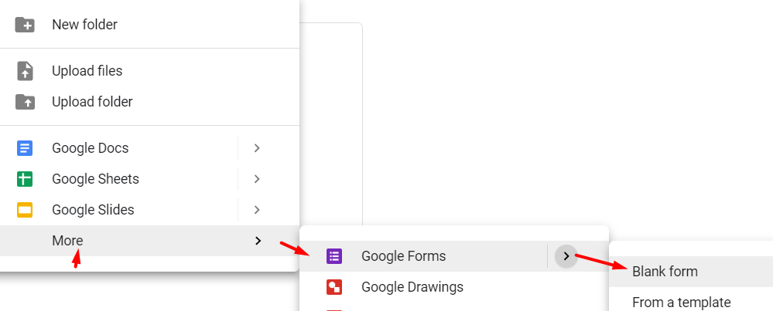
CREATE GOOGLE FORM
Login at https://drive.google.com/ with your Google Account and create form:

Slide 7
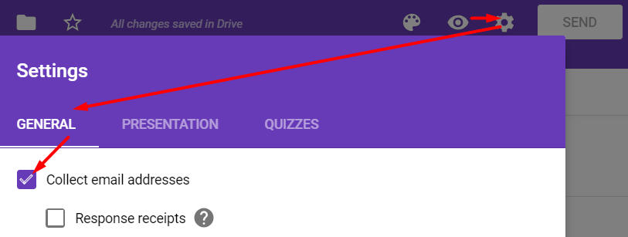
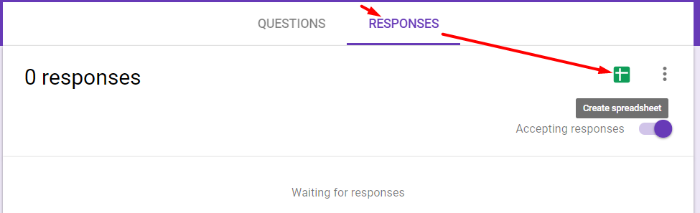
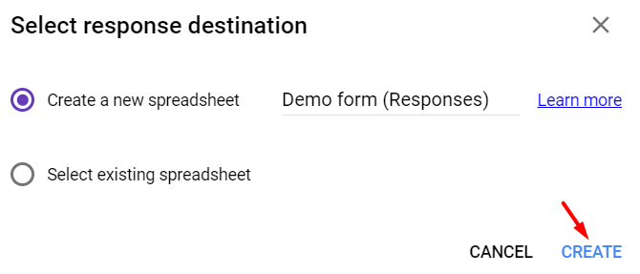
CREATE GOOGLE FORM
Add fields need for receive data from our website visitors, as ex.:
- Name (short answer text)
- E-mail (use form settings)
- Message (short answer text)
Set store answers in Google spreadsheet, its table like MS Excel, we will use it as Database for storing:

Slide 8
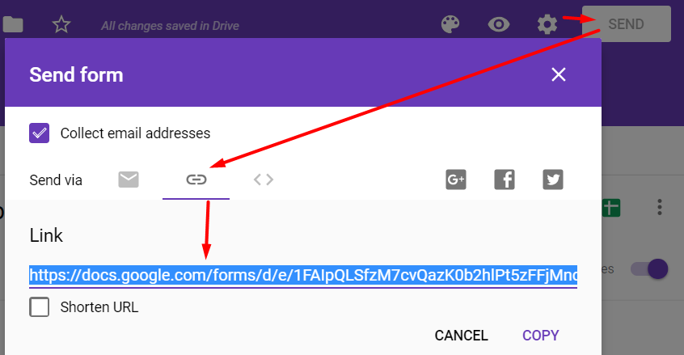
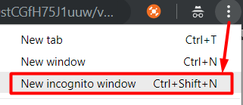
EXPLORE GOOGLE FORM
Get this form link: https://docs.google.com/forms/d/e/1FAIpQLSfzM7cvQazK0b2hlPt5zFFjMncvMA6Io904DstCGfH75J1uuw/viewform?usp=sf_link and open as other user (use incognito mode):

Slide 9
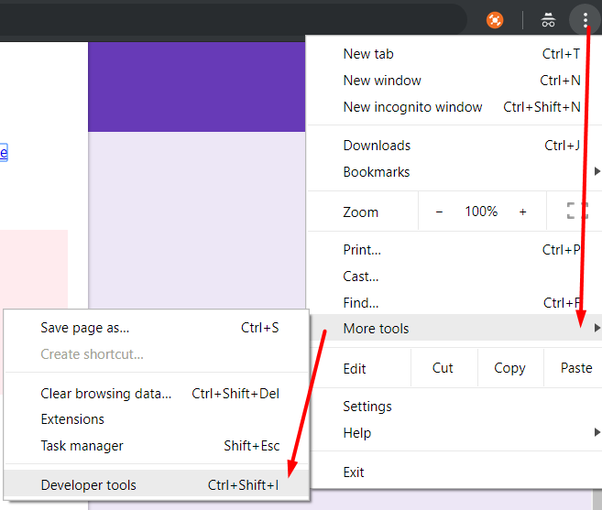
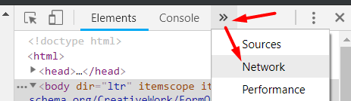
EXPLORE GOOGLE FORM
Open developer tools console (Ctr+Shift+I) and switch to Network:

Slide 10
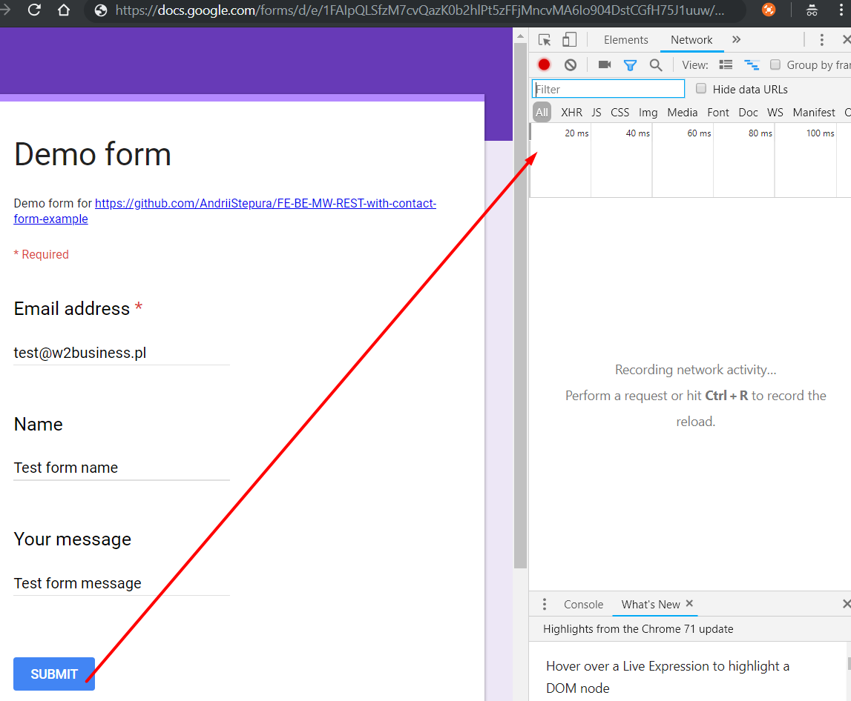
EXPLORE GOOGLE FORM
Fill form and click on Submit button:

Slide 11
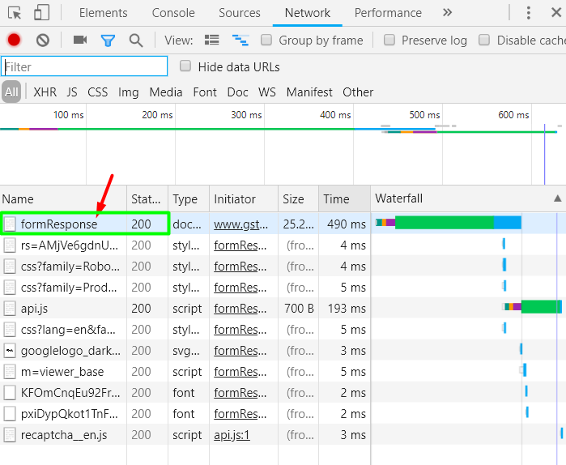
EXPLORE GOOGLE FORM
In network communication record with this post to Google form API is appeared:

Slide 12
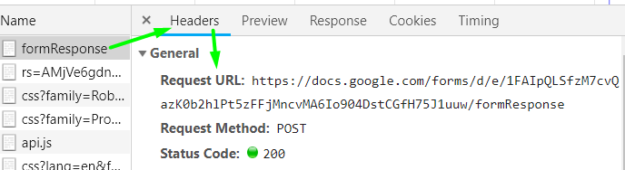
EXPLORE POST REST REQUEST
Let's explore this request, headers:
Request URL: https://docs.google.com/forms/d/e/1FAIpQLSfzM7cvQazK0b2hlPt5zFFjMncvMA6Io904DstCGfH75J1uuw/formResponse
Request Method: POST
Status Code: 200
Where request URL – is Google API endpoint for our form
Method is HTTP call type, more about REST - https://en.wikipedia.org/wiki/Hypertext_Transfer_Protocol#Request_methods
Status is result from endpoint, more about status codes - https://en.wikipedia.org/wiki/List_of_HTTP_status_codes

Slide 13
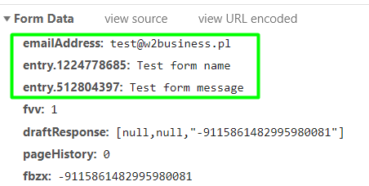
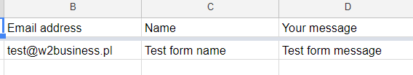
EXPLORE POST REST REQUEST
With POST HTTP method we send not just headers (instead GET), we also send body:
Same data saved in our spreadsheet:
emailAddress: test@w2business.pl
entry.1224778685: Test form name
entry.512804397: Test form message

Slide 14
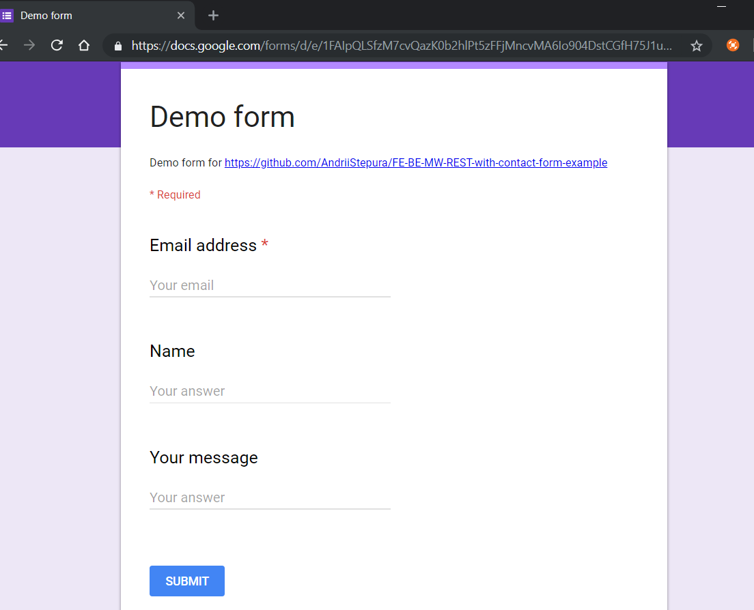


SOLUTION ARCHITECTURE
Let's analyze our current solution layers:
HTML form received by browser with GET request to endpoint -
HTML5 GOOGLE FORM
Front
end
https://docs.google.com/forms/d/e/1FAIpQLSfzM7cvQazK0b2hlPt5zFFjMncvMA6Io904DstCGfH75J1uuw/viewform
Request
Response
REST API endpoint receive POST request, validate and save to DB
GOOGLE FORM
REST API
Google API
Back
end
https://docs.google.com/forms/d/e/1FAIpQLSfzM7cvQazK0b2hlPt5zFFjMncvMA6Io904DstCGfH75J1uuw/formResponse
DB
spreadsheet

Slide 15
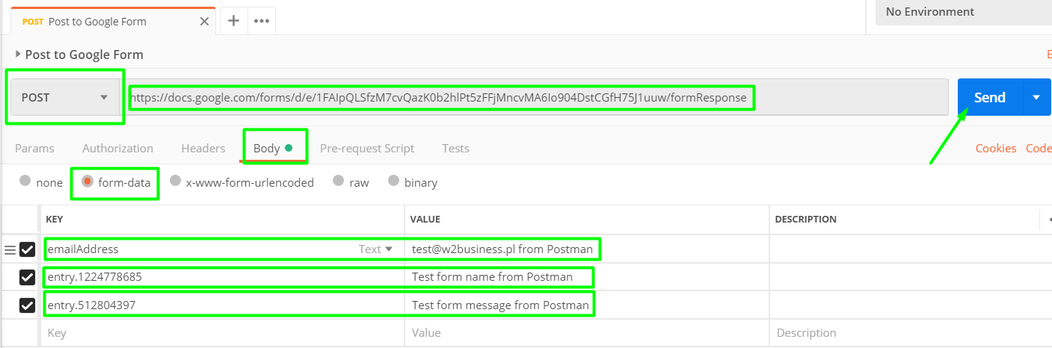
HTTP RESTS WITH POSTMAN
Use Postman tool for send POST HTTP request instead browser client:
Form-data:
emailAddress:test@w2business.pl from Postman
entry.1224778685:Test form name from Postman
entry.512804397:Test form message from Postman

Slide 16


HELLO ERROR “400 Bad Request”
Our request data not satisfied for REST API endpoint validation rules, so we receive response code 400 instead 200
Check DB – any changes, just 1 record try again with proper form-data emailAddress: emailAddress:test_from_postman@w2business.pl and form data saved in DB (spreadsheet):

Slide 17

SOLUTION ARCHITECTURE
Let's analyze our current solution layers:
Front
end
REST
CLIENT
Postman
Request
Response
REST API endpoint receive POST request, validate and save to DB
GOOGLE FORM
REST API
Google API
Back
end
https://docs.google.com/forms/d/e/1FAIpQLSfzM7cvQazK0b2hlPt5zFFjMncvMA6Io904DstCGfH75J1uuw/formResponse
DB
spreadsheet

Slide 18
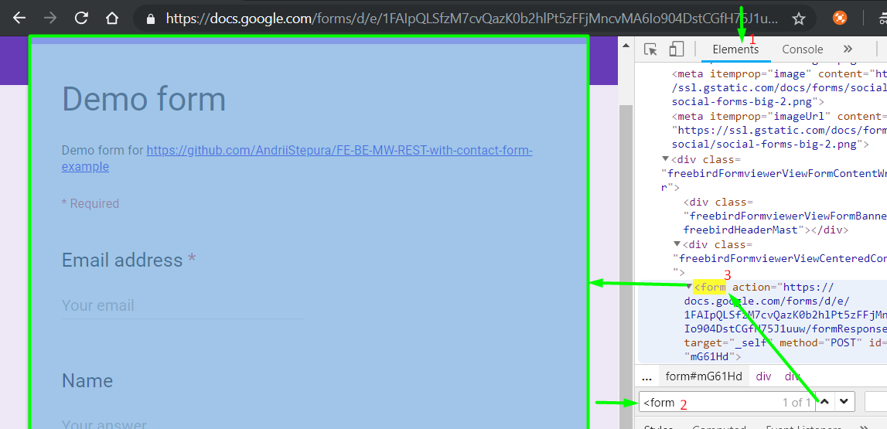
EXPLORE GOOGLE FORM HTML
Return to Google form and inspect HTML code with Elements tab:

Slide 19
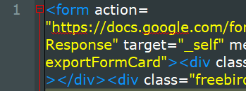
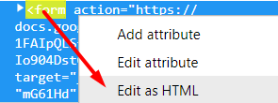
CREATE OUR HTML FORM
Copy all form HTML code to code editor:
After remove classes, additional div and attributes we receive short form HTML code:
<form action="https://docs.google.com/forms/d/e/1FAIpQLSfzM7cvQazK0b2hlPt5zFFjMncvMA6Io904DstCGfH75J1uuw/formResponse" target="_self" method="POST">
<input type="email" name="emailAddress">
<input type="text" name="entry.1224778685">
<input type="text" name="entry.512804397">
</form>

Slide 20
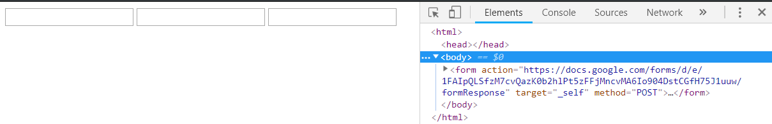
CREATE OUR HTML FORM
Open new created HTML form in browser: it's almost worked we need just add a button for submit this form, so let's add:
<form action="https://docs.google.com/forms/d/e/1FAIpQLSfzM7cvQazK0b2hlPt5zFFjMncvMA6Io904DstCGfH75J1uuw/formResponse" target="_self" method="POST">
<input type="email" name="emailAddress">
<input type="text" name="entry.1224778685">
<input type="text" name="entry.512804397">
<input type="submit" name="submit" value="Submit">
</form>

Slide 21
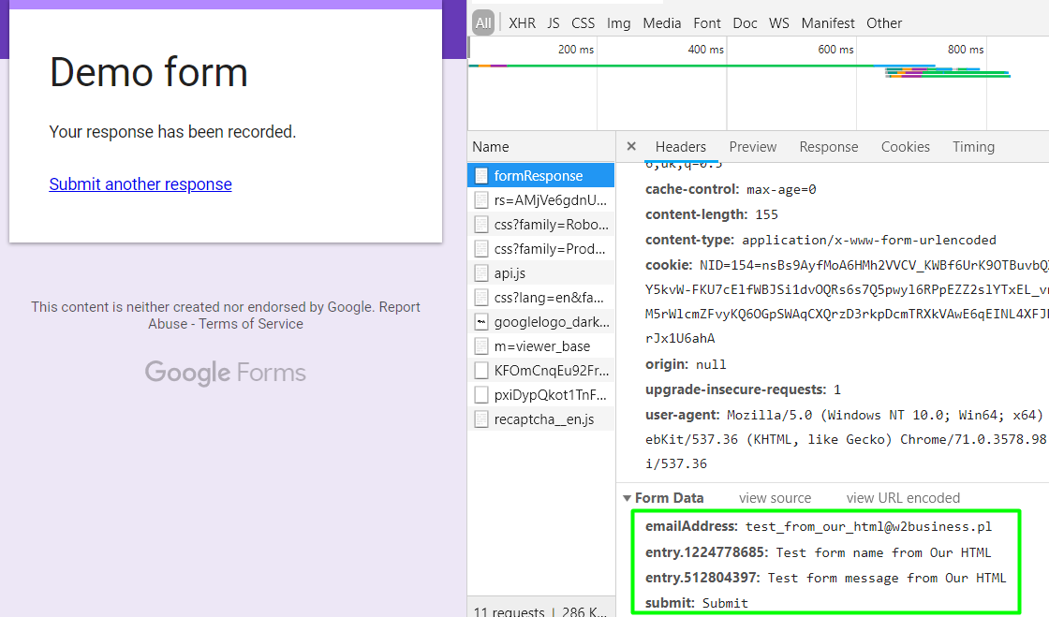
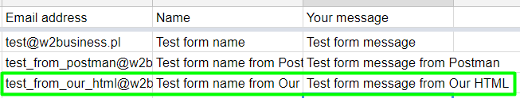
CREATE OUR HTML FORM
Let's try submit correct data to OUR HTML form and check data saved in DB (spreadsheet):
It's work (with redirect to Google forms, but work). Data from our HTML form, local hosted page or hosted online at our website now send data to Google forms

Slide 22
SOLUTION ARCHITECTURE
Let's analyze our current solution layers:
OUR WEBSITE
Our HTML form POST data and redirected to Google form page
Front
end
GOOGLE FORM
Request
Response
REST API endpoint receive POST request, validate and save to DB
GOOGLE FORM
REST API
Google API
Back
end
https://docs.google.com/forms/d/e/1FAIpQLSfzM7cvQazK0b2hlPt5zFFjMncvMA6Io904DstCGfH75J1uuw/formResponse
DB
spreadsheet

Slide 23
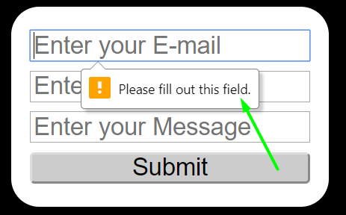
OUR Front end
Let's make form more pretty with styled by CSS and HTML5 tags: style.css file:
<link type="text/css" rel="stylesheet" href="style.css" />
<form action="https://docs.google.com/forms/d/e/1FAIpQLSfzM7cvQazK0b2hlPt5zFFjMncvMA6Io904DstCGfH75J1uuw/formResponse" target="_self" method="POST">
<input type="email" name="emailAddress" placeholder="Enter your E-mail">
<input type="text" name="entry.1224778685" placeholder="Enter your Name">
<input type="text" name="entry.512804397" placeholder="Enter your Message">
<input type="submit" name="submit" value="Submit">
</form>
body {background: #000;}
form {background: #fff; display:block; width:300px; -webkit-border-radius: 30px; border-radius:30px; padding:20px; margin-left: auto; margin-right: auto;}
input {width:100%; font-size:26px; padding: 0 2px; margin: 5px 0;}
input[type=submit] {background:#ccc; cursor:pointer; -webkit-border-radius: 5px; border-radius: 5px;}

Slide 24
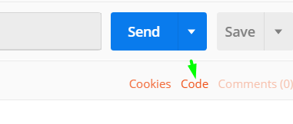
OUR Front end
Looks better but form still redirect us to Google form page. But we know about HTTP method POST and can implement this call (same as in Postman) at our Front end side with JavaScript.
1. Create file form.js and add it to HTML page:
2. Update Submit button with call post function:
<input type="button" name="submit" value="Submit" onclick="sendForm()">
Get code generated by Postman and use as function in our form.js
<script type="text/javascript" src="form.js"></script>

Slide 25
OUR Front end
Update form.js file code:
function sendForm(){
var data = new FormData();
data.append("emailAddress", "test_from_FE_JS1@w2business.pl");
data.append("entry.1224778685", "Test form name from JS");
data.append("entry.512804397", "Test form message from JS");
var xhr = new XMLHttpRequest();
xhr.withCredentials = true;
xhr.addEventListener("readystatechange", function () {
if (this.readyState === 4) {console.log(this.responseText);}});
xhr.open("POST", "https://docs.google.com/forms/d/e/1FAIpQLSfzM7cvQazK0b2hlPt5zFFjMncvMA6Io904DstCGfH75J1uuw/formResponse");
xhr.send(data);
}

Slide 26
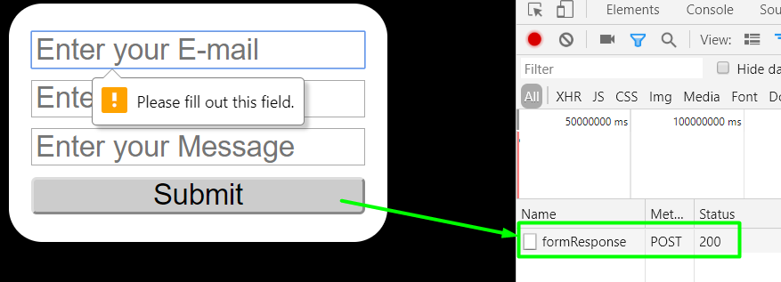
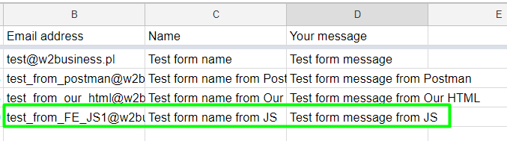
OUR Front end
Click on Submit button: data from JS file saved to DB:

Slide 27
OUR Front end
Update form.js file with validation:
document.getElementById('formErrors').innerHTML= "";
var errors = [];
var emailInForm = document.getElementsByName("emailAddress")[0].value;
var nameInForm = document.getElementsByName("entry.1224778685")[0].value;
var messageInForm = document.getElementsByName("entry.512804397")[0].value;
if(emailInForm == ""){errors.push("Fill field Email");}
else{
if(!validateEmail(emailInForm)){errors.push("Please enter valid Email");}
}
if(nameInForm == ""){errors.push("Fill field Name");}
if(messageInForm == ""){errors.push("Fill field Message");}

Slide 28
OUR Front end
Update form.js with email validation function:
function validateEmail(email) {
var re = /^(([^<>()\[\]\\.,;:\s@"]+(\.[^<>()\[\]\\.,;:\s@"]+)*)|(".+"))@((\[[0-9]{1,3}\.[0-9]{1,3}\.[0-9]{1,3}\.[0-9]{1,3}\])|(([a-zA-Z\-0-9]+\.)+[a-zA-Z]{2,}))$/;
return re.test(String(email).toLowerCase());
}
Update style.css for errors:
#formErrors div{
background: #d68585;
margin: 5px 0;
text-align: center;
border-radius: 10px;
color: #fff;
}

Slide 29
OUR Front end
Update form.js to show errors or send data:
if (errors.length > 0){
errors.forEach(function(element) {
console.log("Show error - " + element);
let errorBlock = document.createElement("div");
errorBlock.appendChild(document.createTextNode(element));
document.getElementById('formErrors').appendChild(errorBlock);
});
}
else{//form validation end
var data = new FormData();
data.append("emailAddress", emailInForm);
data.append("entry.1224778685", nameInForm);
data.append("entry.512804397", messageInForm);
… etc var xhr = new XMLHttpRequest(); ...

Slide 30
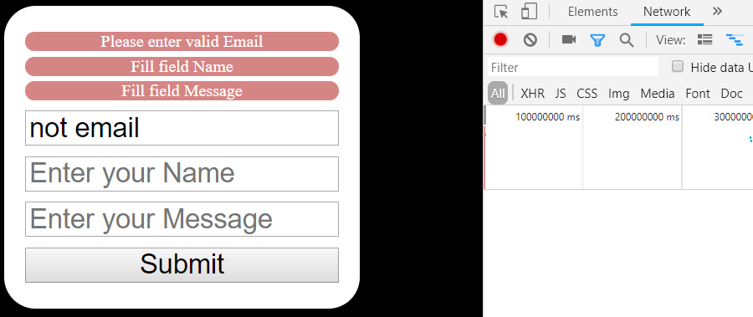
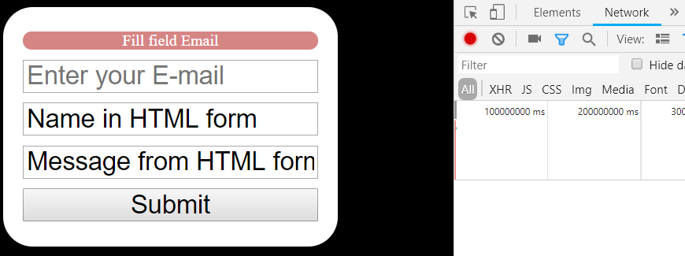
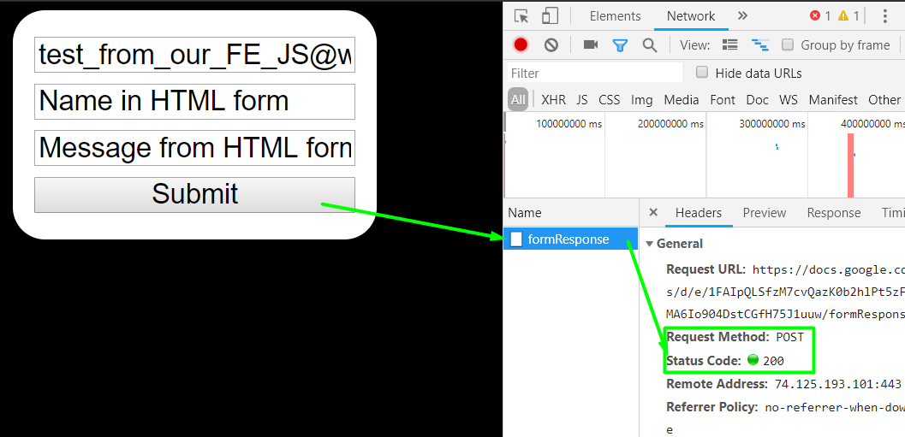
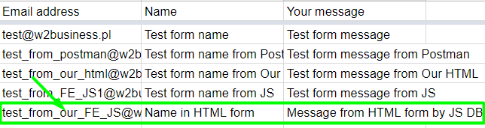
OUR Front end
Let's test negative and positive data sets:

Slide 31
SOLUTION ARCHITECTURE
Let's analyze our current solution layers:
OUR WEBSITE
Front end
Client browser
Front
end
Our HTML form POST data by JS to Google form
Request
JS
G. FORM
Response
Request
REST API endpoint receive POST request, validate and save to DB
GOOGLE FORM
REST API
Google API
Back
end
https://docs.google.com/forms/d/e/1FAIpQLSfzM7cvQazK0b2hlPt5zFFjMncvMA6Io904DstCGfH75J1uuw/formResponse
DB
spreadsheet

Slide 32
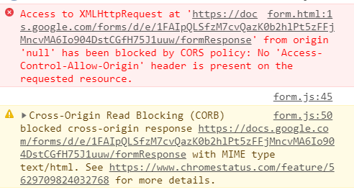
CORS?
https://stackoverflow.com/questions/20035101/why-does-my-javascript-get-a-no-access-control-allow-origin-header-is-present

Slide 33
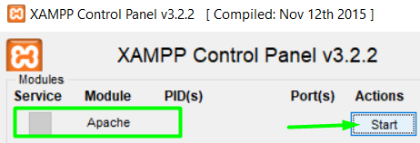
OUR Back end
Use web hosting or install XAMPP and start Apache server
According to HOW-TO Guides - http://localhost/dashboard/docs/configure-vhosts.html add virtual hosted domain. Add in file \apache\conf\extra\httpd-vhosts.conf :
<VirtualHost *:80>
DocumentRoot "C:/xampp/htdocs/"
ServerName localhost
</VirtualHost>
<VirtualHost *:80>
DocumentRoot "C:/xampp/htdocs/demo/htdocs"
ServerName demo.localhost
</VirtualHost>
… restart Apache and open demo.localhost in browser

Slide 34
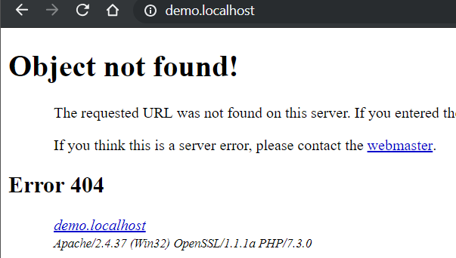
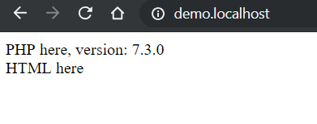
OUR Back end
At your website create file index.php
<?php
echo "PHP here, version: ".phpversion();
?>
<br>
HTML here
Note for XAMPP – create folders \demo\htdocs in \xampp\htdocs and put this file inside.
Refresh website in browser:

Slide 35
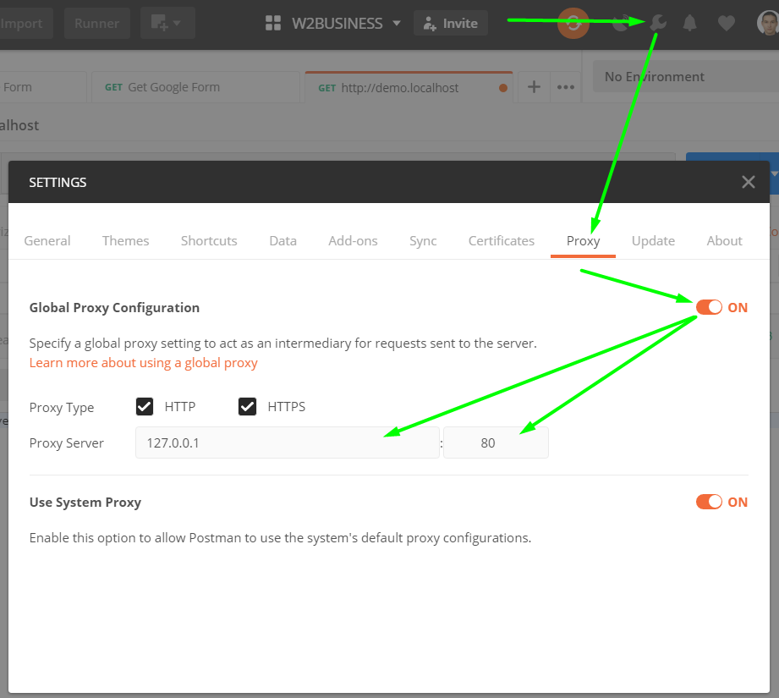
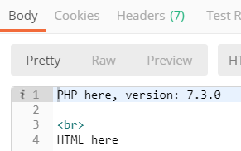
OUR Back end
Change Postman settings and call GET demo.localhost

Slide 36
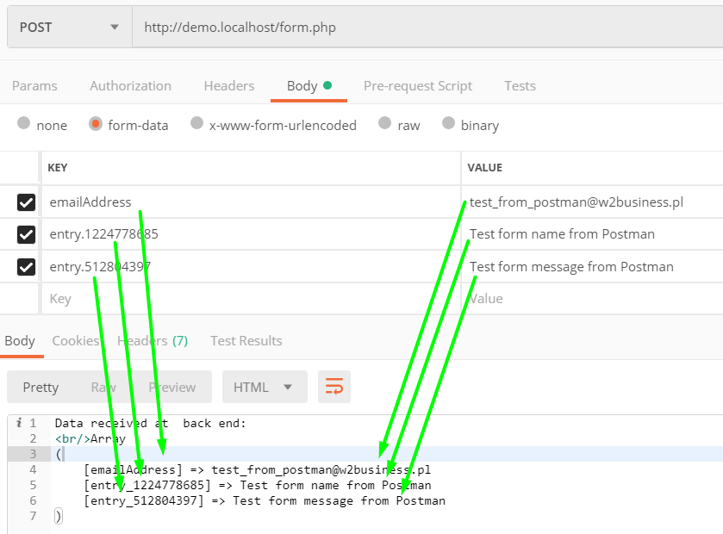
OUR Back end
At your website create file form.php
<?php
echo "Data received at back end:"."<br/>";
print_r($_POST);
?>
Call this form from browser (GET request) and from Postman as POST and change Google form endpoint url to demo.localhost/form.php :

Slide 37
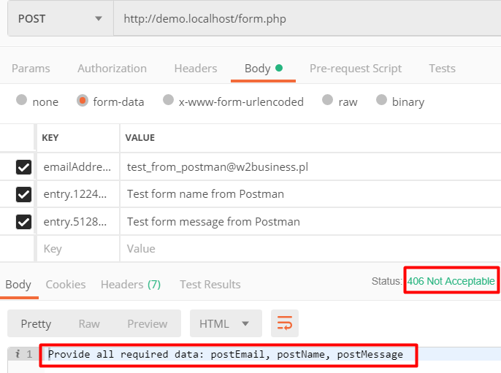
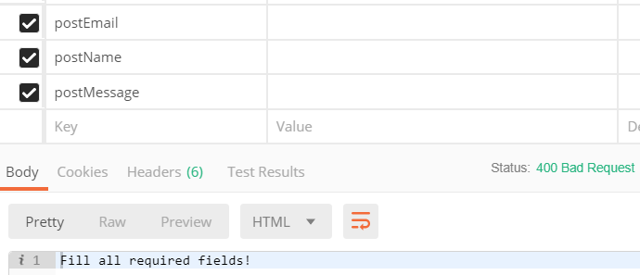
OUR Back end
Lets update form.php
Call updated BE form.php:
<?php
if($_SERVER['REQUEST_METHOD'] == 'POST' && isset($_POST['postEmail']) && isset($_POST['postName']) && isset($_POST['postMessage'])){
$email = $_POST['postEmail'];
$name = $_POST['postName'];
$message = $_POST['postMessage'];
if ($name == "" || $email == "" || $message == ""){
http_response_code(400);
echo "Fill all required fields!";
}
else{ // All form data looks good, so:
http_response_code(200);
echo "Data valid";
}
}
else{
http_response_code(406);
echo "Provide all required data: postEmail, postName, postMessage";
}
?>
Change postman POST requests keys and call again:

Slide 38
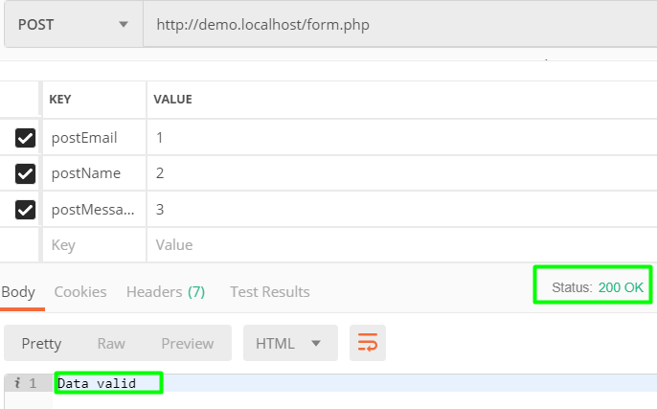
OUR Back end
Lets update form.php
Call updated BE form.php with proper data:
<?php
if($_SERVER['REQUEST_METHOD'] == 'POST' && isset($_POST['postEmail']) && isset($_POST['postName']) && isset($_POST['postMessage'])){
$email = $_POST['postEmail'];
$name = $_POST['postName'];
$message = $_POST['postMessage'];
if ($name == "" || $email == "" || $message == ""){
http_response_code(400);
echo "Fill all required fields!";
}
else{ // All form data looks good, so:
http_response_code(200);
echo "Data valid";
}
}
else{
http_response_code(406);
echo "Provide all required data: postEmail, postName, postMessage";
}
?>

Slide 39
OUR Back end
Lets increase BE validation in form.php
<?php
if($_SERVER['REQUEST_METHOD'] == 'POST' && isset($_POST['postEmail']) && isset($_POST['postName']) && isset($_POST['postMessage'])){
$email = strtolower($_POST['postEmail']);
$name = $_POST['postName'];
$message = $_POST['postMessage'];
if ($name == "" || $email == "" || $message == ""){
http_response_code(400);
echo "Fill all required fields!";
}
else{ // All form data looks good, so:
http_response_code(200);
echo "Data valid";
}
}
else{
http_response_code(406);
echo "Provide all required data: postEmail, postName, postMessage";
}
?>
Add errors for invalid cases:
elseif (strlen($name) < 3) {
http_response_code(400);
echo "Name must be not less than 2 characters";
}
elseif (strlen($name) > 25) {
http_response_code(400);
echo "Name must be less than 26 characters";
}
elseif(!preg_match("^[_a-z0-9-]+(\.[_a-z0-9-]+)*@[a-z0-9-]+(\.[a-z0-9-]+)*(\.[a-z0-9-]{2,20})$^",$email)){
http_response_code(400);
echo "Enter the correct e-mail";
}
elseif (strlen($message) < 5) {
http_response_code(400);
echo "Message must be not less than 5 characters";
}
elseif (strlen($message) > 300) {
http_response_code(400);
echo "Message must be less than 300 characters";
}

Slide 40
OUR Back end
If data proper according to our back end validation let's send this to Google form
Replace code:
With request which send data to Google API:
// All form data looks good, so:
http_response_code(200);
echo "Data valid";
// All form data looks good, so lets start curl to Google form:
$url = 'https://docs.google.com/forms/d/e/1FAIpQLSfzM7cvQazK0b2hlPt5zFFjMncvMA6Io904DstCGfH75J1uuw/formResponse';
// Fix for cyrillic variables with urlencode:
$myvars = 'emailAddress=' . urlencode($email) . '&entry.1224778685=' . urlencode($name).'&entry.512804397=' . urlencode($message);
$ch = curl_init( $url );
curl_setopt( $ch, CURLOPT_POST, 1);
curl_setopt( $ch, CURLOPT_POSTFIELDS, $myvars);
curl_setopt( $ch, CURLOPT_FOLLOWLOCATION, 1);
curl_setopt( $ch, CURLOPT_HEADER, 1);
curl_setopt( $ch, CURLOPT_RETURNTRANSFER, 1);
// grab URL and pass it to the browser
$response = curl_exec( $ch );
$responseinfo = curl_getinfo($ch);
// close cURL resource, and free up system resources
curl_close($ch);
if($responseinfo["http_code"] == 200){
http_response_code(200);
echo "Form received.";
}
else{
http_response_code(421);
echo "Form not received, please try again or contact with us by phone";
}

Slide 41
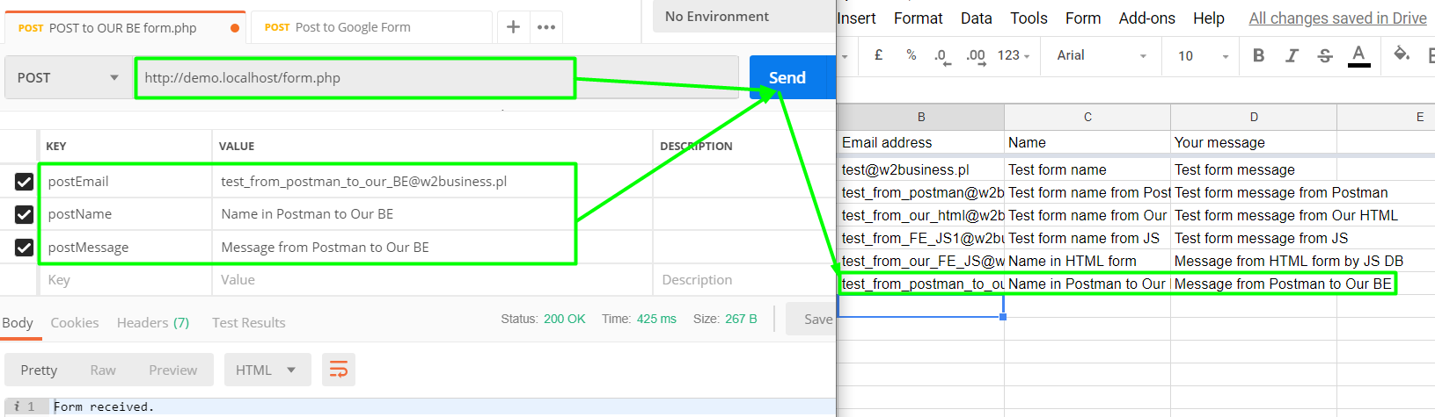
OUR Back end
Let's test it. Positive data set send from Postman to OUR back end must be forwarded to Google Form API and saved in our DB (spreadsheet):

Slide 42
Final solution (integration FE-MW)
1. Copy code from form.html to index.php (also You can rename this file to index.html)
2. Place files form.js and style.css in website root directory
3. In form.js replace line 49 with this call to our back end: xhr.open("POST", "form.php");
Back end become a middleware now.

Slide 43
Final solution (update FE)
Open our FE (http://demo.localhost/) in browser and try submit form
FE send to BE incorrect POST form keys values, so need update html form code:
<input type="email" name="postEmail" placeholder="Enter your E-mail">
<input type="text" name="postName" placeholder="Enter your Name">
<input type="text" name="postMessage" placeholder="Enter your Message">
FE form.js code also need update. Replace all
emailAddress for postEmail
entry.1224778685 for postName
entry.512804397 for postMessage

Slide 44
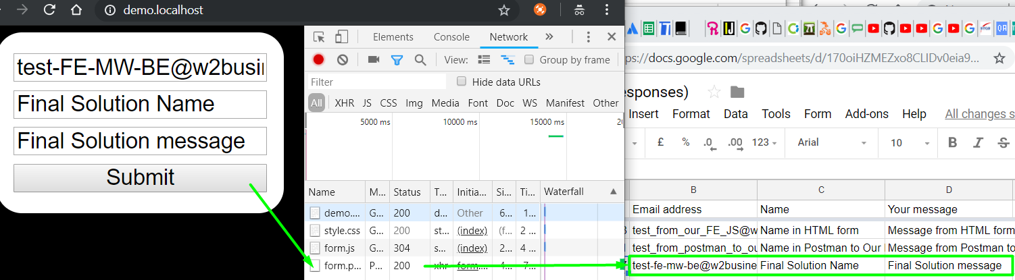
Final solution (test)
Let's try submit correct data to OUR website form and check data saved in DB:
Now it works without redirect to Google forms!

Slide 45
Final solution (update FE)
Let's update our FE in form.js
Disable submit while wait for response (for test use sleep(5); at form.php), show errors from middleware hide form if success and :
xhr.addEventListener("readystatechange", function () {
if (this.readyState !== 4) {
console.log("while wait for response result, block form");
document.getElementsByName("submit")[0].disabled = true;
}
if (this.readyState === 4) {
console.log(this.responseText);
if (this.responseText == "Form received."){
document.getElementsByTagName("form")[0].innerHTML = this.responseText;
}
else{
document.getElementsByName("submit")[0].disabled = false;
let errorBlock = document.createElement("div");
errorBlock.appendChild(document.createTextNode(this.responseText));
document.getElementById('formErrors').appendChild(errorBlock);
}
}
});

Slide 46
FINAL SOLUTION ARCHITECTURE
Let's analyze our final solution layers:
Front
end
OUR WEBSITE
HTML+JS
JS update DOM (HTML)
Client browser show our HTML form, validate and send data to middleware
Response
Middle
ware
Our server side BE
Request
Server side validation, communication with BE and return results to FE
PHP
Request
Response
Back
end
GOOGLE FORM
REST API
Google API
REST API endpoint receive POST request, validate and save to DB
DB
spreadsheet
Stores data

Slide 47

THANK YOU...
Do you have any questions?
Svitlana Samko
https://www.linkedin.com/in/svitlana-samko/
Andrii Stepura
https://www.linkedin.com/in/andriistepura/
Graphics from focus-education.co.uk

