Slide 1
Introduction to REST API testing with Postman tools or how create first 434 automation tests

Slide 2


Who?
Svitlana Samko
https://www.linkedin.com/in/svitlana-samko-b87532114/
Senior Developer in Test
over 9 years web development practice
over 10 delivered software projects for middle and large business
My strongest side: I like to learn business from the inside. Only so you can be sure that the product is need an correct at any stages of development
Andrii Stepura
https://www.linkedin.com/in/andriistepura/
Senior Quality Assurance Automation Engineer
over 14 years web development practice
over 300 delivered web projects as PO / Dev / Analyst / QA
My strongest side: Imagination to set myself as any stakeholder. All software start from idea and first written code lines it's just half of our way to delivery this idea.

Slide 3
Definition of done
1
Theory:
What is API
What is HTTP
CRUD by HTTP methods
Theory:
What is API
What is HTTP
CRUD by HTTP methods
4
Test:
Develop system requirements
Create tests
Prioritize tests
Exploratory testing with Postman
Verification tests with Postman Runner
Report bugs with Postman code (cURL)
2
Analyse:
Example project
Familiarizing with business needs
Business requirements
Develop system requirements
5
Continuous integration:
Regression testing with Postman CLI tool Newman
Verification of fixed API v.1.1 ... 2.0
3
Configuration:
Install tools: Postman, Postman Interceptor, Node.js with NPM, Newman, Notepad++, Git Bash
Deploy “Demo API v.1.0”

Slide 4

What is API?
1
Theory
2
Analyse
3
Config
4
API - Application Programming Interface
a set of functions and procedures that allow the creation of applications which access the features or data of an operating system, application, or other service.
Purpose:
Just as a graphical user interface makes it easier for people to use programs, application programming interfaces make it easier for developers to use certain technologies in building applications.
Test
5
CI
©
Text - https://en.wikipedia.org/wiki/Application_programming_interface
Graphic - https://semaphoreci.com/community/tutorials/building-and-testing-a-rest-api-in-go-with-gorilla-mux-and-postgresql

Slide 5
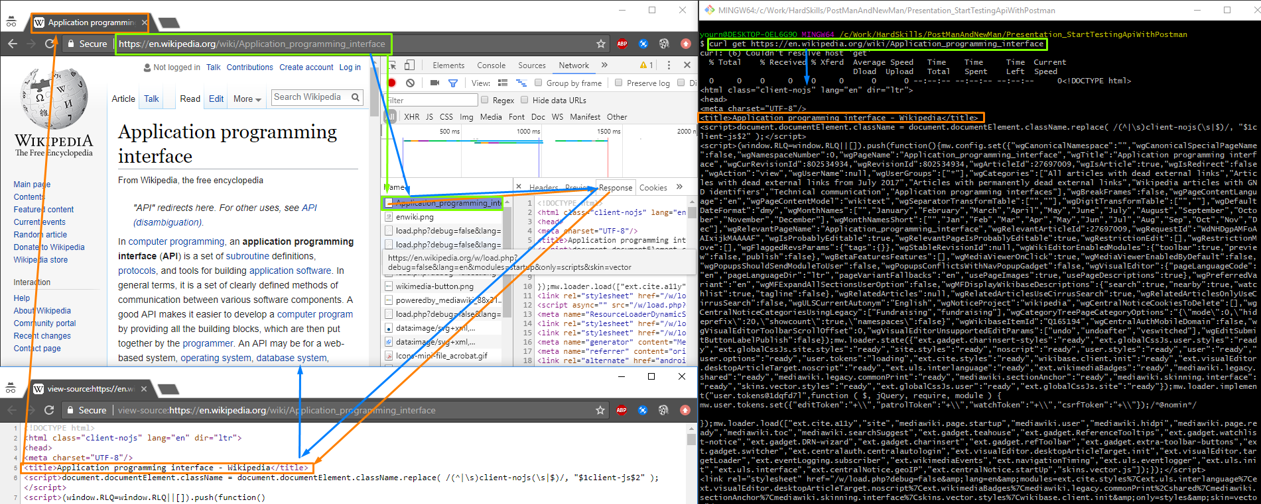
What is API? (simplification for web rest APIs)
1
Theory
2
Analyse
3
Config
4
Just as a graphical user interface makes it easier for people:
open https://en.wikipedia.org/wiki/Application_programming_interface
Your browser, send request to website, receive/send packages (example in networks tab), than provide response to UI model and show it for you.
API make it easier for developers to use certain technologies in building applications.
API just send request and receive response
curl get https://en.wikipedia.org/wiki/Application_programming_interface
Test
5
CI

Slide 6
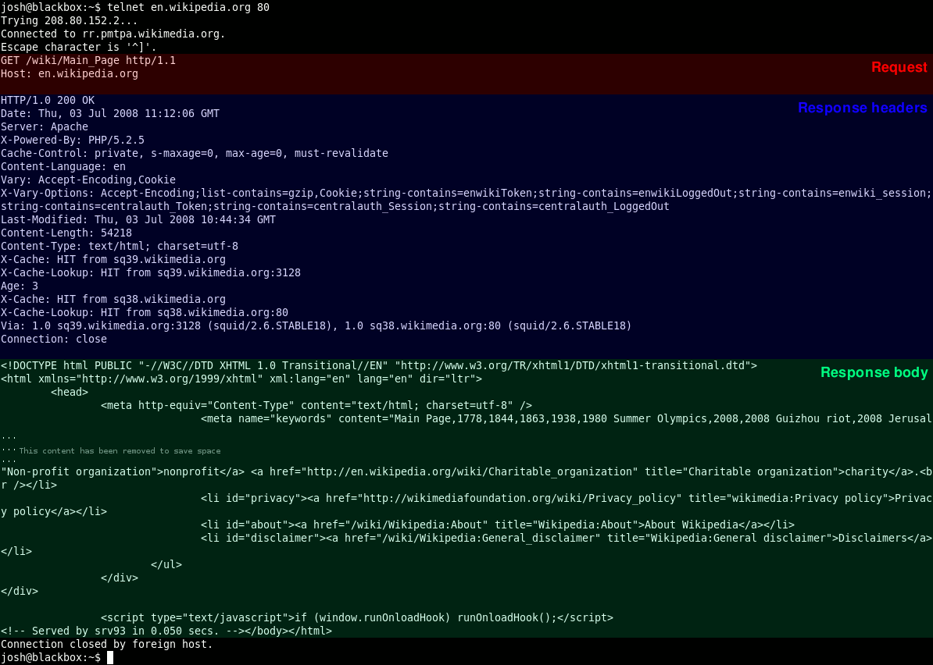
What is HTTP?
1
Theory
2
Analyse
3
Config
4
HTTP - Hypertext Transfer Protocol
The Hypertext Transfer Protocol (HTTP) is an application protocol for distributed, collaborative, and hypermedia information systems.
Test
5
CI
HTTP is the foundation of data communication for the World Wide Web.
The HTTP/1.0 specification defined the GET, POST and HEAD methods and the HTTP/1.1 specification added 5 new methods: OPTIONS, PUT, DELETE, TRACE and CONNECT.
©
Text & Graphic - https://en.wikipedia.org/wiki/Hypertext_Transfer_Protocol

Slide 7
CRUD by HTTP methods
1
Theory
2
Analyse
3
Config
4
In computer programming, create, read, update, and delete (as an acronym CRUD) are the four basic functions of persistent storage.
The Data Distribution Service for real-time systems (DDS) is an Object Management Group (OMG) machine-to-machine (sometimes called middleware) standard that aims to enable scalable, real-time, dependable, high-performance and interoperable data exchanges using a publish–subscribe pattern.
Test
5
CI
Operation | HTTP | DDS
Create | PUT / POST | write
Read (Retrieve) | GET | read / take
Update (Modify) | PUT / POST / PATCH | write
Delete (Destroy) | DELETE | dispose
©
Text - https://en.wikipedia.org/wiki/Data_Distribution_Service

Slide 8

Example project
1
Theory
2
Analyse
3
Config
4
What: Online Currency Converter API
Functionality for API clients:
- Receive info about API available calls
- Receive info about currency BYE price
- Receive info about currency SELL price
Test
5
CI
©
Graphic - http://www.androidfinances.com/download-all-currency-converter-pro.html

Slide 9
Business requirements
1
Theory
2
Analyse
3
Config
4
- User must have access to API documentation
- User can receive information about each currency according to ISO 4217
- User must receive BYE/SELL prices for all available currency
- Every our business order must bring for company at least 1% benefit
- Marketing should have possibility grand for individual clients 1% discount
- User can receive company contacts details with contact phone number
Test
5
CI
©
ISO 4217 - https://www.iso.org/iso-4217-currency-codes.html

Slide 10
Develop system requirements
1
Theory
2
Analyse
3
Config
GET API documentation always available
4
Test
GET company contacts with phone number always available
5
CI
User must have access to API documentation
User can receive company contacts details with contact phone number
User can receive information about each currency according to ISO 4217
User must receive BYE/SELL prices for all available currency
Every our business order must bring for company at least 1% benefit
Marketing should have possibility grand for individual clients 1% discount
GET BYE price for each currency according to ISO 4217 always available
GET SELL price for each currency according to ISO 4217 always available
GET for any not available currency return message with info "Currently unavailable BYE/SEL {CURRENCY} currency" where {CURRENCY} - requested currency name
For every available currency SELL price must be at least for 4% highest than SELL price for same currency
©
ISO 4217 - https://www.iso.org/iso-4217-currency-codes.html

Slide 11
Install tools
1
Theory
2
Analyse
3
Config
4
Test
Software | Resource
Postman | https://www.getpostman.com/
Postman Interceptor | https://chrome.google.com/webstore/detail/postman-interceptor/aicmkgpgakddgnaphhhpliifpcfhicfo?hl=en
Node.js with NPM | https://nodejs.org/en/download/
Newman | https://www.npmjs.com/package/newman $ npm install newman --global;
Notepad++ | https://notepad-plus-plus.org/download/
Git bash | https://git-scm.com/downloads
5
CI

Slide 12
Deploy “Demo API v.1.0”
1
Theory
2
Analyse
3
Config
4
Run Git bash
Comand cd c
git clone https://github.com/AndriiStepura/letslearnapitesting.git
Comand cd c\letslearnapitesting
run with command: node server.js
Open brouser at 127.0.0.1:3001
Test
5
CI

Slide 13
Title
1
Theory
2
Analyse
3
Config
4
Text
Test
5
CI
©
Text -

Slide 14
Title
1
Theory
2
Analyse
3
Config
4
Text
Test
5
CI
©
Text -

Slide 15
Title
1
Theory
2
Analyse
3
Config
4
Text
Test
5
CI
©
Text -

Slide 16
Use this links
https://www.getpostman.com/
https://www.getpostman.com/docs/postman/scripts/test_examples
https://www.currency-iso.org/dam/downloads/lists/list_one.xml
https://www.npmjs.com/package/newman#newmanrunoptions-object--callback-function--run-eventemitter

Slide 17
Theory part
Demo API deploj:
Install node.js with npm
Install

Slide 18
Example of a chart

Slide 19

Picture slide
Bullet 1
Bullet 2

Slide 20
Examples of default styles
Text and lines are like this
Hyperlinks like this
Visited hyperlinks like this
Table
Text box
Text box
With shadow

Slide 21



Introduction to API testing with Postman tools or how create 3472 tests scripts in 37 minutes
Gratitude:
Thank for great tools!
https://www.getpostman.com/
Thank for great team review:
http://w2business.pl/
W2BUSINESS
QA academy
Thanks for the presentation tech background:
http://www.spyro-soft.com

