Slide 1

Communication Between Processes – PM2
Pravinkumar R .D.
Notes:
<number>

Slide 2
Our Example
PM2
Request1
Express App
Instance – 1
Publisher
Subscriber - 1
Request2
Redis
Request3
Request4
Express App
Instance – 2
Publisher
Subscriber - 2
Request5

Slide 3
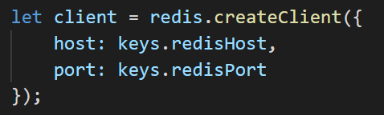
Creating Publisher

Slide 4
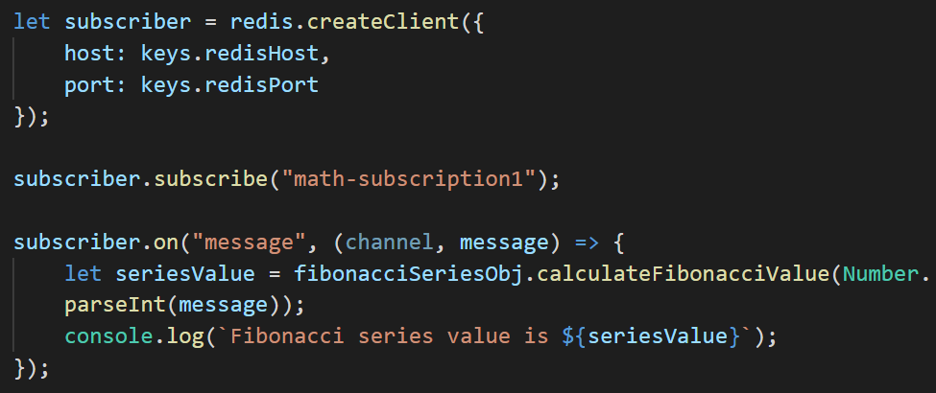
Creating Subscriber

Slide 5
Let’s look at an example!!!

