Slide 1

Introduction to Nginx
Pravinkumar R .D.
Notes:
<number>

Slide 2
What is Nginx?
It is one of the most powerful Web Server which follows non-threaded and event driven architecture
It can also be used as –
Reverse proxy
Load balancer
Caching server
Nginx has one master process and several worker processes

Slide 3
What is Nginx?
The main job of master is to –
Read and evaluate configuration
Maintain worker processes
Worker processes do the actual processing of the requests
The number of worker processes are defined in configuration file –
The number of processes can be fixed for a given configuration
Or can be dynamic to the number of available CPU cores

Slide 4
Download and Install Nginx
To download Nginx, please use the below link –
http://nginx.org/en/download.html
After downloading the Nginx, unzip the file in your choice of location
Go to the extracted folder – [In my case]
C:\Users\LiteITLabs\Downloads\nginx-1.16.1\nginx-1.16.1
Double click on nginx.exe and your server will start

Slide 5
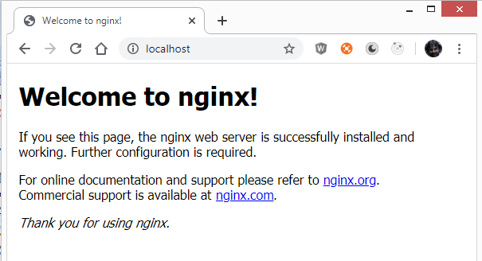
Check Nginx Is Running
Open browser and type URL – http://localhost

Slide 6
Few Commands of Nginx
stop – fast shutdown
nginx –s stop
quit – graceful shutdown
nginx –s quit
reload – reloading the configuration file
nginx –s reload
reopen – reopening the log files
nginx –s reopen

Slide 7

Configure Nginx as Reverse Proxy
Request1
Nginx Web Server
Request2
Node JS
Application
Request3
Request4
http://localhost
http://localhost:3000
Request5

Slide 8
Nginx Reverse Proxy with Load Balancing
Request1
Nginx Web Server
Node JS
Application
Request2
Request3
http://localhost:3000
Node JS
Application
Request4
http://localhost
Request5
http://localhost:3001

