Slide 1

Introduction to PM2
Pravinkumar R .D.
Notes:
<number>

Slide 2
What is PM2?
PM2 is a production process manager for Node JS applications with a built-in load-balancer
PM2 allows to –
Keep applications alive forever
Reload them without downtime
Facilitate common system admin tasks like –
Monitoring, stopping, deleting processes etc.

Slide 3
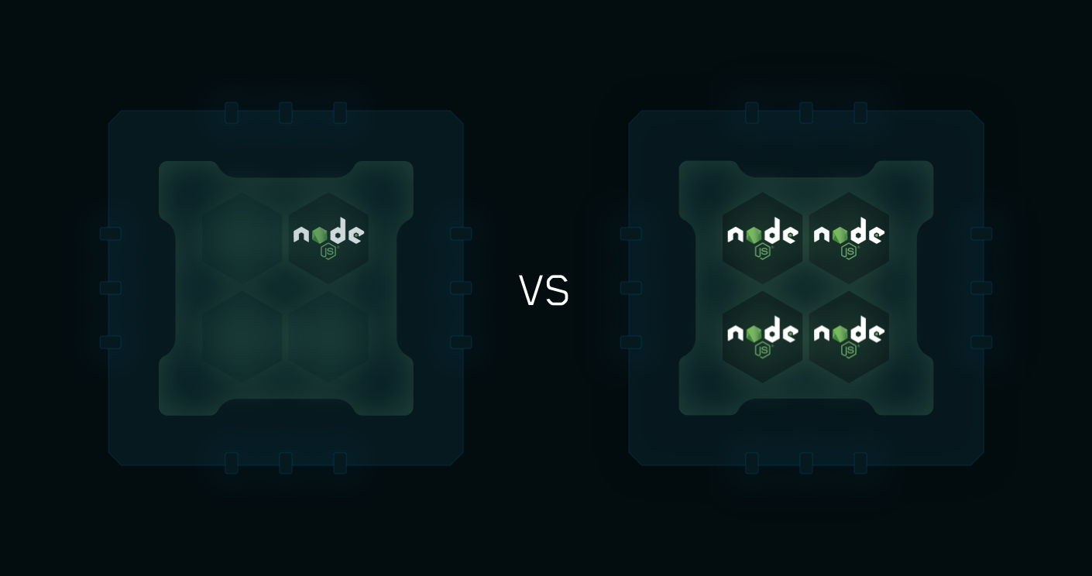
PM2 Load Balancer

Slide 4
PM2 Working
PM2 makes usage of Node JS cluster module
The scaled application’s child processes can automatically share server ports
You can start Node JS application using PM2 by using –
Command line options
Process configuration file [js/yaml/json file]

Slide 5
Install PM2 using NPM
To install PM2 on your machine, use npm install command –
npm install –g pm2

Slide 6
Creating Process File
You can create a process file to –
Fine-tune the behavior
Options
Environment variables
Log files of each application
To create a process file use command –
pm2 ecosystem
After creating a process file, use command –
pm2 [start|restart|stop|delete] ecosystem.config.js

Slide 7
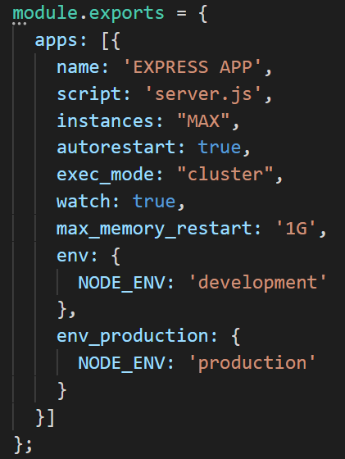
Process File

Slide 8
Few PM2 Commands
PM2 start command –
pm2 start ecosystem.config.js
To monitor the processes, use –
pm2 monit
To stop any/all processes use –
pm2 stop all/app-name
To delete any/all processes use –
pm2 delete all/app-name
To list all the applications use – pm2 list

Slide 9
Let’s look at an example!!!

