Slide 1

Sentinel-Lab
Failed RDP to IP Geolocation Information

Slide 2
Description
The Powershell script in this repository is responsible for parsing out Windows Event Log information for failed RDP attacks and using a third-party API to collect geographic information about the attackers' location. The script is used in this demo where I set up Azure Sentinel (SIEM) and connect it to a live virtual machine. I will observe live attacks (RDP Brute Force) from all around the world. I will use a custom PowerShell script to Look up the attackers' Geolocation information and plot it on an Azure Sentinel Map!

Slide 3
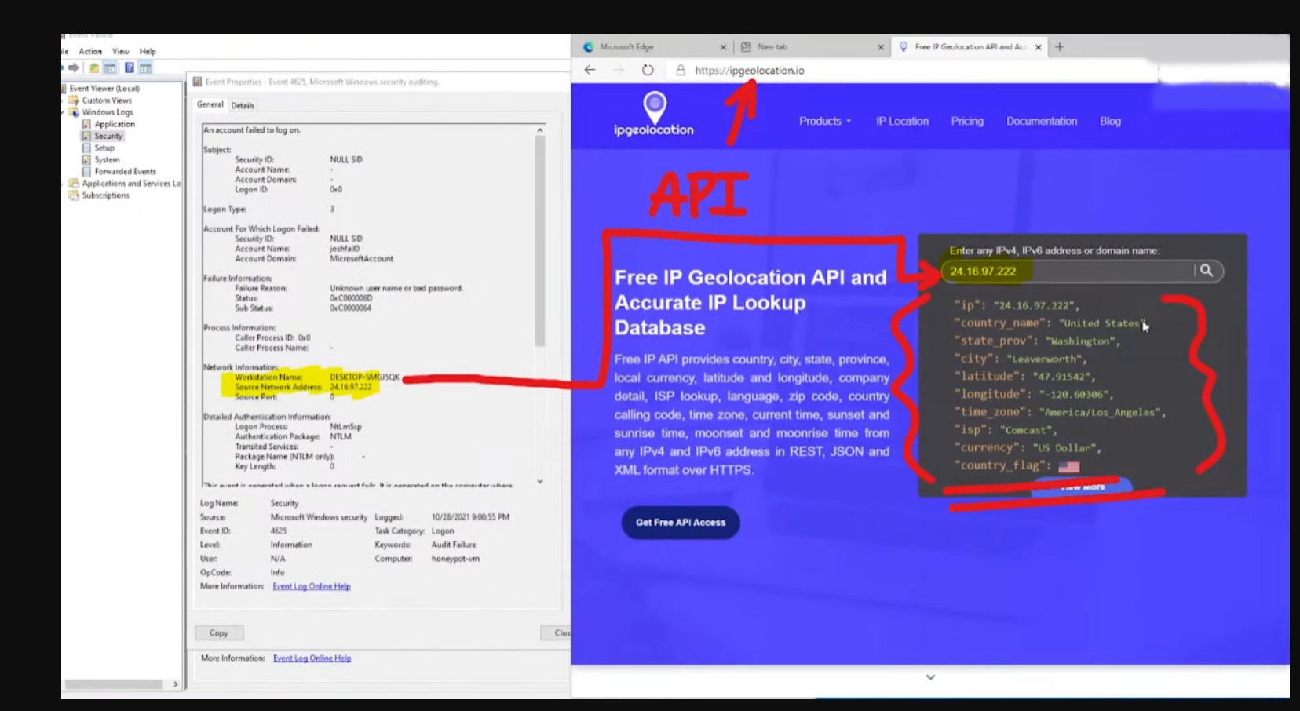
Utilities Used ipgeolocation.io: IP Address to Geolocation API

Slide 4
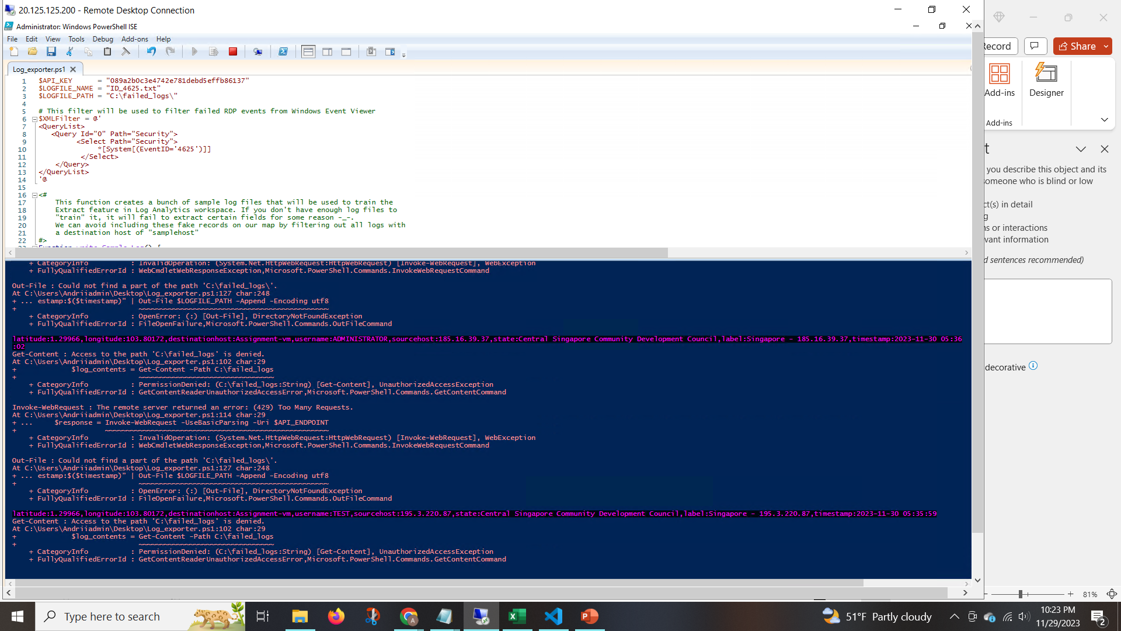
Languages Used PowerShell: Extract RDP failed logs from Windows Event Viewer Attacks from Singapore coming in; Custom logs being output with geodata

Slide 5
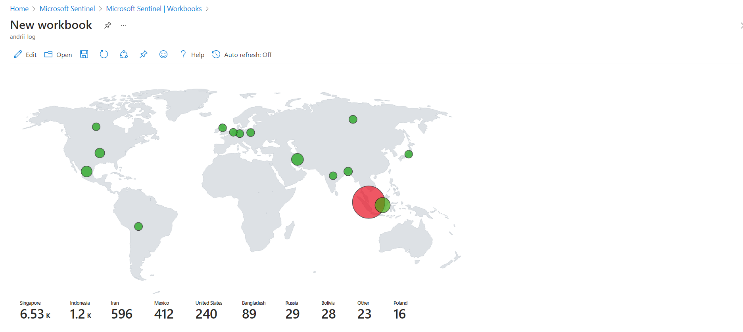
World map of incoming attacks after 24 hours (built custom logs including geodata)

