Slide 1
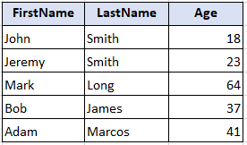
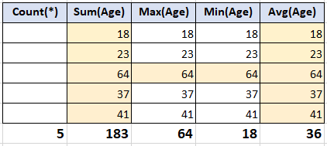
Aggregate functions in SQL
Count ()
Sum ()
Max()
Min ()
Avg()

Slide 2
Aggregate (examples)
Select Count(*), Sum(Age), Max (Age)
From Bank.Client;
Select Count(*), Sum(Age), Max (Age)
From Bank.Client
Where Type = ‘private’;

Slide 3
Aggregate (examples)
Select ClientId, Max(Balance), Min(Balance)
From Bank.Accounts
Where Type = ‘CREDIT’
Group by ClientId;
Select ClientId, Avg(Balance), Sum(Balance)
From Bank.Accounts
Group by ClientId
Having Avg(Balance) > 10000;

Slide 4
Join
SQL JOIN is used to combine rows from two or more tables, based on a common field between them.

Slide 5
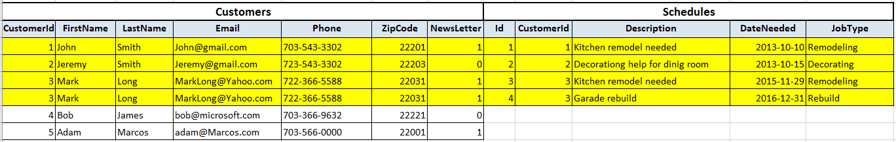
JOIN (inner join)
The INNER JOIN keyword selects records that have matching values in both tables.
SELECT *
FROM HomePro.Customers
join HomePro.Schedules
on Customers.CustomerId = Schedules.CustomerId

Slide 6
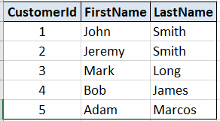
How it works

