Slide 1
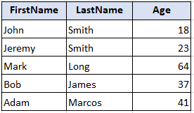
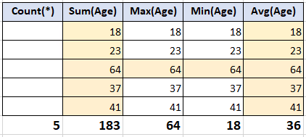
Aggregate functions in SQL
Count ()
Sum ()
Max()
Min ()
Avg()

Slide 2
Aggregate (examples)
Select Count(*), Sum(Age), Max (Age)
From Bank.Client;
Select Count(*), Sum(Age), Max (Age)
From Bank.Client
Where Type = ‘private’;

Slide 3
Aggregate (examples)
Select ClientId, Max(Balance), Min(Balance)
From Bank.Accounts
Where Type = ‘CREDIT’
Group by ClientId;
Select ClientId, Avg(Balance), Sum(Balance)
From Bank.Accounts
Group by ClientId
Having Avg(Balance) > 10000;

Slide 4
Join
SQL JOIN is used to combine rows from two or more tables, based on a common field between them.

Slide 5
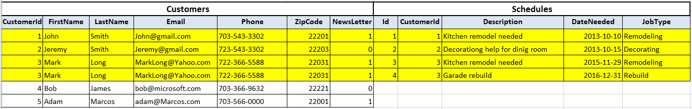
JOIN (inner join)
The INNER JOIN keyword selects records that have matching values in both tables.
SELECT *
FROM HomePro.Customers
join HomePro.Schedules
on Customers.CustomerId = Schedules.CustomerId

Slide 6
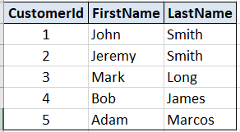
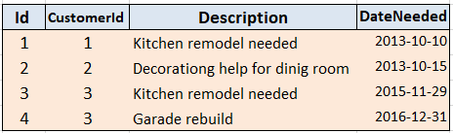
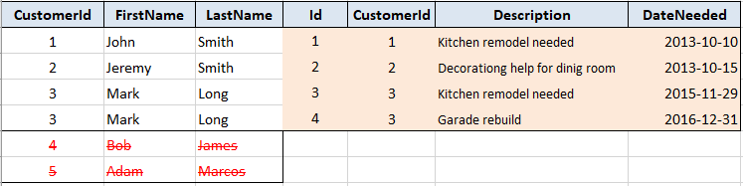
How it works

Slide 7
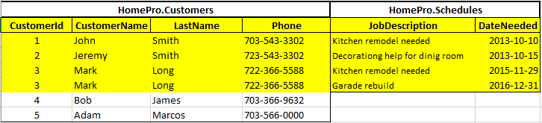
Using table and column alias
SELECT
a.CustomerId, a.FirstName as CustomerName, a.Lastname, b.Description as JobDescription, b.DateNeeded
FROM HomePro.Customers a
join HomePro.Schedules b
on a.CustomerId = b.CustomerId

Slide 8
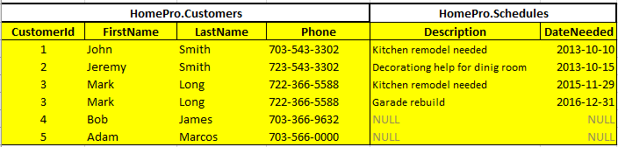
Left join
returns all rows from the left table (table1), with the matching rows in the right table (table2). The result is NULL in the right side when there is no match.
SELECT
c.CustomerId, c.FirstName, c.Lastname, c.Phone, s.Description, s.DateNeeded
FROM HomePro.Customers c
left join HomePro.Schedules s
on c.CustomerId = s.CustomerId

Slide 9

Customers without Schedules
SELECT
c.CustomerId, c.FirstName, c.Lastname, c.Phone, s.Description, s.DateNeeded
FROM HomePro.Customers c
left join HomePro.Schedules s
on c.CustomerId = s.CustomerId
WHERE s.CustomerId is null

Slide 10
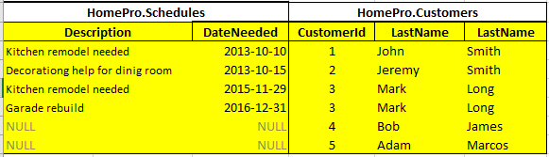
Right join
Returns all rows from the right table (table2), with the matching rows in the left table (table1). The result is NULL in the left side when there is no match.
SELECT
s.Description, s.DateNeeded, c.CustomerId, c.FirstName, c.Lastname
FROM HomePro.Schedules s
right join HomePro.Customers c
on c.CustomerId = s.CustomerId

Slide 11
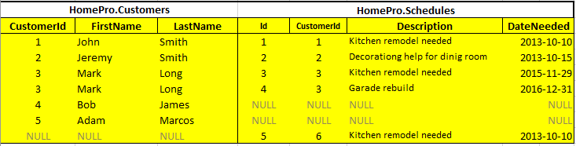
Full outer join
Combines the result of both LEFT and RIGHT joins
SELECT
c.CustomerId, c.FirstName, c.Lastname, c.Phone, s.id, s.CustomerId,
s.Description, s.DateNeeded
FROM HomePro.Customers c
full outer join HomePro.Schedules s
on c.CustomerId = s.CustomerId

Slide 12
Three tables join
SELECT
C.CustomerId, C.FirstName, C.Lastname, S.Description, S.DateNeeded, Q.Estimation
FROM HomePro.Customers C
join HomePro.Schedules S on C.CustomerId = S.CustomerId
join HomePro.Quotes Q on C.CustomerId = Q.CustomerId

Slide 13
Three tables left join
SELECT
C.CustomerId, C.FirstName, C.Lastname, S.Description, S.DateNeeded, Q.Estimation
FROM HomePro.Customers C
left join HomePro.Schedules S on C.CustomerId = S.CustomerId
left join HomePro.Quotes Q on C.CustomerId = Q.CustomerId

