Slide 1
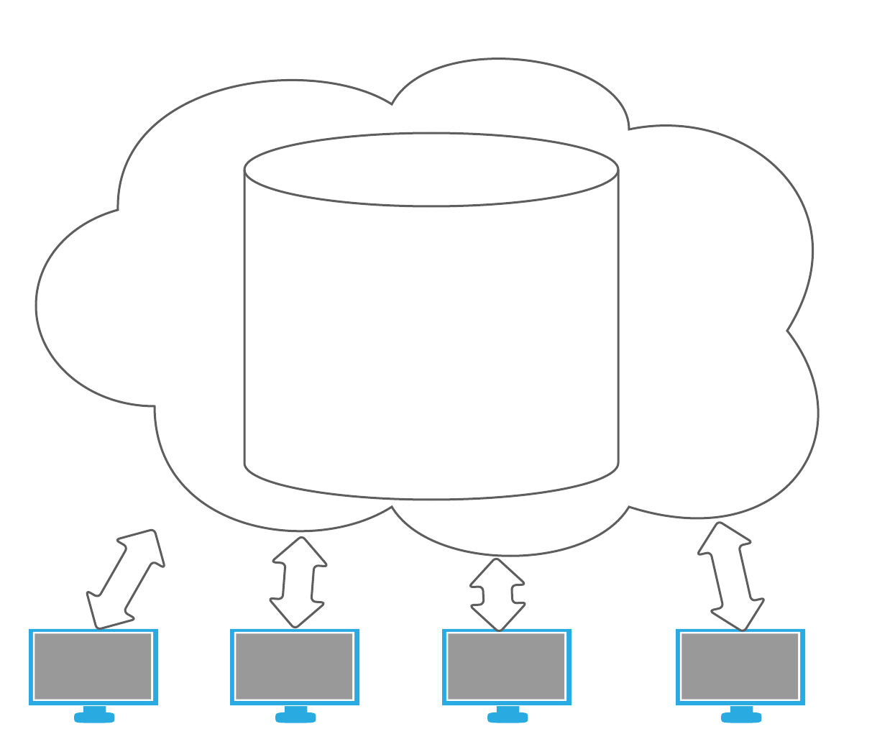
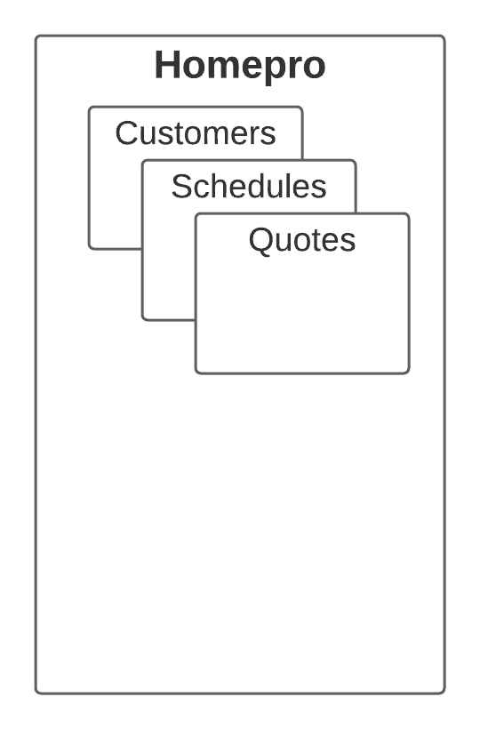
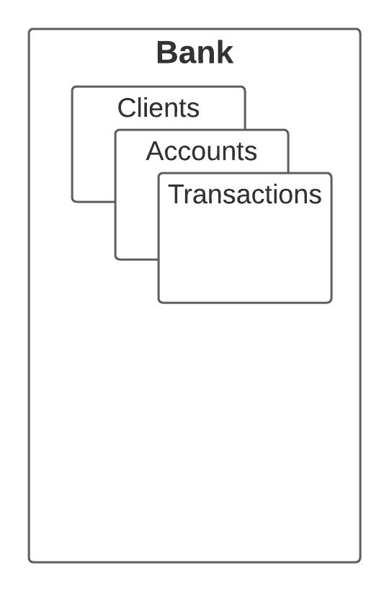
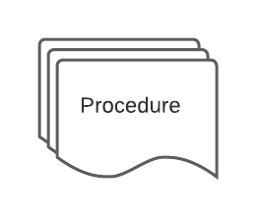

Slide 2
Stored Procedures
A stored procedure is a set of structured query language (SQL) statements with an assigned name, which are stored in a relational database management system as a group, so it can be reused and shared by multiple programs.
Set of SQL statements
Has an assigned name
Stored in a database
Can be reused and shared by multiple programs

Slide 3
Create procedure basic syntax
Declaration
CREATE PROCEDURE <SchemaName>.<ProcedureName>
AS
BEGIN
--Your code ..
SELECT
END
Usage
Execute <schemaName>.<ProcedureName>

Slide 4
Example
CREATE PROCEDURE HomePro.GetAllCustomers
AS
BEGIN
Select
CustomerId, FirstName, LastName, ..
From HomePro.Customers
END
-----
ALTER PROCEDURE HomePro.GetAllCustomers
AS
BEGIN
…….
END
Execute HomePro.GetAllCustomers
Or
Exec HomePro.GetAllCustomers

Slide 5
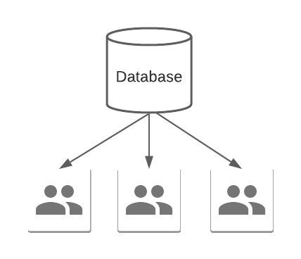
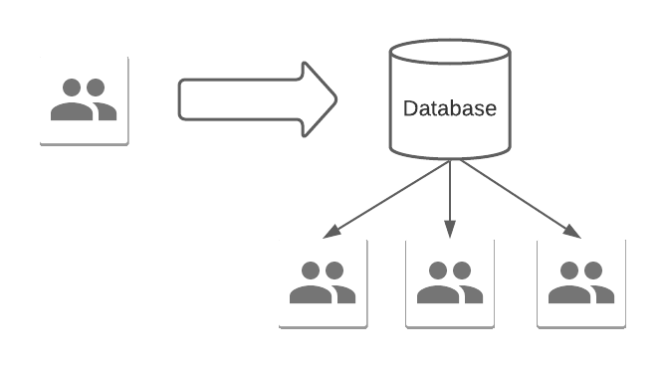
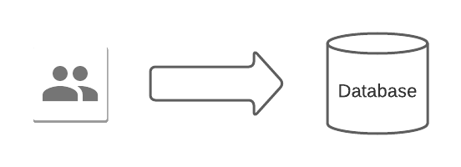
Benefits of using procedures
Store
Share
Distribute

Slide 6
Naming conventions
Schema name
Procedures action name: GET, SET, UPDATE and so on
Detail of actions: AllClients, ClientsNoSchedule
Alias or owner’s name for distinguish
Examples:
HomePro.GetAllCustomers_Andrey
Bank.GetClientsNoSchedules_Andrey

Slide 7
Parameters
Declaration
Usage
CREATE PROCEDURE Bank.GetClientsByAge_Andrey
@Age int
AS
BEGIN
select ClientId, FirstName, LastName
from Bank.Clients
where age > @Age
END
EXEC Bank.GetClientsByAge_Andrey
@Age = 10

Slide 8
Verify the passed value of parameter
CREATE PROCEDURE Bank.GetClientsByAge_Andrey
@Age int
AS
BEGIN
if (@Age < 10 or @Age > 100)
begin
Raiserror ('The parameter Age is not valid ', 16,10);
Return
end
select ClientId, FirstName, LastName, Age
from Bank.Clients
where age > @Age
END

