Slide 1







Bank system

Slide 2



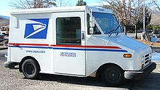
Web store (eCommerce)

Slide 3



Database
A database is an organized collection of data. It is the collection of schemas, tables, queries, views, stored procedures, and other objects.
A database management system (DBMS) is a computer software application that interacts with the user, other applications, and the database itself to capture and analyze data.
Relational database management system (RDBMS) is a type of dbms having relationships between the tables using indexes and different constraints like primary key, foreign key etc.

Slide 4
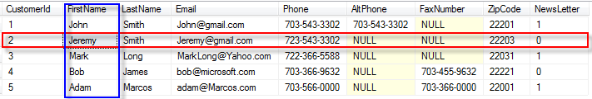
Table
A table is a collection of related data held in a structured format within a database. It consists of columns, and rows.

Slide 5
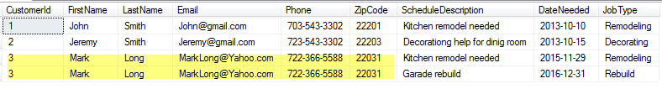
Database design
Customers + Schedules relationship
Problems:
Duplicated data
Updated problem
Possible data ambiguity

Slide 6
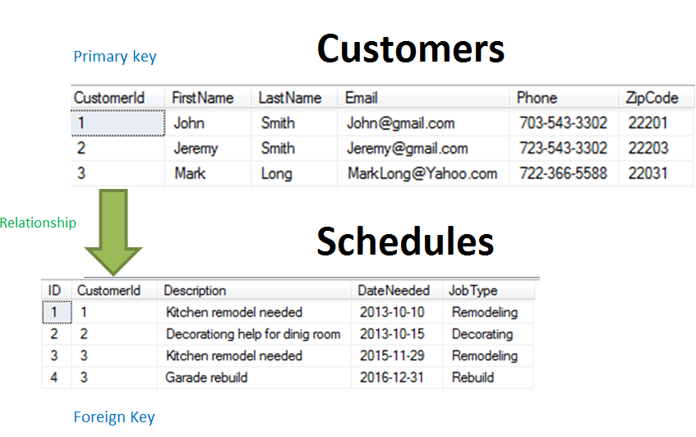
Database design (Normalization)
Solution
Each table contains information about single functional item.

Slide 7
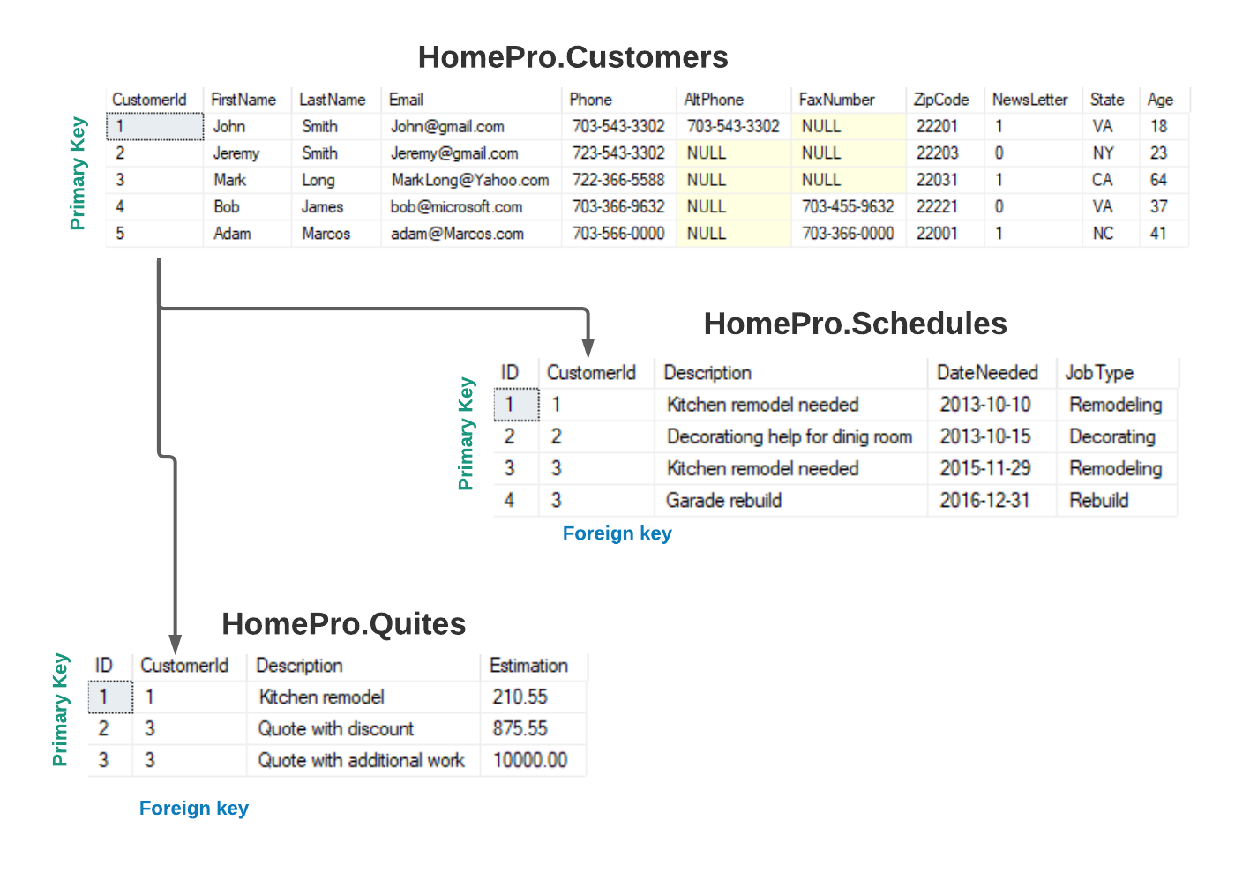
HomePro

Slide 8
Primary key
Primary key – the column(s) that has completely unique data throughout the table
The main role of a primary key in a data table is to maintain the internal integrity of a data table.
Table can have only one primary key.

Slide 9
Foreign key
Foreign key – the column that links one table to another table’s primary key or unique constraint
Table can have any number of foreign keys defined.

Slide 10
Structured Query Language
(SQL)
SQL is a language used for creating, storing, fetching and updating of data and database objects in RDBMS.

Slide 11
SELECT
SELECT is used to retrieve rows selected from one or more tables.
Basic syntax:
SELECT <columns>
FROM <Table>
WHERE <condition>
ORDER BY <columns>

Slide 12
Select (examples)
Select * from HomePro.Customers;
Select FirstName, LastName
From HomePro.Customers
Order by LastName;

Slide 13
Where (char, varchar)
Select * from HomePro.Customers
Where LastName = ‘Smith’
Select * from HomePro.Customers
Where LastName like ‘S%’
Select * from HomePro.Customers
Where LastName like ‘_m%’

Slide 14
Where (numbers)
Where Age = 10
Where Age > 10
Where Age > 10 and Age < 40
Where Age >= 10 and Age <= 40
Where Age between 10 and 40
Where Age in (10, 20, 30)

Slide 15
Where (date)
1. Where DateNedeed = ‘2015-11-29’
2. Where DateNedeed > ‘2014-12-30’
3. Where DateNedeed between ‘2015-12-01’ and ‘2015-12-30’

Slide 16
NULL values
NULL is an unknown and undefined value.
Arithmetic operation with NULL in SQL will return a NULL.
Where Value = Null -> Where Value is Null
Question: How much money do you have?
Answer 1. I have $10 Meaning: $10
Answer 3. I have no money Meaning: $0
Answer 3. I don’t tell you Meaning: Null

Slide 17
Query with NULL
Select *
from HomePro.Customers
where AltPhone is null;

Slide 18
Aggregate functions
Count ()
Sum ()
Max()
Min ()
Avg()

Slide 19
Aggregate (examples)
Select Count(*), Avg(Age)
From Bank.Client;
Select Count(*), Avg(Age)
From Bank.Client
Where Type = ‘private’;

Slide 20
Aggregate (examples)
Select ClientId, Max(Balance), Min(Balance)
From Bank.Client
Where Type = ‘CREDIT’
Group by ClientId;
Select ClientId, Avg(Balance), Sum(Balance)
From Bank.Client
Group by ClientId
Having Avg(Balance) > 10000;

