Slide 1
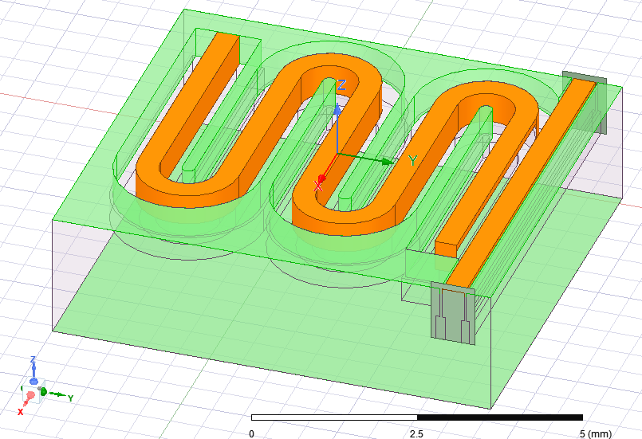
Top-ish View

Slide 2
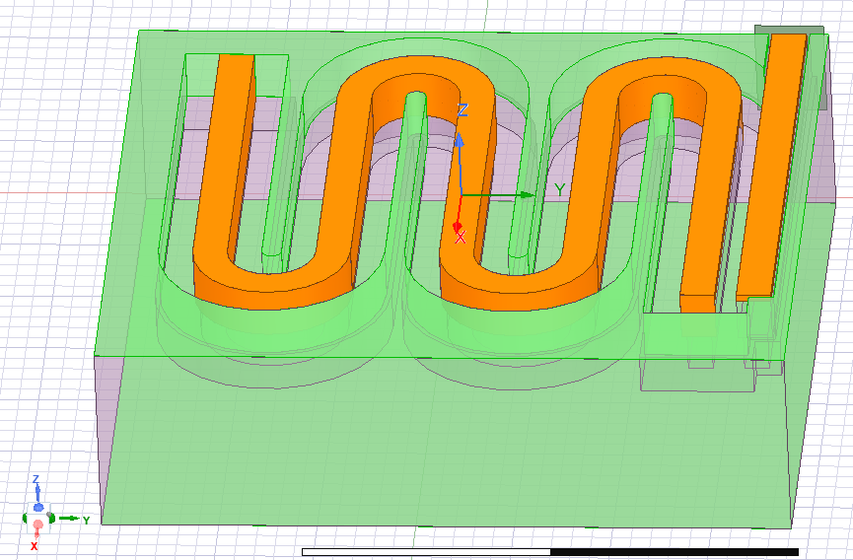
Gnd end
Length of end strip
(380um)
Gnd trace width
(200um)
Distance to feedline gnd
(35um)
Length of vertical strip
(300um)
λ/4 line
Gap distance (900um)
Feedline width
(350um)
Length of first strip
(380um)
Dist. to gnd (350um)
Trace width
(350um)
Coupling distance (220um)
Open end
(350um to gnd)

Slide 3
Gnd end
D_gnd0
(200um)
D_feedline_gnd
(W_feedline/10)
L_res_vert_4
(380um)
L_res_vert
(300um)
D_gap
(2*D_gnd+D_gnd0)
W_feedline
(W_res_vert)
D_gnd
(350um)
L_res_vert_0
(380um)
W_res_vert
(350um)
D_couple
(220um)
D_gnd
(350um)

Slide 4
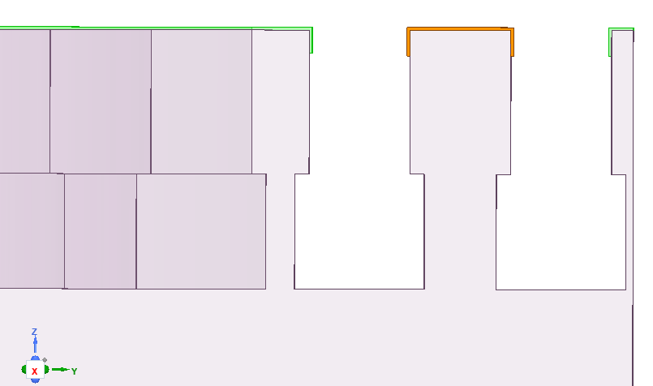
Side View
Trace
(350um)
Gap
(350um)
Trace
(200um)
Trace width
(350um)
Metal coatings
Trace gap
(350um)
Upper trench depth
(500um)
Undercut width
(50um)
Lower trench depth
(400um)
Bottom gap
(450um)
Substrate (total 2mm thick)

Slide 5
Side View
Assuming coatings on the wall. This drawing is not to scale. I usually assume the entire “island wall” is coated.
W_res_vert
(350um)
D_gnd
(350um)
D_gnd0
(200um)
W_res_vert
(350um)
gap_depth
D_gnd
(350um)
gap_depth
(500um)
D_cut
(50um)
t_cut
(400um)
W_res_vert_cut_out
(W_res_vert+2*D_cut)
Substrate (total 2mm thick)

