Slide 1
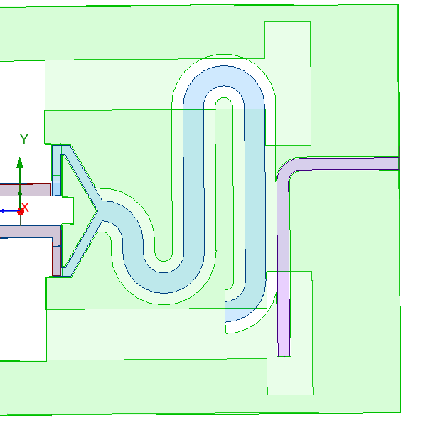
Shorter may be better, I just extended it to the edge
inner_radius = feedline_width
(200um)
L_feedline_vert
(3mm)
Outer_radius = 2 * feedline_width
(400um)
y_res_edge
(-1.925mm)
D_extend
(600um)
y_res_edge – D_extend
(-2.525mm)

Slide 2
Shorter may be better, I just extended it to the edge
inner_radius = feedline_width
(200um)
L_feedline_vert
(3mm)
Outer_radius = 2 * feedline_width
(400um)
y_res_edge
(-1.925mm)
D_extend
(600um)
y_res_edge – D_extend
(-2.525mm)

