Slide 1
NoSQL databases. Mongoose.
By Andrii Lymych

Slide 2
Agenda
What is NoSQL?
SQL vs. NoSQL
Why NoSQL?
Types of NoSQL Databases
Mongoose

Slide 3
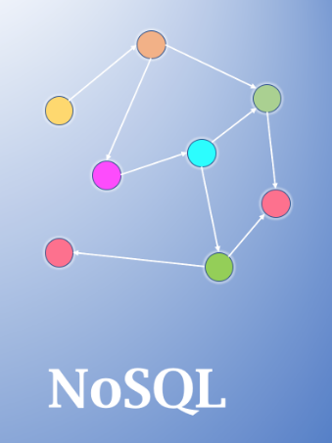
What is NoSQL?
NoSQL databases are purpose built for specific data models and have flexible schemas for building modern applications. NoSQL databases are widely recognized for their ease of development, functionality, and performance at scale.

Slide 4
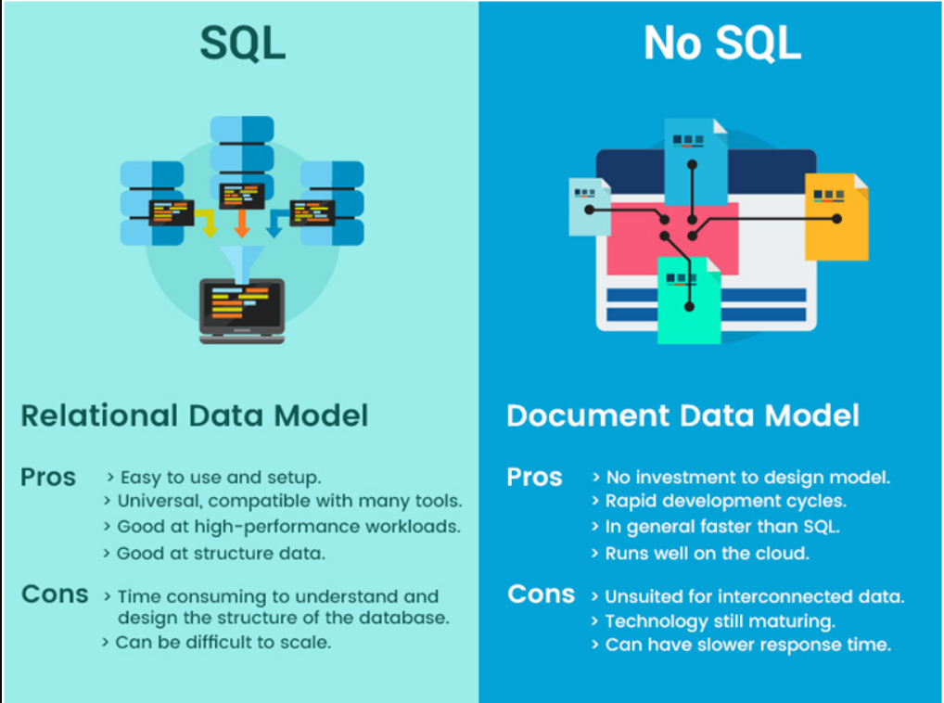
SQL vs. NoSQL

Slide 5
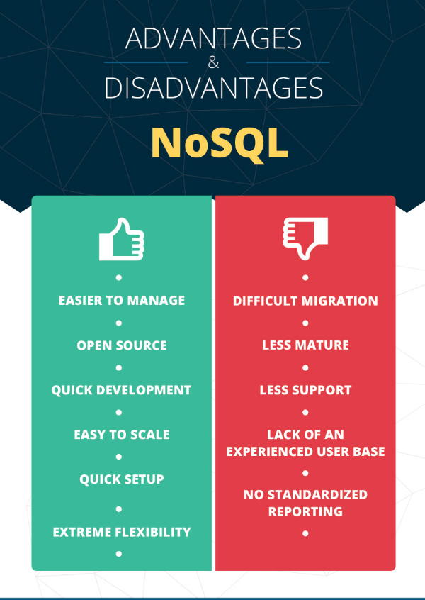
Why NoSQL

Slide 6
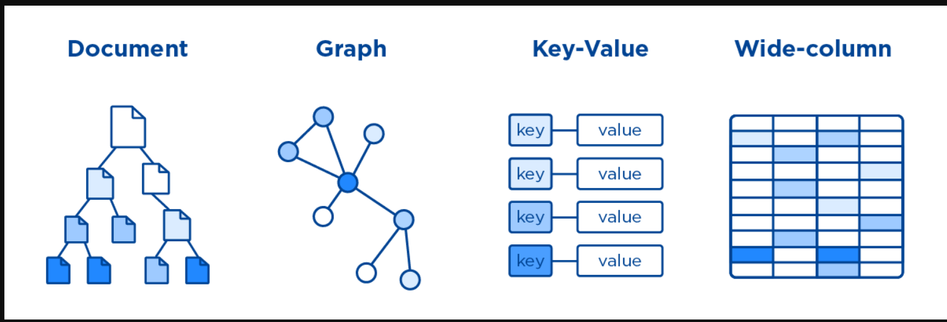
Types of NoSQL Databases
NoSQL Databases are mainly categorized into four types: Key-value pair, Column-oriented, Graph-based and Document-oriented. Every category has its unique attributes and limitations. None of the above-specified database is better to solve all the problems. Users should select the database based on their product needs.
Types of NoSQL Databases:

Slide 7
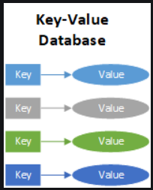
Key Value Pair Based
A key-value database, aka key-value store, associates a value (which can be anything from a number or simple string, to a complex object) with a key, which is used to keep track of the object. In its simplest form, a key-value store is like a dictionary/array/map object as it exists in most programming paradigms, but which is stored in a persistent way and managed by a Database Management System (DBMS).
Redis, Dynamo, Riak are examples of key-value store DataBases.

Slide 8
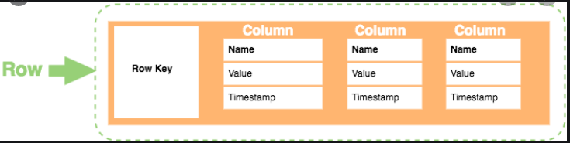
Column-based
A column family is a database object that contains columns of related data. It is a tuple (pair) that consists of a key-value pair, where the key is mapped to a value that is a set of columns. In analogy with relational databases, a column family is as a "table", each key-value pair being a "row".
HBase, Cassandra, HBase, Hypertable are NoSQL query examples of column based database.

Slide 9
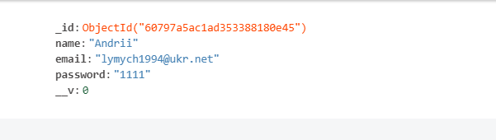
Document-Oriented
NoSQL document databases are based on a model that does not require SQL and tables, unlike relational databases. Instead of using tables with the data types, columns, rows, schemas, and tabular relations used in relational databases, NoSQL databases use documents with data type descriptions and values.
MongoDB, Riak, Lotus Notes, MongoDB, are popular Document originated DBMS systems.

Slide 10
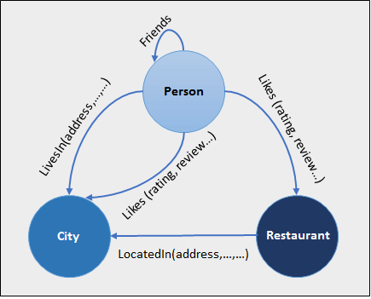
Graph-Based
A graph type database stores entities as well the relations amongst those entities. The entity is stored as a node with the relationship as edges. An edge gives a relationship between nodes. Every node and edge has a unique identifier.
Compared to a relational database where tables are loosely connected, a Graph database is a multi-relational in nature. Traversing relationship is fast as they are already captured into the DB, and there is no need to calculate them.
Graph base database mostly used for social networks, logistics, spatial data.
Neo4J, Infinite Graph, OrientDB, FlockDB are some popular graph-based databases.

Slide 11


MONGOOSE
Object Data Modelling (ODM) for Node.js
Features:
Async and sync validation of models
Model casting
Object lifecycle management
Pseudo-joins
Query builder

Slide 12



Mongoose vs. native MongoDB driver
No data validation
No casting during inserts
No encapsulation
No references (joins)

Slide 13
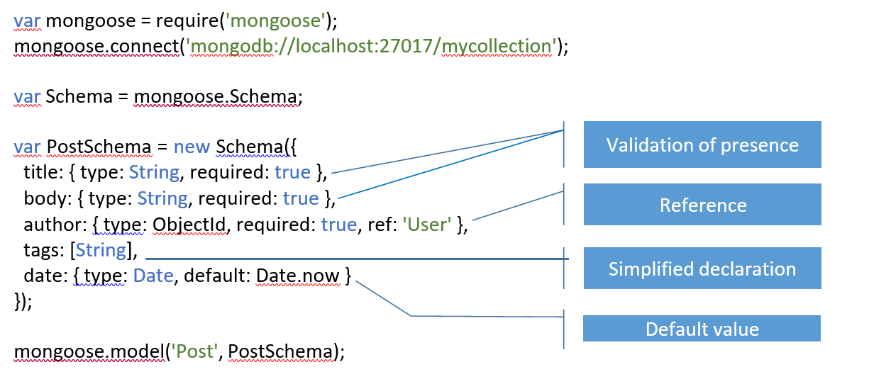
How to connect mongoose

Slide 14
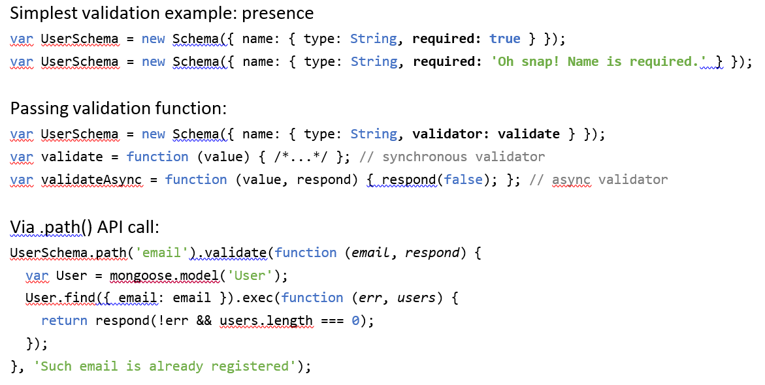
Mongoose validation

Slide 15
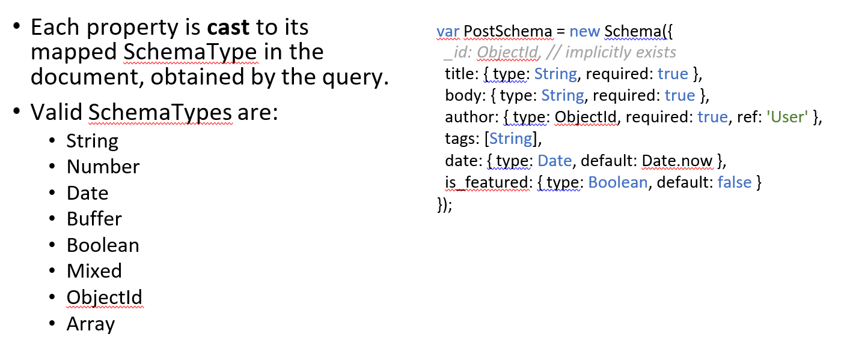
Casting

Slide 16
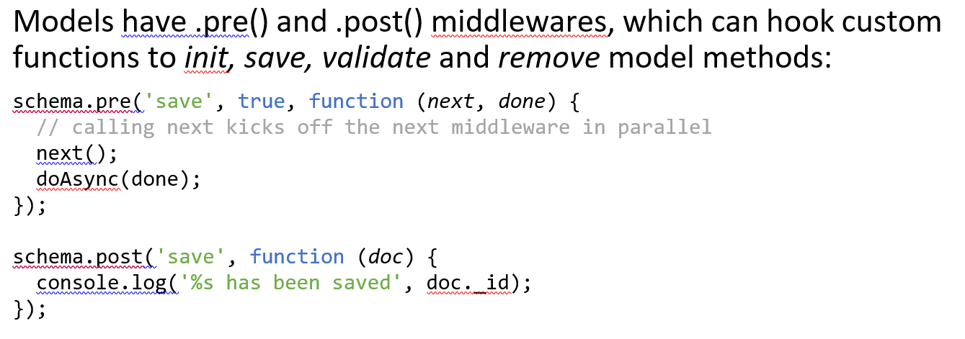
Lifecycle management

Slide 17
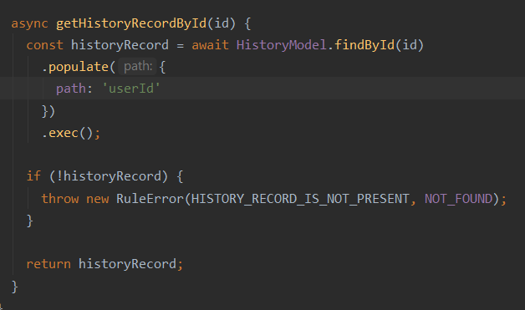
Population
Population is the process of automatically replacing the specified paths in the document with document(s) from other collection(s).

Slide 18
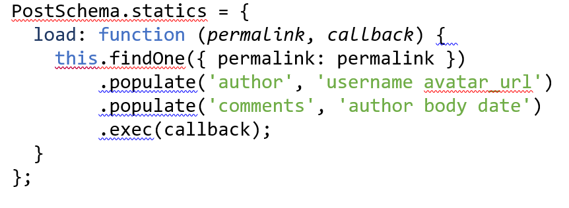
Population by couple fields

Slide 19
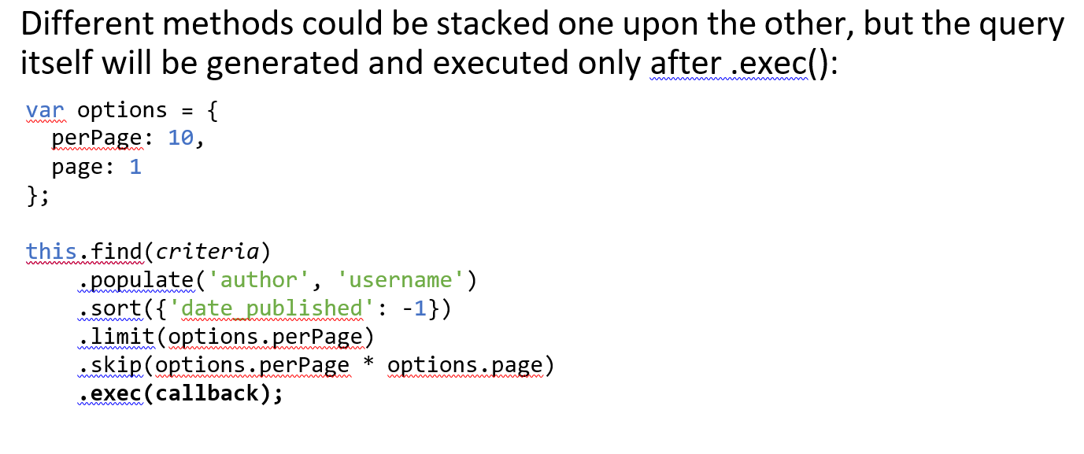
Query building

Slide 20


