Slide 1
Conditional statements. Loops
By Andrii Lymych

Slide 2
Content
Conditional statements
If…else
Switch…case
Ternary statement
Loops
While…do
Do…while
For
For…in
For..of
Break
Continue

Slide 3

Very often when you write code, you want to perform different actions for different decisions.
You can use conditional statements in your code to do this.

Slide 4
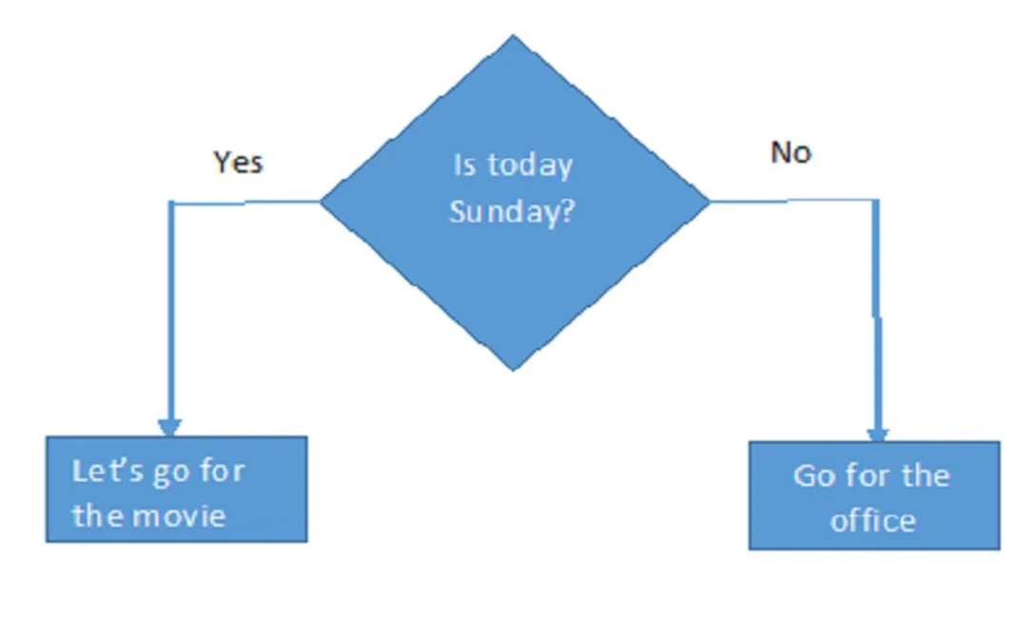
Types of Conditional Statements:
If statement
If…Else statement
If…Else If…Else statement
Switch…case statement
Ternary statement

Slide 5
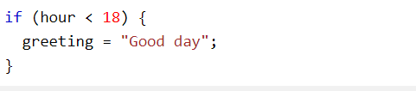
The if Statement:
Use the if statement to specify a block of JavaScript code to be executed if a condition is true.
Syntax:

Slide 6
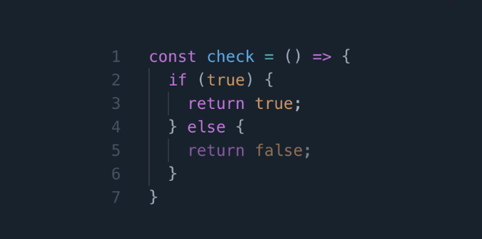
if...else statement
Use else to specify a block of code to be executed, if the same condition is false
Syntax:

Slide 7
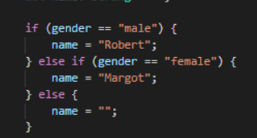
if...else if... Statement
Use else if to specify a new condition to test, if the first condition is false
Syntax

Slide 8
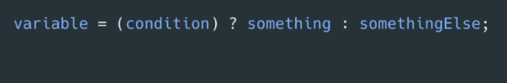
Ternary operator
The conditional ternary operator in JavaScript assigns a value to a variable based on some condition and is the only JavaScript operator that takes three operands.

Slide 9
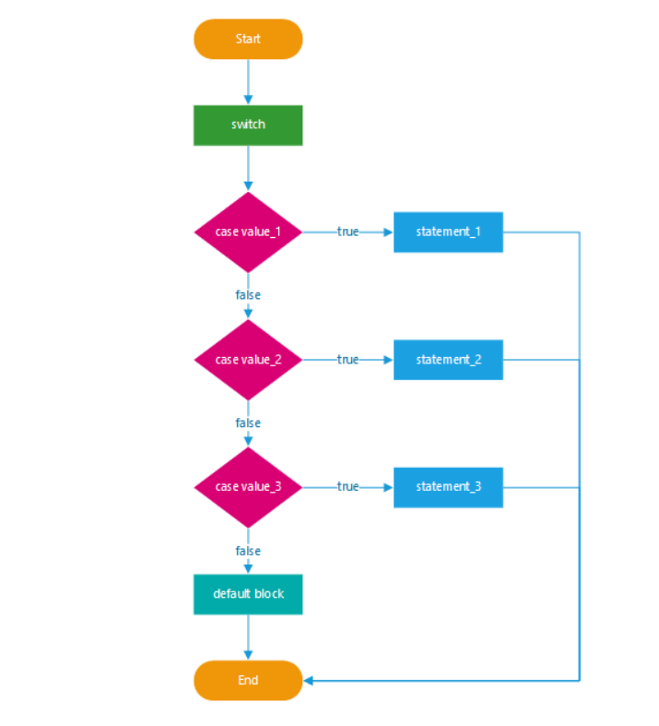
Switch Statement
Use the switch statement to select one of many code blocks to be executed.

Slide 10
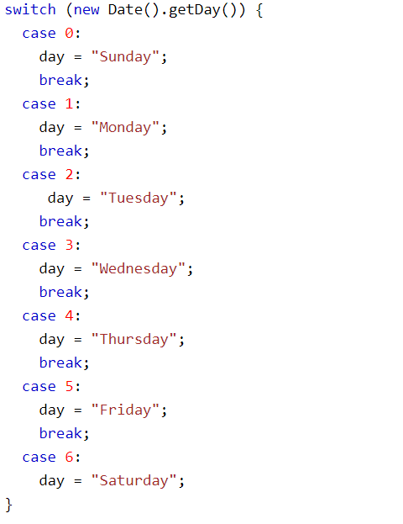

Slide 11
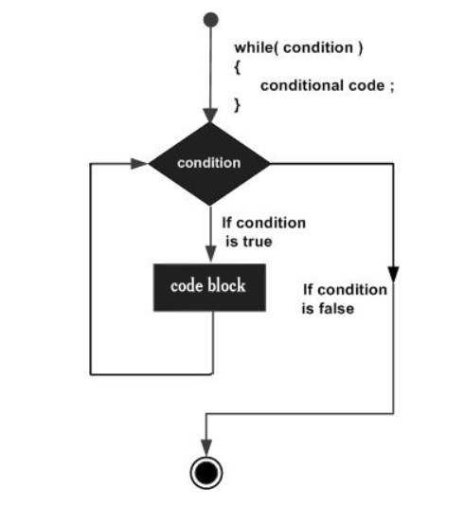
The while Loop
Loops can execute a block of code as long as a specified condition is true.
The while loop loops through a block of code as long as a specified condition is true.

Slide 12
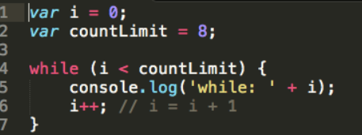
Syntax

Slide 13
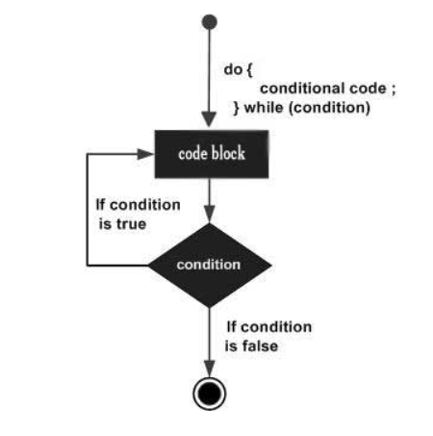
The do...while Loop
The do/while loop is a variant of the while loop. This loop will execute the code block once, before checking if the condition is true, then it will repeat the loop as long as the condition is true.

Slide 14
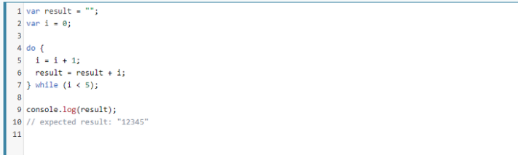
Syntax

Slide 15

The For Loop:
Statement 1 is executed (one time) before the execution of the code block.
Statement 2 defines the condition for executing the code block.
Statement 3 is executed (every time) after the code block has been executed.

Slide 16
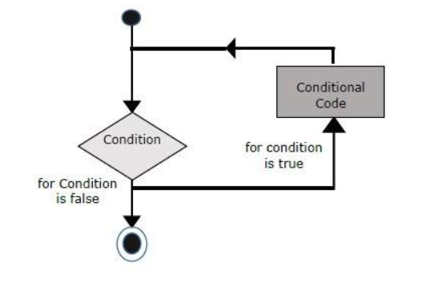

Slide 17
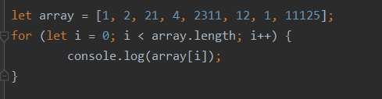
Syntax

Slide 18
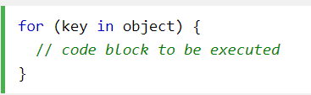
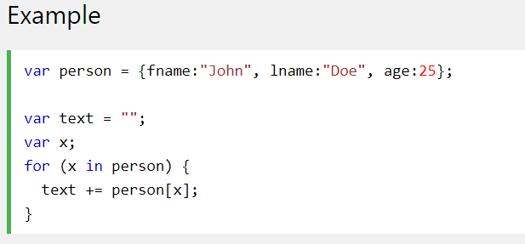
The For/In Loop
The JavaScript for/in statement loops through the properties of an Object:

Slide 19
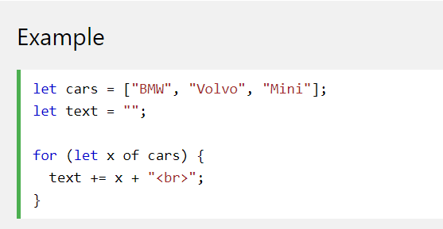
The For/Of Loop
The JavaScript for/of statement loops through the values of an iterable object.

Slide 20
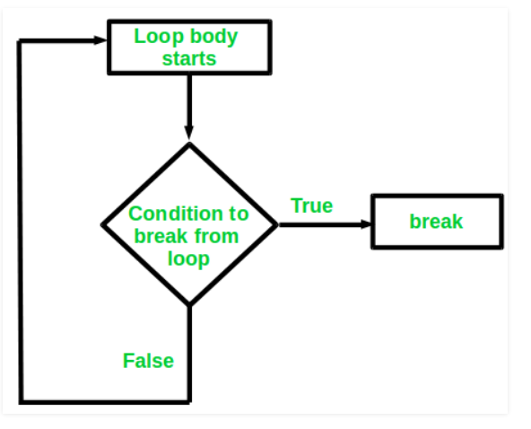
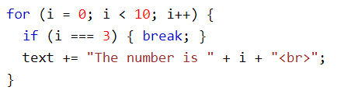
The break Statement
The break statement can also be used to jump out of a loop

Slide 21
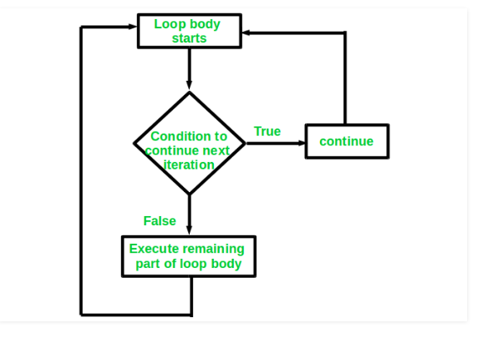
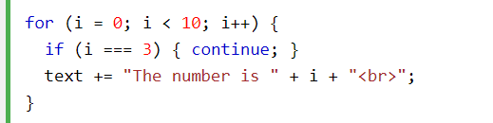
The continue Statement
The continue statement "jumps over" one iteration in the loop.

Slide 22


