Slide 1
Asynchronous programming
By Andrii Lymych

Slide 2
Agenda
What is asynchronous programming
Event Loop
Timeouts
Async callbacks
Callback hell
Promises
Async Await

Slide 3
The term asynchronous refers to two or more objects or events not existing or happening at the same time (or multiple related things happening without waiting for the previous one to complete). In computing, the word "asynchronous" is used in two major contexts.

Slide 4
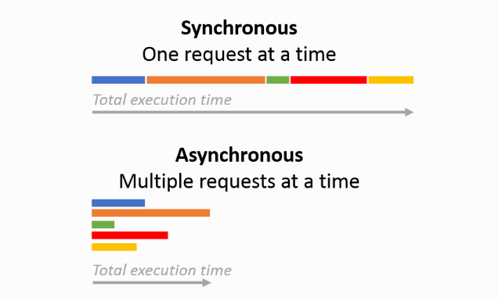

Slide 5
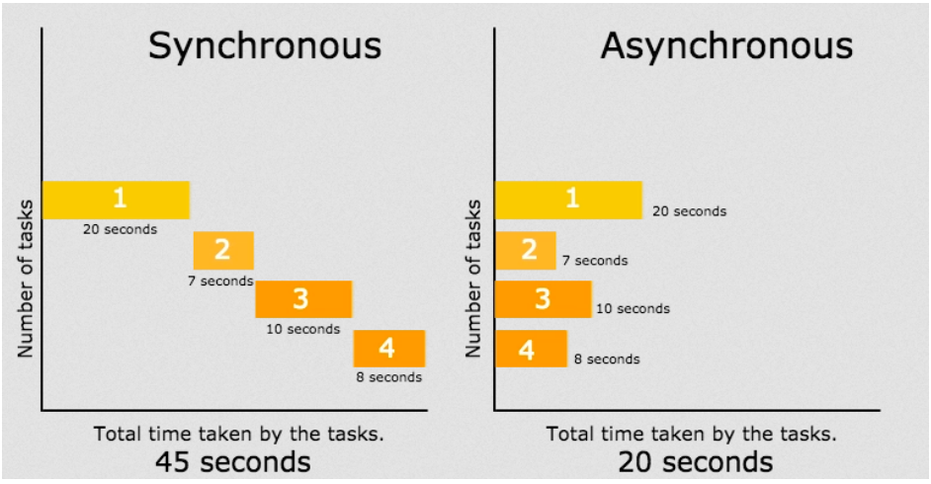
Why is it good

Slide 6
The event loop continuously checks the call stack to see if there's any function that needs to run. While doing so, it adds any function call it finds to the call stack and executes each one in order.
EVENT LOOP

Slide 7
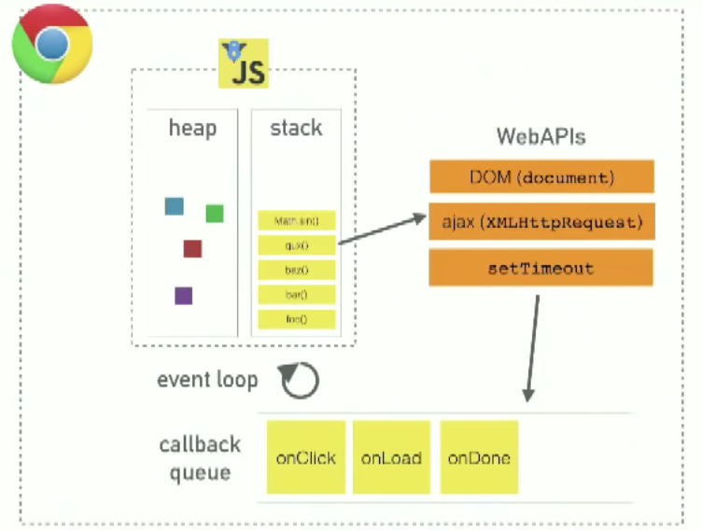
The Event Loop

Slide 8
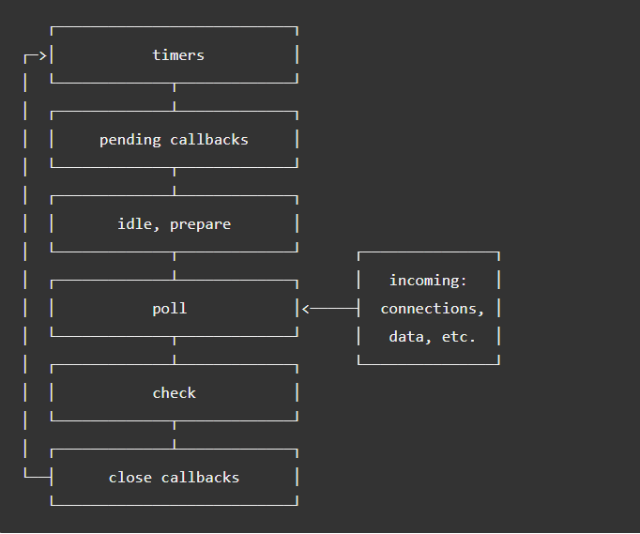
Phases of the event loop

Slide 9
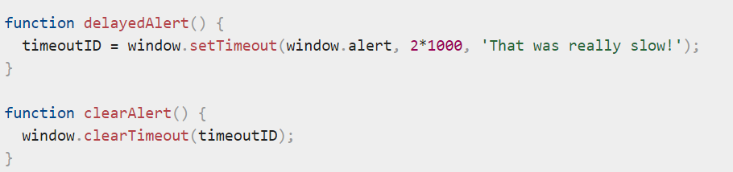
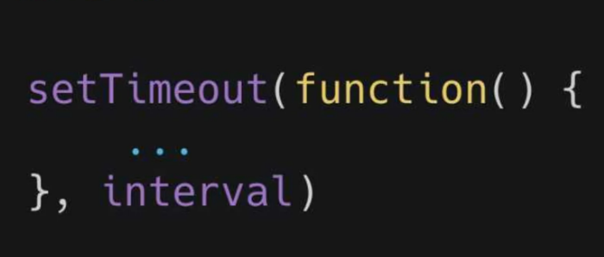
setTimeout()
setTimeout() executes a particular block of code once after a specified time has elapsed. It takes the following parameters:
1) a function to run, or a reference to a function defined elsewhere.
2) number representing the time interval in milliseconds (1000 milliseconds equals 1 second) to wait before executing the code. If you specify a value of 0 (or omit the value), the function will run as soon as possible.

Slide 10
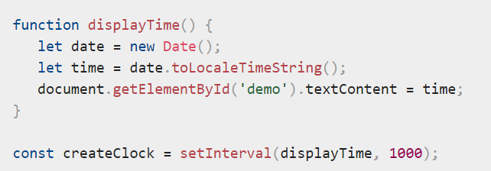
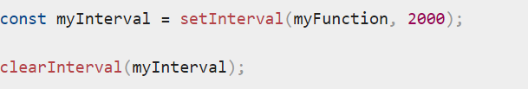
setInterval()
This works in a very similar way to setTimeout(), except that the function you pass as the first parameter is executed repeatedly at no less than the number of milliseconds given by the second parameter apart, rather than once.

Slide 11
There are two main types of asynchronous code style you'll come across in JavaScript code, old-style callbacks and newer promise-style code.

Slide 12
Callback
Async callbacks are functions that are specified as arguments when calling a function which will start executing code in the background. When the background code finishes running, it calls the callback function to let you know the work is done, or to let you know that something of interest has happened.

Slide 13
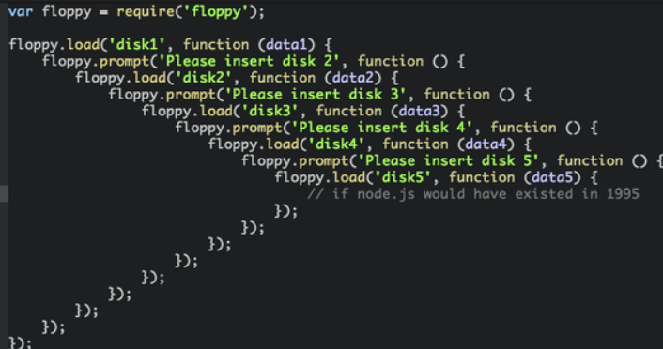
Callback Hell

Slide 14
Promises
Promises are a comparatively new feature of the JavaScript language that allow you to defer further actions until after a previous action has completed, or respond to its failure. This is useful for setting up a sequence of async operations to work correctly.
Promise states
- pending: initial state, neither fulfilled nor rejected.
- fulfilled: meaning that the operation was completed successfully.
- rejected: meaning that the operation failed.

Slide 15
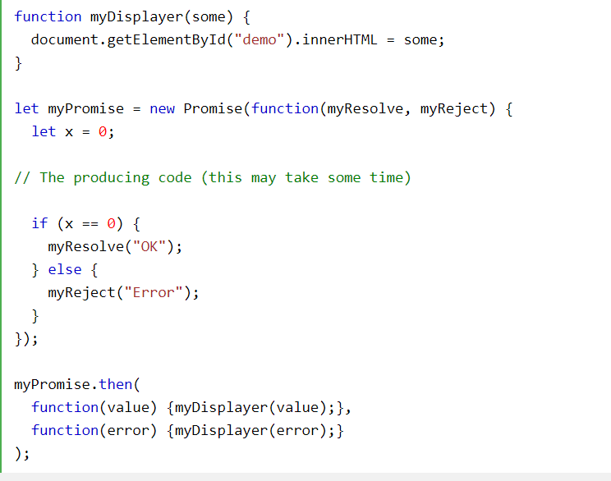

Slide 16
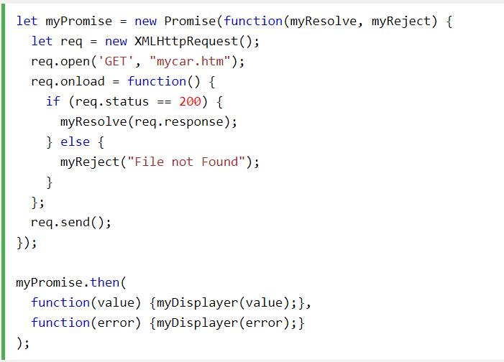

Slide 17
Async/Await
Async and Await are extensions of promises. An async function is a function declared with the async keyword. The async and await keywords enable asynchronous, promise-based behavior to be written in a cleaner style, avoiding the need to explicitly configure promise chains.
-async and await make promises easier to write
-async makes a function return a Promise
-await makes a function wait for a Promise

Slide 18
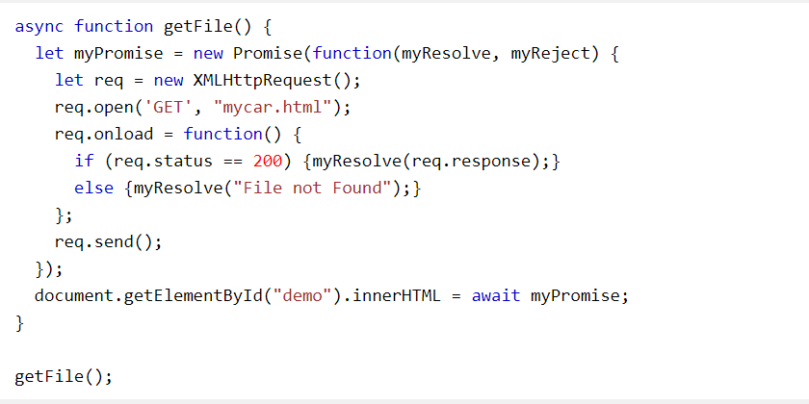

Slide 19


