Slide 1

Web Scraping & Data Analysis
NYCDSA
Wei-Jian Guo

Slide 2

Introduction:
Web scraping:
Scrapy
Lucky, found api?
Two websites
Cars.com
Cargurus.com
Exploratory data analysis
Data visualization
Trends
“Hot car” analysis

Slide 3

API?

Slide 4
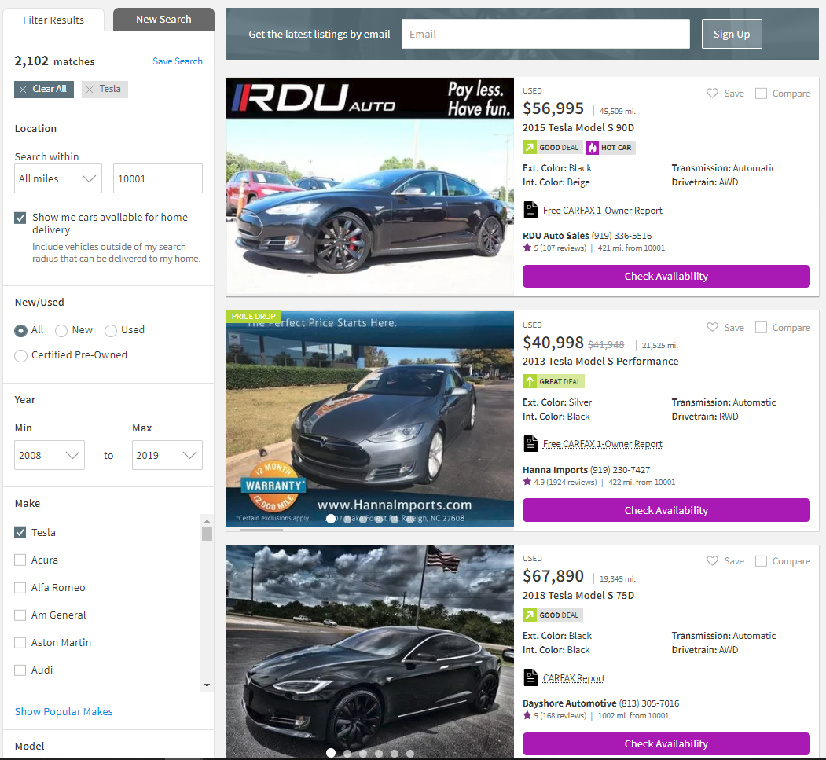
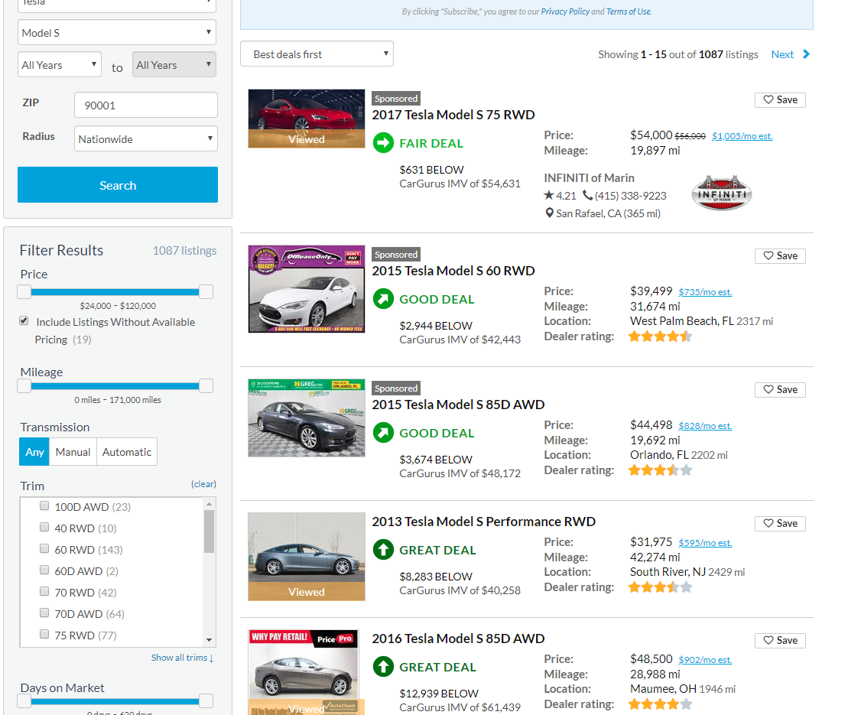
List Page:
Cars.com
Cargurus.com

Slide 5
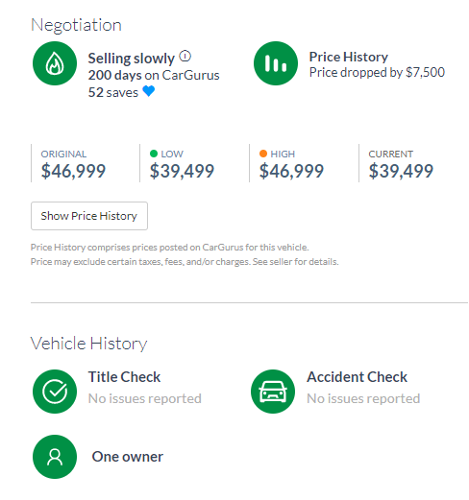
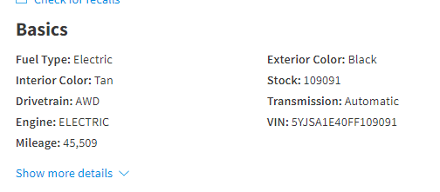
Detail Page:
Why do I scrap both websites?
To verify if there is price difference
More useful information
Both website provides vin number of cars.
Cargurus.com:
Cars.com:

Slide 6
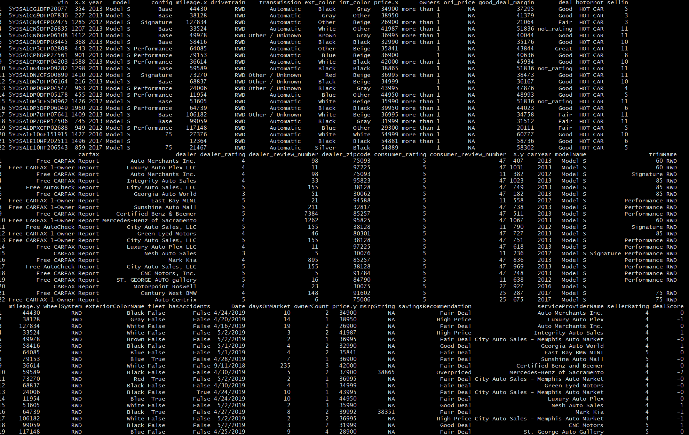

Slide 7
Exploratory data analysis:
Both data sets contains more than 20+ variables
Cars.com
Cargurus.com
Cars.com dataset:
Year
Trim
Mileage
Price
Deal condition
Color
Dealer information
(rating, review number)
Vin number
(for combining data set
About: 2115 rows
Accident
Days on market
Fleet car
Number of
previous owners
Only Model S
Hot Car
All models
After dropping duplicates:
1202 rows left

Slide 8
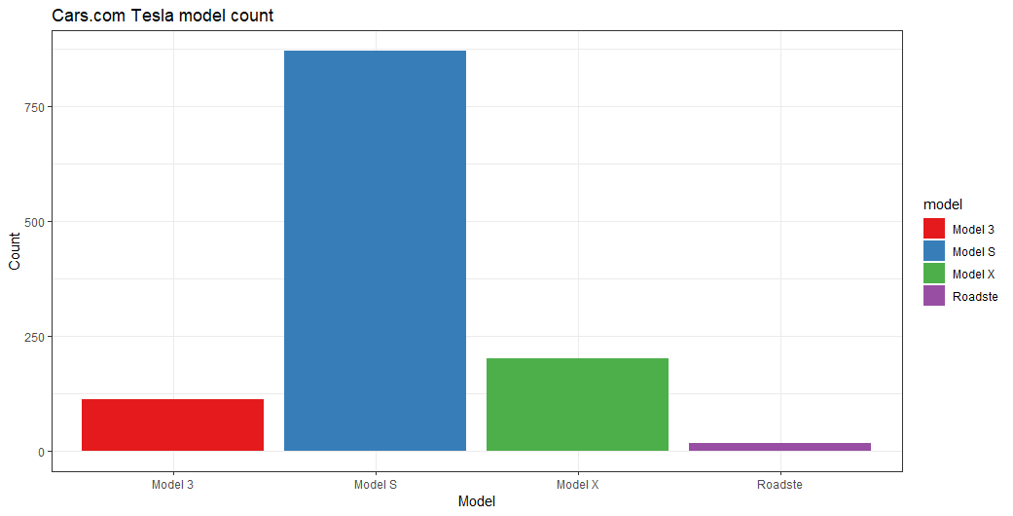
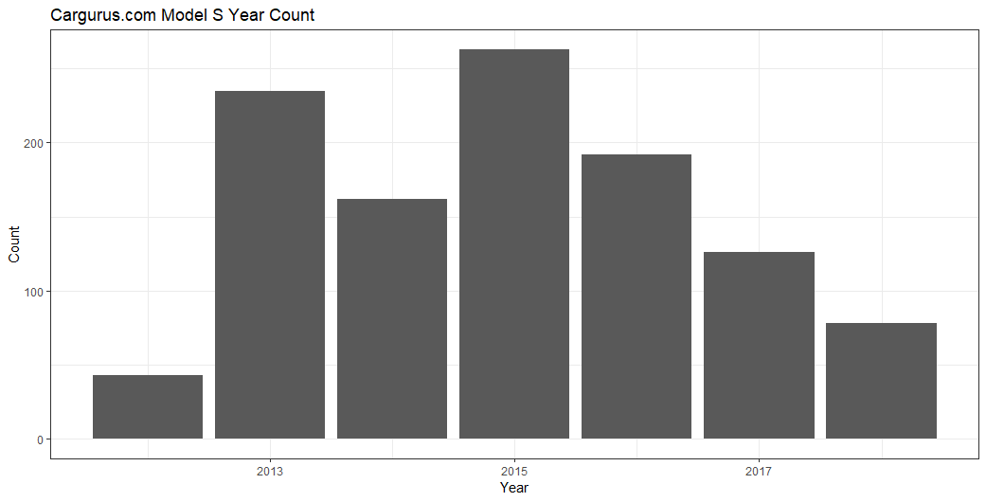
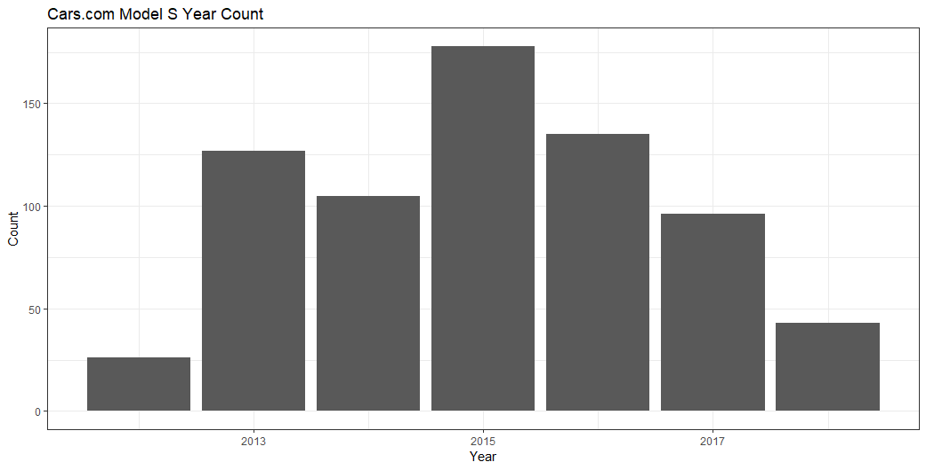
Exploratory data analysis:
Cars.com Model S count | Cargurus.com Model S count
871 rows | 1099 rows
After combine both data sets by vin number
Merged data set
710 rows

Slide 9
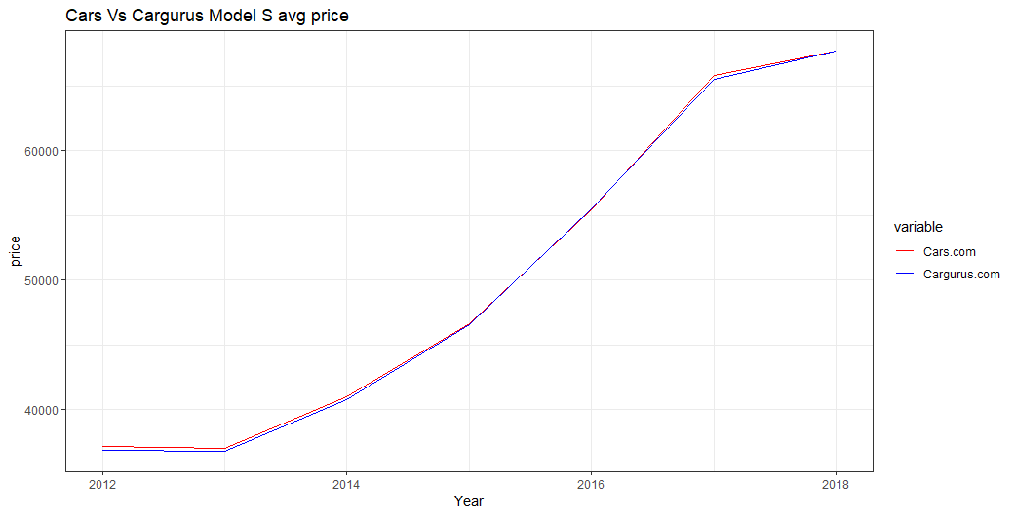
Exploratory data analysis:

Slide 10
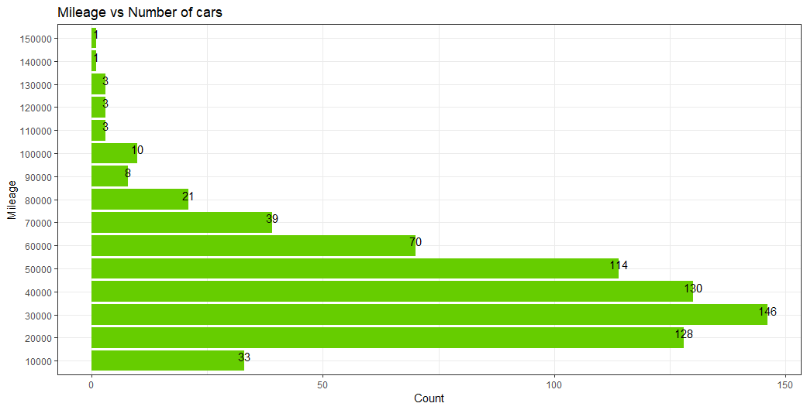
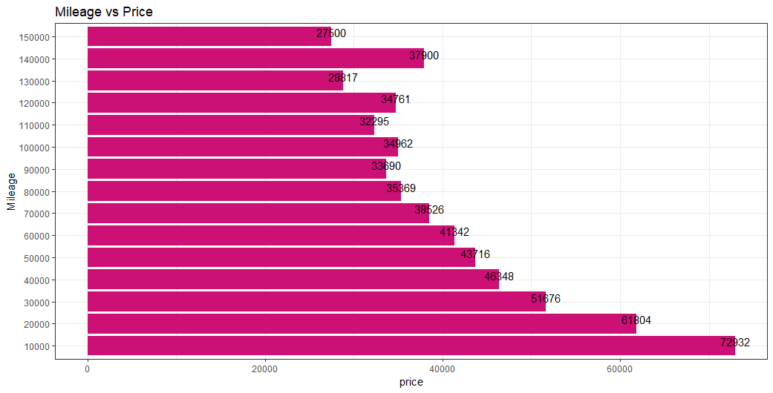
EDA: Factors that affects the price

Slide 11
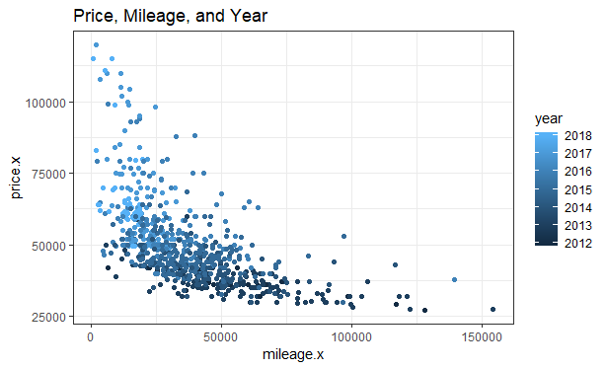
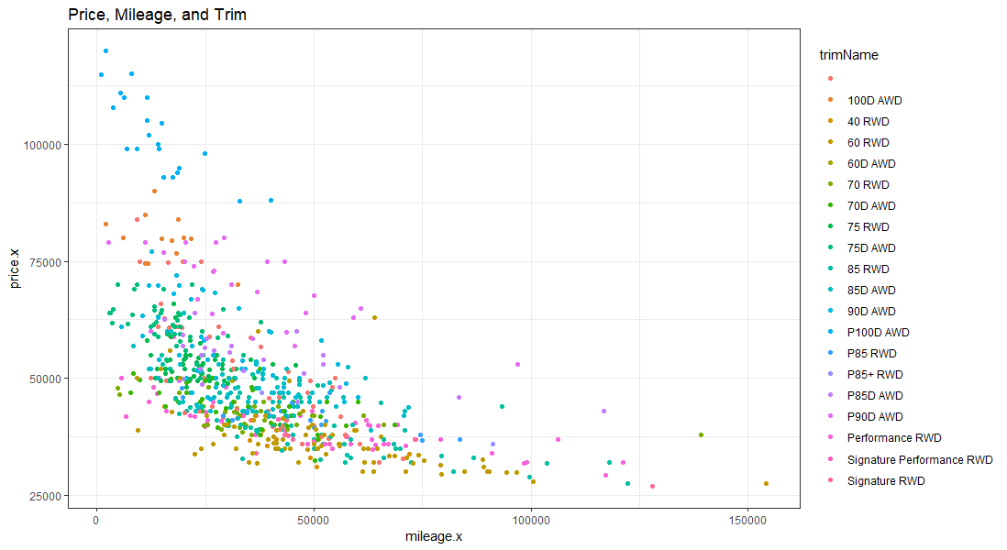
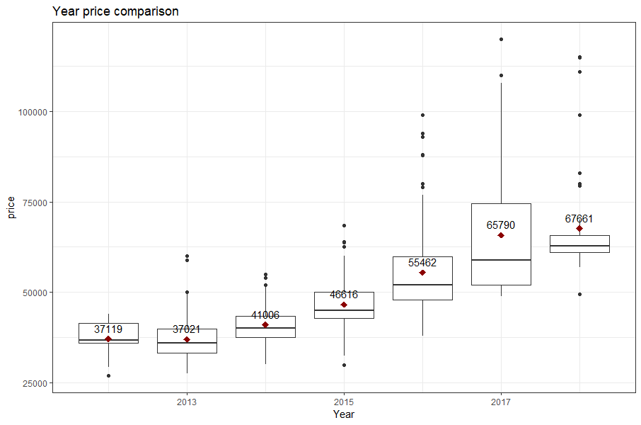
EDA: Factors that affects the price

Slide 12
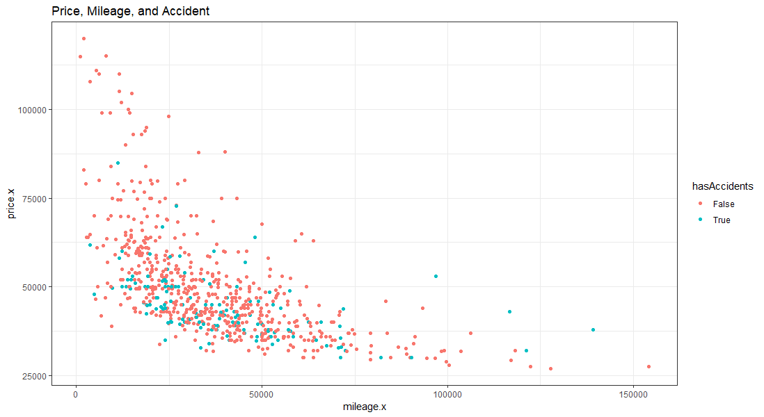
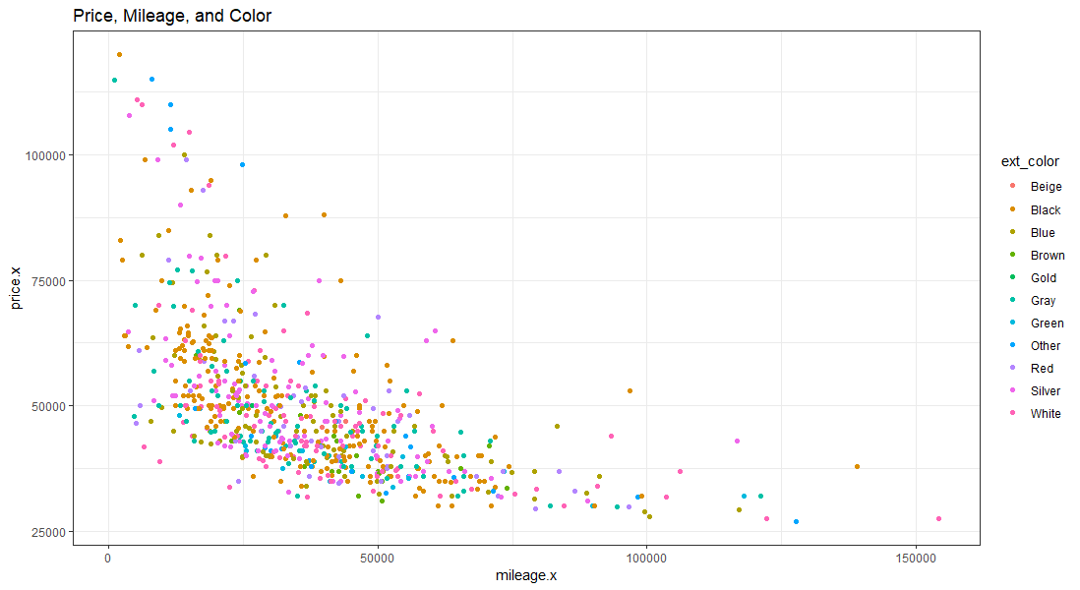
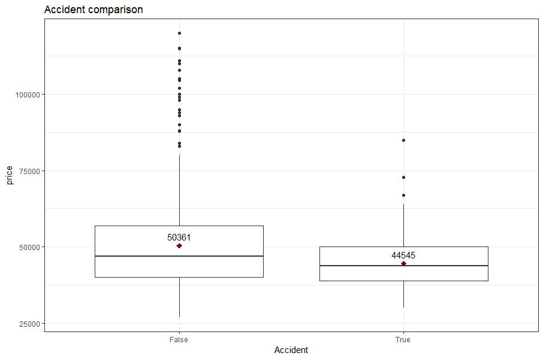
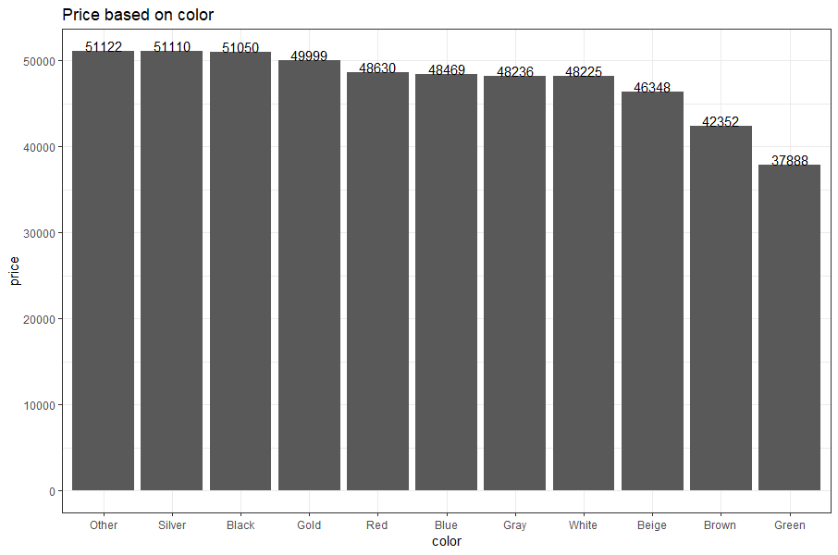
EDA: Factors that affects the price
Avg Price Difference:
$5,815

Slide 13
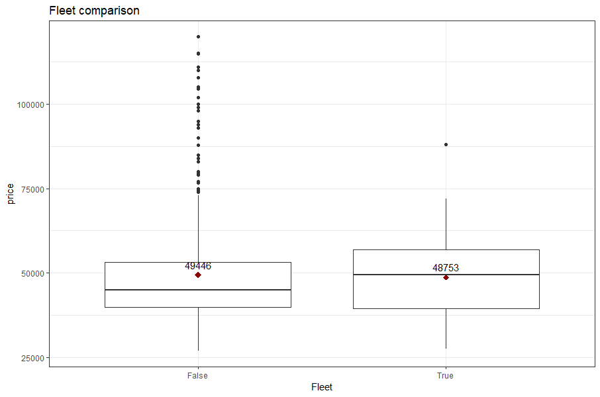
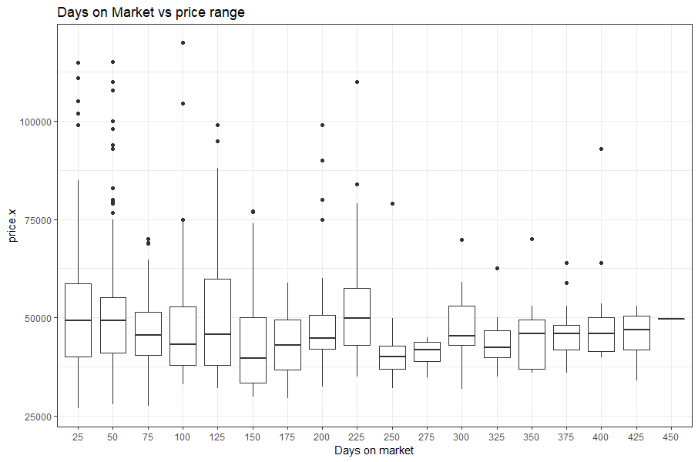
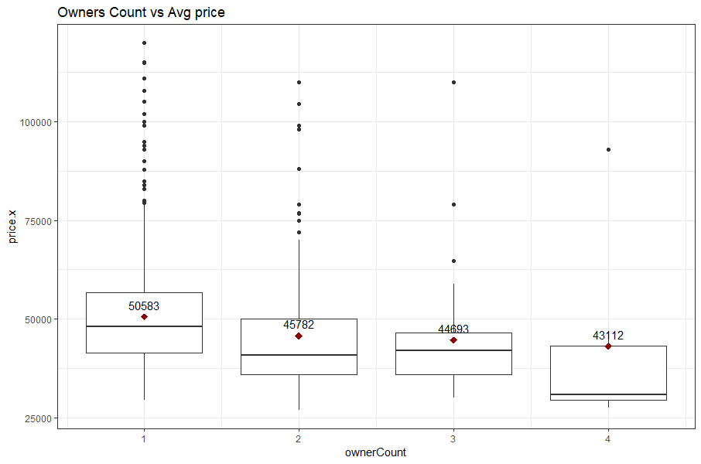
EDA: Factors that affects the price

Slide 14
EDA conclusion:
Factors that affect the price most:
Mileage
Price
Accident
Many outliers possible causes:
Cars with expensive trim

Slide 15
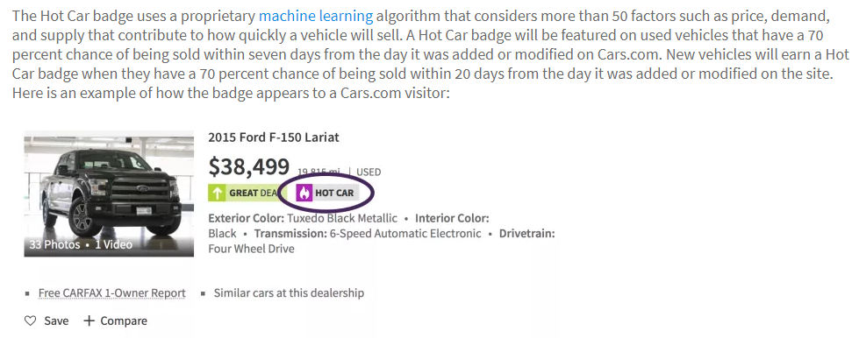
HOT CAR Analysis:
We want to know why Cars.com consider a car as a HOT CAR
Official explanations:

Slide 16
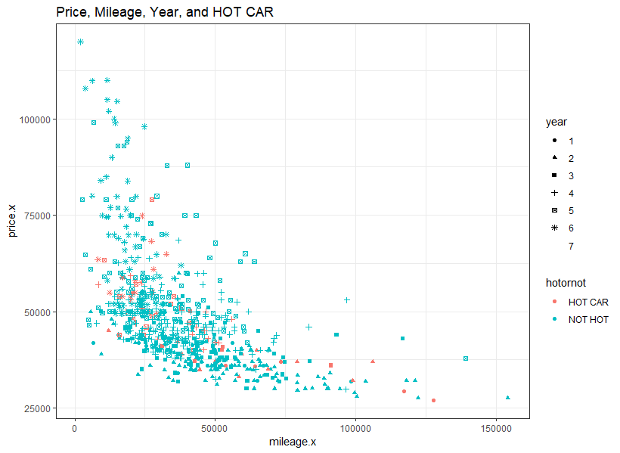
HOT CAR Analysis:
Can you tell anything from this plot?

Slide 17
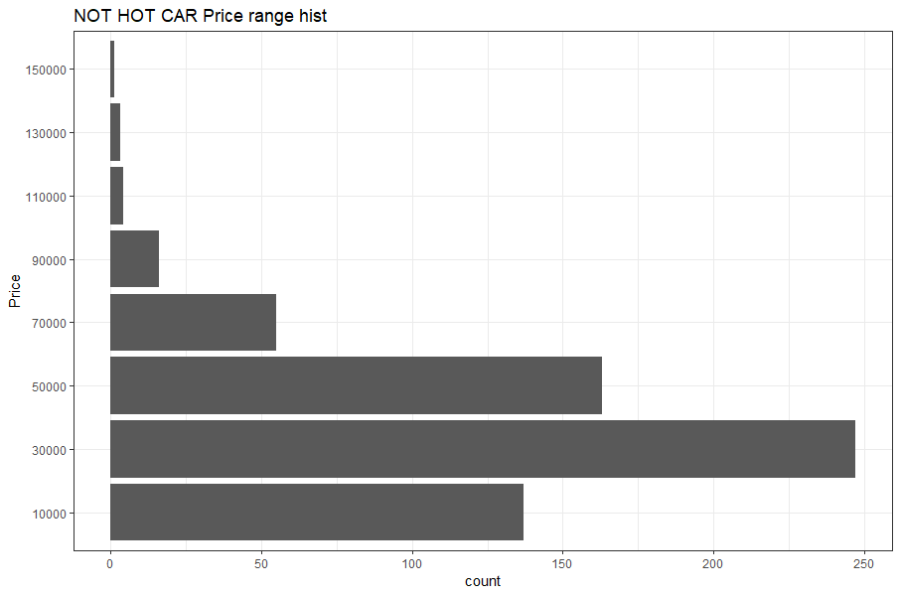
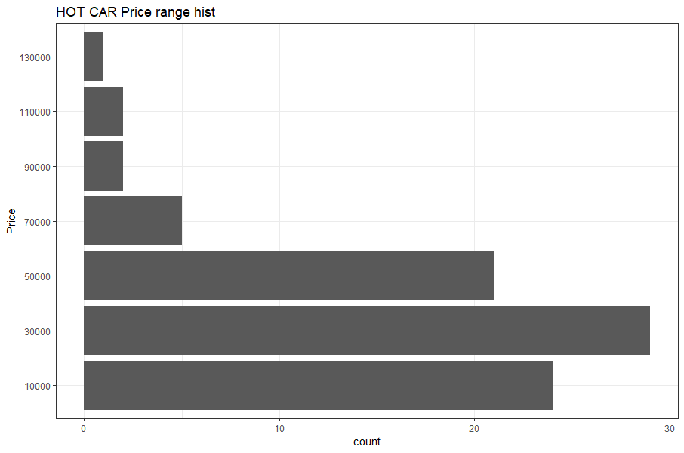
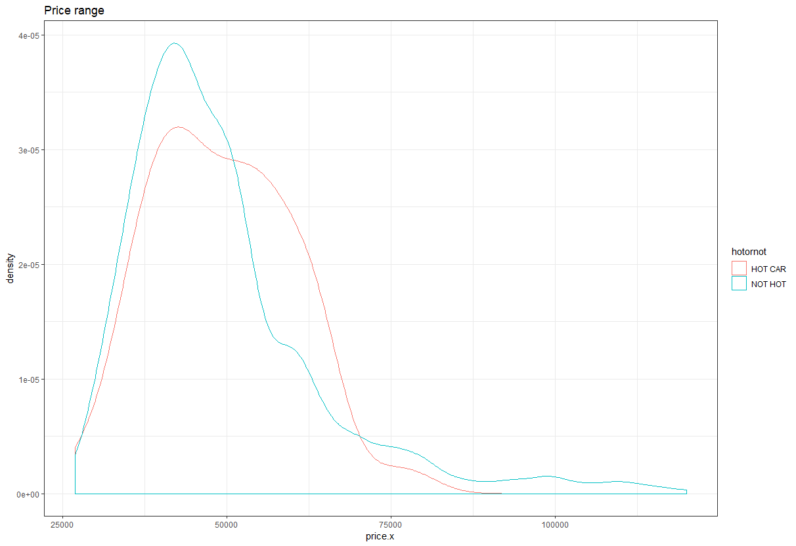
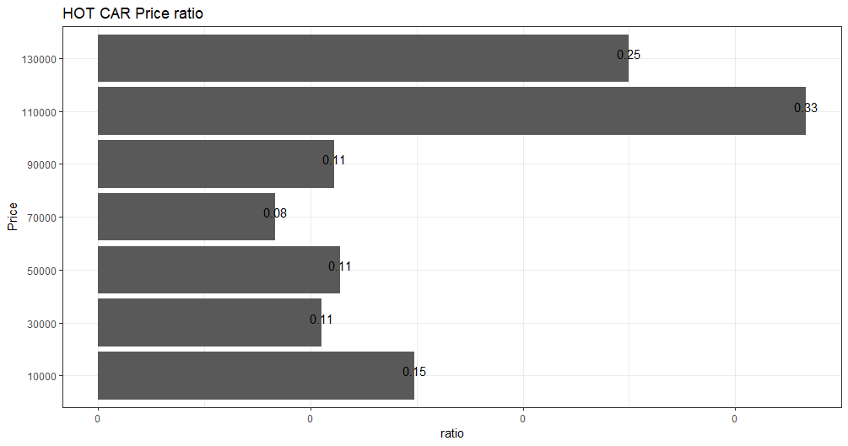
HOT CAR Analysis: Price
Conclusion:
not significant
(Hot Car number)/(Total car number)

Slide 18
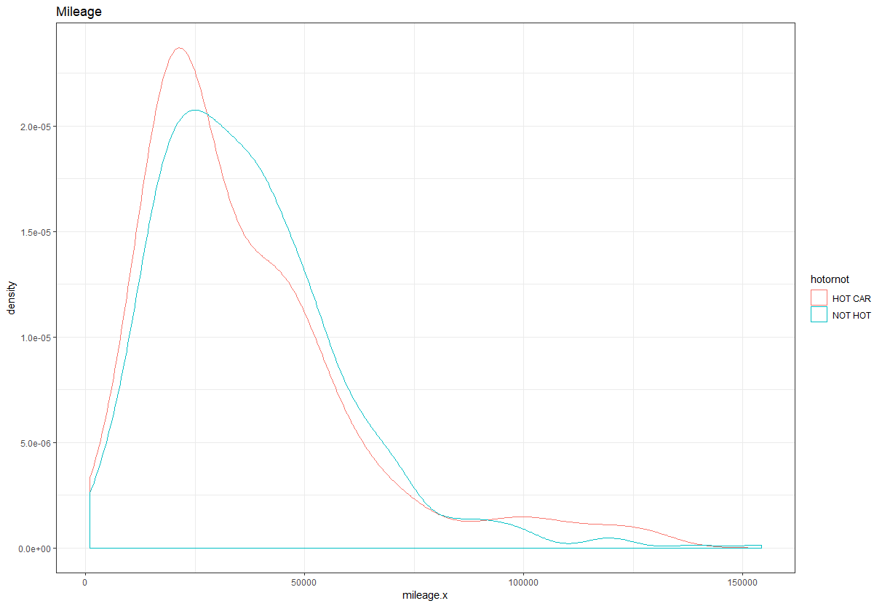
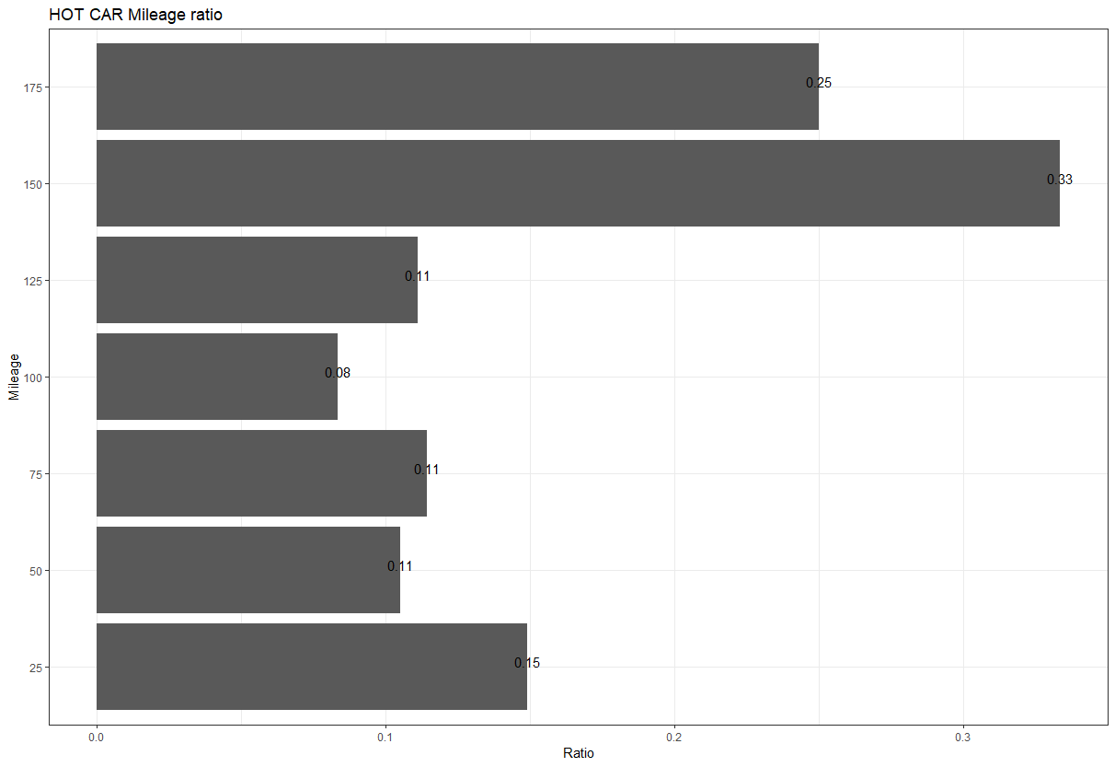
HOT CAR Analysis: Mileage
Conclusion: Not significant

Slide 19
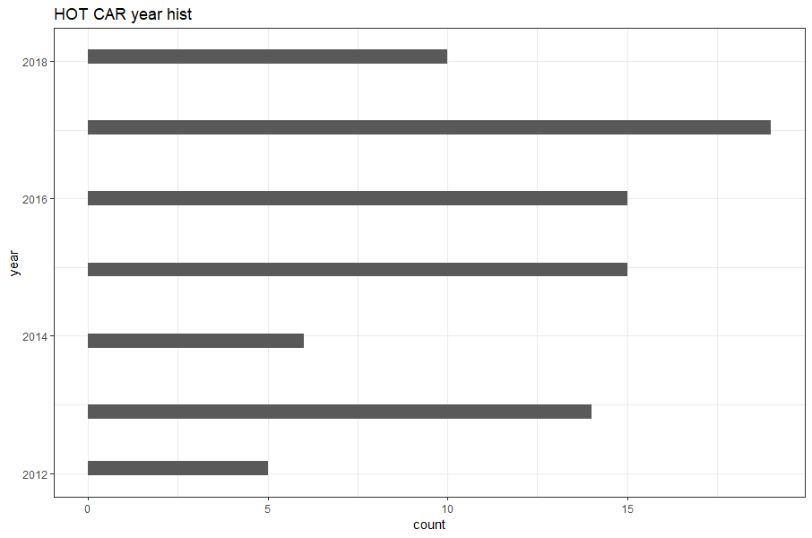
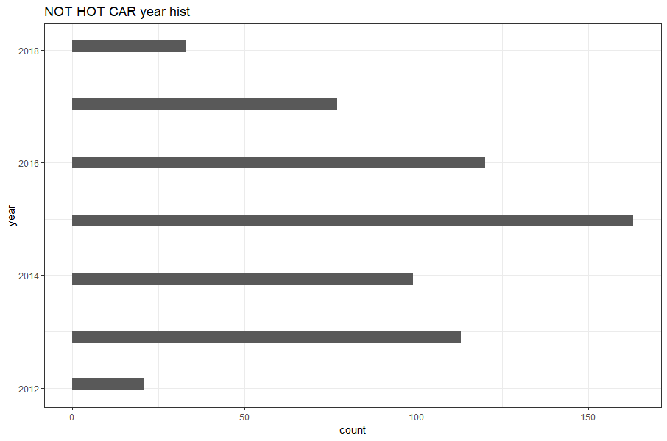
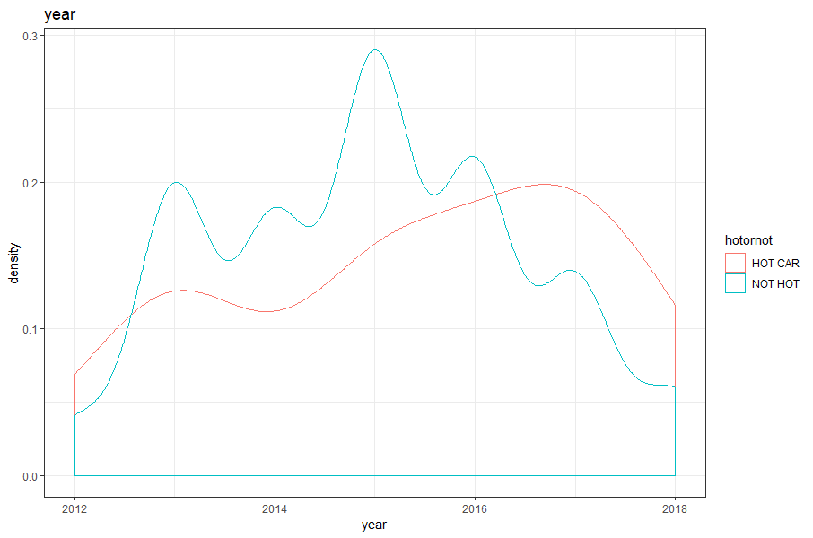
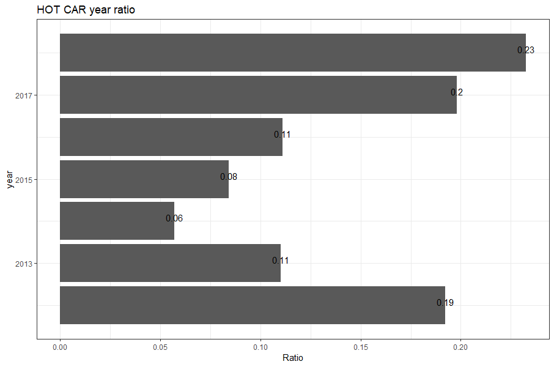
HOT CAR Analysis: Year
Conclusion:
Newer year and older year model are more like to be in HOT CAR category.

Slide 20
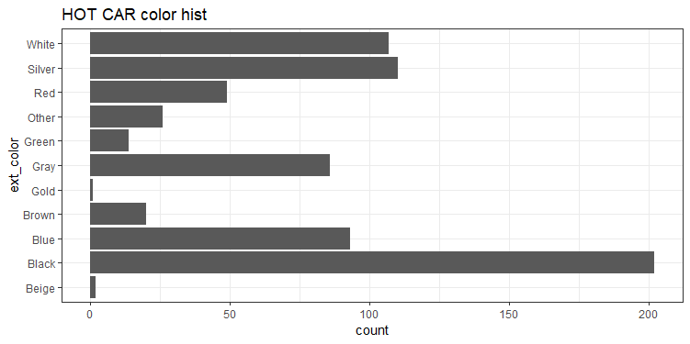
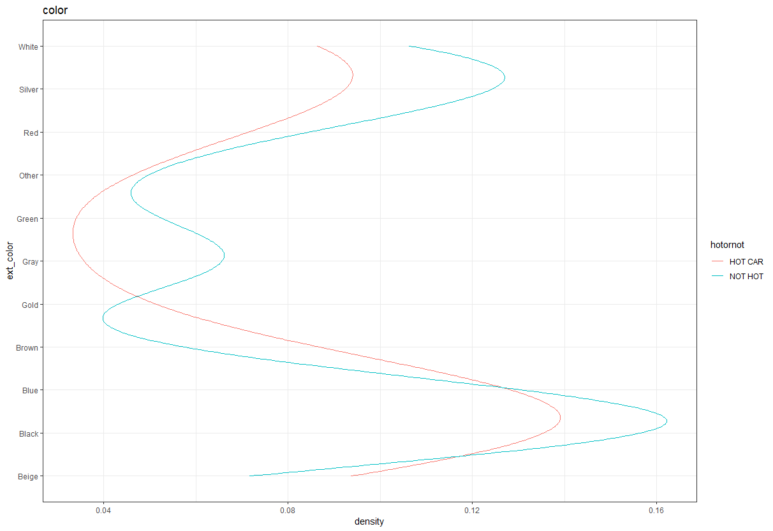
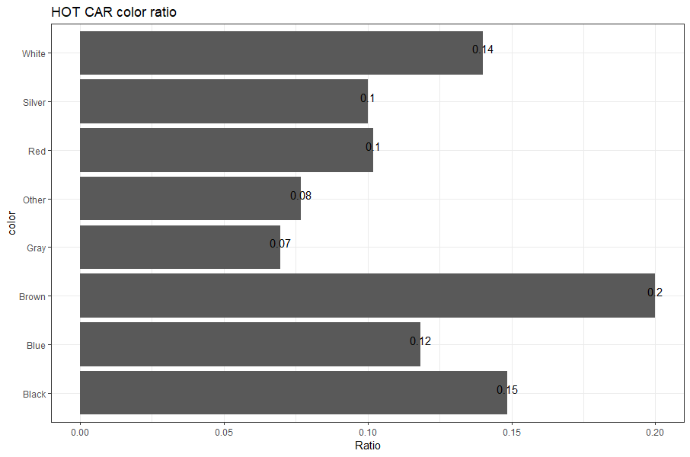
HOT CAR Analysis: Color
Conclusion: Black, white and silver color likely to be in HOT CAR category

Slide 21
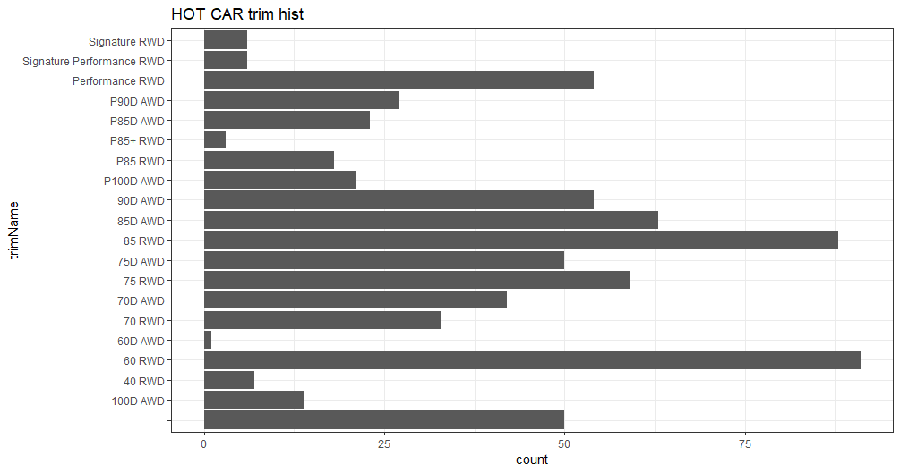
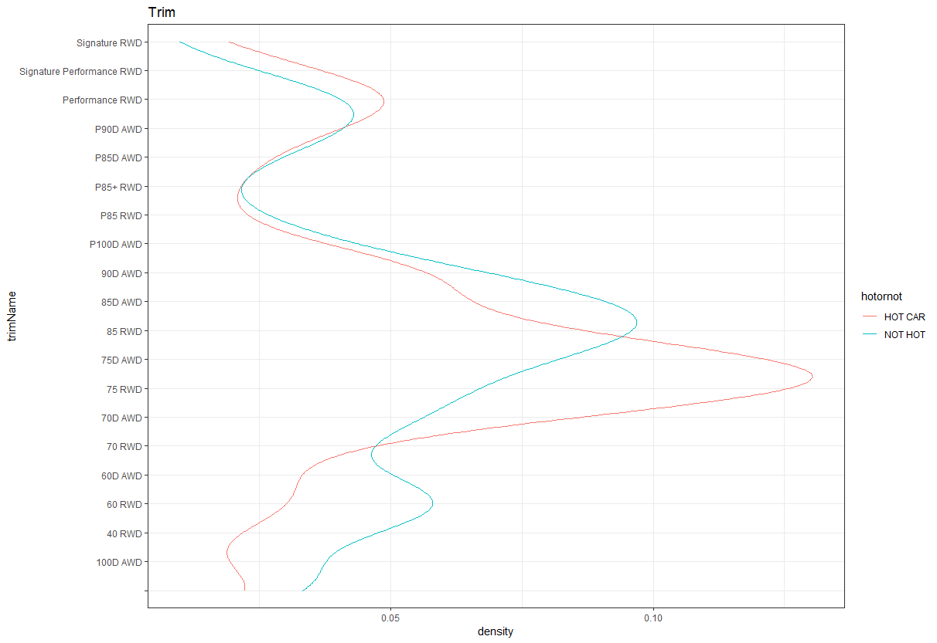
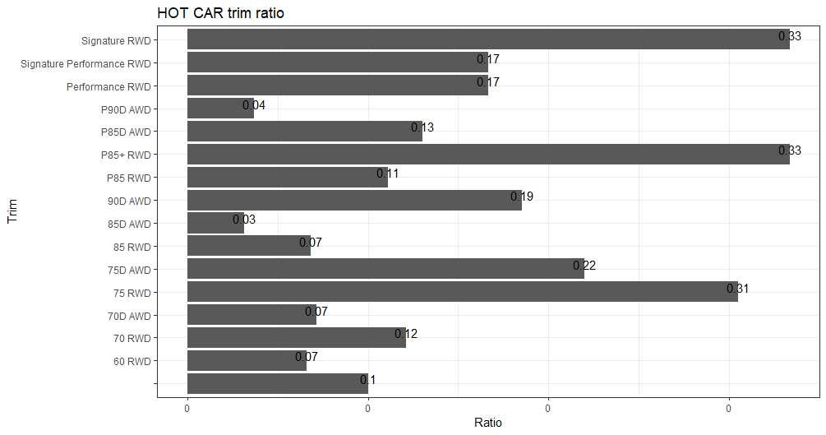
HOT CAR Analysis: Trim
Conclusion: trim 75D AWD and 75 RWD are more likely to be in HOT CAR category

Slide 22
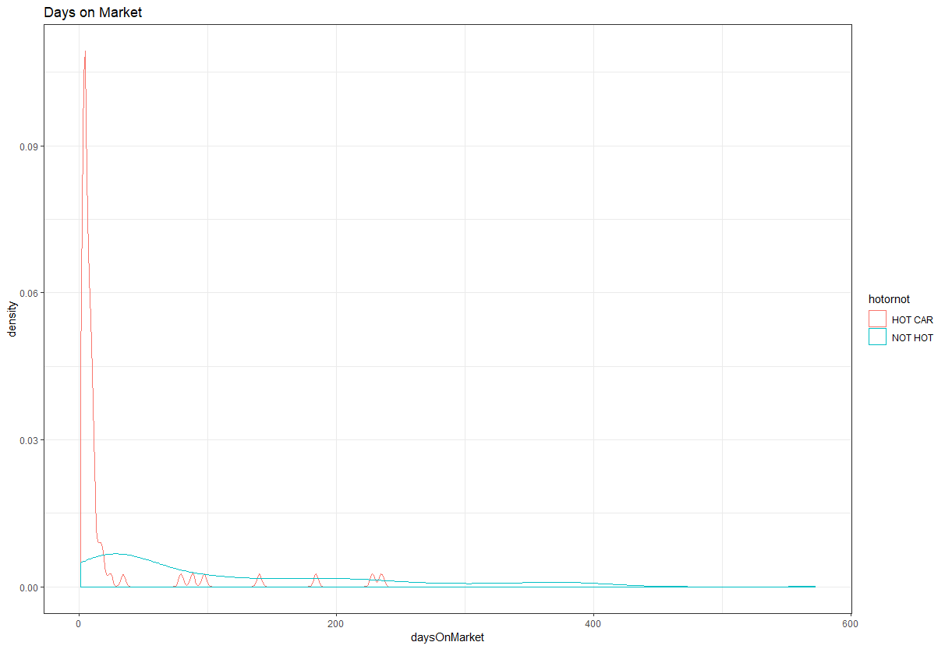
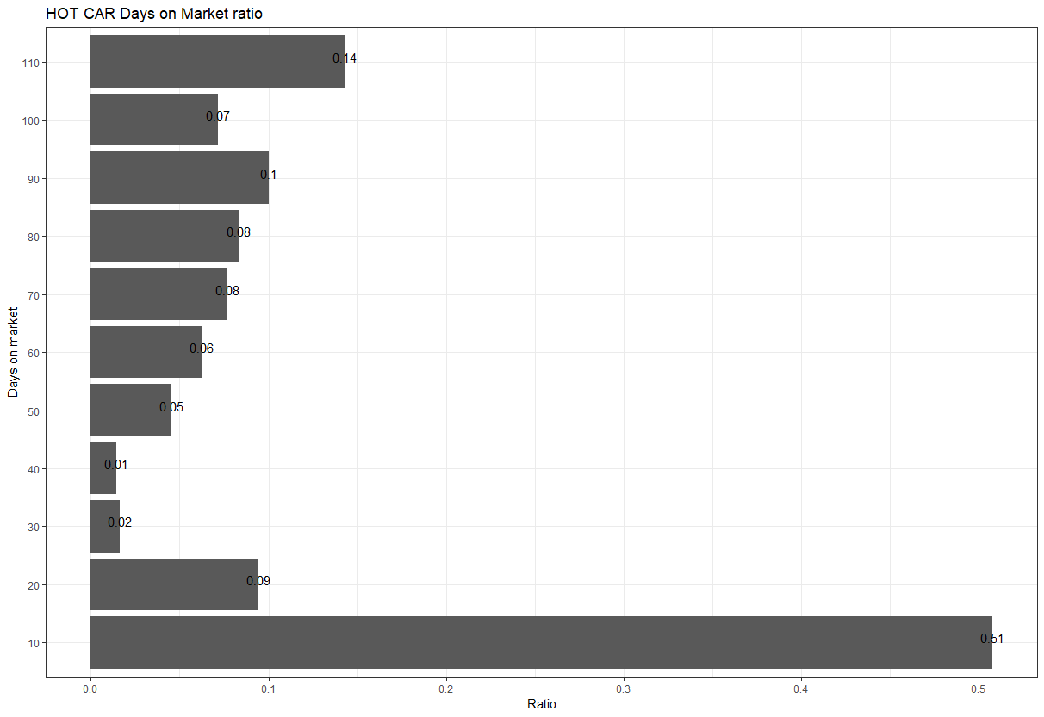
HOT CAR Analysis: Days on the market
outlier
Conclusion: Most hot car sells within a 10 days

Slide 23
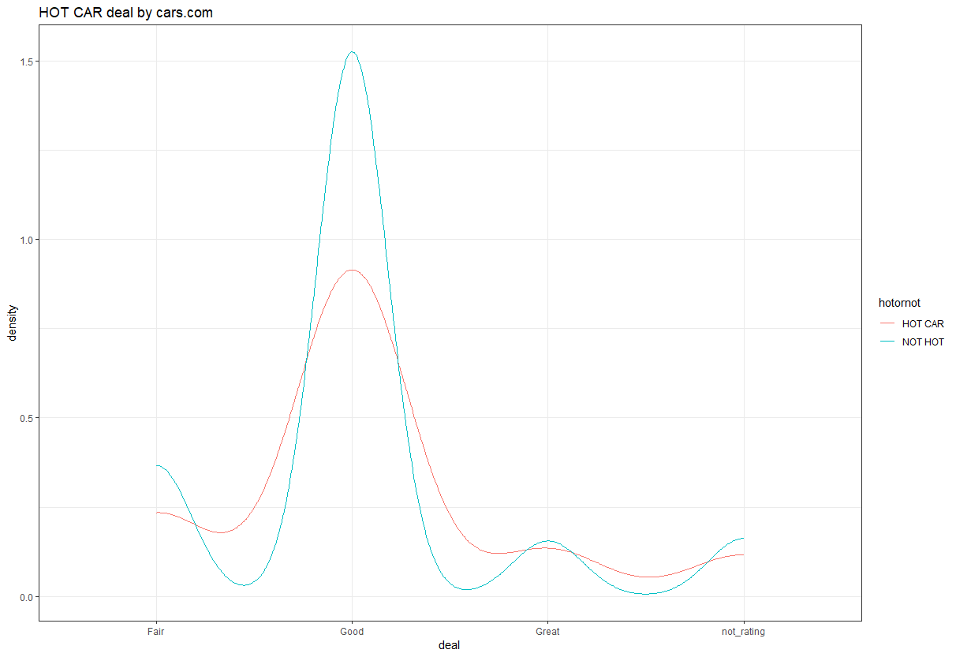
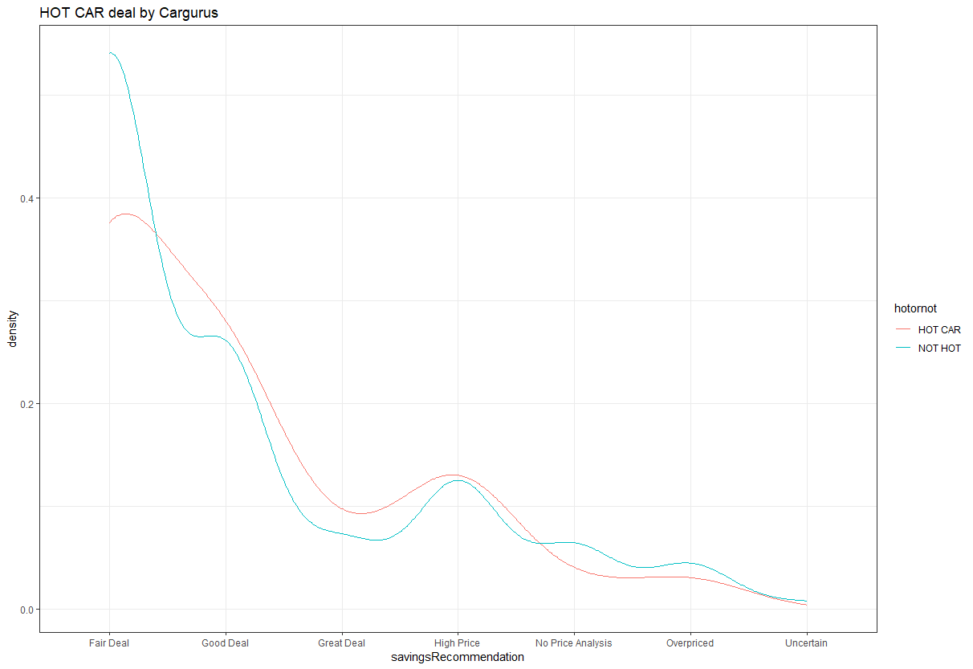
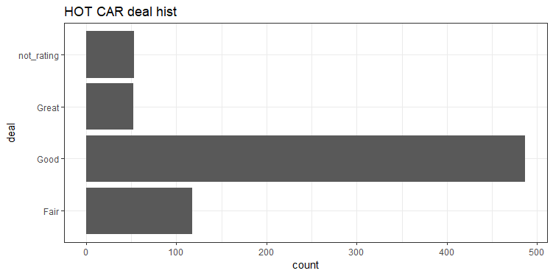
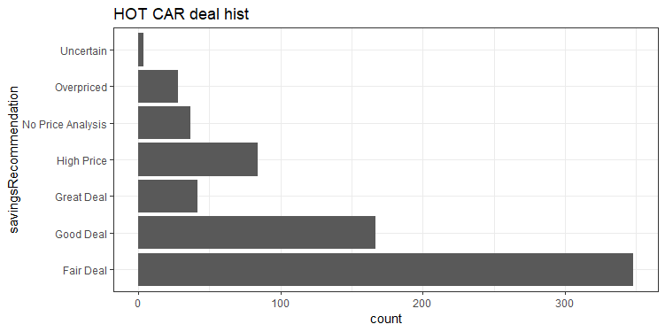
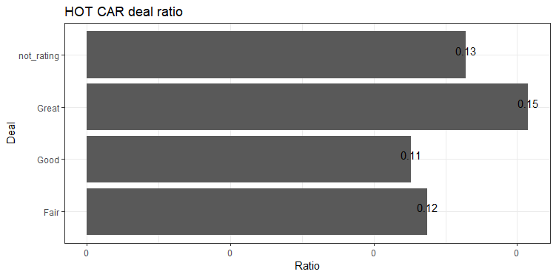
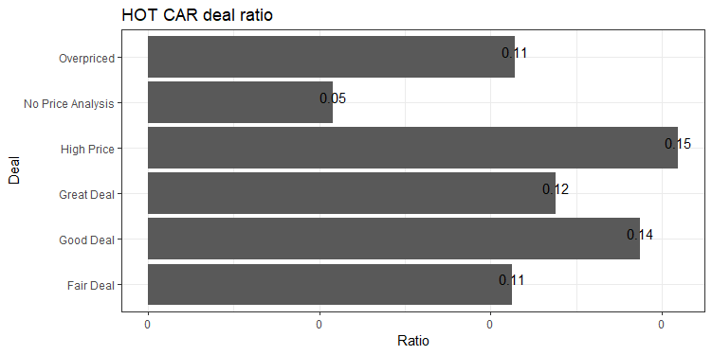
HOT CAR Analysis: Deals
Cars.com
Cargurus.com
Conclusion:
The great deal on the cars.com
might be overpriced

Slide 24
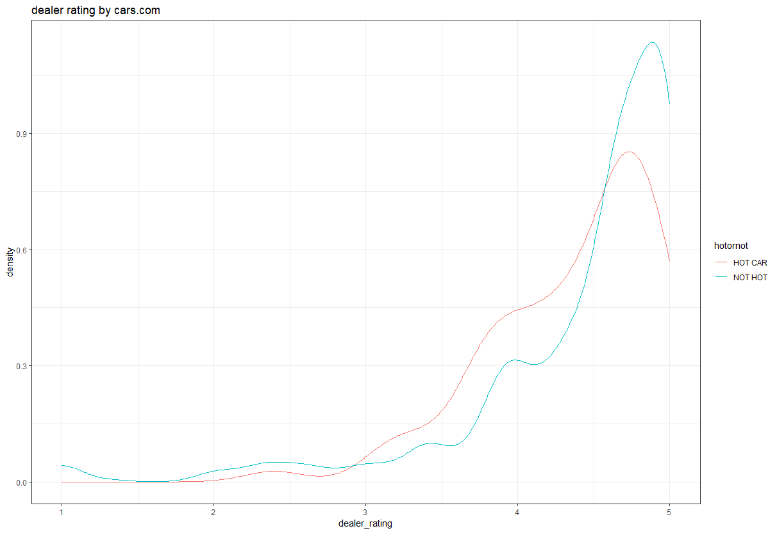
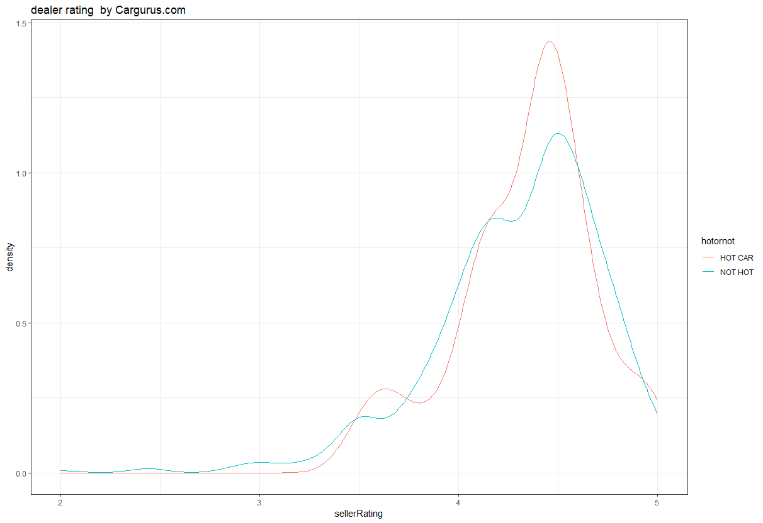
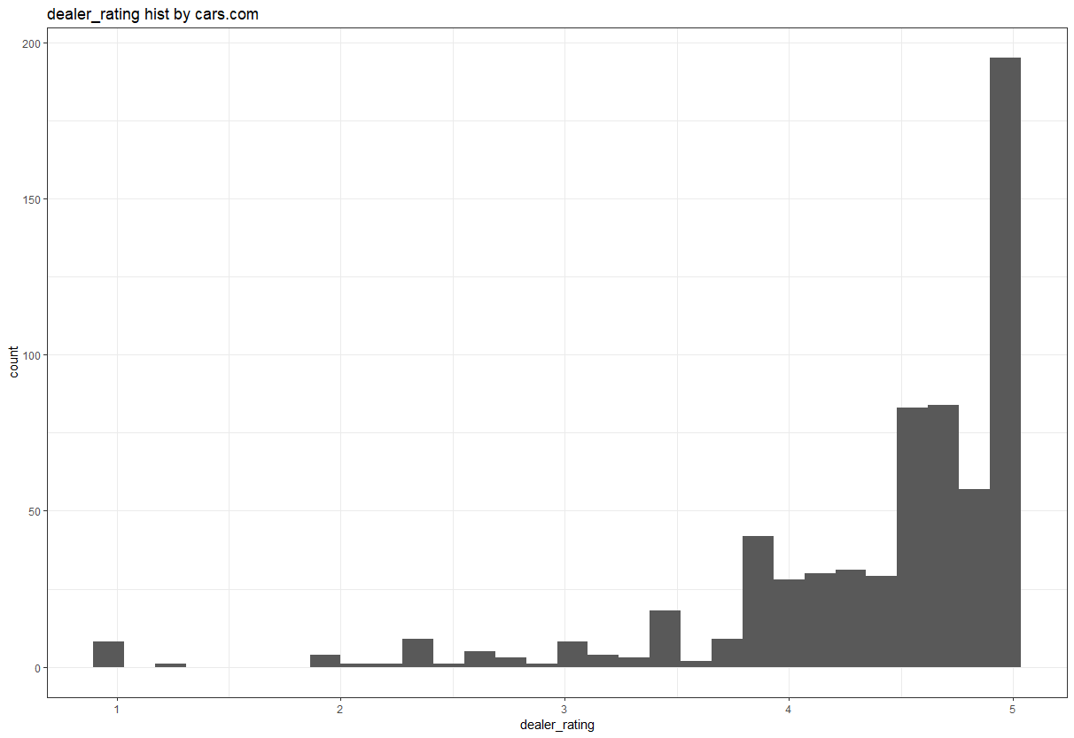



HOT CAR Analysis: Dealer rating
Cargurus.com
Cars.com
Conclusion:
Insignificant

Slide 25


HOT CAR Analysis: Owner Count
Conclusion: insignificant

Slide 26


HOT CAR Analysis: Accident
Conclusion: car with accident is less likly to be in HOT CAR category

Slide 27



HOT CAR Analysis: Fleet
Conclusion: fleet car is more likely to be in HOT CAR category

Slide 28


K-NN try
Input of
Mileage
Price
Good deal margin
Dealer rating
Dealer review number
Consumer rating
Consumer review number
Days on Market
Result:
KNN=1
KNN=5
KNN=10
KNN=20
KNN=24
KNN=27

Slide 29
Conclusion
Some significant factors:
Year
Color
trim
Days on market
Accident condition
Fleet condition

Slide 30
THANK YOU

