Slide 1

Predicting House Prices with Supervised Learning
A Regression Approach Using EDA, Feature Engineering, and Model Analysis

Slide 2

Problem Statement
Predict home sale prices based on property features
Help buyers, sellers, and investors make better decisions
Challenge: Many diverse features (size, location, quality, etc.)

Slide 3

Dataset Overview
Source: Kaggle House Prices Competition
79 features, ~1700 entries
Mix of numeric and categorical variables
Target Variable: SalePrice

Slide 4
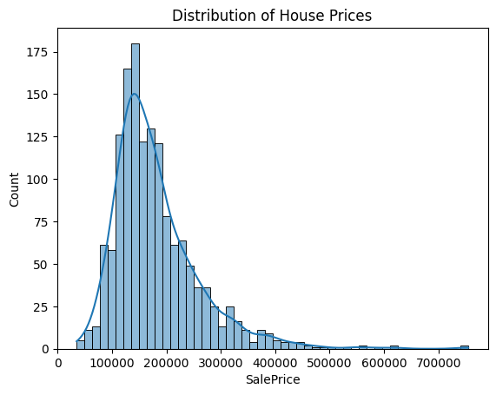
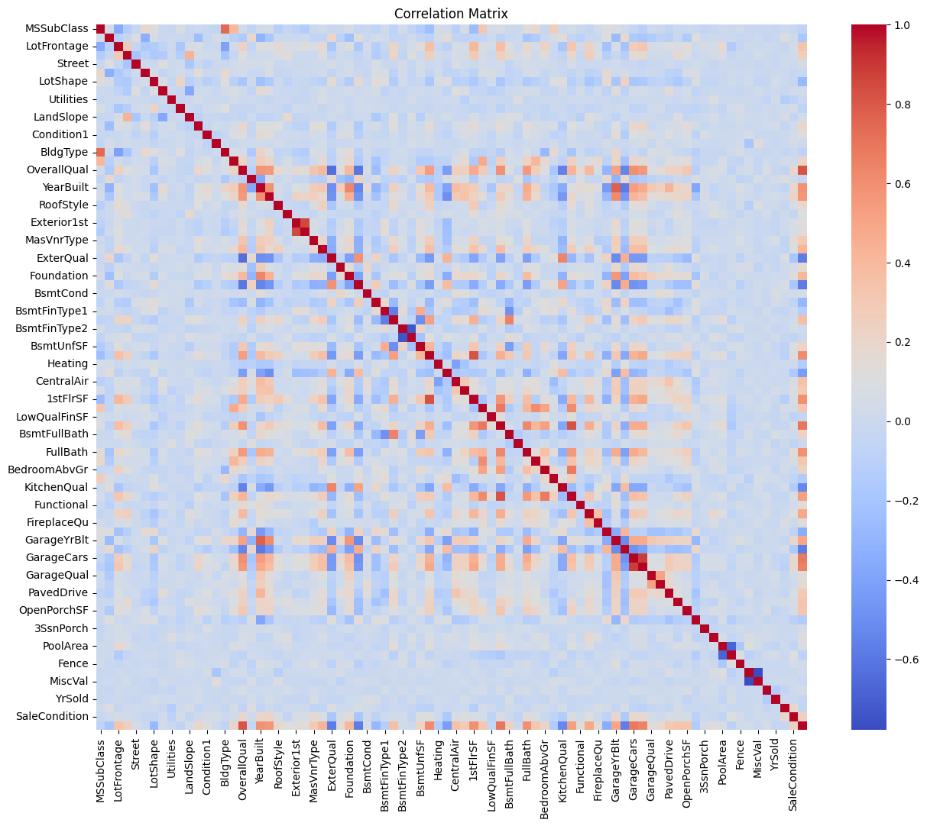
Exploratory Data Analysis (EDA)
Inspected distributions (SalePrice was right-skewed)
Handled missing values (imputation)
Visualized correlations (heatmaps)
Log-transformed skewed variables

Slide 5

Feature Engineering and Selection
One-hot encoded categorical variables
Standardized numerical features
Feature Selection with Lasso Regression

Slide 6
Modeling Approaches
Linear Regression
Random Forest Regressor
Ridge Regressor
Hyperparameter tuning with GridSearchCV

Slide 7
Model Evaluation and Comparison
Metrics: RMSE, R² Score
5-Fold Cross-Validation
Random Forest outperformed others
Visualized predictions vs actual prices

Slide 8
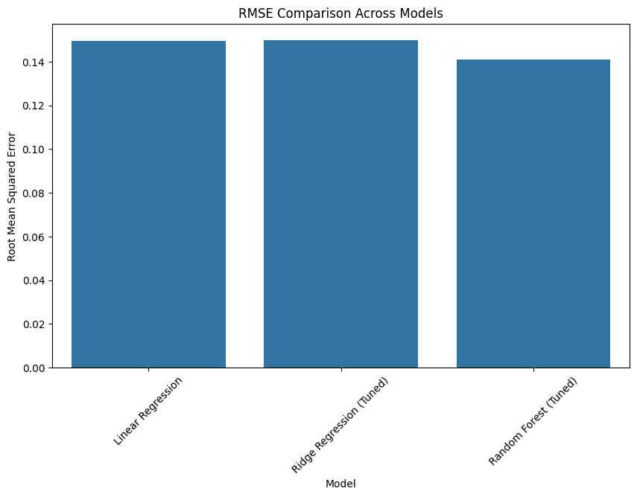
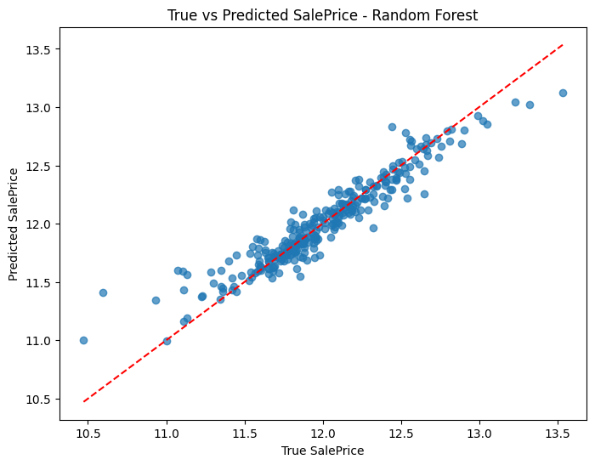
Final Results
Best Model: Random Forest Regressor
RMSE: 0.141
Key factors: OverallQual, GrLivArea, GarageCars

Slide 9
Conclusion and Future Work
Thorough cleaning, feature engineering are critical
Ensemble models outperform baseline
Future: Try stacking models or neural networks

Slide 10
Resources
GitHub Repo: Intro-To-ML-Final
Dataset: Kaggle House Prices Competition
Thank you!

