Slide 1
Speech Emotion Recognition
Exploring Deep Learning for Emotion Classification from Speech

Slide 2
Introduction
The task: Automatically classify emotions in human speech
Applications in healthcare, customer service, AI assistants, etc.
8 emotions to classify: neutral, calm, happy, sad, angry, fearful, disgusted, surprised
Dataset: RAVDESS (Emotional Speech Audio)

Slide 3
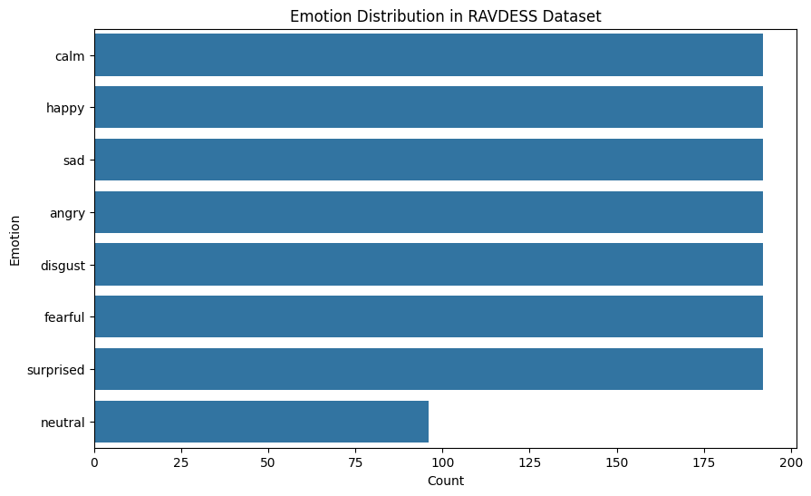
Data Collection, EDA
Dataset: RAVDESS Emotional Speech Audio (1440 .wav files)
24 professional actors portraying different emotions
Data source: RAVDESS Emotional Speech Audio

Slide 4
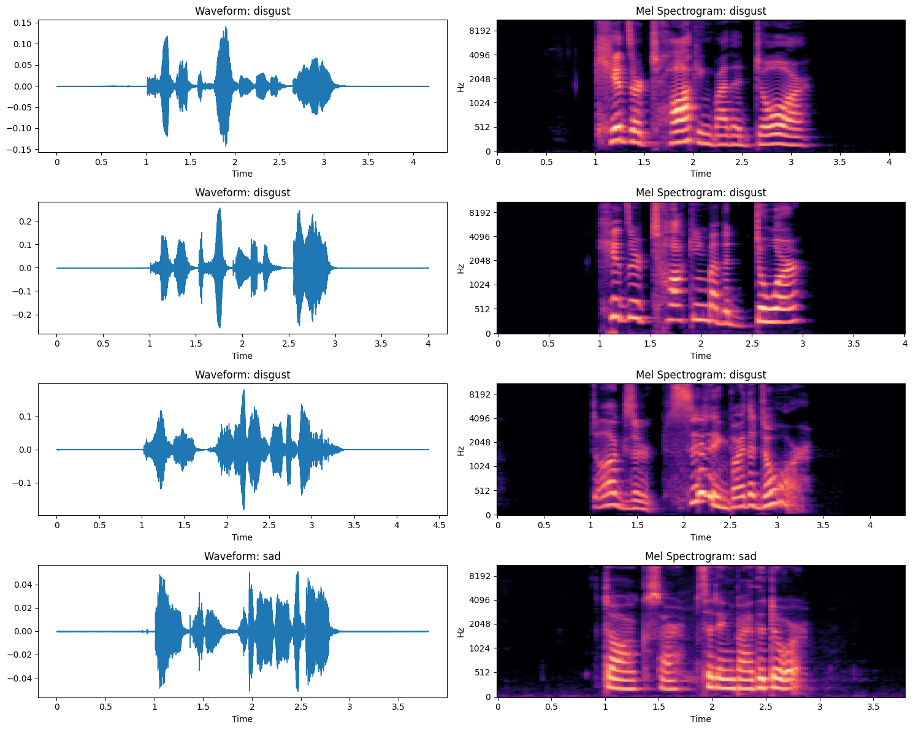
Augmentation and Feature Engineering
Audio files transformed into pseudo-images (Spectrograms & MFCCs)
Channel 1: Mel Spectrogram
Channel 2: MFCCs
Channel 3: Duplicate MFCCs
Input to pre-trained MobileNetV2 model

Slide 5
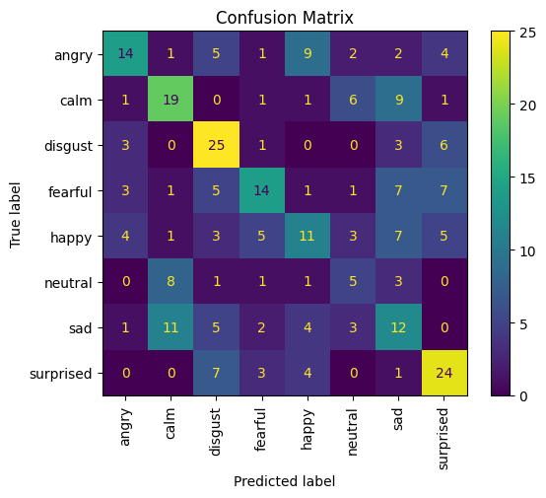
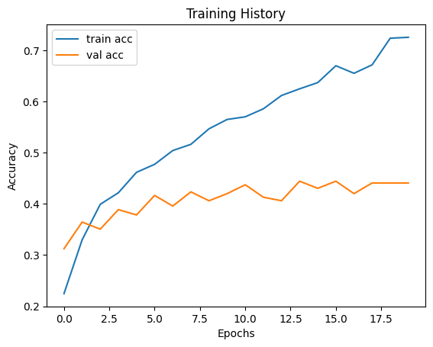
Modeling Approach & Results
Pre-trained MobileNetV2 model used for feature extraction
Custom top layers for emotion classification
Evaluation metrics: Accuracy, Confusion Matrix
Training and validation performance results

Slide 6
Conclusions & Future Work
Model performs well in classifying emotions from speech
Insights into the limitations and possible future improvements
Next steps: Experiment with more advanced models or data augmentation techniques

Slide 7
Thank You!
GitHub Repo:
Dataset: RAVDESS Emotional speech audio

