Slide 1
Anomaly Detection in Financial Transactions
Using the PaySim Dataset

Slide 2
Introduction
Fraud detection is critical, but fraud is rare and often unlabeled.
Supervised methods require labeled data — which is not always available.
This project explores unsupervised methods to detect anomalous transactions using PaySim data.

Slide 3
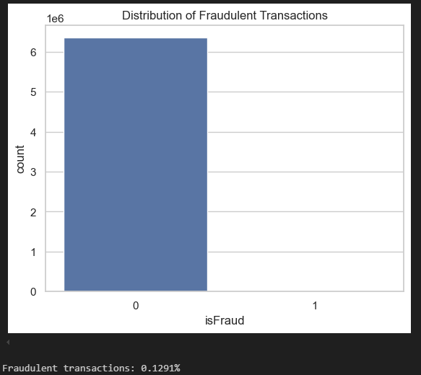
Dataset Overview
Simulated mobile transaction data (6 million+ records).
Extremely imbalanced: only 0.13% of transactions are fraudulent.
Important features: transaction type, amount, origin/destination balances.

Slide 4

Preprocessing
Dropped redundant ID and time fields.
Encoded type (e.g., CASH_OUT, TRANSFER) as numeric.
Standardized all numerical features using StandardScaler.

Slide 5
Models Used
Isolation Forest
Local Outlier Factor (LOF)
One-Class SVM
Each model trained without using fraud labels (unsupervised learning).

Slide 6
Isolation Forest
Randomly splits data to isolate outliers.
Outliers require fewer splits to isolate — higher anomaly score.
High precision, fast and scalable.

Slide 7
Local Outlier Factor (LOF)
Measures local density around a point.
Points with lower density than neighbors flagged as anomalies.
High recall, but more false positives.

Slide 8
One-Class SVM
Learns a decision boundary around normal transactions.
Anything outside is flagged as anomalous.
Sensitive to rare fraud, flexible but slower.

Slide 9
Hyperparameter Tuning
Isolation Forest
contamination = [0.0001, 0.001, 0.005, 0.01]
n_estimators = [50, 100, 200]
Local Outlier Factor (LOF)
n_estimators = [10, 20, 50]
contamination = [0.001, 0.005, 0.01]
One-Class SVM
kernel = rbf
nu = [0.001, 0.005, 0.01]
gamma = [scale, auto]

Slide 10
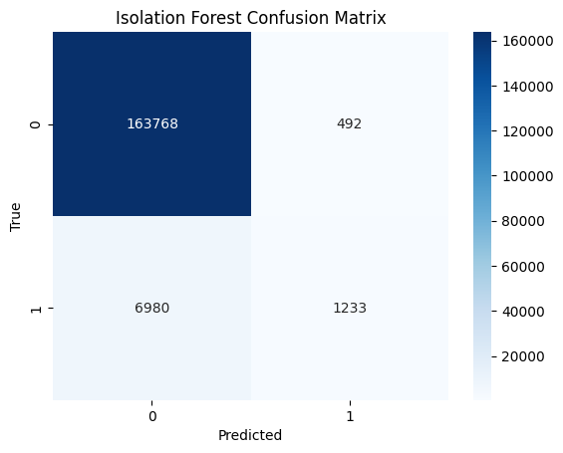
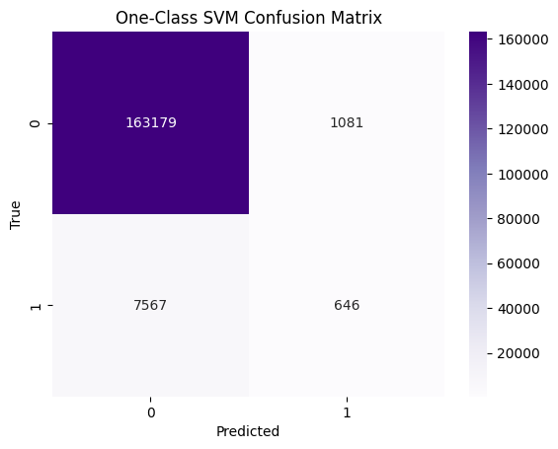
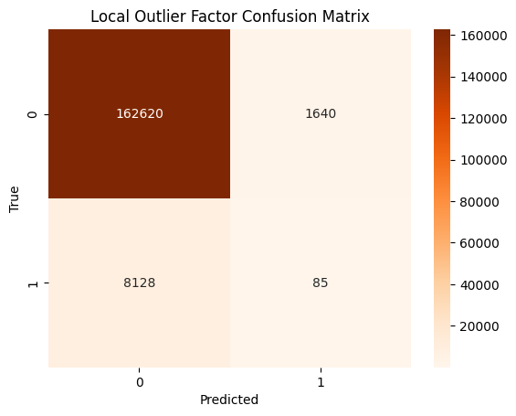
Results
Isolation Forest
One-Class SVM
Local Outlier Factor

Slide 11
Challenges
Severe class imbalance (0.13% fraud).
Choosing contamination rate for unsupervised models.
Evaluating models without labels during training.
Visualization of high-dimensional anomaly scores.

Slide 12
Future Work
Incorporate sequence/timing features (fraud may evolve over time).
Explore autoencoders or deep learning for high-dimensional embeddings.
Consider semi-supervised learning where some labels exist.
Tune Models manually and more carefully.

Slide 13
Conclusion
Unsupervised methods can flag rare fraud effectively without labels.
Isolation Forest was most robust and balanced.
Further tuning and hybrid models may improve recall and precision further.

Slide 14
Thank You!
GitHub Repo: AndroGermisa2938/unsupervised-learning-final
Dataset: Synthetic Financial Datasets For Fraud Detection

