Slide 1

Emotion Detector model using Convolutional Neural Networks (CNNs) Final Project
Nathan T. , Yaniv D.
January 2024

Slide 2
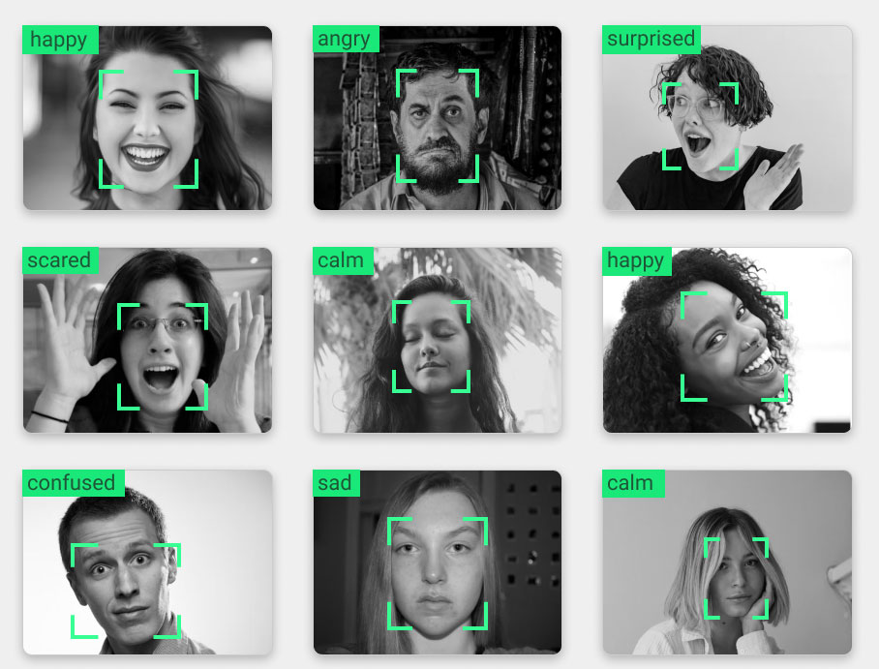
Overview
Background and Objective
The Data
Feature Engineering
The Model
Summary
Further Analysis

Slide 3
Background
Emotion Recognition's Relevance: In today's digital era, understanding human emotions plays a pivotal role in enhancing interactive technologies. It bridges the gap between human emotional expressions and computer understanding, paving the way for empathetic, user-centric applications.
Applications Across Fields: This technology is not just limited to one sector but spans across various domains like healthcare (mental health monitoring), education (student engagement analysis), entertainment (audience response), and security (behavioral analysis).
The Power of Facial Expressions: Among various emotion recognition methods, facial expression analysis stands out for its non-invasive nature and high potential for accuracy, leveraging subtle cues that convey a wide range of emotions.

Slide 4
Objective
Primary Goal: To develop and fine-tune a Convolutional Neural Network (CNN) model capable of accurately identifying and classifying human emotions from facial expressions in images.
Real-time Analysis Vision: The ultimate aim is to deploy this model in a real-world application that can analyze emotions in real-time, providing immediate feedback or interaction based on the user's emotional state.
Striving for Accuracy and Efficiency: While maintaining high accuracy in emotion detection, the model also aims to be efficient enough for practical applications, striking a balance between computational complexity and real-time performance.

Slide 5
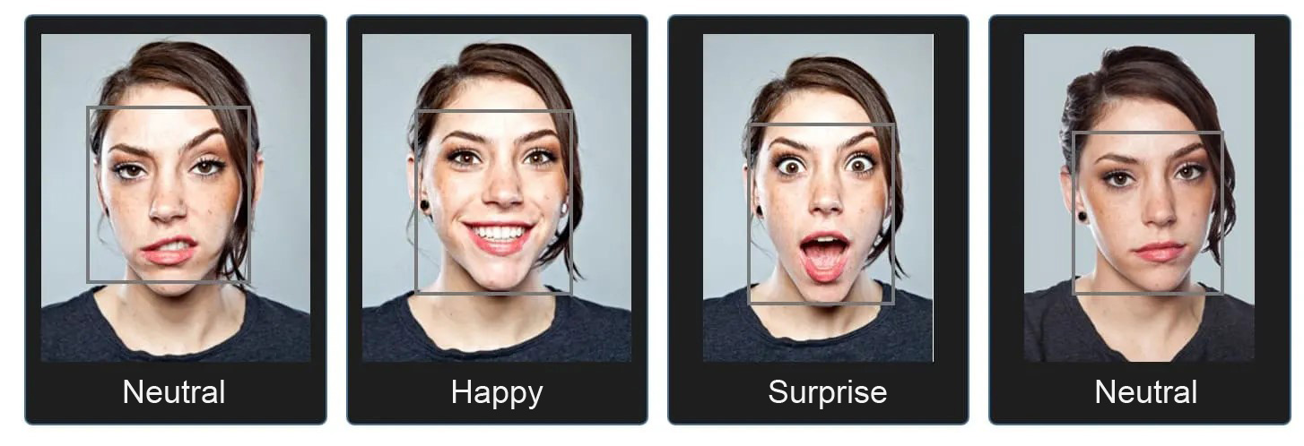
The fusion of advanced CNN models and emotion recognition has the potential to revolutionize how machines understand and interact with humans, making technology more intuitive and empathetic

Slide 6
The Data
Data Source:
Dataset Name: FER-2013, The dataset contains images along with categories describing the emotion of the person in it. The dataset contains 48×48 pixel grayscale images with 7 different emotions such as Angry, Disgust, Fear, Happy, Sad, Surprise, and Neutral.
The dataset was split into 22967 examples for train set, 5742 examples for validation set and 7178 examples test set.

Slide 7
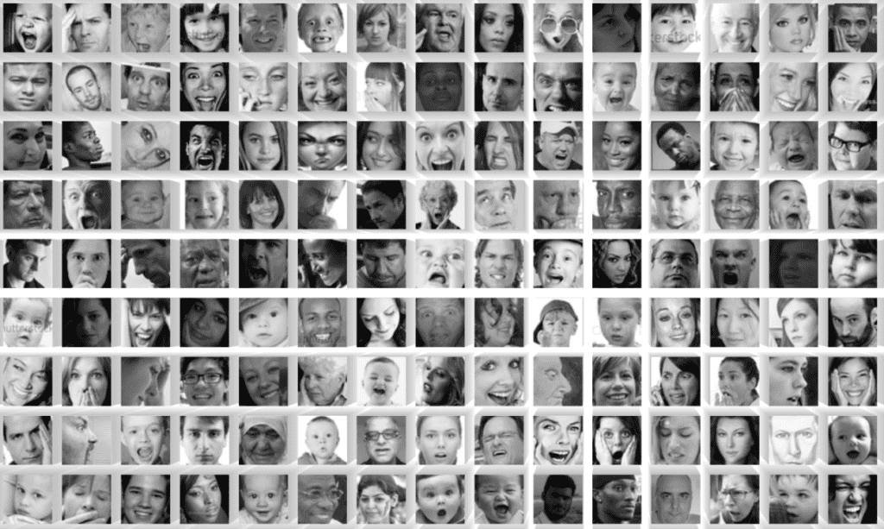

Slide 8
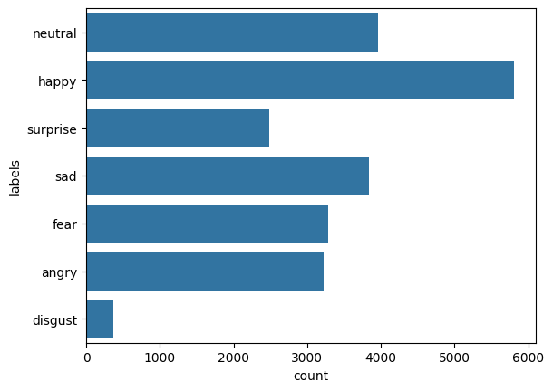
The Data
Class Distribution:

Slide 9
The Data
Imbalance: The classes in the data are imbalanced , with the extreme being disgust.
Quality Variance: The images are grayscale and small size, which can negatively affect the results of the model.
Usage in the Project: Training and Validation Split: "The dataset was split into 80% training and 20% validation sets.“

Slide 10
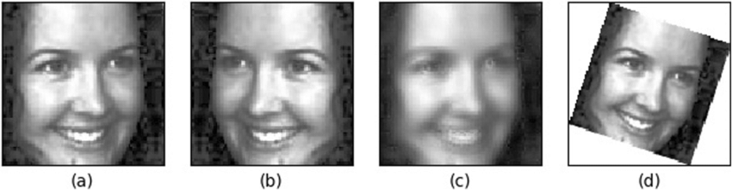
Feature Engineering
Data Augmentation:
The Purpose of Data Augmentation is to enhances the diversity of the dataset.
Improves generalization of the model and prevents overfitting by providing a larger and more varied dataset.
Techniques Used:
Image Rotation (within a certain degree) ,
Width and Height Shifts: to simulate off-center facial positions ,
Shear Transformation: to simulate a tilting effect ,
Zoom: to simulate different distances from the camera,
Flipping: to simulate mirrored facial expressions.

Slide 11
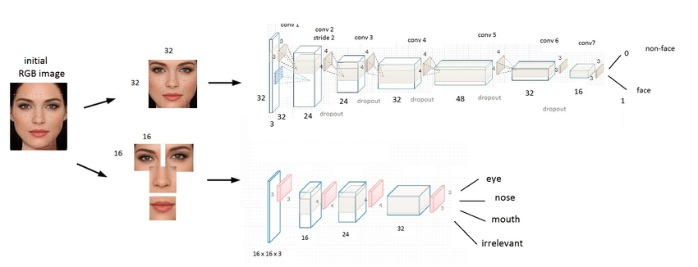
The Model - Why to use CNN model ?
Role of Convolutional Neural Networks (CNNs):
Primary mechanism for extracting features from facial images.
Learns hierarchical feature representations - from basic edges to complex facial expressions.

Slide 12
The Model- Architecture Overview
Layer Details:
The model consists of multiple convolutional layers, each followed by batch normalization for stabilizing learning and enhancing performance.
After each set of convolutional layers, max-pooling layer is applied to reduce spatial dimensions
Dropout is used between blocks for regularization to prevent overfitting.
The network then transitions from convolutional layers to fully connected layers, culminating in a softmax output layer for multi-class classification.

Slide 13
The Model- Training Process
Training Details:
The model is trained using a categorical cross-entropy loss function, suitable for multi-class classification tasks
We used the RMSprop optimizer, with an initial learning rate set to 0.001
Batch Size & Epochs:
The training process involved mini-batch sizes of 64 and the model was trained for 30 epochs

Slide 14
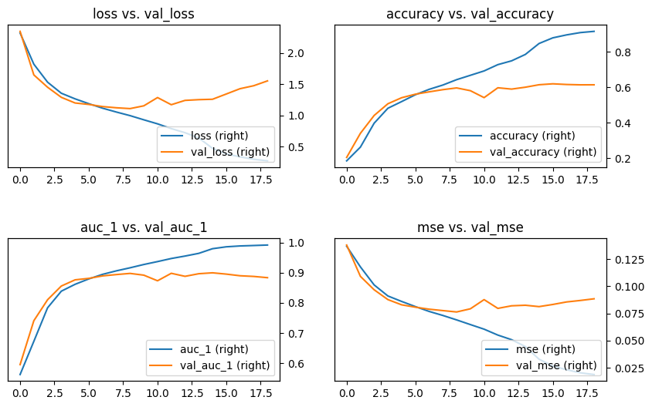
The Model- Evaluation Metrics
To assess the performance of our emotion detection model, we focused on accuracy as our primary metric. In addition we have calculated AUC and MSE.

Slide 15
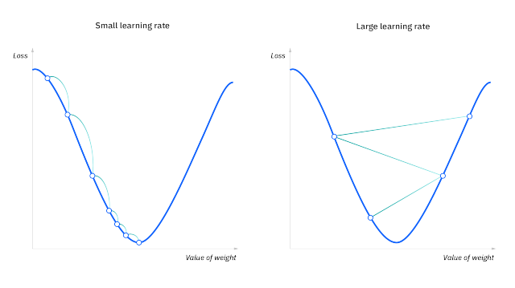
The Model- Experiments
To improve the performance of the model couple of methods have been used
Early Stopping: To avoid overfitting of the model early stopping tracks the validation loss and stops the training if it degrades.
Reducing learning rate on plateau: If the validation loss stops improving, then by lowering the learning rate the model can more precisely converge.
Optimal hyper parameters search – By iterating the whole learning process with different hyper parameter there could be found a better performing model.

Slide 16
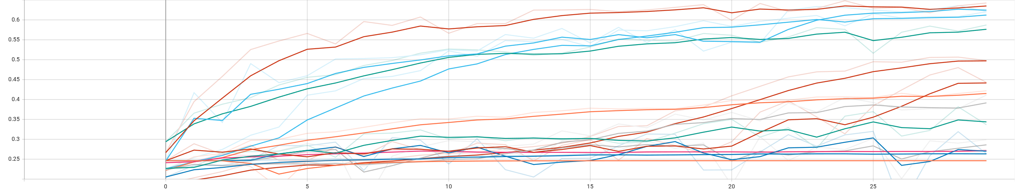
Conclusions and Summary
Key Findings
Model Performance:
Our CNN model achieved an accuracy of 64% on the validation set.
Data augmentation techniques improved the model's ability to generalize, evident from a 6% increase in accuracy on the augmented dataset
Dropout layer improved the performance by 2% compared to the same architecture without it.
Some hyper parameters caused the model training to stall and not improve from the initial state.
Stalled Trainings

Slide 17
Future Analysis and Steps
Further Research: Future research could focus on integrating more diverse datasets to enhance the model's ability to generalize across different demographics.
Real-World Testing: Deploying the model in real-world scenarios to gather more data and feedback for continuous improvement.
Enhanced Architectures: Investigate advanced neural network architectures such as ResNet or Inception models for potentially improved accuracy
Incorporating Additional Features: Facial Landmarks detection to focus on key areas of the face that are more expressive of emotions and explore the integration of multimodal data such as audio cues or body language for a more comprehensive emotion detection system

Slide 18
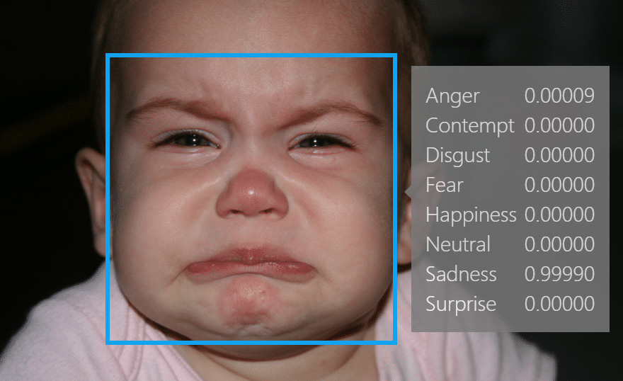
Thank You

