Slide 1


dev hack

Slide 2

OUTLINERS
-
-
-
-
Debjit Chakraborty
Biswarup Mukherjee
Ganesh Bhandarkar
Akash Pandey
HealthCare

Slide 3
Due to COVID-19 a huge number of people in our country are on the streets not with no food and shelter. How can you use technology to help the authorities solve this problem?

Slide 4

The approach we took to solve the problem was fairly simple. We wanted to ease the problems that were in hand for all the workers who are helping others by risking their lives in this pandemic. We thought that if the people helping knows what's going around them if they know who are the people who haven’t yet received any help in any form, or if they can keep track of the people who need help or are being helped, it would be a massive help for them. In our project, we aimed to build a multi-purpose application that can keep track of the locations on map about the people who are currently being helped and the information of the organization, community, or an individual helping them along with their contact info. Our application also has a feature that will help locals or any people to inform the nearby organization or community if any kind of help is needed in that area. We also provided all the details and link for the government fund raising websites and schemes.

Slide 5
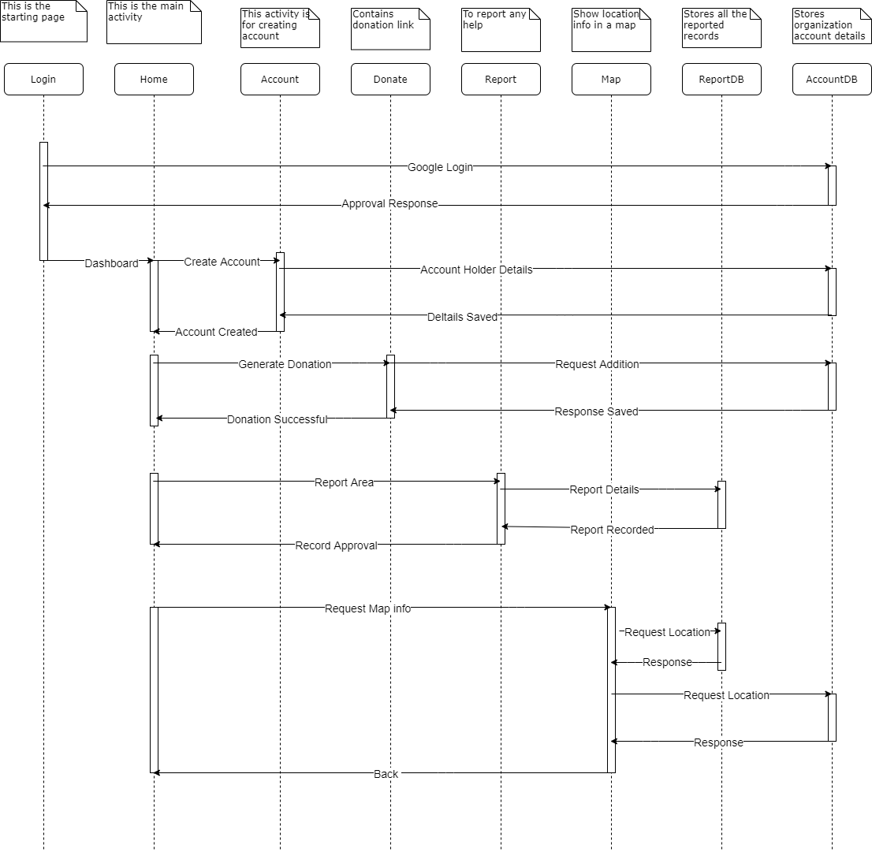
ARCHITECTURE DIAGRAM

Slide 6
Social Media will be the main platform for advertising our application. It will be a free app and could be found on both google play store and apple app store. This app is accessible by everyone who has an android or apple device. If we had to compare our application with other similar application then we could say that our app has more features and the simple and interactive UI will help the user to easily understand the working.

Slide 7


☺

