Slide 1


dev hack

Slide 2

OUTLINERS
-
-
-
-
Debjit Chakraborty
Biswarup Mukherjee
Ganesh Bhandarkar
Akash Pandey
HealthCare

Slide 3
Due to COVID-19 a huge number of people in our country are on the streets not with no food and shelter. How can you use technology to help the authorities solve this problem?

Slide 4

The approach we took to solve the problem was fairly simple. We wanted to ease the problems that were in hand for all the workers who are helping others by risking their lives in this pandemic. We thought that if the people helping knows what's going around them if they know who are the people who haven’t yet received any help in any form, or if they can keep track of the people who need help or are being helped, it would be a massive help for them. In our project, we aimed to build a multi-purpose application that can keep track of the locations of the people or group(s) who need help, of who are currently being helped and the information of the organization, community, or an individual helping them along with their contact and location info. Our application also has a feature that would help locals or any person to inform the nearby authorities or community if any kind of help is needed in that area. Wd’d also keep details of all the regional and national NGOs and government relief camps, and on the admin side of things, a map with locations of places where the locations of people in need would be listed. We plan to generate a heatmap using that data which would show how much in need the people are so the authorities can plan out their sending of helps instead of randomly sending helps to any people. We also plan to provide all the details and link for the government and non governmental fund raising websites and schemes.

Slide 5
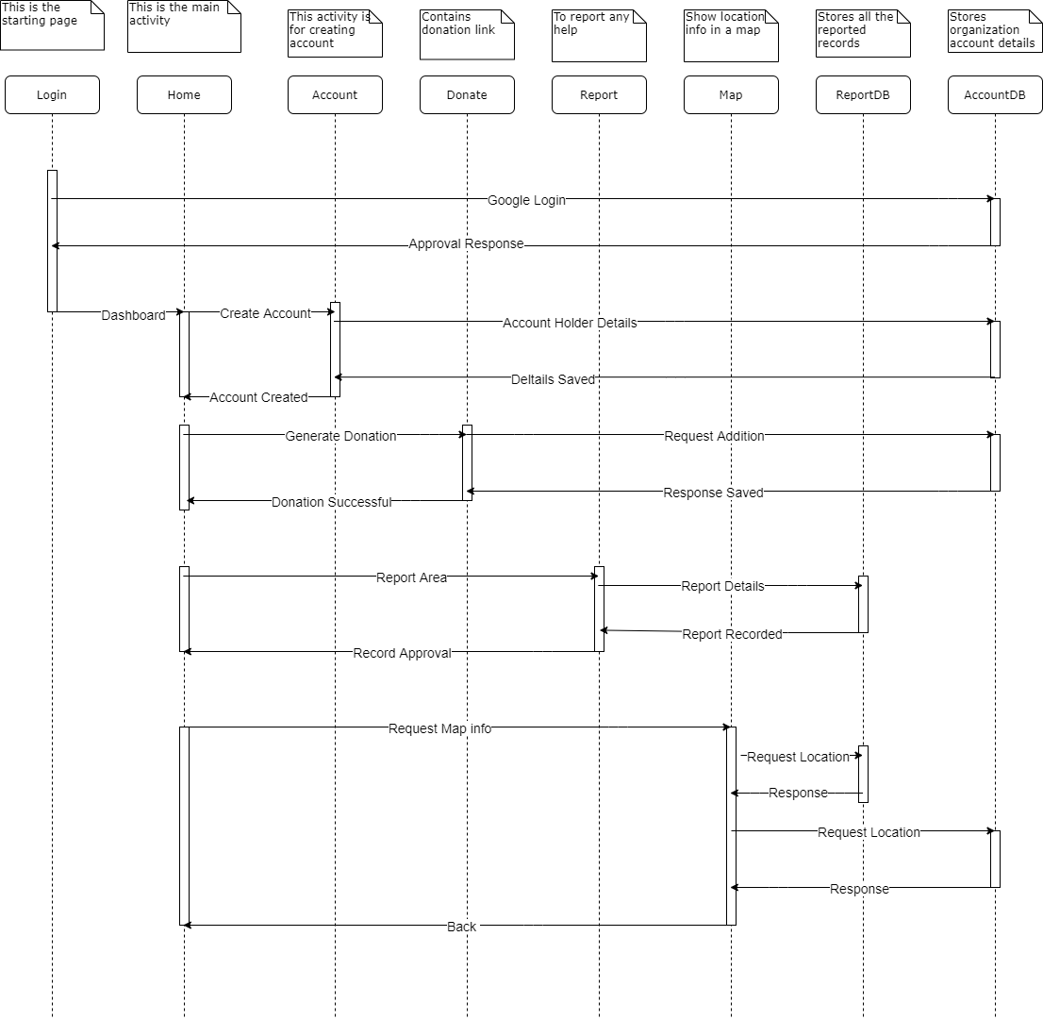
ARCHITECTURE DIAGRAM

Slide 6
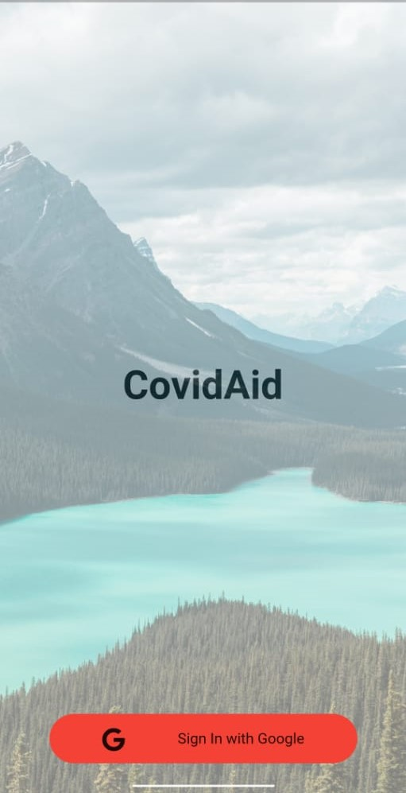
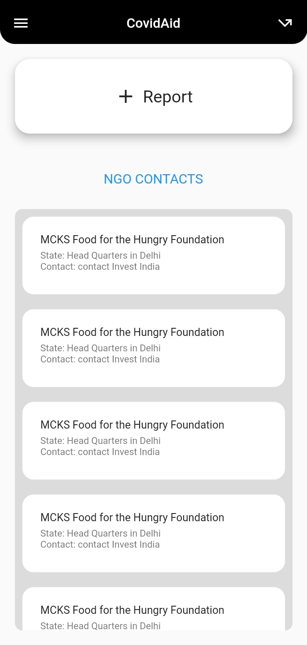
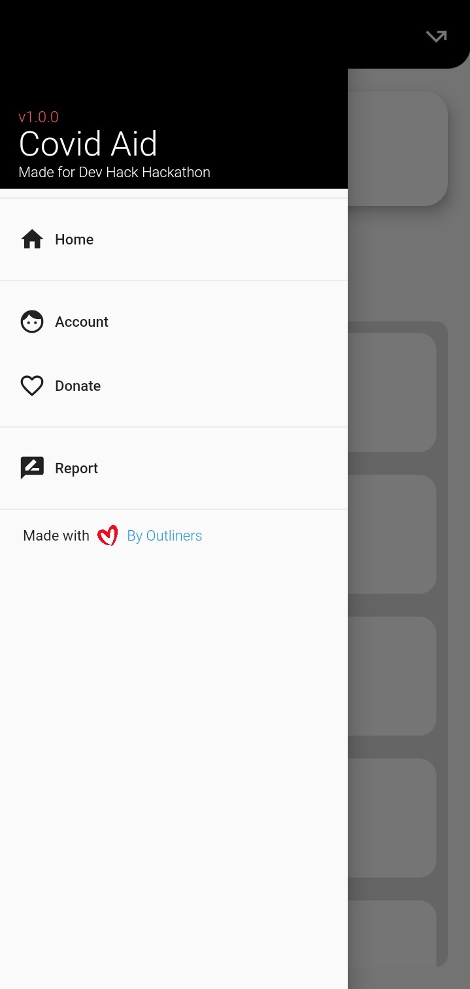
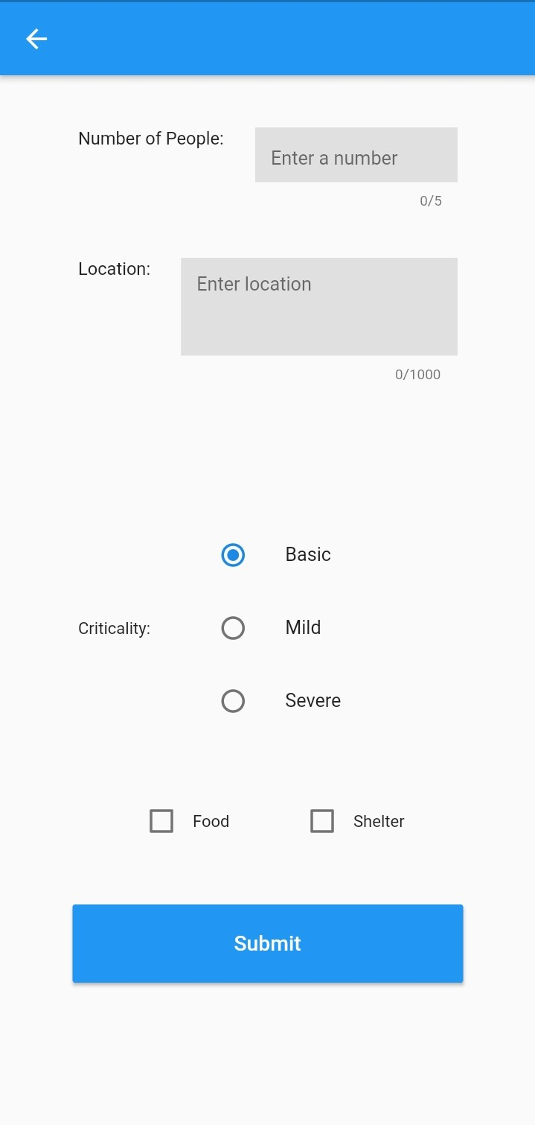
App Design
1.
2.
3.
4.

Slide 7
Screen 1.:-This is the login screen which allows the user to enter the app.We kept sign in option with Google.
Screen 2.:-This is the home screen which we will see in the app.Originally the idea was to show the no. of NGOs present around the user based on his/her loacation.But since it is a prototype and we didn't have enough time to complete it , it shows the given list of NGOs.
Screen 3.:-This is the navigation bar from which we can navigate to different pages.By default, it is in the home page which shows the given no. of NGOs.
Screen 4.:-This is the report page in which the user can input the credentials of himself/herself according to his need.
Future Planning(on the Admin side of things) on this model:-
We plan to take the reports presented by different users around the country and store them in Google Firebase from which we will then retrieve those data and present it in a map showing the urgency and density of the needs of people around the country.
In this map, places having severe criticality will be marked in red, places having mild criticality will be marked in yellow,places having basic criticality will be marked in blue.
This map will help the government to take their decisions fluidly so that the number of people helped during this lockdown will be more and this process will be fast and smooth.
Integration of UID verification to remove fake requests would also be added.

Slide 8
Social Media will be the main platform for advertising our application. It will be a free app and could be found on google play store, apple app store and on the web. This app can be accessible by everyone who has any device that can connect to the internet. If we had to compare our application with other similar application then we could say that our app has more features and the simple and interactive UI will help the user to easily understand the working.

Slide 9


☺

