Slide 1
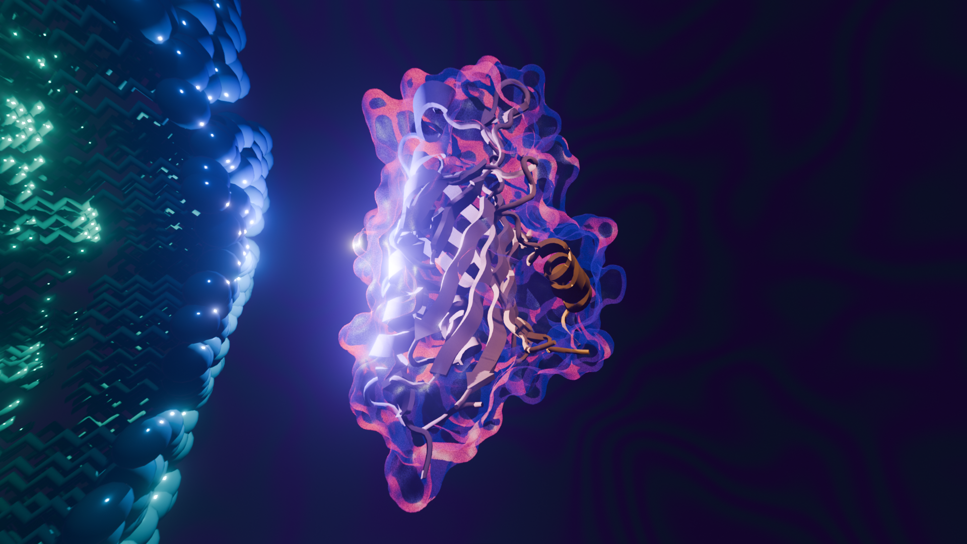
Emulsify : Investigating Protein-Lipid Interaction with Deep Learning

Slide 2
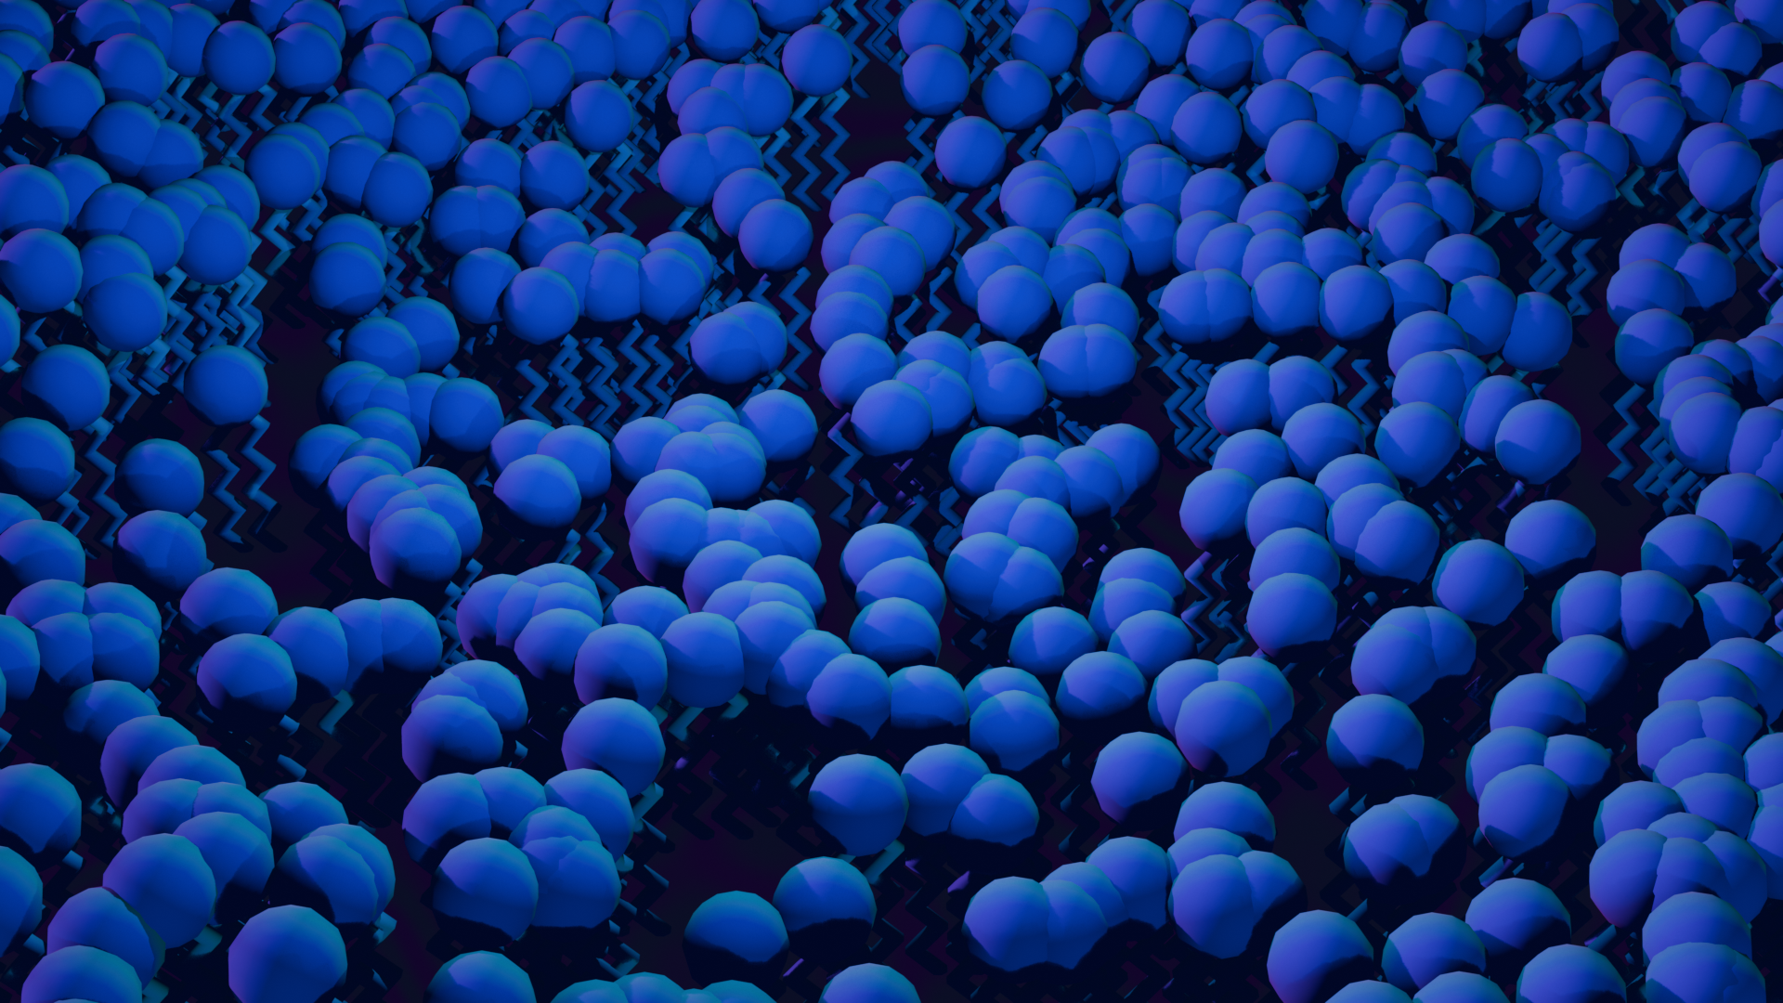
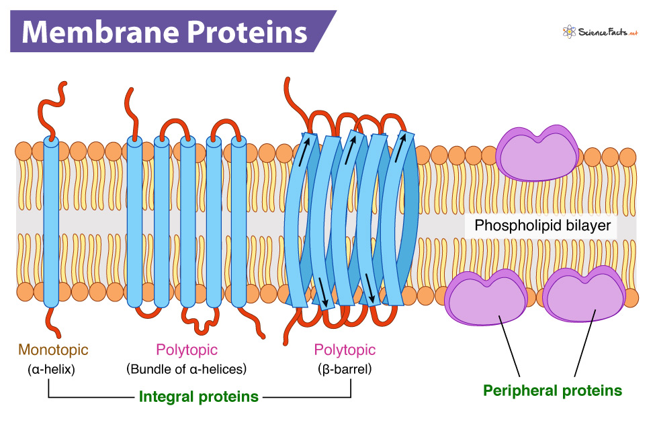
Peripheral membrane Protein (PMP)

Slide 3

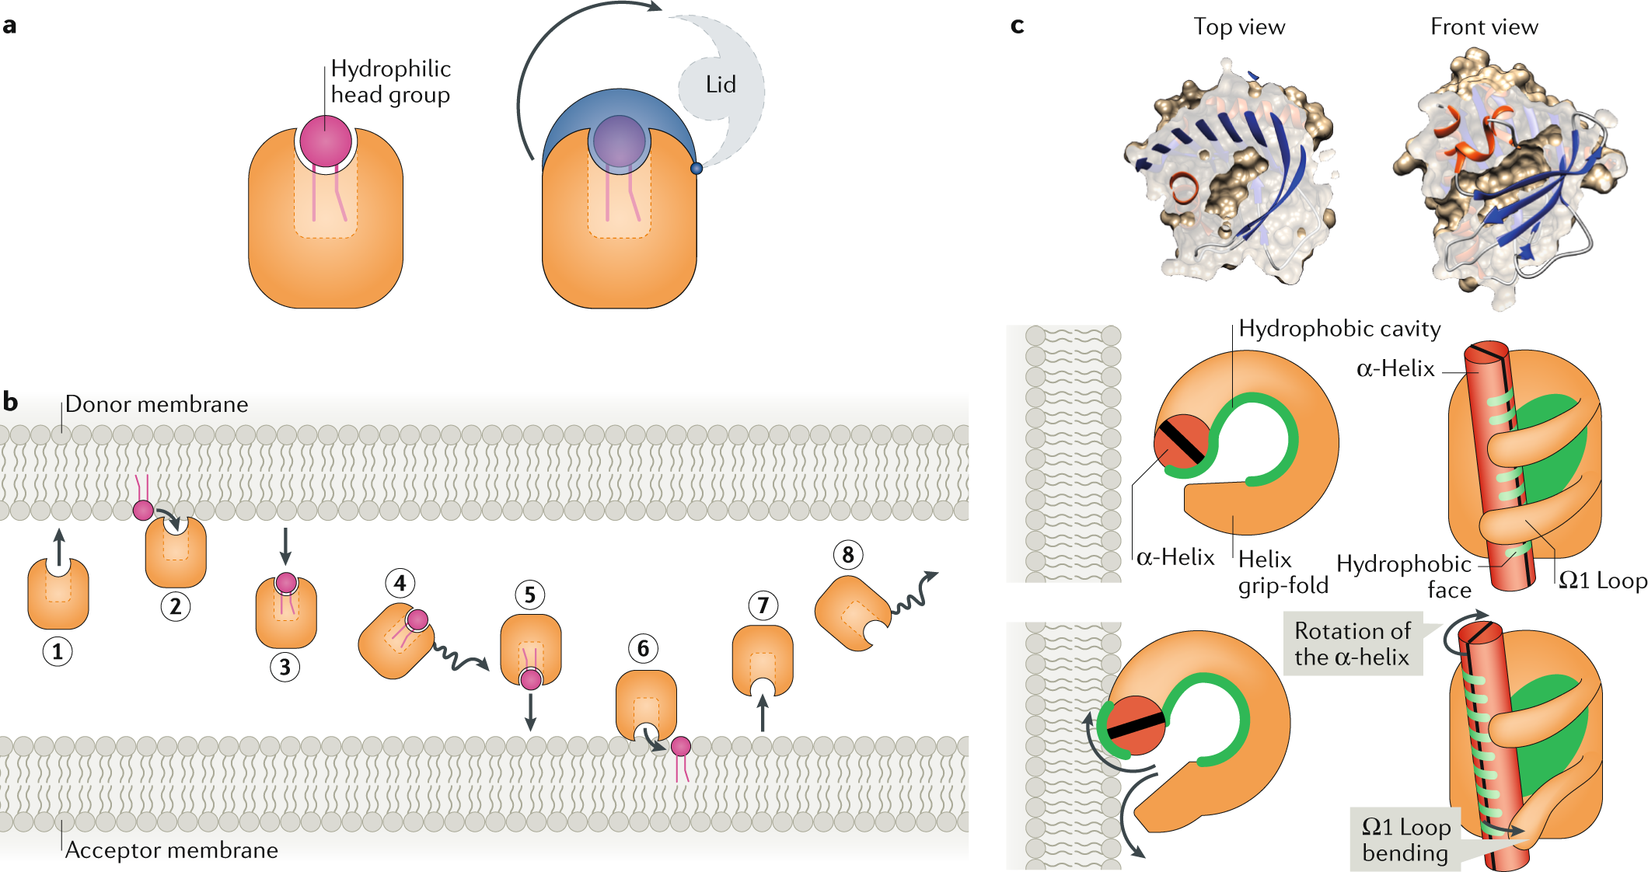
Lipid Transfer Protein (LTP)

Slide 4
Challenges
Experimental structures are sparse (lipids have a lot of diversity) (both for protein and lipid species)
Functional characterization not trivial (transient interaction)

Slide 5
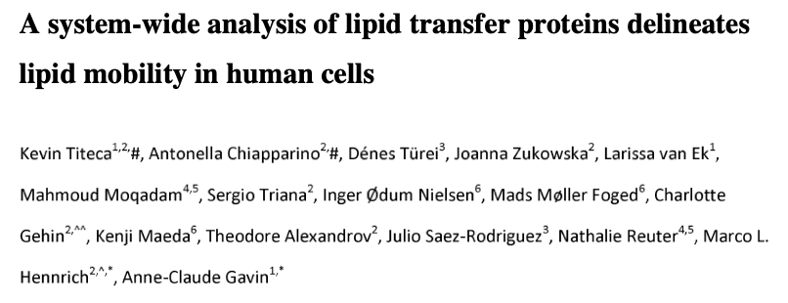
Goal
Take advantage the dataset :
Extrapolate on lipid-protein interaction

Slide 6
Data
Mass spectrometry
- for one expressed protein, which lipid is transported
- information ABOUT the structure, but not complete
Ex : Phosphatidylethanolamine (36:2) => (18:1/18:1)
PDB
- Can recover structures with gene name
- AFDB otherwise

Slide 7
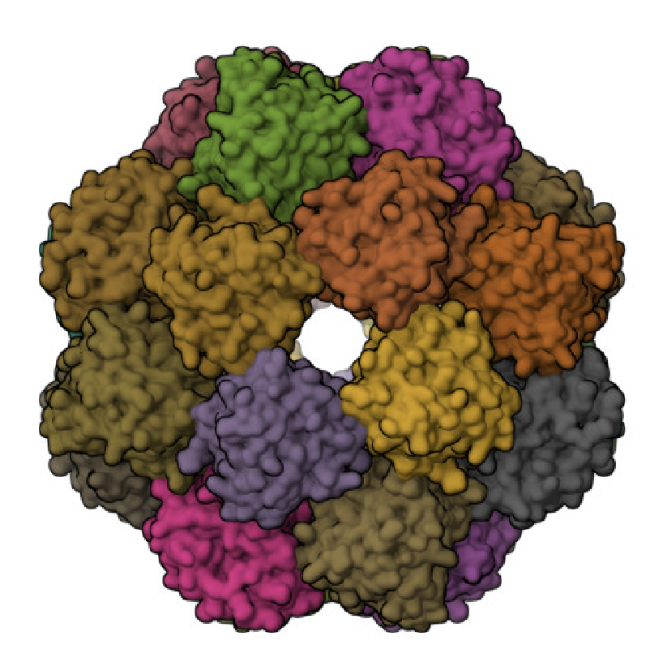
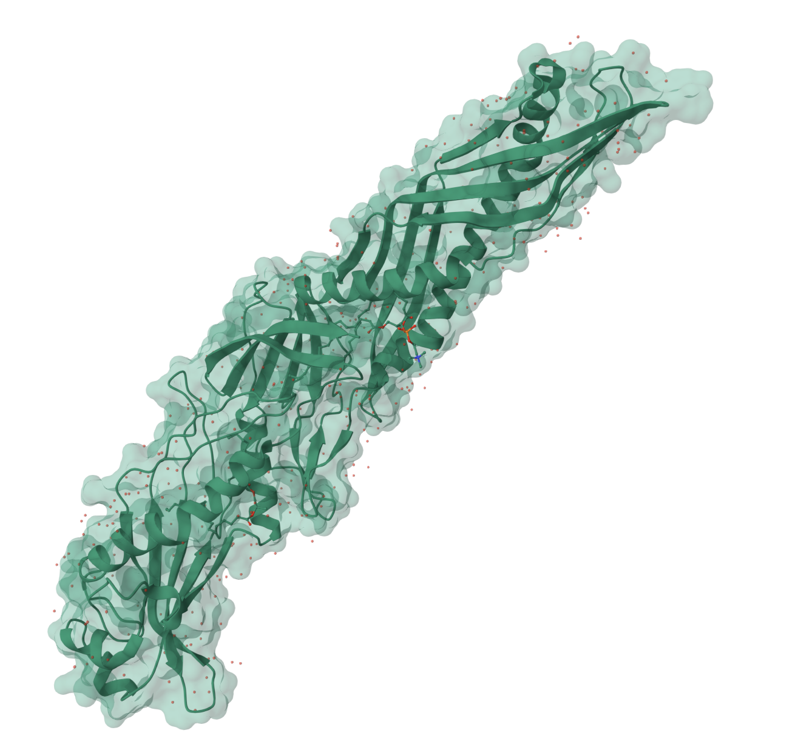
Outliers
TTPA (a-tocopherol)
24-mer
BPI
Not box-like

Slide 8
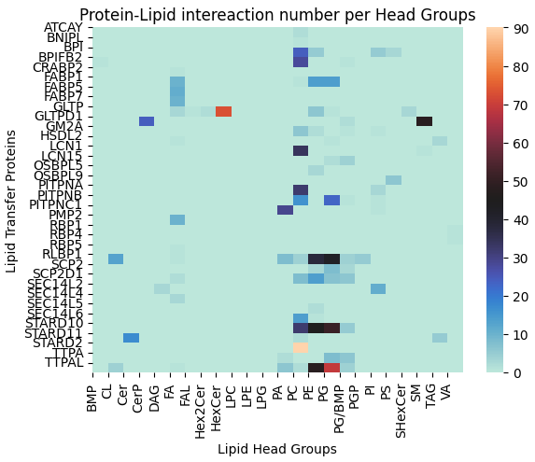

Slide 9
Methods
Encoding
Language Model
Graph
Interaction
Attention

Slide 10
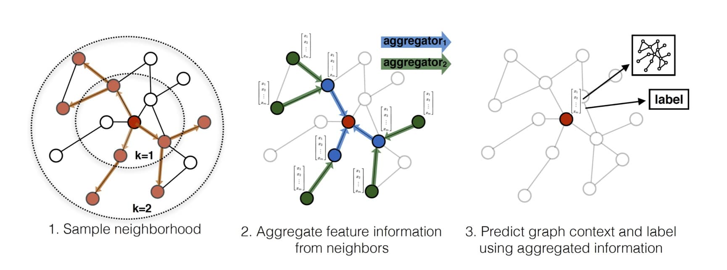
Graph Neural Networks

Slide 11
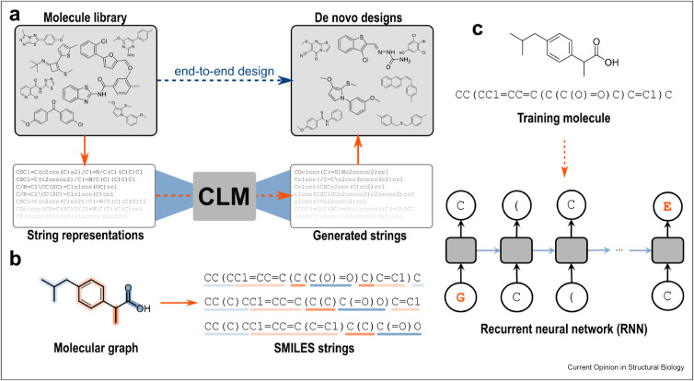
Language Models

Slide 12
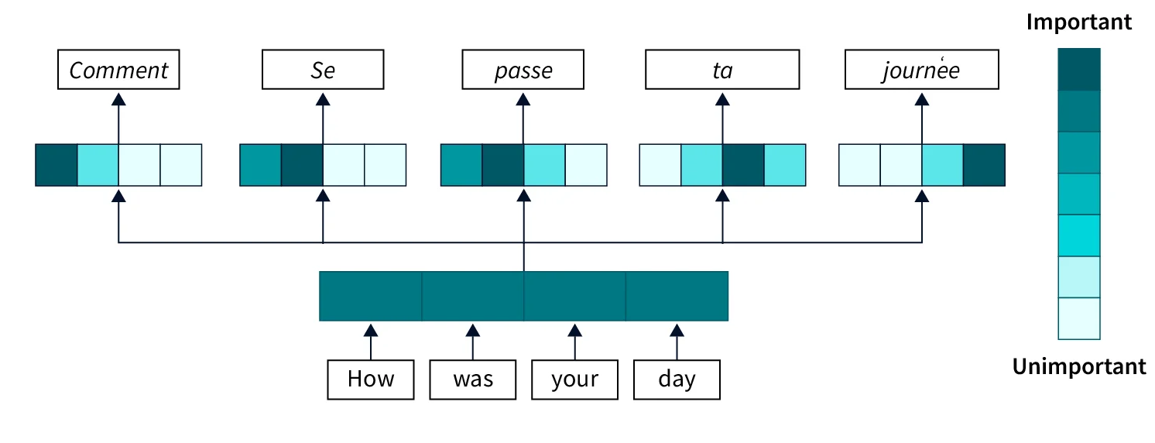
Transformer (Attention)

Slide 13
Equivariant GNN
Necessity for the same input to have the same profile in the network
Similar structure = similar embedding
No effect from translations and rotations

Slide 14
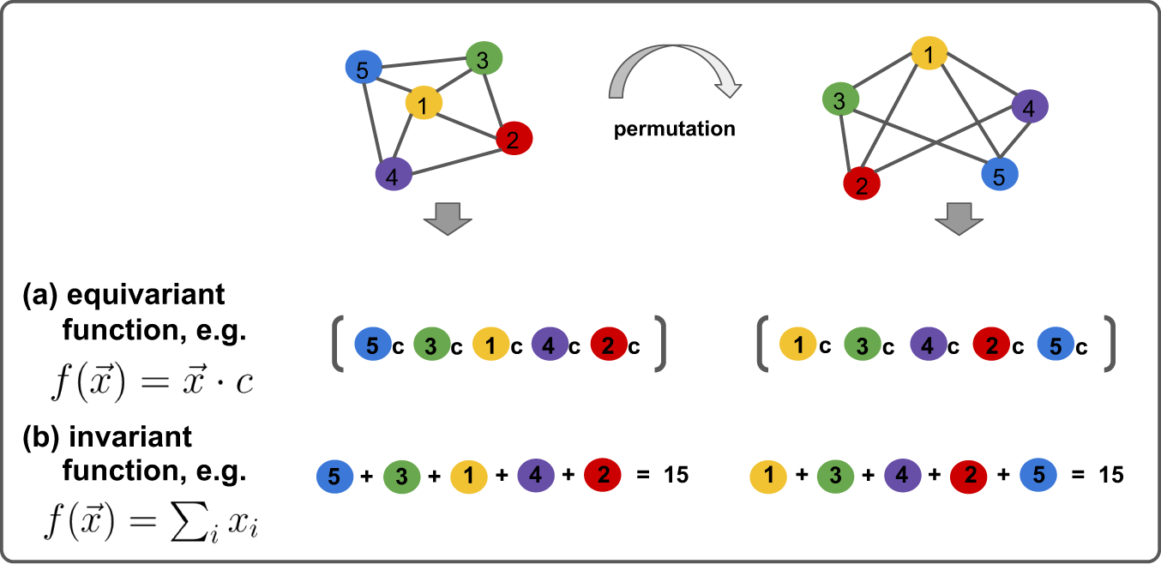
Equivariant GNN

Slide 15
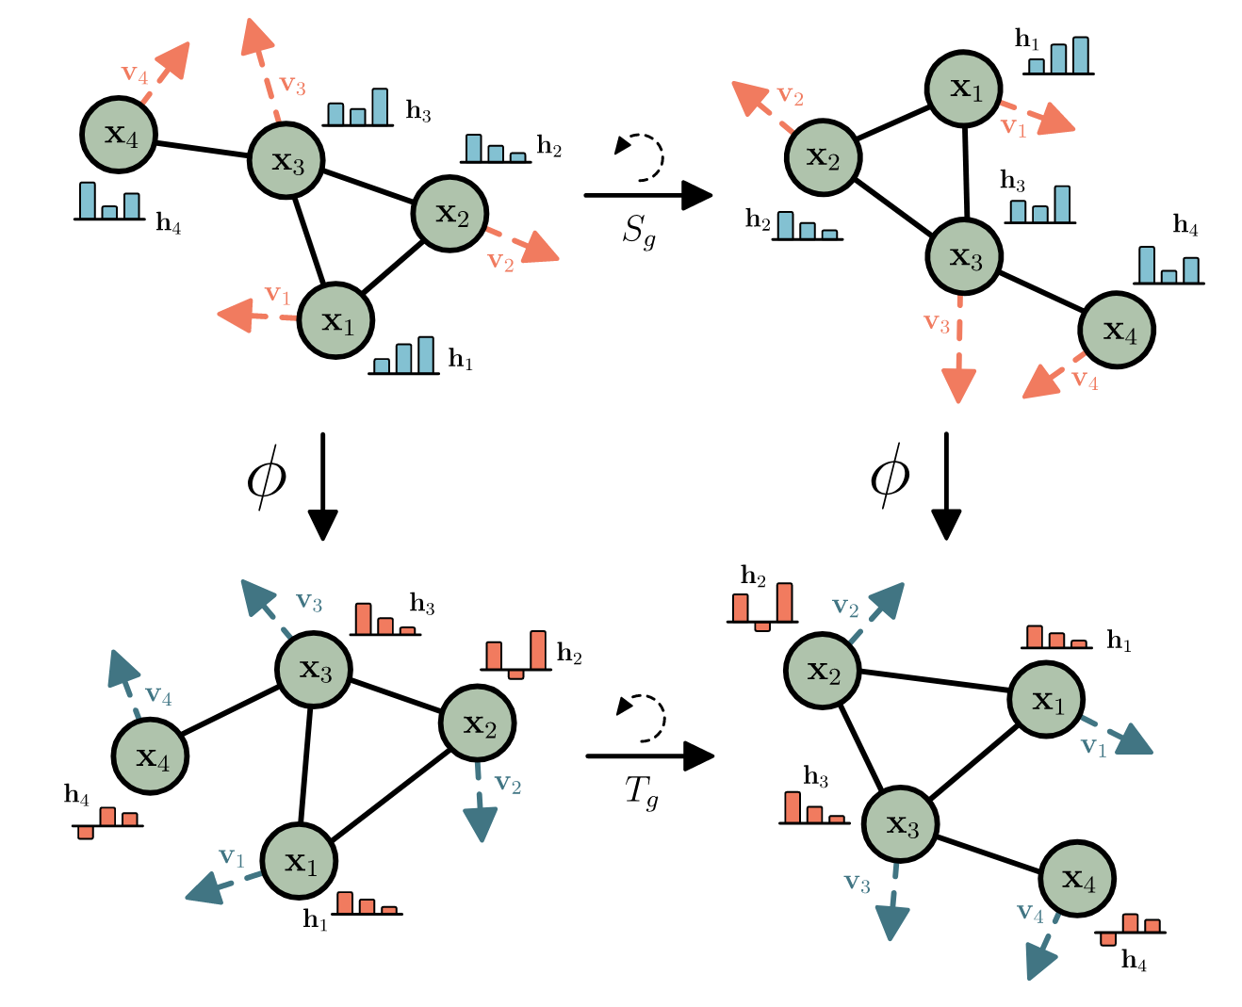
Equivariant GNN

Slide 16
Chemical LM
Large language model trained on large amount of small molecules
Lipids very similar in composition

Slide 17
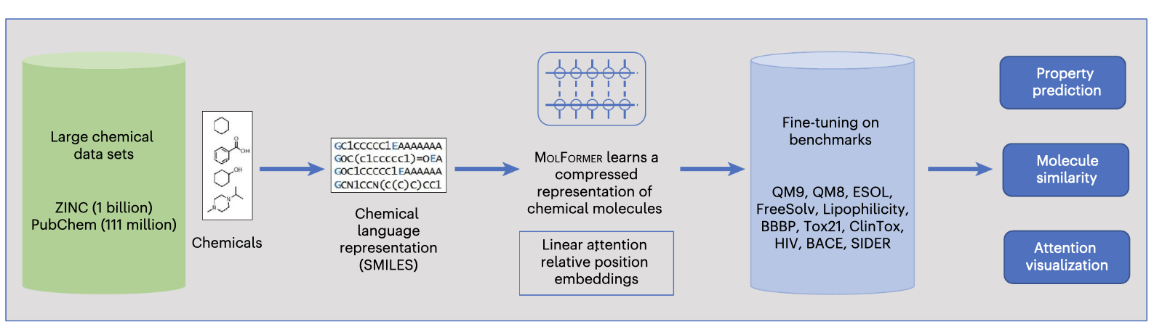
Chemical LM
Large-scale chemical language representations capture molecular structure and properties, Jerret Ross et al., Nature Machine Intelligence, 2022

Slide 18
Self and Cross-Attention
“Attend” to which tokens of the protein and lipid contribute to the interaction
Combining these profiles give a more complete picture

Slide 19
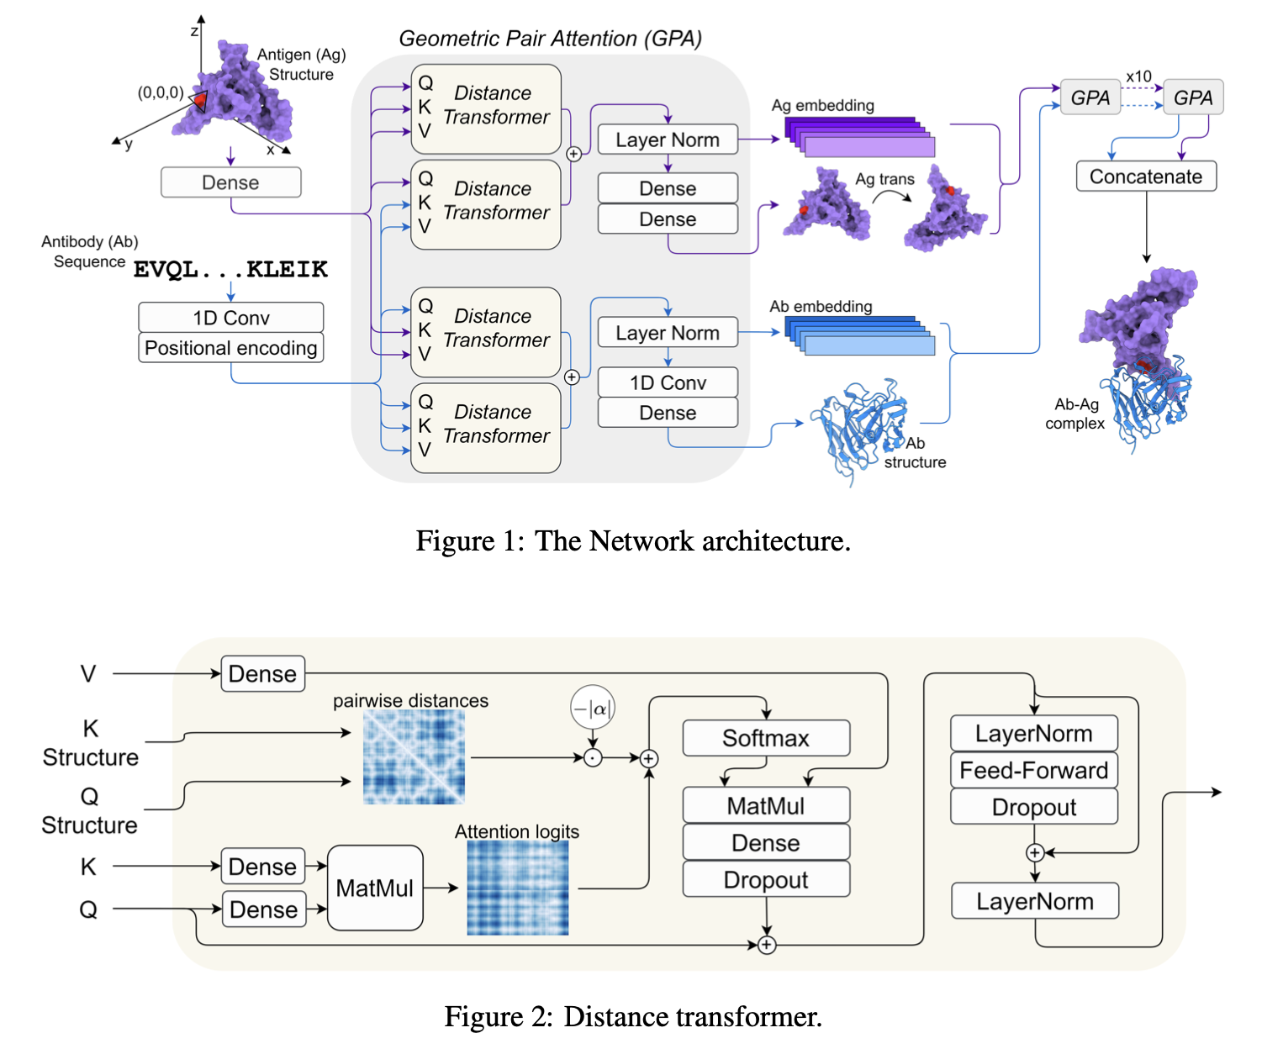
Transformer (Attention)
End-to-end accurate and high-throughput modeling of antibody-antigen complexes, Tomer Cohen, Dina Schneidman-Duhovny, NeurIPS 2022

Slide 20
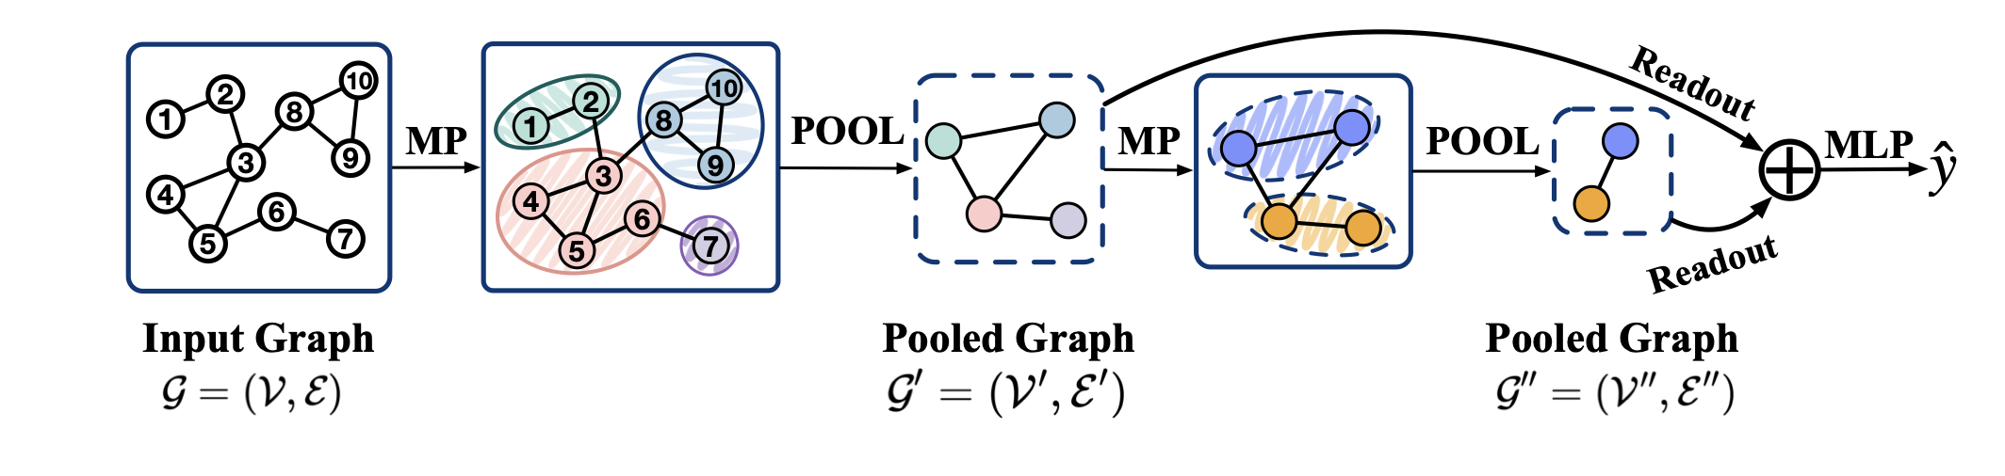
Graph pooling

Slide 21
Main points
Graph Model for Protein Structures
Language Model for Lipid Composition
Transformer for Interaction
Need to work on EGNN, Pooling, Combination of the two tracks

Slide 22
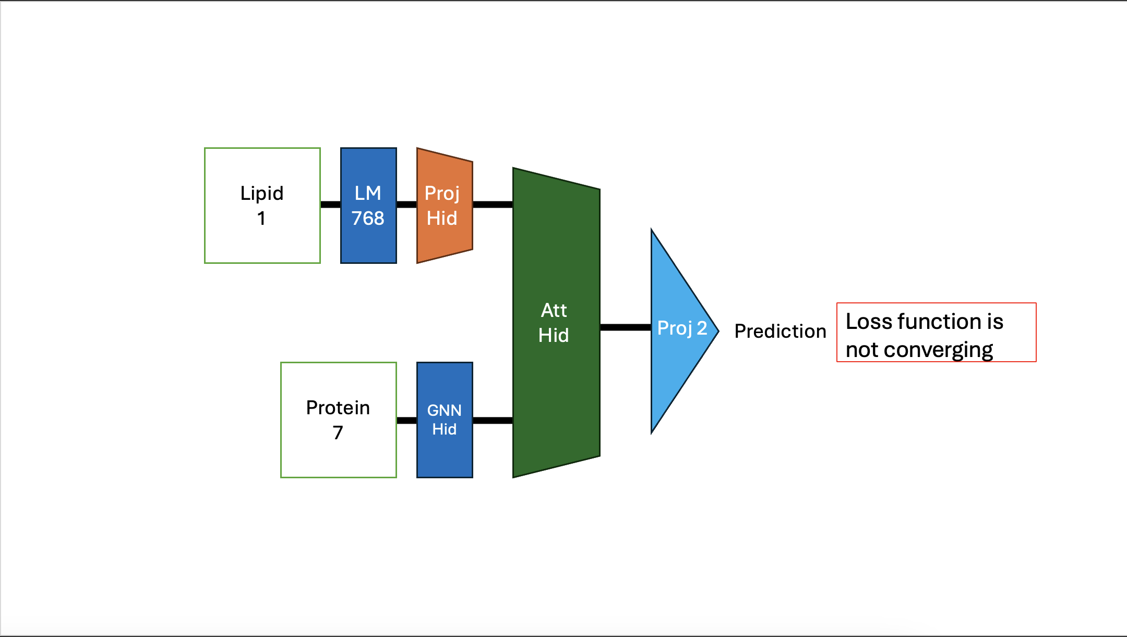
Initial Designs
Lipid
1
LM
768
Proj
Hid
Att
Hid
Proj 2
Prediction
Loss function is not converging
Protein
7
GNN
Hid

Slide 23
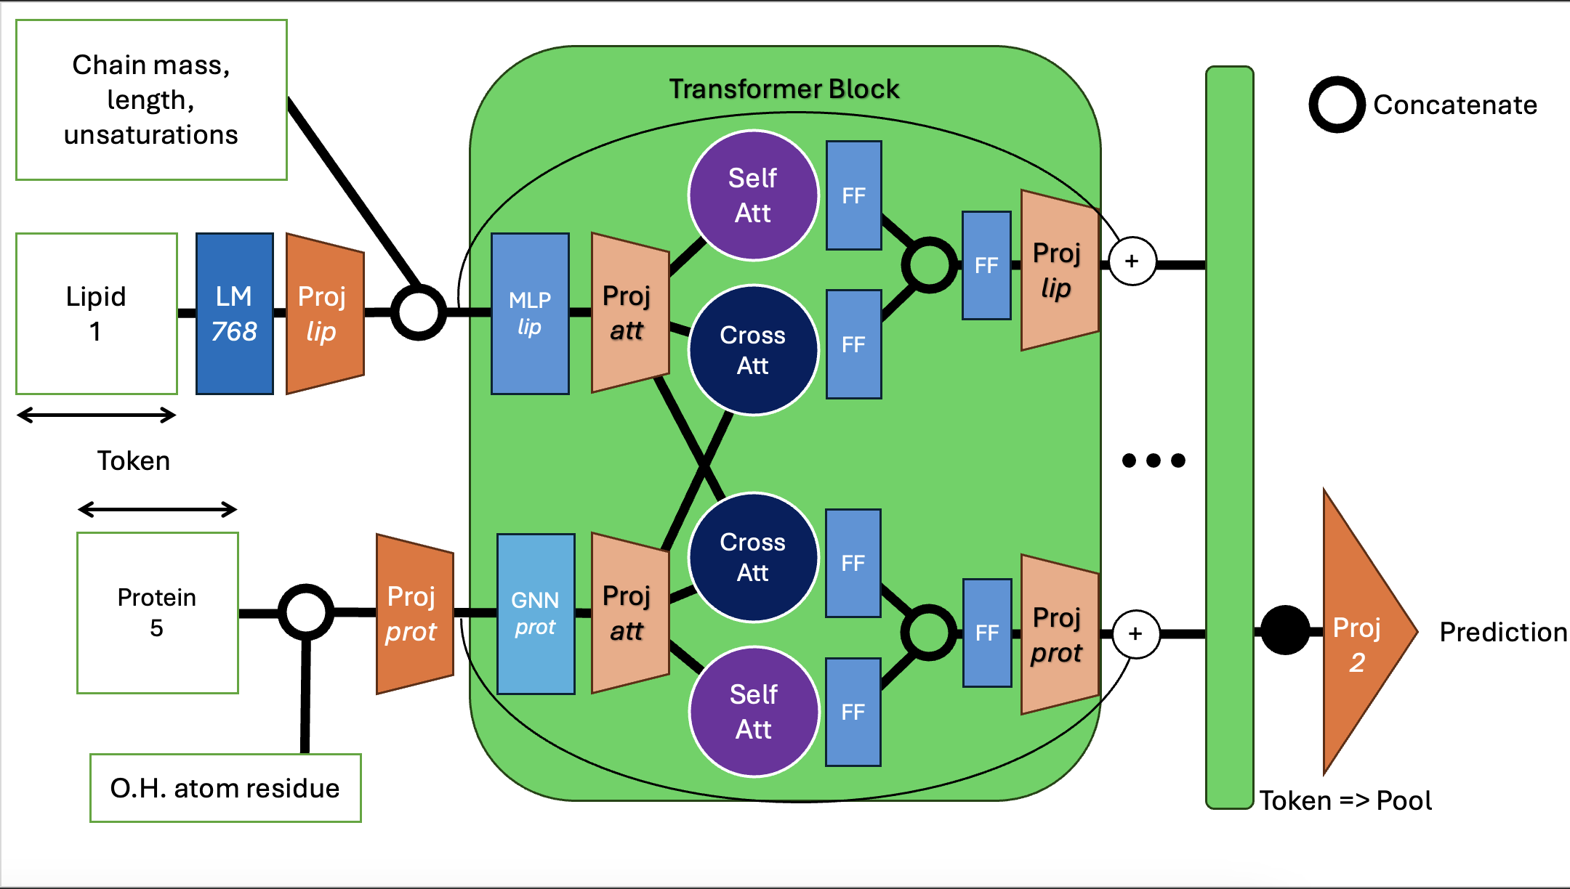
Chain mass, length, unsaturations
Transformer Block
Concatenate
Self Att
FF
FF
Lipid
1
LM
768
MLP
lip
Proj
lip
+
Proj
lip
Proj
att
Cross Att
FF
Token
Cross Att
FF
Protein
5
GNN
prot
Proj
prot
Proj
att
FF
Proj
prot
Proj
2
Prediction
+
Self Att
FF
O.H. atom residue
Token => Pool

Slide 24
Transformer Block
Lipid
+
Proj
2
Prediction
Self Att
FF
Loss
Token
Protein
Self Att
FF
+
Proj
2
Prediction
Token => Pool

Slide 25
Toy Task
Concatenate
Lipid
MLP
Self Attention
FF
Property (head group, mass, length, unsaturation)
Prediction
Protein
GNN
Self Attention
FF
Pocket
Token => Pool

Slide 26
Concatenate
Lipid
SMILES
Interaction
Prediction
Protein
Structures
Token => Pool

Slide 27
GNN ?
Protein
Pocket ?
PLM ?

Slide 28
Protein
Geometric:
AA type
SAS area
Volume
Buriedness
Pre-trained PLM:
ESM3 embeddings
Concatenate
GCN
Layer Normalisation
GAT
Projection
GCN
Projection
GCN
Family Prediction
Class (10)
Pool

Slide 29
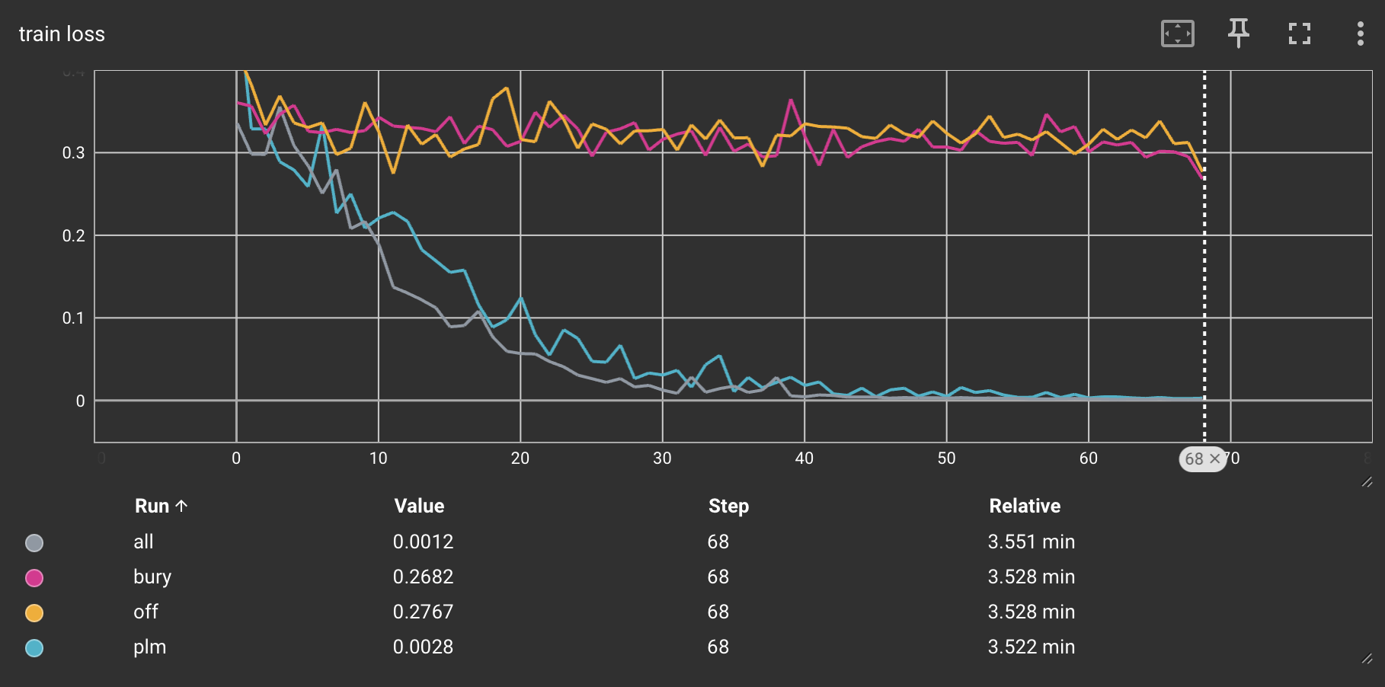
H
Learning rate : 0.001
Hidden dimensions : 32
With and without PLM embeddings
With and without buriedness
Binary Cross Entropy Loss

Slide 30
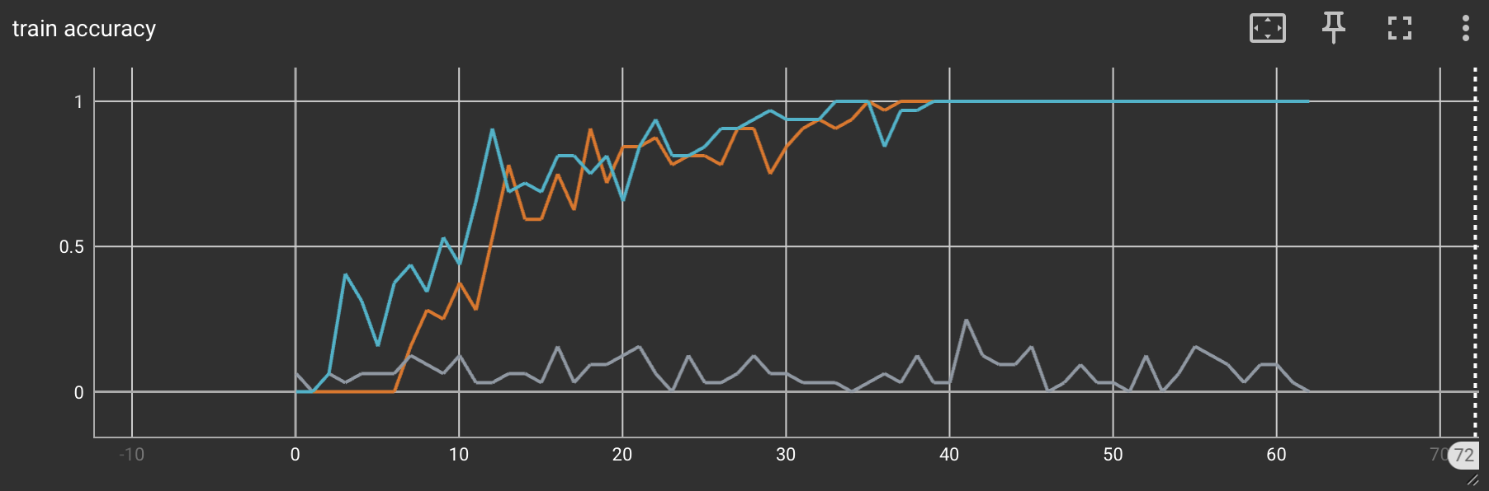
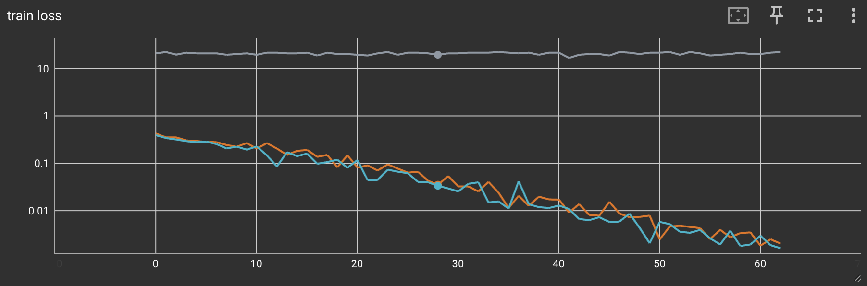
MAX and MEAN pool same performances, ADD doesn’t converge
Validation behaves the same

Slide 31
Lipid
Pre-trained CLM:
Molformer embeddings
Concatenate
N layers
Transformer
FF
Projection
Linear
Projection
Linear
Head Group (41) Prediction Class
Pool
Or <CLS> token

Slide 32
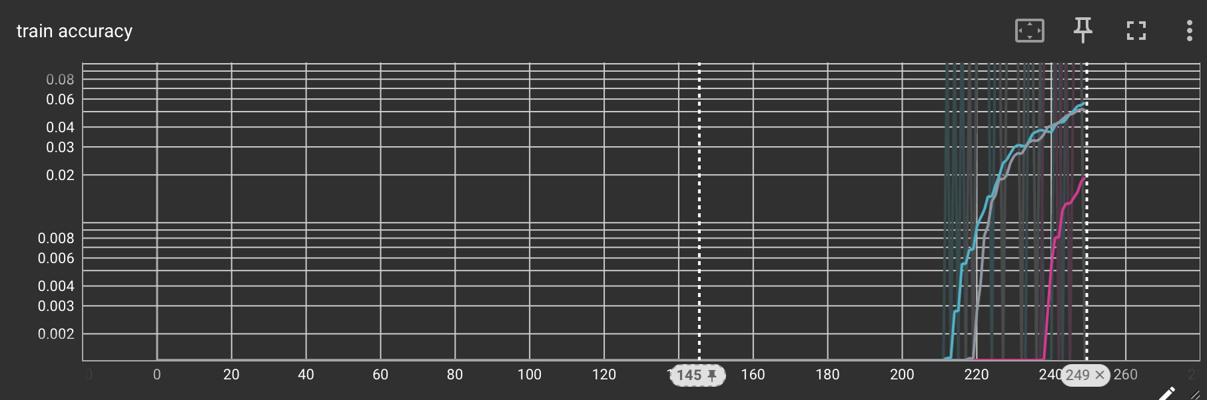
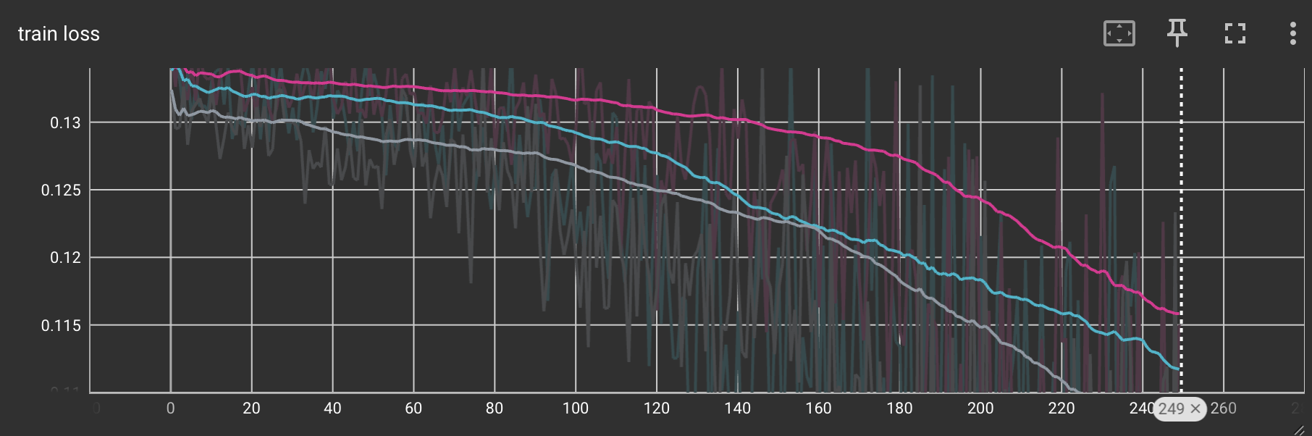
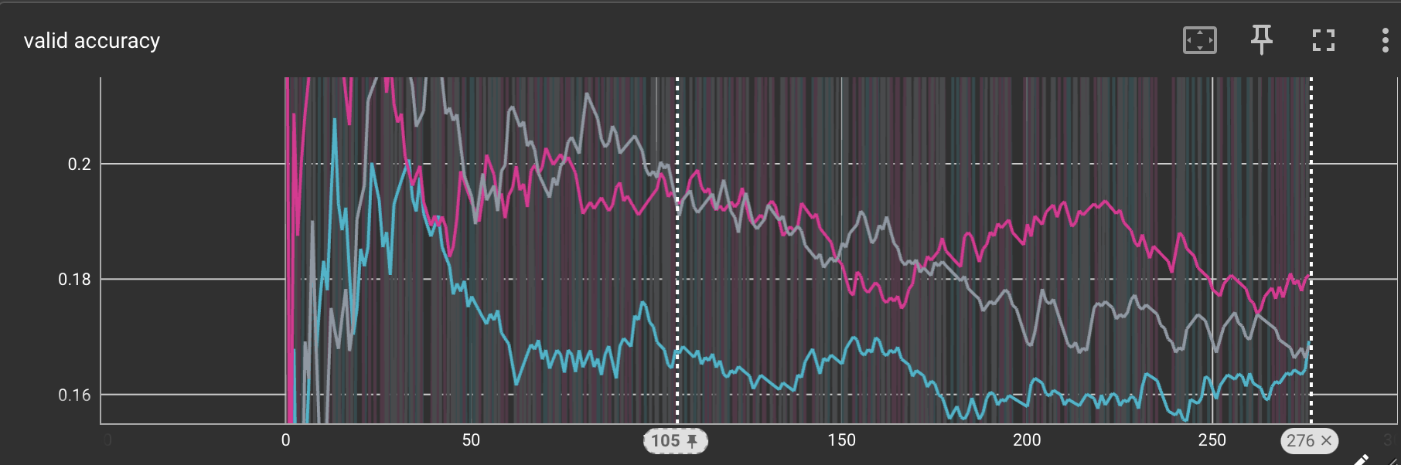
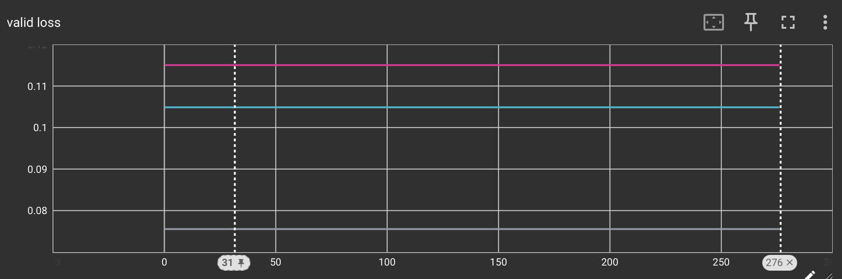
Learning rate : 0.001
Hidden dimensions : 8
Binary Cross Entropy Loss
Epoch 1
1 Layer

Slide 33
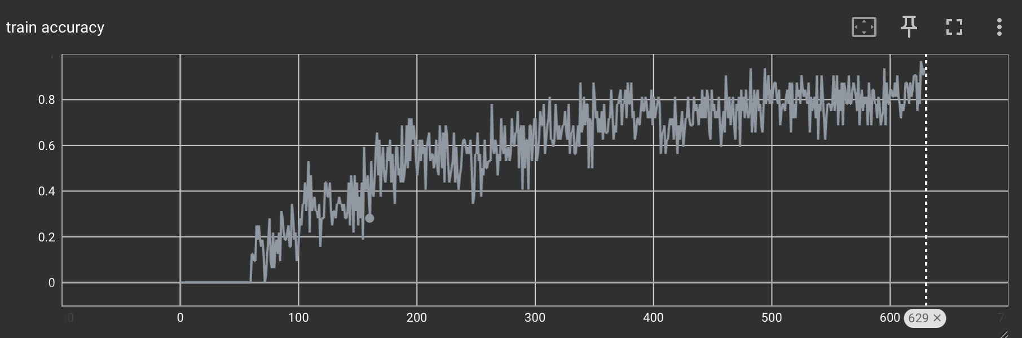
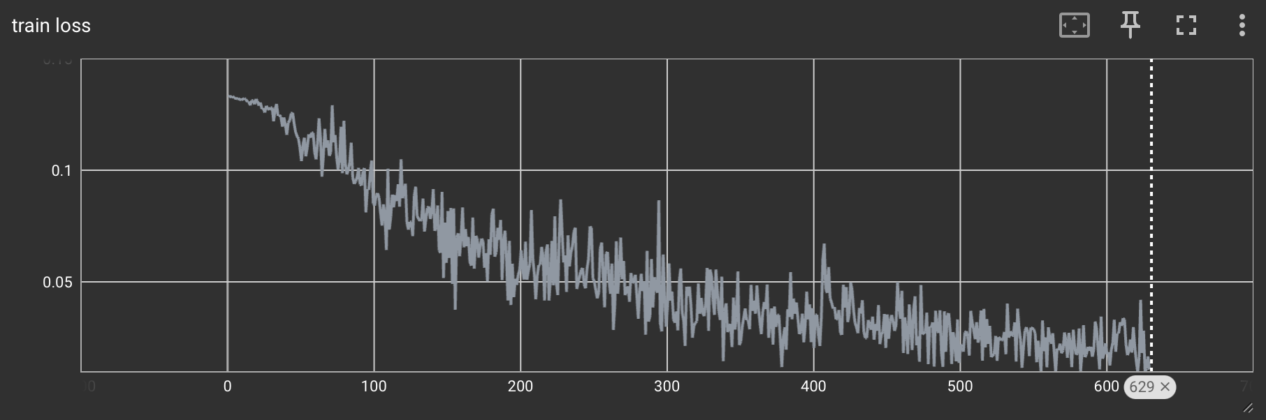
Learning rate : 0.001
Hidden dimensions : 32
Binary Cross Entropy Loss
Epoch 10
2 Layers

Slide 34
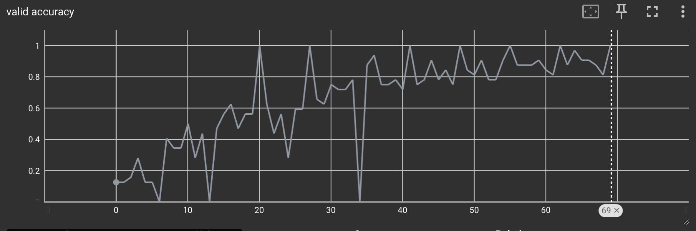
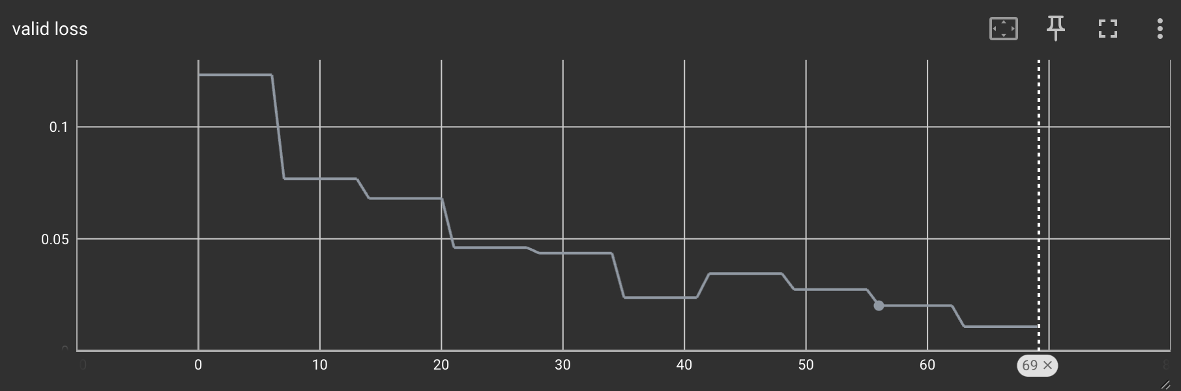
Learning rate : 0.001
Hidden dimensions : 32
Binary Cross Entropy Loss
Epoch 10
2 Layers

Slide 35
Try non structural PLM embeddings like ESM2
Test pooling only on pocket for protein family task
Combine the lipid and protein track only at the end to predict 410 classes

Slide 36
Protein
Geometric:
AA type
SAS area
Volume
Buriedness
Pre-trained PLM:
ESM3 embeddings
GCN
Layer Normalisation
GAT
Projection
GCN
Projection
GCN
Pool
Family Prediction
Class (10)
x
Head Group (41) Prediction Class
N layers
Transformer
FF
Projection
Linear
Projection
Linear
Lipid
Pre-trained CLM:
Molformer embeddings
Pool
Or <CLS> token

Slide 37
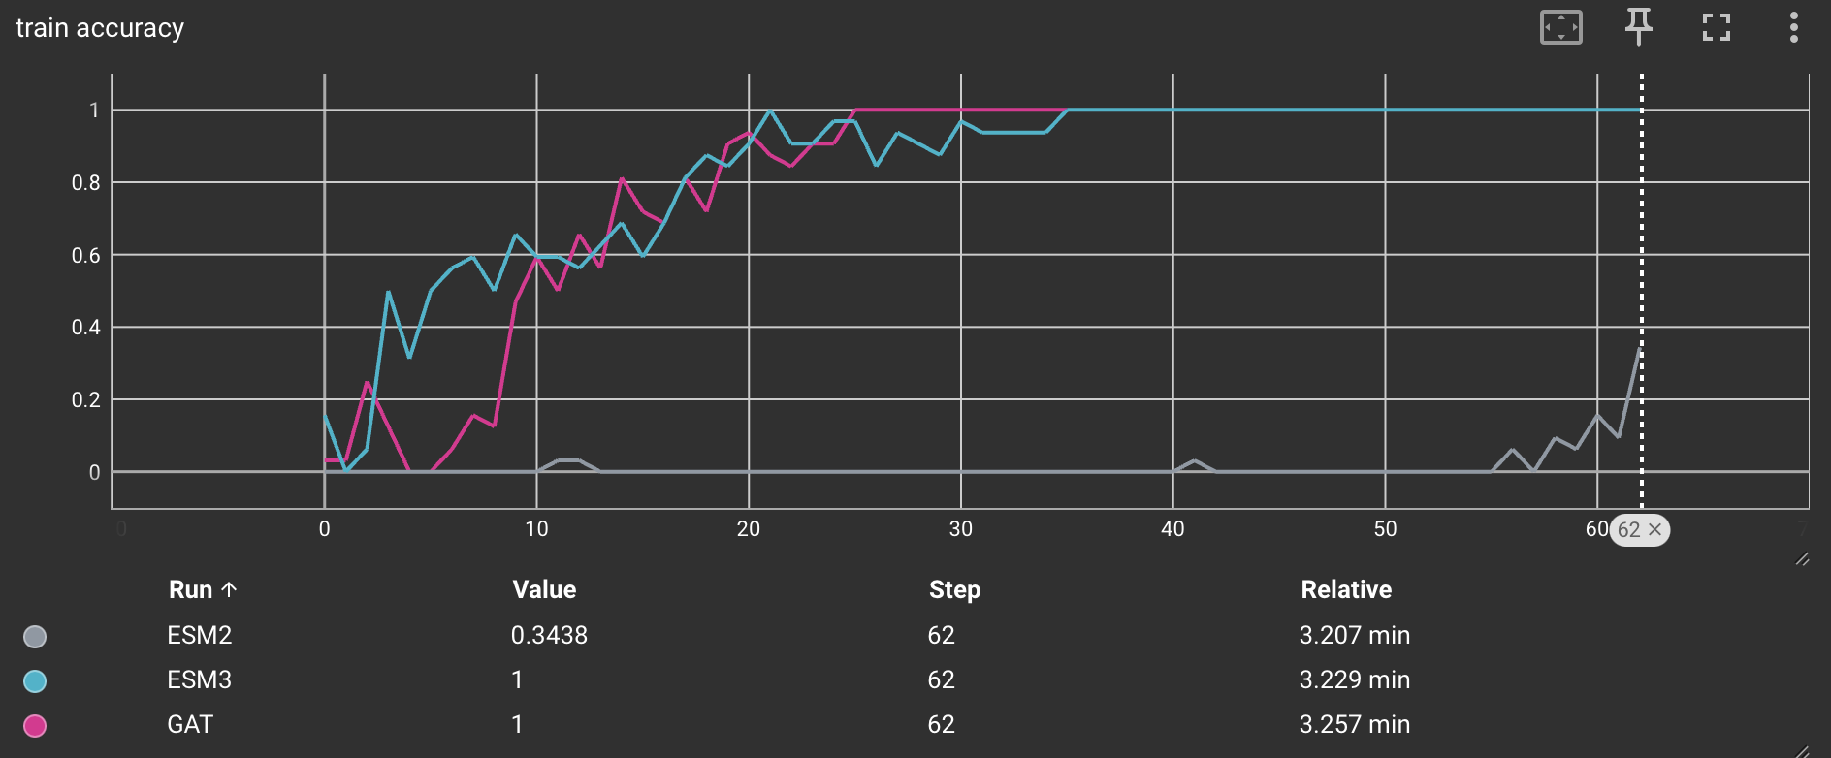
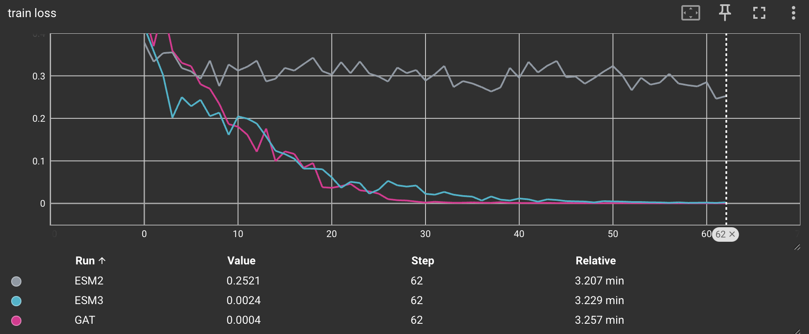
ESM3 has better results

Slide 38
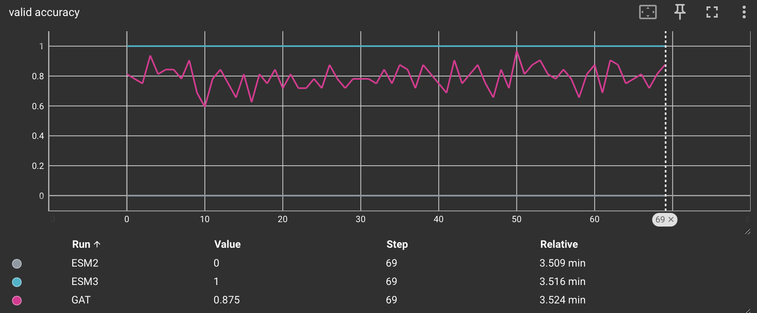
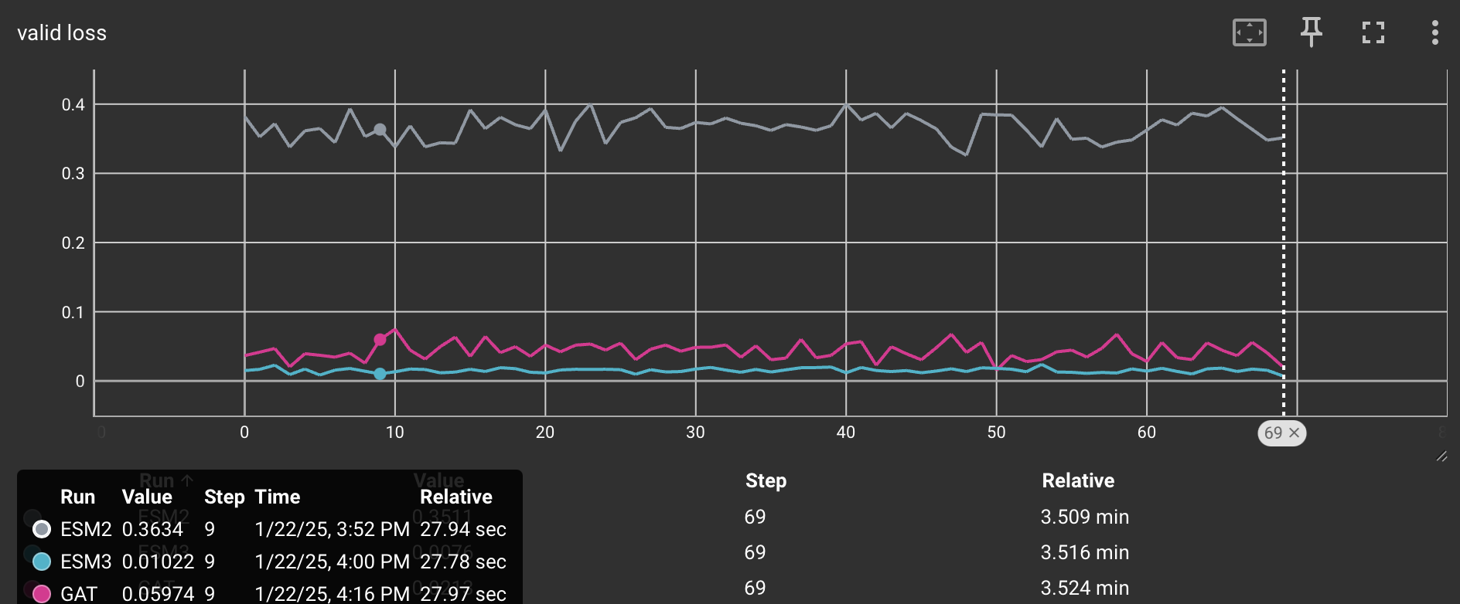
ESM3 has better results and can generalize

Slide 39
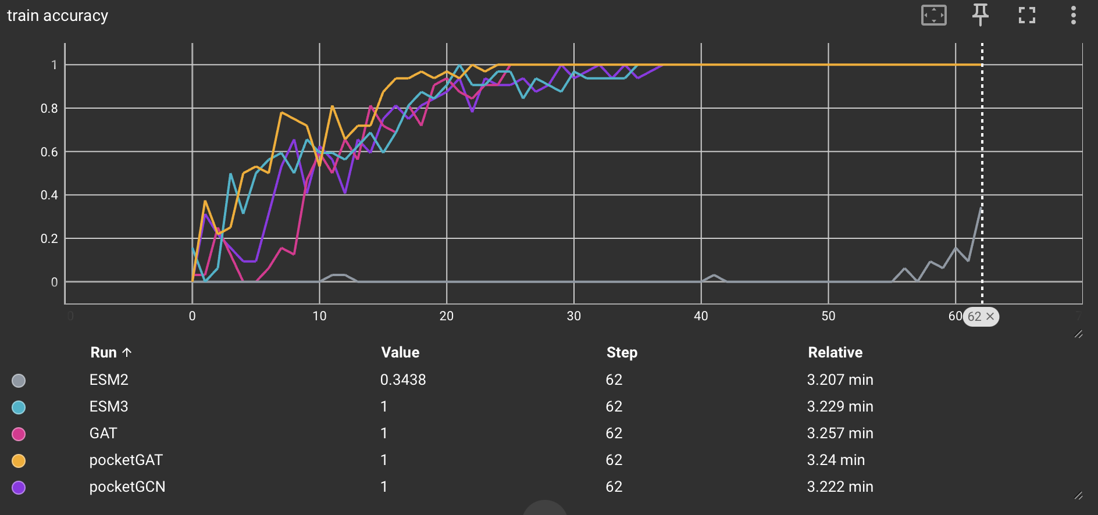
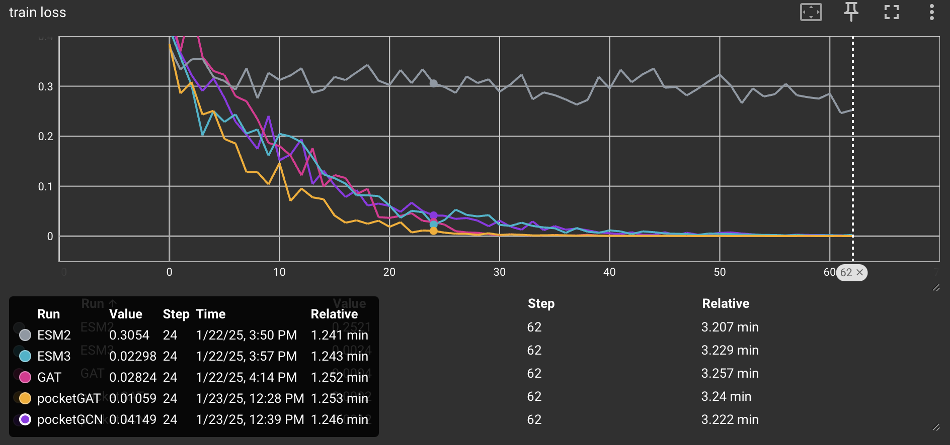
Similar results are obtained for global and pocket pool

Slide 40
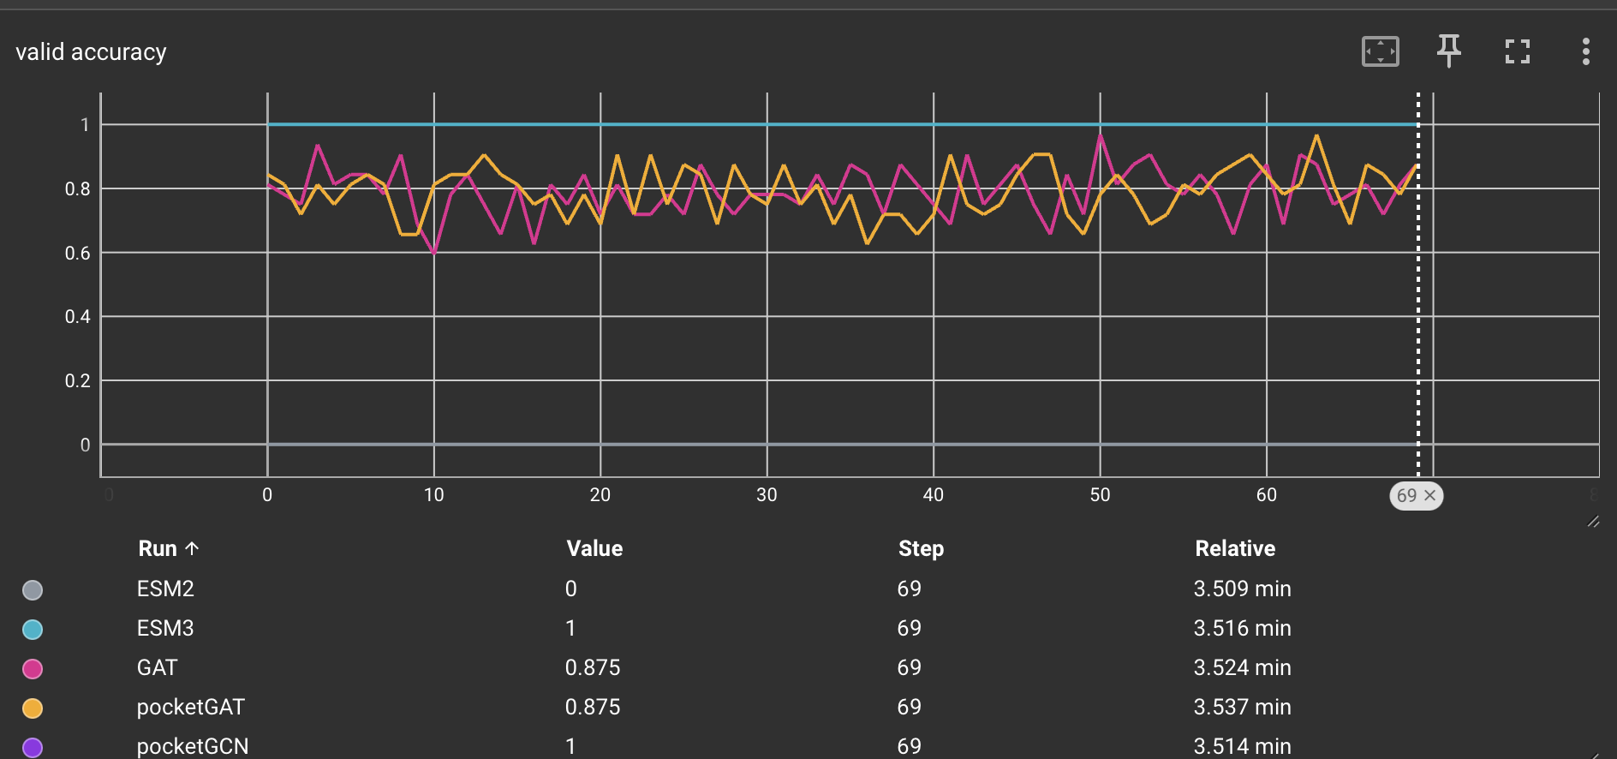
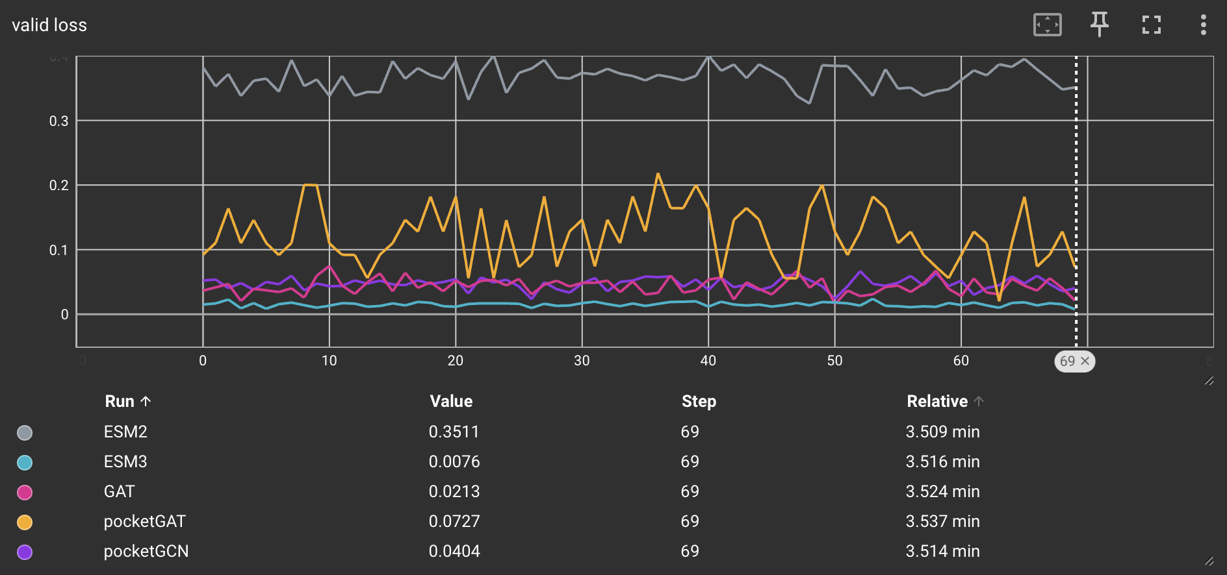

Slide 41

Pre-Trained
Chemical Language Model
Graph Neural Network
Lipid
Protein
Unraveling Transient Interactions Between Transport Proteins and Membrane Lipids
Florian Echelard, UiB

