Slide 1

https://github.com/AndroidCap/FidelitasApp/

Slide 2
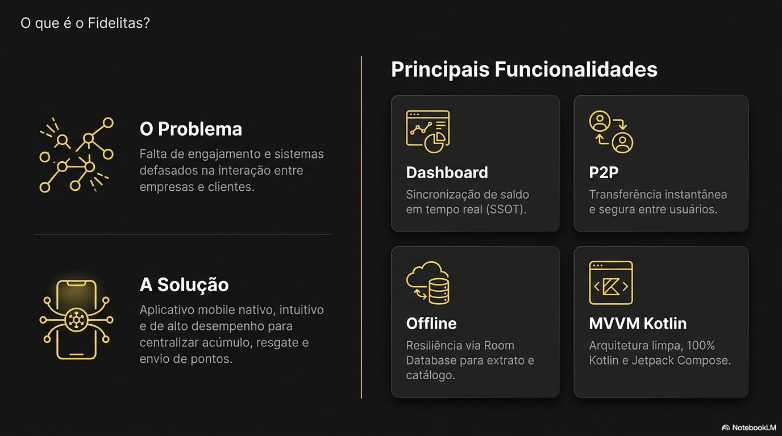

Slide 3
