Slide 1
Securing application with Access Manager and enabling delegated authorization to third party vendor using OAuth
Dissertation
(BITS ZG628T)
By
Dennis Abraham
2016HT13037
BITS, Pilani

Slide 2
Why application security?
Around 48% of world population uses internet for various reasons.
Critical operations must be secured against cyber criminals.
User’s identity can be misused for fraud and theft.
Customer experience is a deciding factor for a business.

Slide 3
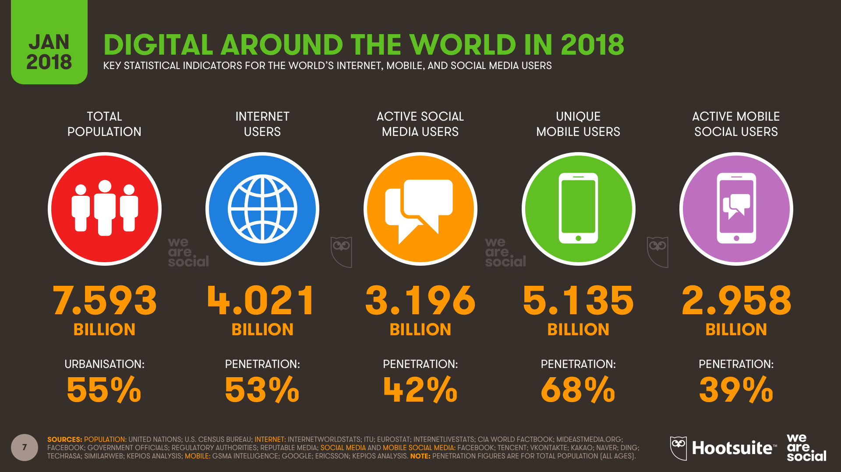
World internet users
Notes:
Source: https://wearesocial.com/us/blog/2018/01/global-digital-report-2018

Slide 4
Business goals of security
Reduce Risk — Including those from third-parties
Protect Brand Image — by projecting security and preventing leaks
Protect and Build Customer Confidence — Customer experience is driving competition
Protect and Safeguard Data — both your own and your customers
Improve Trust from customers, investors, and lenders — Mitigating risk improves trust from all parties

Slide 5
Data breaches in past
Data breaches could be accidental – absence of proper authorization checks, sharing sensitive data to public etc.
With ever increasing security, cyber criminals are using new methods to hack into secure systems such as Phishing, Social Engineering etc.
For e.g. –
Sony Data breach (PSN – 2011; Pictures - 2014)
Ashley Madison data breach (2015)
Yahoo! Data Breach (2013)- 4.3b accounts hacked
Notes:
Sony PSN data breach
The attack occurred between April 17 and April 19, 2011, forcing Sony to turn off the PlayStation Network on April 20. On May 4 Sony confirmed that personally identifiable information from each of the 77 million accounts had been exposed. The outage lasted 23 days
Roughly 77 million customers who have been affected by the outage
Sony expects the attack to cost $170 million this financial year.
Ashley Madison breach
In July 2015, a group calling itself "The Impact Team" stole the user data of Ashley Madison, a commercial website billed as enabling extramarital affairs.
The group copied personal information about the site's user base and threatened to release users' names and personally identifying information if Ashley Madison would not immediately shut down.
On 18 and 20 August, the group leaked more than 25 gigabytes of company data, including user details.
Sony Pictures 2011 breach
On November 24, 2014, a hacker group which identified itself by the name "Guardians of Peace" (GOP) leaked a release of confidential data from the film studio Sony Pictures.
The data included personal information about Sony Pictures employees and their families, e-mails between employees, information about executive salaries at the company, copies of then-unreleased Sony films, and other information.

Slide 6
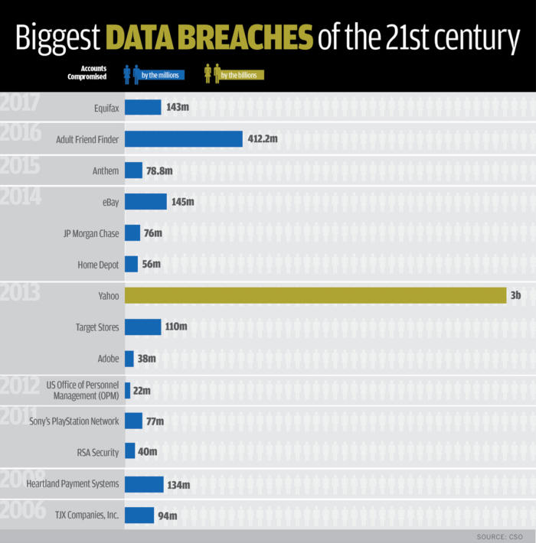
Notes:
Source: https://www.csoonline.com/article/2130877/data-breach/the-biggest-data-breaches-of-the-21st-century.html

Slide 7
Identity and Access Management(IAM)
Identity and access management (IAM) is the security discipline that enables the right individuals to access the right resources at the right times for the right reasons.
IAM addresses the mission-critical need to ensure appropriate access to resources across increasingly heterogeneous technology environments, and to meet increasingly rigorous compliance requirements like Multi-factor authentication, Geo IP blocking, Blacklisting, etc
Enterprises that develop mature IAM capabilities can reduce their identity management costs and, more importantly, become significantly more agile in supporting new business initiatives.
Notes:
Authentication
Authorization
Role Based Access Control (RBAC)
Attribute Based Access Control (ABAC)

Slide 8
Oracle Access Manager(OAM)
Oracle Access Manager is Oracle Identity Management’s solution for web access management and user identity administration.
It protects resources against unauthorized and unauthenticated access.
The Access System secures applications by providing centralized authentication, authorization and auditing to enable single sign-on and secure access control across enterprise resources.
Notes:
Using version OAM 11g R2 PS2
OAM does support latest security measures like OTP, Device fingerprinting, IP validation, encrypted communication
Custom java plugins could be employed to make use of Third-party security measures like RSA AA and Trusteer Rapport
Provides granular authorization measures straight out-of-the-box providing temporal, LDAP filter based, attribute based authZ

Slide 9
OAuth 2
The OAuth 2.0 authorization framework enables a third-party application to obtain limited access to an HTTP service, either on behalf of a resource owner by orchestrating an approval interaction between the resource owner and the HTTP service, or by allowing the third-party application to obtain access on its own behalf.

Slide 10
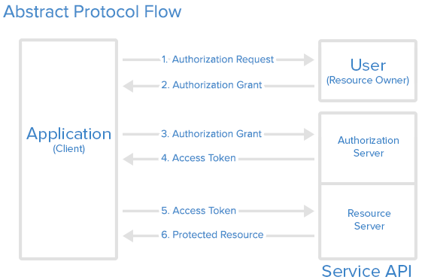
OAuth 2 (contd.)
Notes:
OAuth has four roles-
Resource Owner
Client
Resource Server
Authorization Server
Authorization Grant has four types-
Authorization Code: used with server-side Applications
Implicit: used with Mobile Apps or Web Applications (applications that run on the user's device)
Resource Owner Password Credentials: used with trusted Applications, such as those owned by the service itself
Client Credentials: used with Applications API access

Slide 11
Basic terminology
Authentication
Authorization
REST services
MVC architecture
Java Persistence API
Spring Boot
Hibernate
Notes:
1. Authentication
Authentication is the process of determining whether someone or something is, in fact, who or what it declares itself to be. It is process of validating one’s identity against reliable source. In OAM’s context user credentials are validated against configured ID store.
2. Authorization
Authorization is the process of determining if an authenticated user is entitled to access a stated resource or execute a stated operation. In practice, authorization depends on role of the user. For e.g. Admin can create users, but is not authorized to do bank transactions
3. REST services
While REST stands for Representational State Transfer, which is an architectural style for networked hypermedia applications, it is primarily used to build Web services that are lightweight, maintainable, and scalable. REST is not dependent on any protocol, but almost every RESTful service uses HTTP as its underlying protocol.
4. MVC Architecture
Model View Controller or MVC as it is popularly called, is a software design pattern for developing web applications. A Model View Controller pattern is made up of the following three parts −
Model − The lowest level of the pattern which is responsible for maintaining data.
View − This is responsible for displaying all or a portion of the data to the user.
Controller − Software Code that controls the interactions between the Model and View.
5. Java Persistence API
The Java Persistence API (JPA) is a Java specification for accessing, persisting, and managing data between Java objects / classes and a relational database.
6.Spring Boot
Spring Boot is a Spring framework module which provides RAD (Rapid Application Development) feature to the Spring framework. It is highly dependent on the starter templates feature which is very powerful and works flawlessly.
7.Hibernate
Hibernate ORM (Hibernate in short) is an object-relational mapping tool for the Java programming language. It provides a framework for mapping an object-oriented domain model to a relational database. Hibernate handles object-relational impedance mismatch problems by replacing direct, persistent database accesses with high-level object handling functions.

Slide 12
The project setup
Online Banking application (OLB)
Aggregator client
Oracle Access Manager (OAM)
Database
OAuth authorization server and resource server

Slide 13
Online Banking application(OLB)
OLB is a rudimentary bank web application which allows authorized customers to do bank operations like -
View user profile
Cash deposit
Transfer money
OLB supports two user roles –
Customer (user)
Admin
Notes:
User is stored in embedded LDAP store of OAM
Each user has two additional properties set- username and employeetype
Username – username of the user
Employeetype- User role either admin or user

Slide 14
Online banking Application (OLB)
OLB application is developed using Spring Boot and implementing MVC architecture
Bank related user information is stored in MySQL 8.0 Database
JPA and Hibernate framework are used to make data persistence abstract and simple to implement.

Slide 15
OLB users - Admin
Admin user is a user with role as ‘admin’ in ID store.
OLB application allows admin following operations-
Search user (customer)
Create User
Create Branch
Admin is not authorized to make any bank transactions.

Slide 16
OLB Users- Customer
Customer is a user with role as ‘user’
Customer is authorized to execute following operations-
View own profile
Cash deposit
Money transfer
Customer is not authorized to do admin level operations.

Slide 17
OLB user role evaluation
OLB has a page - /ui/evaluate
This page retrieves USERTYPE header populated by authorization policy of OAM
If the value is user, redirect user to customer home page - /ui/home/<username>
Else if value is admin, redirect to user search page- /ui/admin/searchuser

Slide 18
Aggregator
Aggregator is a simple OAuth Client that requests access to user bank details.
It requests the user details via OAuth authorization code flow.
It has a static Client_ID and secret to identify itself during OAuth flow.

Slide 19
Oracle Access Manger (OAM)
OAM is a middleware product which provides secure authentication, granular authorization to protected resource.
In this project, OAM provides protection to OLB resources.
Three authorization polices have been configured to ensure a user can access only those resources he is entitled to.

Slide 20
Oracle Access Manger (OAM)
The authorization policies are-
OnlineBanking_AuthZPolicy
OnlineBanking_AuthZPolicy_Customer
OnlineBanking_AuthZPolicy_Admin
Notes:
OnlineBanking_AuthZPolicy - Authorization policy for protecting Online Banking application allowing all authenticated users
OnlineBanking_AuthZPolicy_Customer - Authorization policy for protecting Online Banking application allowing only Customers
OnlineBanking_AuthZPolicy_Admin - Authorization policy for protecting Online Banking application allowing only Admin users

Slide 21
Oracle Access Manger (OAM)
OAM allows responses to be set in authentication and authorization policies post user is authenticated and authorized respectively.
Authentication policy sets USERNAME and USER_ROLE post authentication as session variables
These session parameters are used in Authorization policy to set Headers – USERNAME and USERTYPE
Notes:
Three types of responses are allowed –
Session – Available only for OAM use
Cookie – Available for protected resource
Header – Available for protected resource

Slide 22
Oracle HTTP Server(OHS)
Oracle HTTP server is a web server based on Apache server. It can only host static pages.
OHS has webgate plugin installed, hence it could intercept all HTTP requests at OHS listen port 7777
A reverse proxy must be configured between OLB application running at 9000 and OHS running at 7777

Slide 23
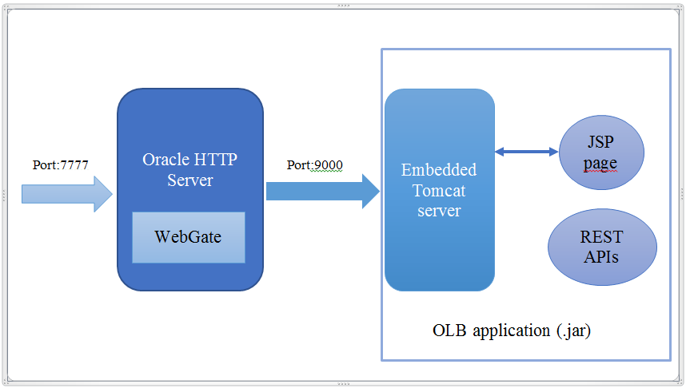
OHS reverse proxy

Slide 24
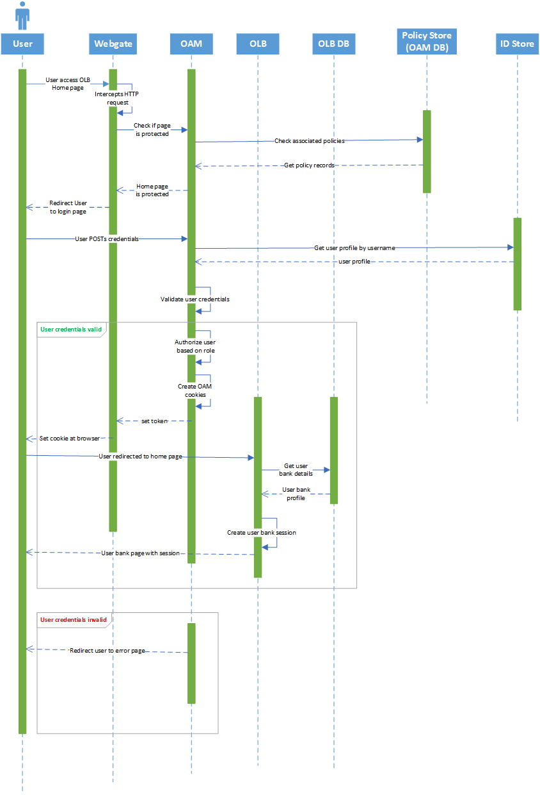
Sequence diagram for OLB

Slide 25
Database
In this project, two database are used – Oracle 11g and MySQL 8
Oracle contains Schema required for OAM. No other data is persisted in Oracle database
All other data – OLB and OAuth related data is persisted in MySQL database

Slide 26
OAuth authorization and resource server
OAuth requires OAuth Authorization server to authorize client requesting access to resource owner protected details.
Authorization server generates authorization code and access token.
Client gets access to Resource owner protected resource in exchange of access token.

Slide 27
DEMONSTRATION

Slide 28
Challenges encountered
One of the biggest hurdle was OAM setup.
OAM is a heavy product with multiple co-dependent software-
WebLogic server
Oracle Database 11g
Database schema configuration
Oracle HTTP Server 11g
Webgate 11g

Slide 29
Challenges encountered
The installation had started with OAM 11g PS3
After facing multiple bugs and performing reconfigurations, it was decided to downgrade to 11g PS2 instead.
Some minor, but critical configuration were done to make the OAM setup work.
Implementing OAuth was also a big challenge

Slide 30
Conclusions
OAM is an able middleware product which can handle real-time customer requests, in order of thousands per few seconds. OAM is being used by numerous Fortune 500 companies to keep their data secure.
OAuth is a improved delegated authorization specification. It is being incorporated by countless applications worldwide.

