Slide 1
Losses incurred by the TSPs due to shifting from Voice to VoIP
AAYUSH GUPTA 2013B3A3652P
PRADEEP BANERJEE 2013A3PS274G

Slide 2
What Is OTT?
OTT – Over The Top Content
Service Provider offering Information Communication Technology
Does not use TSP network
Relies on global internet network
Hence low price for usage
Examples: WhatsApp, Facebook, Skype

Slide 3
Rise of VoIP
Technology improvement - voice into packets of data
Exponential increase in data transfer speeds from 1G to 4G
Increasing popularity of OTT apps like WhatsApp, Skype, Viber

Slide 4
Decline of Traditional Calling
Rough estimates show loss of Rs.5000 cr. to telecom companies
Loss may soar to Rs.16000 cr. in next 2-3 years.
SMS sent per day fallen to 2 per user – (check percentage decline - yearly)

Slide 5
Research Objectives
To find out the current losses incurred by the telecom industry due to subscribers switching from voice calling to VoIP.
To estimate the time in which voice calling over OTT will surpass traditional calling techniques in terms of monetary returns

Slide 6

Why This Research?
Calculation of the losses to the telecom companies
With impending net neutrality, estimation of losses is necessary to justify the stance of the TSPs
If justified, in due course regulations on OTT applications can be eased
To make people aware of the shifting trend from traditional voice calling to VoIP

Slide 7
Research Methodology
Identify Gaps
Tools Used
Analyze Situation

Slide 8
Identify Gaps
Large variation in the number of subscribers for each company
Variety of data schemes available
Statistical data kept confidential by TSPs

Slide 9
Research Tools Used
Smart phone with android v2.1 or above
WhatsApp application of v2.12.0.1 or above
Data monitor application
Internet connection – data pack

Slide 10
Analyze Current Situation
Acquire a 3G connection on 3G enabled smartphone
Make VoIP calls using WhatsApp for 5 mins
Calculate average number of MBs consumed for the same
Calculate the average cost per MB of data consumed using data schemes available of different TSPs
Calculate the total cost of making this call
Calculate total profit/loss incurred by the TSPs
Install data monitor
Calculate the cost if the call was a simple voice call

Slide 11
Assumptions
Rational consumer – cheaper is better
Consumer buys 1GB, 3G data pack only
Every WhatsApp user buys a data pack
WhatsApp calling for 20 mins/day per user
Whole subscriber population has prepaid connection

Slide 12
Cost Comparison – Different modes of calling
20 Min. Call | Rate | Data Usage | Cost(in Rs.)
With 2G data pack | Rs.200/1GB | 15MB | <1
With 3G data pack | Rs.250/1GB | 15MB | 3.66
Traditional voice calling | 2p/sec | N/A | 24
Without 3G data pack | 4p/10kB | 15MB | 61.44
Only 1GB data plans are considered
Airtel plans have been taken for comparison

Slide 13
Graphical Comparison

Slide 14
Calculation of Loss
Top 4 TSPs market share = 73.34%

Slide 15

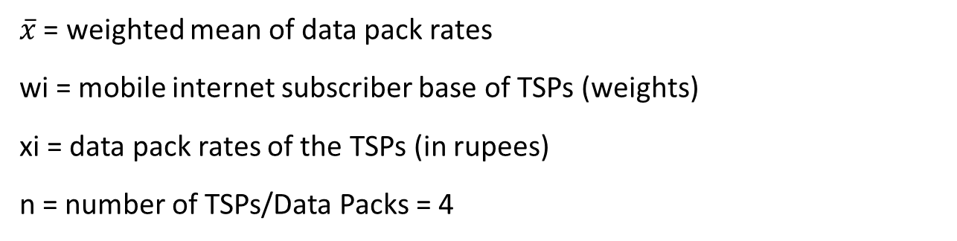
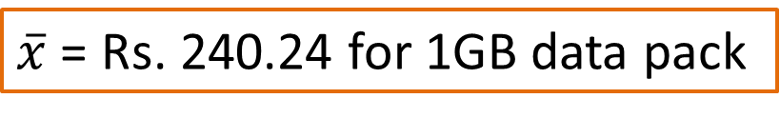
Calculation of Loss(Cont.)
$\overline{x}$ = weighted mean of data pack rates
wi = mobile internet subscriber base of TSPs (weights)
xi = data pack rates of the TSPs (in rupees)
n = number of TSPs/Data Packs = 4
$\overline{x}$ = Rs. 240.24 for 1GB data pack

Slide 16
Calculation of Loss(Cont.)
Loss incurred = (potential traditional-voice-call revenue) – (revenue earned through data packs)
For a 20 min. call:
Loss_{STD} = Loss_{local} = Rs. 24 – Rs. 3.52
= Rs. 20.48

Slide 17
Recommendations
Revenue Share Model
Partial Share in Spectrum Purchase
Quality Of Service (QoS)

Slide 18
Quality of Service
DEFINITION: The collective effect of service performance which determines the degree of satisfaction of a user of the service indicating the performance of a broadband network and of the degree to which the network conforms to the stipulated norms

Slide 19
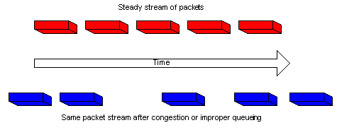
Challenges Faced By VoIP
PROBLEM 1:
Jitter: Refers to the variation in the delay of received packets. Jitter is a typical problem in packet switched network. The quality of voice calls over IP reduces due to this effect.
Solution: Use a jitter buffer.

Slide 20
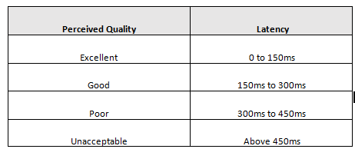
Challenges Faced By VoIP (Cont)
PROBLEM 2:
Latency: Refers to delay in data transmission from source to destination. Causes delay in the transmission of voice and the receiver gets a delayed response.

Slide 21
Solution: Time prioritization of traffic by marking packets with ToS values
Challenges Faced By VoIP (Cont.)

Slide 22
Challenges Faced By VoIP (Cont.)
PROBLEM 3:
Bandwidth: Defined as bit rate measure of available or consumed data communication resources. Sharing of bandwidth leads to degradation of quality of VoIP calls.
Solution: 1. Simple, purchase more bandwidth
2. Sacrifice other data types

Slide 23

Security Threats in VoIP
Leakage of data
Several cases of leakage of confidential data and personal photographs.
Applications like Oreka convert IP voice conversations to simple .wav files.
Unauthorized access to data packets
Tapping IP packets at nodes.

Slide 24
Prevention Against Voip Hacking
Dedicated network for VoIP
Proper authentication mechanism
Security measures like captcha codes.
More complex encryption
Dedicated firewall and intrusion detection and prevention system

Slide 25
Thank You

