Slide 1

Katalon & AWS Device Farm
By Andrew Nixdorf
Maximizing Test Coverage with Katalon Studio
Minimize Costs with AWS Device Farm
Testaholics Anonymous

Slide 2

Agenda
Welcome
Who we are ?
Why Katalon and AWS ?
Demo
Q&A
Submit questions and topics
Notes:
Submit topics: http://goto.testaholics-anonymous.com/topics

Slide 3
Who are we ?
We are a bunch of engineers from all walks of life with one thing in common, a passion for all things QA.
We love learning new skills, expand our knowledge of all things testing, and spend time in the company of our fellow engineers.
In order to feed our addiction to testing, we hold quarterly workshops (don't forget your laptop!) and (virtual) monthly fireside chats, presentations and round tables.
Join us !
Notes:
Are you curious, like to explore the latest trends, want to grow your automation skills?
We are a bunch of engineers from all walks of life with one thing in common, a passion for all things QA. We love learning new skills, expand our knowledge of all things testing, and spend time in the company of our fellow engineers.
In order to feed our addiction to testing, we hold quarterly workshops (don't forget your laptop!) and (virtual) monthly fireside chats, presentations and round tables.
We hunger for knowledge, so please reach out to our organizers if you have a skill or tool you'd love to share, a topic you feel especially passionate about or if you want to participate as a SME in one of our roundtables. If speaking in public is not your thing, but you have a topic you want to learn more about, please let us know. We have a vast network of contacts, so the chance is great we know someone that can help us hone our craft.

Slide 4

Corporate Sponsor
Slalom Build
Consulting company specialized in delivering
"custom build technology solutions as a service", helping companies accelerate their digital transformation journey by blending design, product engineering, analytics and automation.
Notes:
Before we get started, I wanted to take a moment to thank our corporate sponsor “Slalom Build”
Slalom Build is a consulting firm specialized in delivering "custom build technology solutions as a service", helping companies accelerate their digital transformation journey by blending design, product engineering, analytics and automation.
Slalom Build is currently looking for developers and quality engineers of all levels. Manual testers with an aptitude and interest in automation are encouraged to apply. We are currently developing a uBuild program to build up your automation skills.
For more information of Slalom Build, please visit: slalombuild.com.

Slide 5
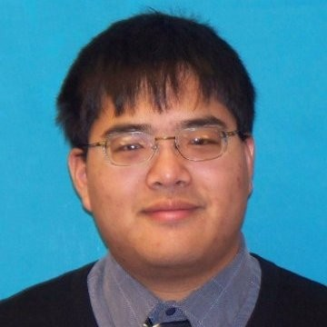
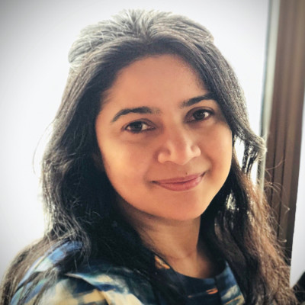
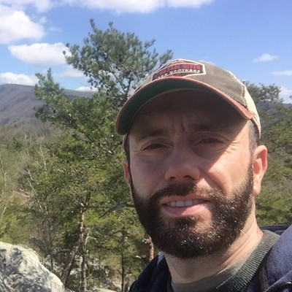
Organizers
David Tan
Karlin Kappala
Sven Thirion
www.linkedin.com/in/qaninja/
www.linkedin.com/in/kkappala/
www.linkedin.com/in/thirion/
Notes:
Testaholics Anonymous organizers are David Tan, Karlin Kappala and Sven Thirion

Slide 6
Who is Andrew Nixdorf ?
https://www.linkedin.com/in/andrewnixdorf/
I’m a lead SDET working at Zywave creating insurance solutions. I live in Reno Nevada and have a passion for QA and Software Testing.
I found the Testaholics group online and it was exactly the group I needed. A bunch of brilliant like minded individuals all with the same passion for quality software.
Notes:
Are you curious, like to explore the latest trends, want to grow your automation skills?
We are a bunch of engineers from all walks of life with one thing in common, a passion for all things QA. We love learning new skills, expand our knowledge of all things testing, and spend time in the company of our fellow engineers.
In order to feed our addiction to testing, we hold quarterly workshops (don't forget your laptop!) and (virtual) monthly fireside chats, presentations and round tables.
We hunger for knowledge, so please reach out to our organizers if you have a skill or tool you'd love to share, a topic you feel especially passionate about or if you want to participate as a SME in one of our roundtables. If speaking in public is not your thing, but you have a topic you want to learn more about, please let us know. We have a vast network of contacts, so the chance is great we know someone that can help us hone our craft.

Slide 7
Katalon and AWS
The Why and How

Slide 8
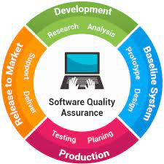
What is the ‘Issue’ we are trying to solve?
Simple Answer… Produce QUALITY SOFTWARE!
Test Coverage designed to be Customer Centric
What did the user experience?
Many factors contribute to Quality
App Experience
Website Experience
Customer Support.
A Seamless User Experience.
How do we Produce Quality Software?
Test before giving the product to our customers (auto/manual)
Provide feedback to the developers making the product
Provide feedback to integrations teams and analysts
Automate as much as possible

Slide 9
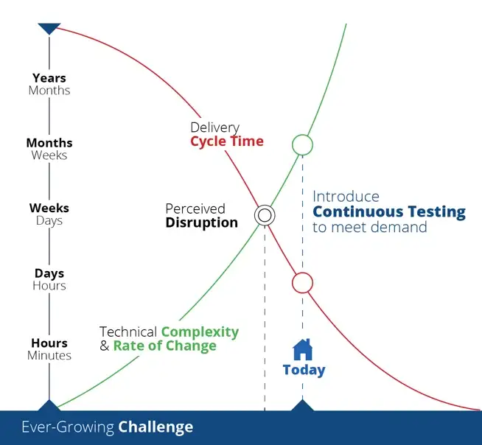
Complexity in Testing
Many different user experiences
Process might require being done in a specific order
Role Access and Boundaries
Different Browsers
Screen Sizes
Operating Systems
Geographical Location
The more complex the software is,
the longer it takes to deliver with confidence.

Slide 10
Ensure Reliable User Experience with Katalon
Create Secure Infrastructure Suitable for Testing
Designing Test Cases around a user story
Test for failure (Make sure the errors show up)
Use multiple environments (dev, staging, uat, production)
Test the same user story across devices and environments
Create Tests with purpose and be clear about their purpose(s) as they would relate to the end user.
Send a clear message to all the people receiving the test results.
Don’t try to do everything all at once.

Slide 11
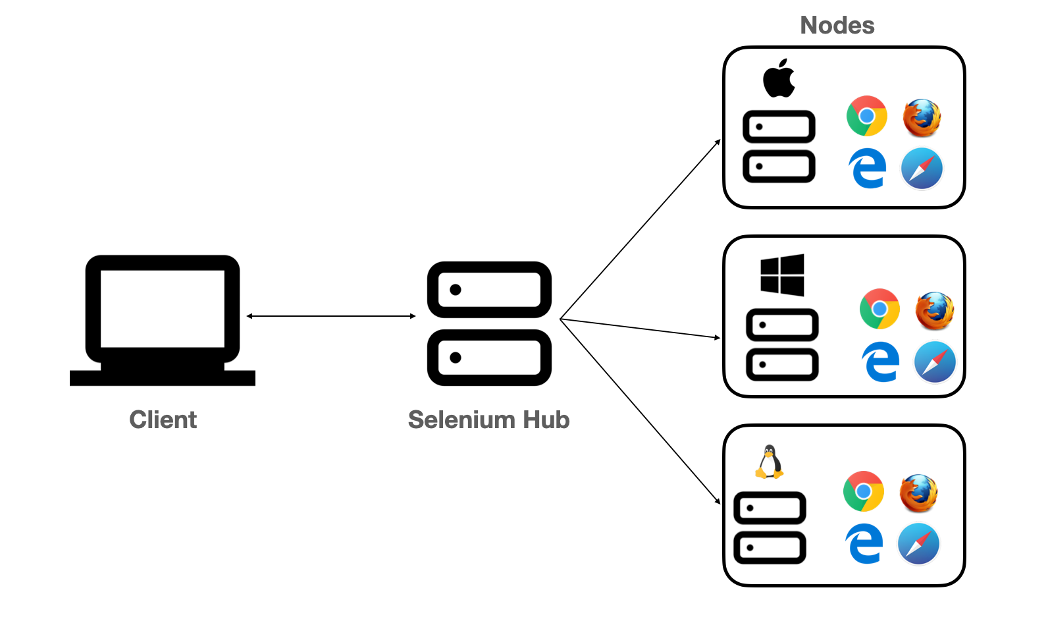
When and How to Scale?
At some point in your testing journey, you start to understand that waiting 8 hours for testing to complete is just unacceptable. Results are needed quicker so people can get back to work.
Parallel Testing on a Selenium Grid
Instead of running one test at a time, tests are run in batches
Most grid providers price their grids based on max number of concurrent user sessions.
Build vs. Buy
Lot’s of options for a grid…

Slide 12
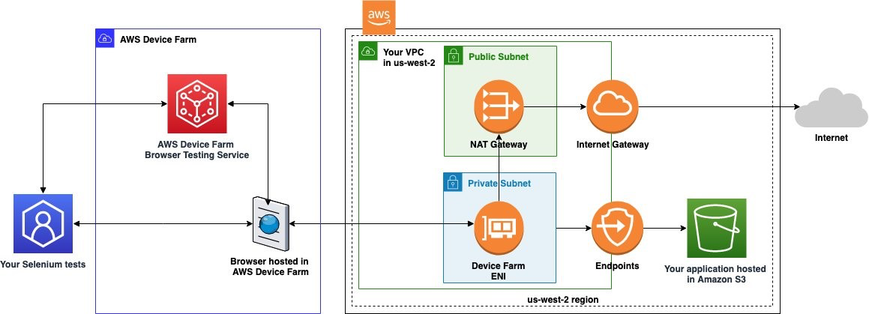
Why AWS Device Farm?
CHEAPEST option out there (behind running it on your own servers)
Unlimited parallel concurrent sessions
You’re only billed for what you use
Avoid cost of paying a developer to setup, maintain, secure grid
Securely runs in private VPC

Slide 13
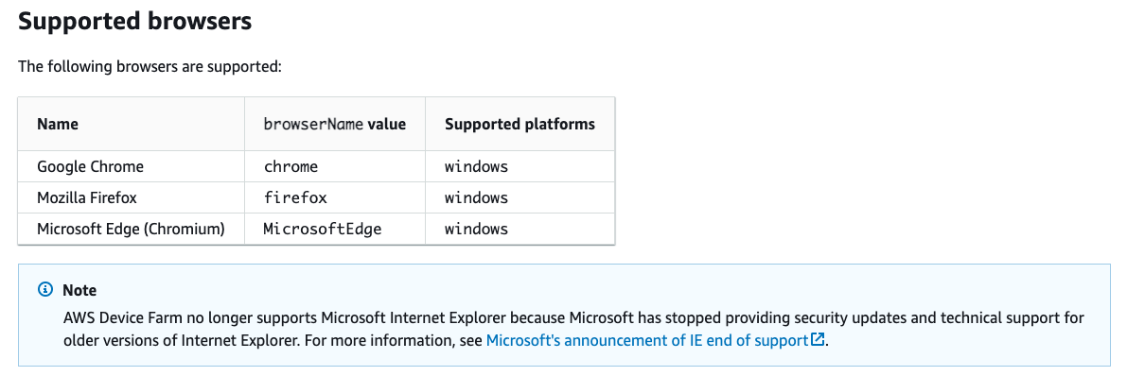
AWS Device Farm Limitations
Device Farm does not take many of the desired capabilities that other grids allow interaction with
Basic Set of Browsers

Slide 14
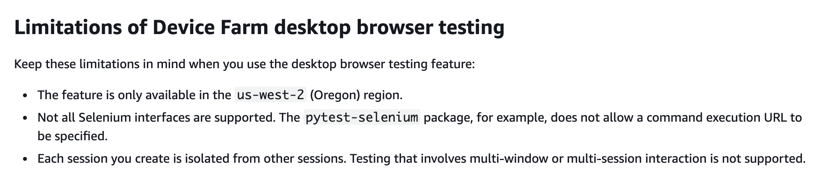
AWS Device Farm Limitations Continued…

Slide 15
AWS Infrastructure Best Practices and Benefits
Limit AWS access to user groups based on need of resources
Roles and Policies keep your organization safe
Grant Permissions based on an “As-Needed” policy
Multiple AWS Accounts = Multiple Environments
Environments designed to isolate and control potential bleed over from unwanted behavior
Separation of user permissions to limit unwanted malicious behavior
Developers have escalated permissions in lower environments while having little to no access to production systems
Limits a disgruntled employee from disrupting an application or site
Try it, before you break it
Plan for disaster recovery and intentionally break stuff

Slide 16
AWS Kickstarter Pro
Project kickstarts a typical professional software organization.
Most secure terraform AWS kickstarter out there.
Use ‘root’ to setup, then try to avoid using ‘root’ at all costs.
Requires very little little prior knowledge of terraform
Users will run `terraform init` and `terraform apply`
Requires very little prior knowledge of AWS
Organization setup has been designed with basic IAM policies for developers and pipeline roles.
To be used in a real organization, IAM policies would need to be tailored

Slide 17
Setup AWS & Terraform Kickstarter Pro
AWS FREE TIER
Install terraform
https://github.com/AndroidNextdoor/aws-kickstarter
https://github.com/AndroidNextdoor/aws-core-modules-tf

Slide 18
Why Katalon? Why Selenium?
Testing Large Complex Applications
Data Driven Testing
Appium for Mobile Testing
Visual Testing
Easy to use
Easy to train
Allows custom integrations with any java package
Automated testing started very quickly
Faster time to feedback from the customer
Sessions seem to mock user interaction more accurately than Cypress

Slide 19
Setup Katalon Studio – Standalone Edition
Download Katalon Studio- Standalone Edition
Follow these special instructions if you are on a Mac with Intel Processor and have upgraded to Ventura
https://github.com/AndroidNextdoor/katalon-aws-workshop
Let’s start the Katalon demo using the AWS infrastructure we just setup!

Slide 20
For Mobile Projects
Supports Appium and mobile testing
https://github.com/katalon-studio-samples/aws-device-farm-integration

Slide 21
Call for speakers
Previous talks - 2022
Testing in times of COVID: how the Pandemic changed QE
From Manual to Automation Engineer in 60 minutes
Workshop: Automating Your Manual Tests With Python & Selenium
Terratest your Terraform: Locally! using LocalStack
The Road Ahead - Testing Trends for 2022
CyberSecurity! Why is it Important?
Cypress in the Wild - A Full End 2 End Testing Solution
Locked & Loaded - A Brief Introduction on Artillery
Slalom QE Academy - Get Paid to become a Quality Engineer!
Postman Essentials
Tech Talk: Selecting your E2E Test Automation Tool

Slide 22
Testaholics: Upcoming Events
On Deck: API testing using Python by (David T)

Slide 23



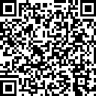
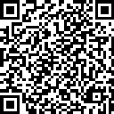
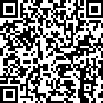
Join Us
Meetup
LinkedIn
Slack

