Slide 1
College Connect
Erin Colgrove, Jackson Tisler, Matt Betanski, Tyler Freeman

Slide 2
FileIO

Slide 3
GUI

Slide 4
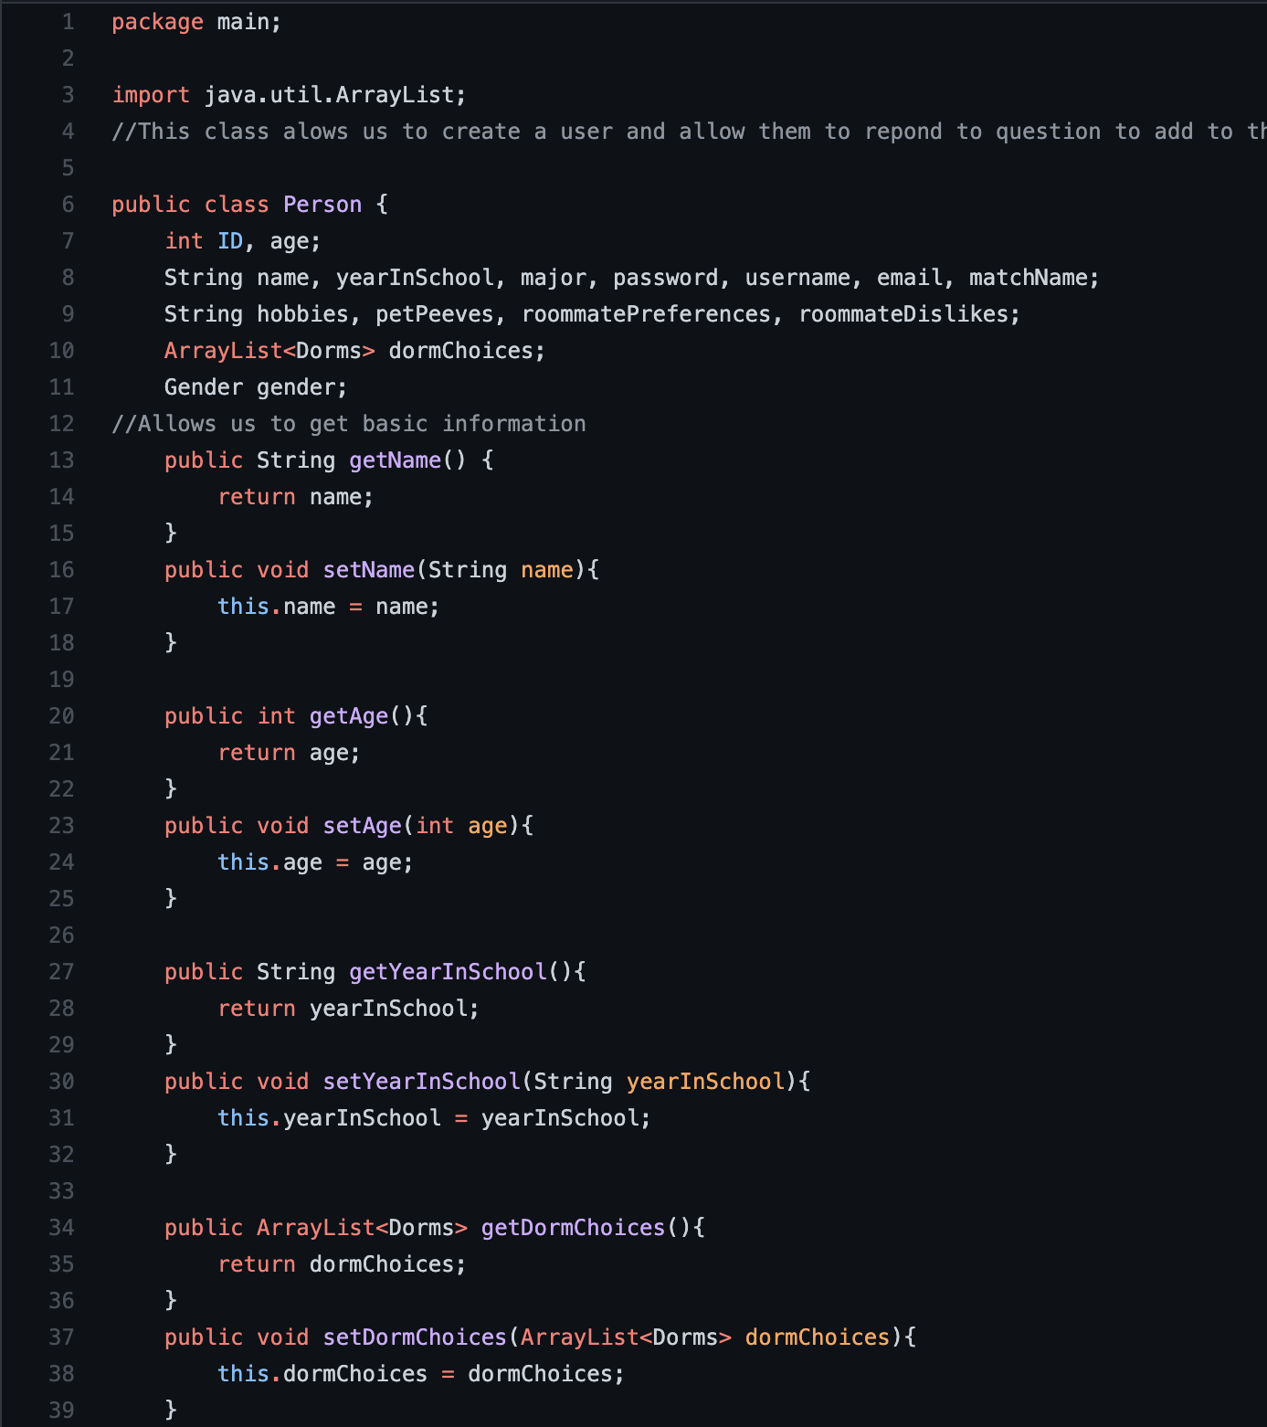
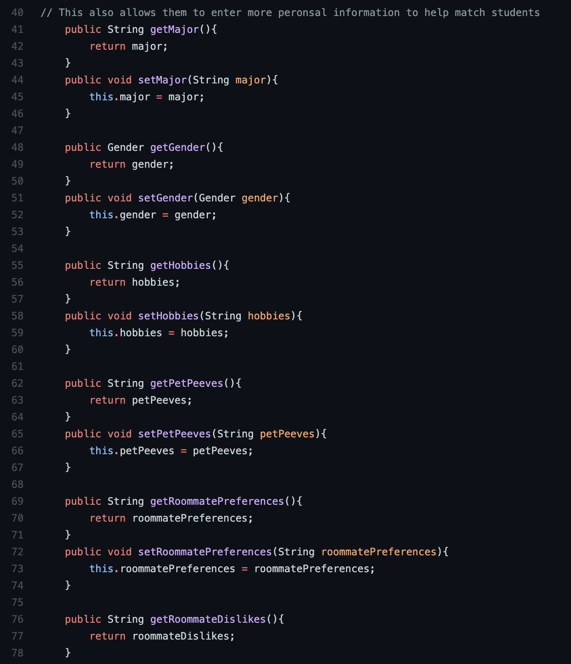
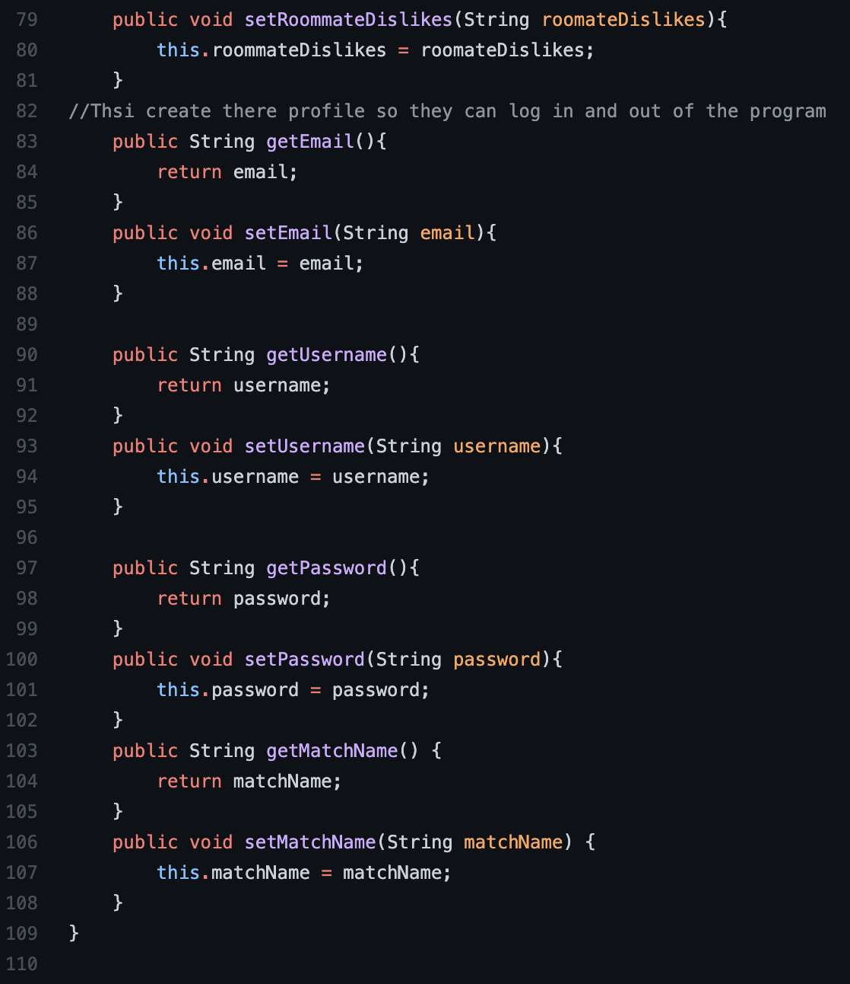
Person Class

Slide 5
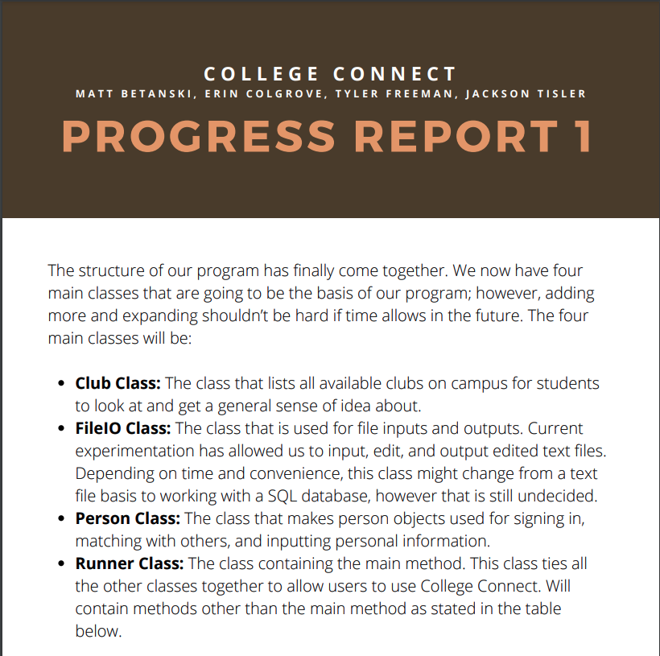
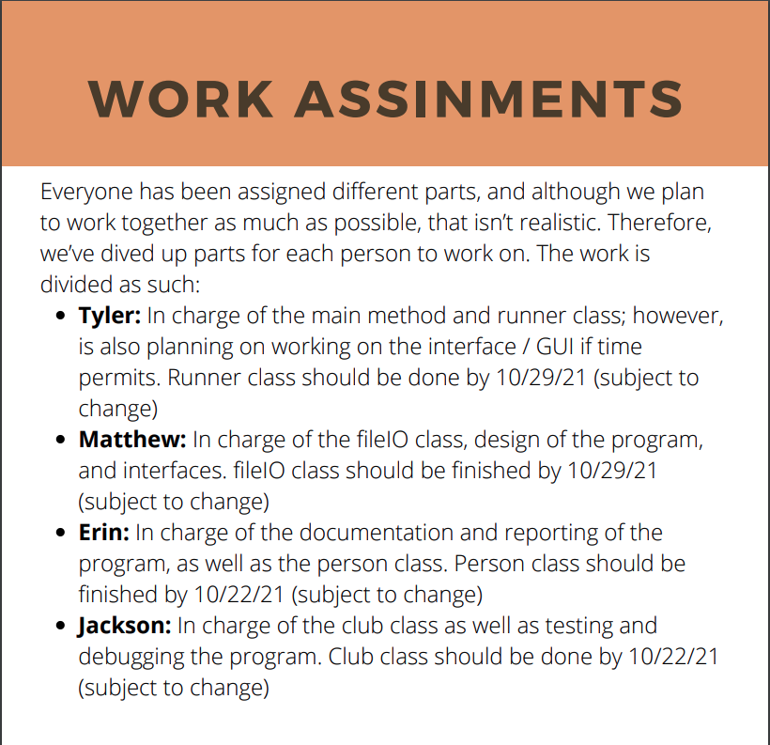
Progress Report1

Slide 6
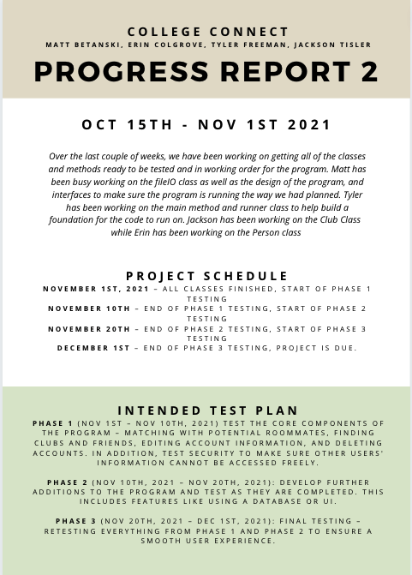

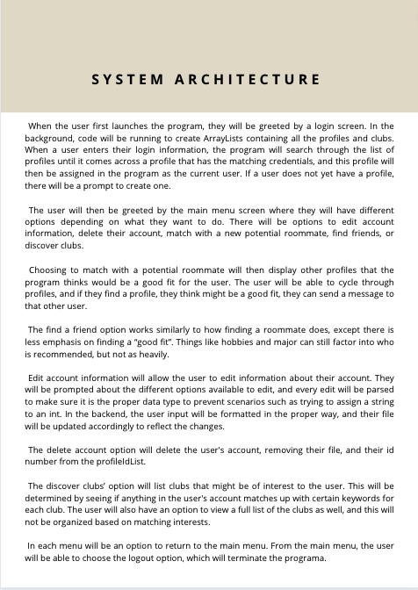
Progress Report 2

