Slide 1
BugVITa
Aashish 19BCE0971
Priyanshu 19BCE0550
Srikanth 19BCE0158

Slide 2
Abstract:
Bug Tracking/Issue Tracking(Project Management tool)
It is a simple tool that provides a list of errors and bugs encountered by the developers during the development process. It will provide a summary of each bug that is reported,along with details such as the description of the bug,who has logged the bug, etc. It will use a database to store this list. The application will retrieve this list each time a user opens up the application so they are always working with the latest list of bugs/errors. It includes basic features like adding, deletion and searching for bugs, refresh bug list. Each bug report will have basic attributes like it’s name, bug description,name of the person who generated the bug, estimated time to fix it, etc. Furthermore, we aim to create an application that we ourselves can use in our projects in the future.

Slide 3
Product Description:
The ‘Bug Tracking System’ tool used to track bugs and issues of a project or a software. It helps the developers and other stakeholders to keep track of outstanding problems with the product
It will store a list of all the bugs/issues created in a database.
The project team can work on the bugs and fix them, Once done, a bug can be marked as ‘resolved’.
Testers can add bugs and issues that they find.

Slide 4
SCOPE:
The scope of this presentation is to give a basic idea about the concept of the project and also, a first glance at the GUI design that will be implemented.
Bug and issue tracking systems are often implemented as a part of integrated project. Some bug trackers are designed to be used with the distributed revision control software. These distributed bug trackers allow bug reports to be conveniently read, added to the database or updated while a developer is offline. Recently, commercial bug tracking system have also begun to integrate with distributed revision control. “All types of bugs” tracking systems are conventionally viewed as a distinct type of software, so we will develop a bug/issue tracking software for all types of bugs.
It is outside the scope of this presentation to provide details about the backend implementation/architecture.

Slide 5
Stakeholders:
Stakeholders are the people who are directly or indirectly involved in the project and will either be developing or using the software there are two categories of stakeholders internal and external. Internal stakeholders are ones who are involved in making the software and external stakeholders are people who will be using the software. The stakeholders involved in our project are

Slide 6
Internal StakeHolders:
Project Manager : Aashish
Responsible for managing time and deadlines of the project such as creating a gantt chart and keeping the teams within the deadlines, all the members contribute to project management equally.
Project Team: Aashish,Srikanth and Priyanshu
Project team consists of 3 people and we are responsible for creating and managing the development of the project.

Slide 7
External Stakeholders:
- Software Developers:
They are the users(customers) that will use
the software to aid them in the development of their software.
Not only will they be able to remotely keep track of bugs among their team but also be able to prioritize the bugs based on their nature and impact on the software.
- Software Testers/Users:
They will be testing the software to see if there exists any exploits or bugs in the system, they will be the users that will report any bugs that have not been foreseen in the development phase and thus send the feedback to the developer team.

Slide 8
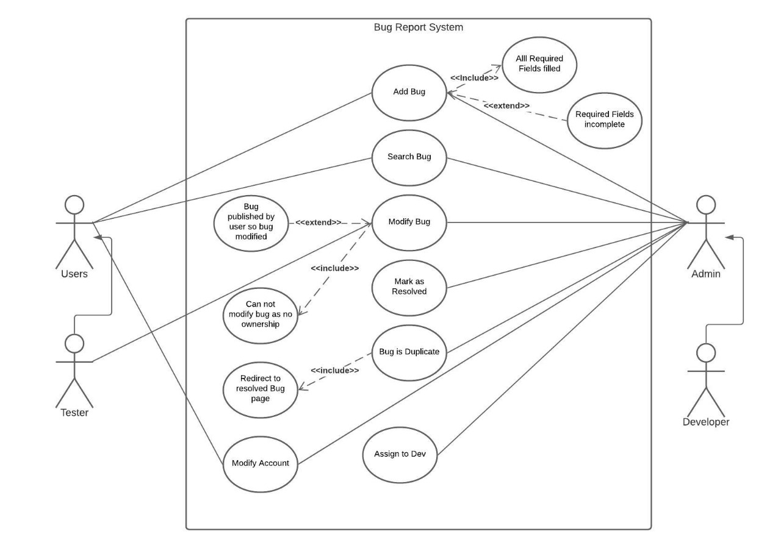
Usecase Diagram

Slide 9
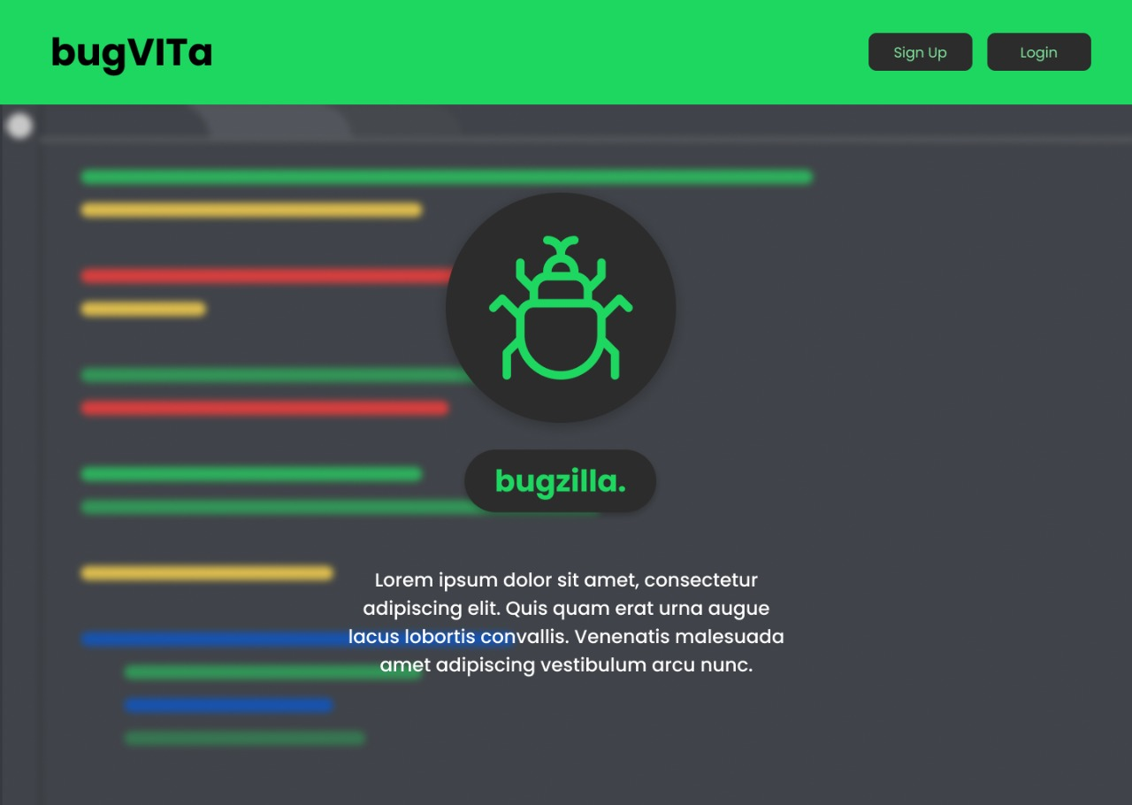

Slide 10
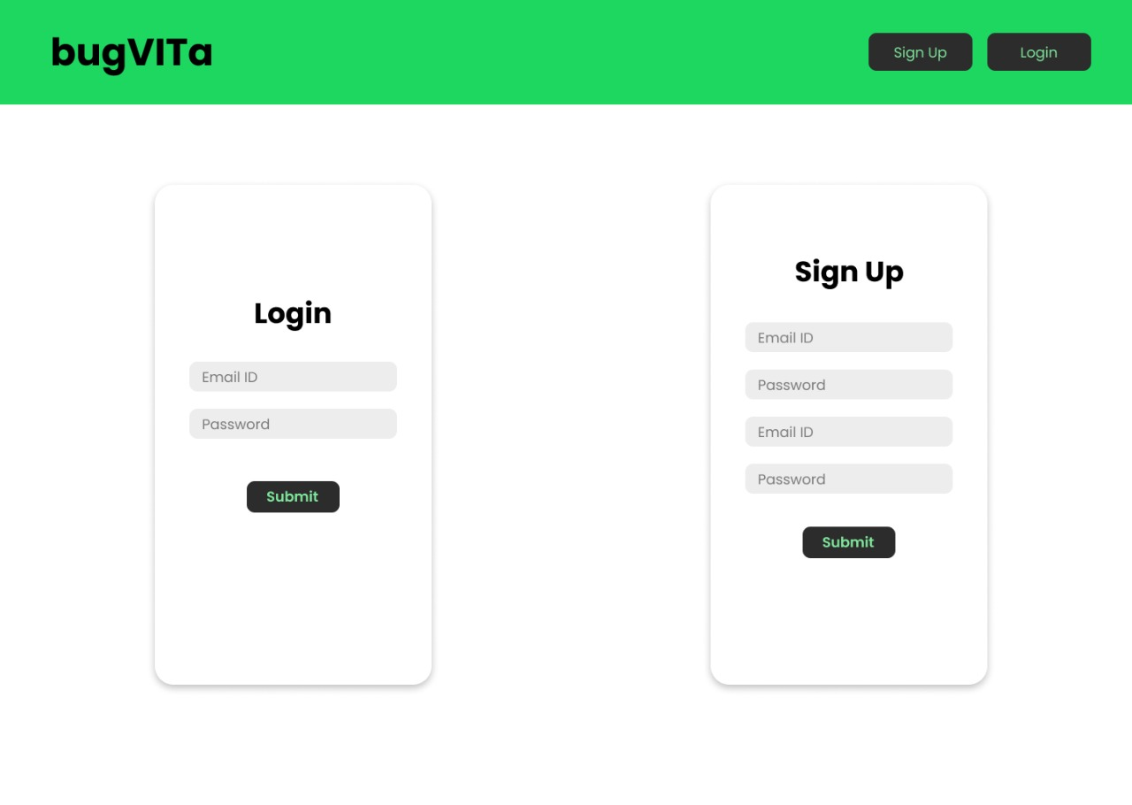

Slide 11
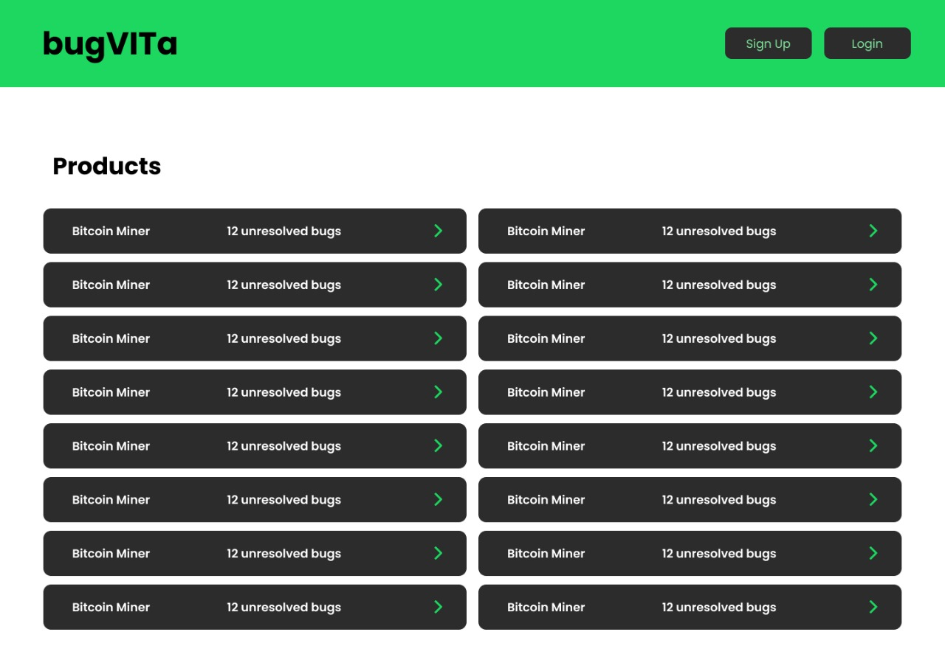

Slide 12
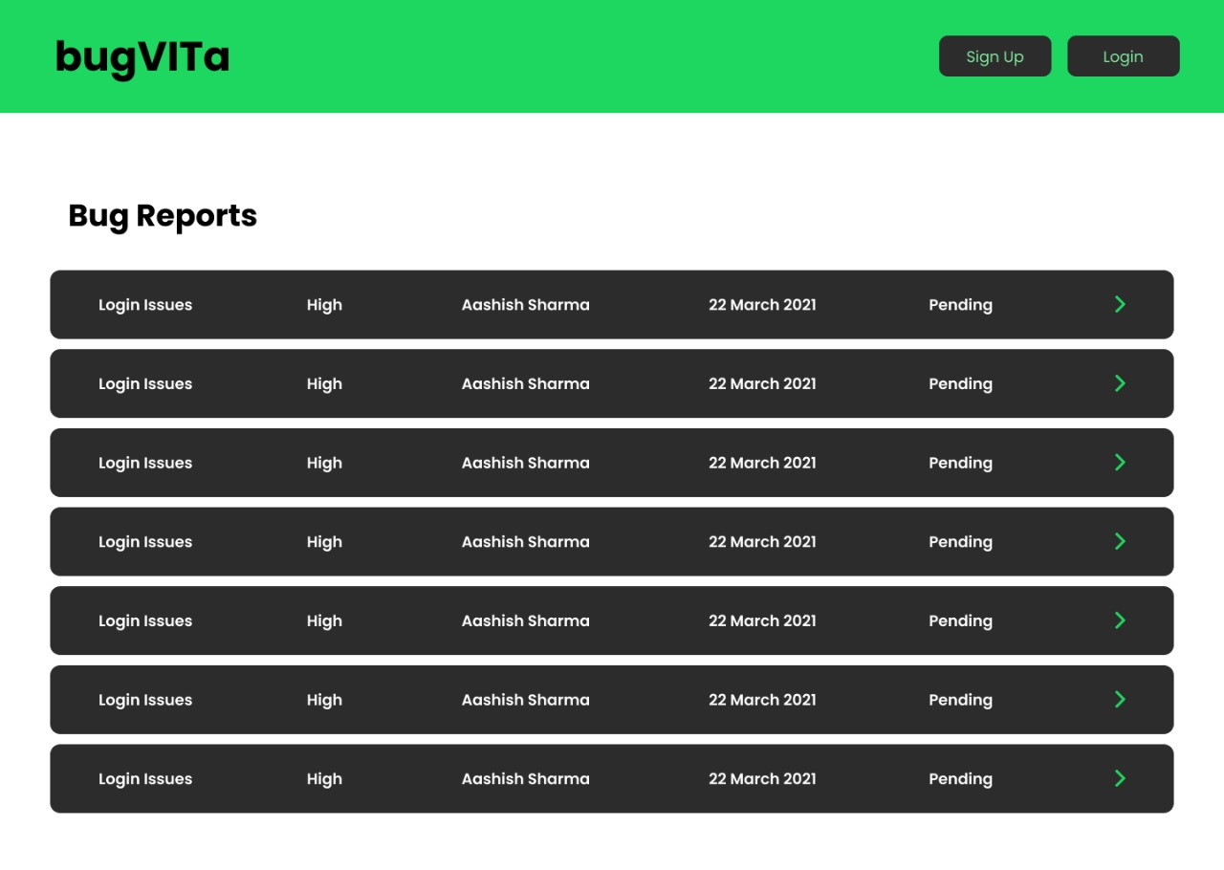

Slide 13
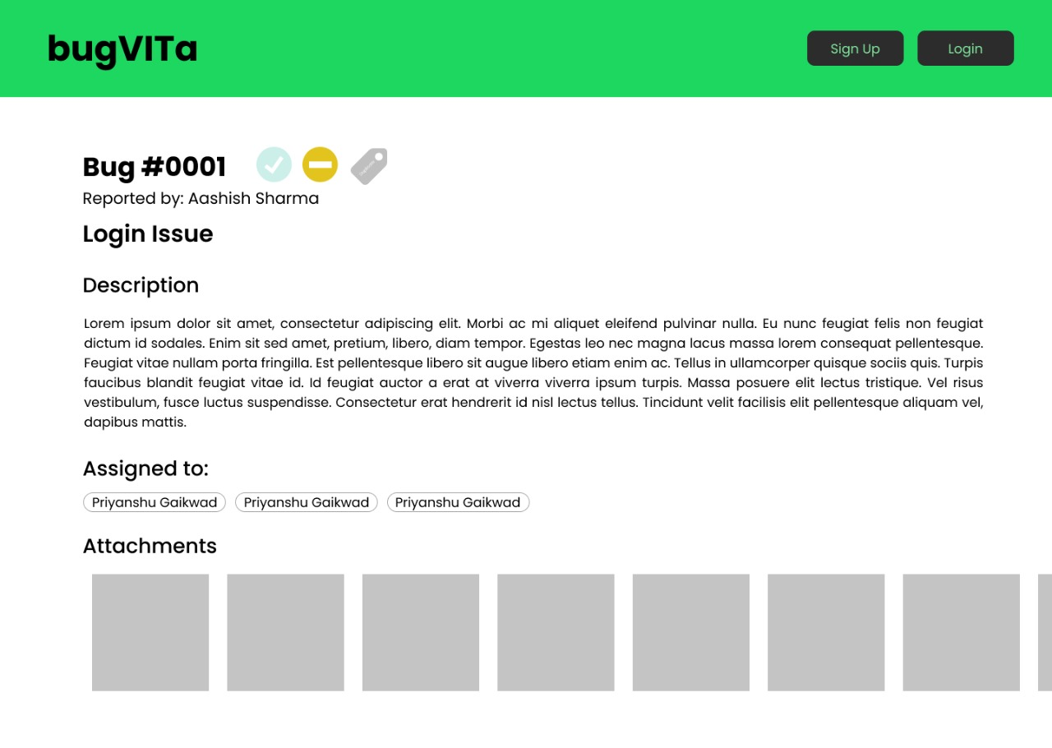

Slide 14
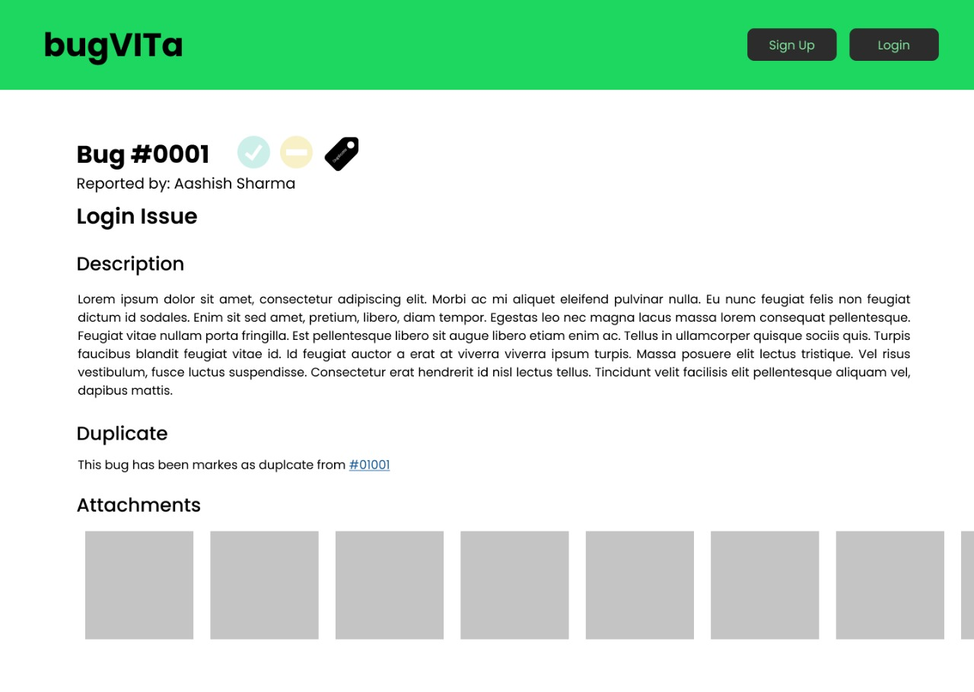

Slide 15
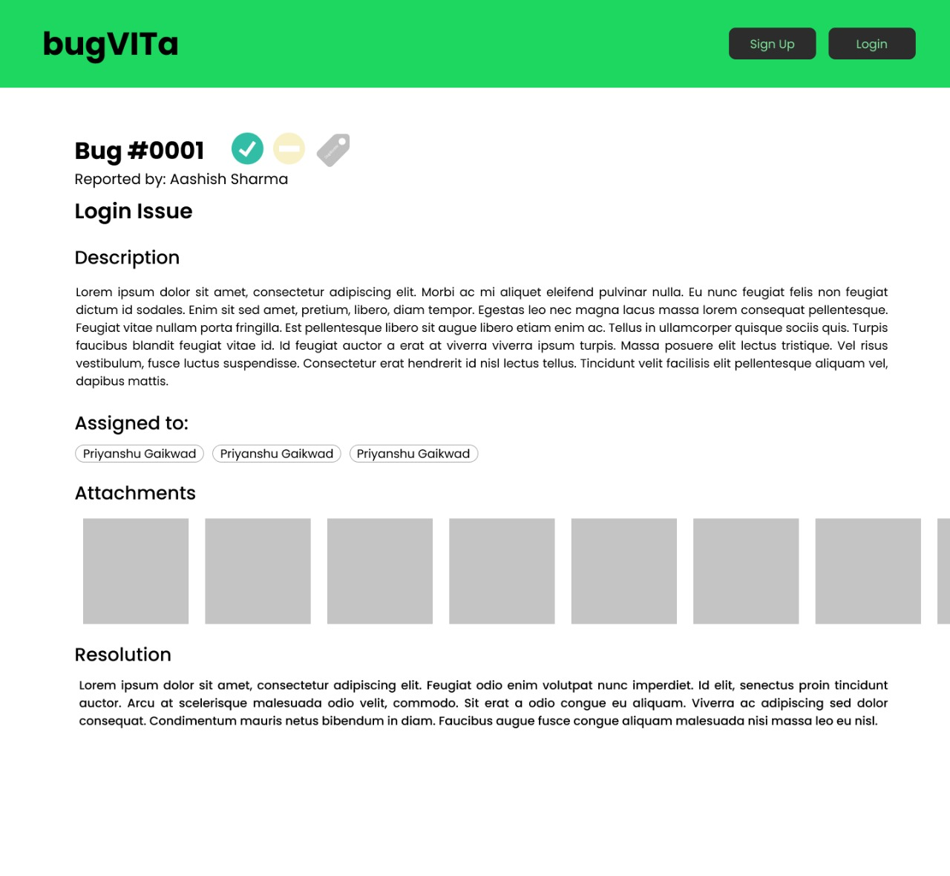

Slide 16
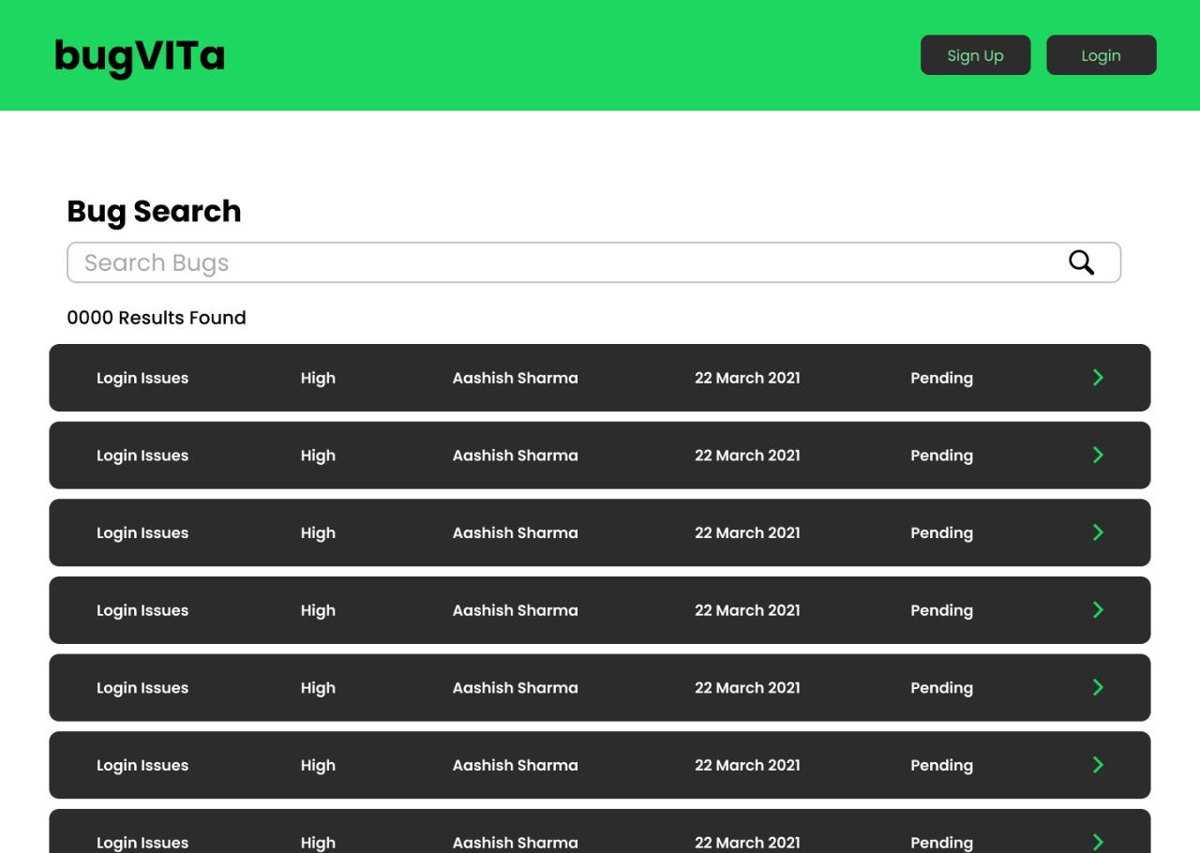

Slide 17
