Slide 1
Introduction to Latex
Anita Bahmanyar
bahmanyar@astro.utoronto.ca
November 2016
U of T Coders

Slide 2
Installing Latex
MikTex (http://miktex.org/) - for Windows
proTeXt (http://www.tug.org/protext ) - for Windows
MacTex (http://www.tug.org/mactex/) - for Mac
Sharelatex (www.sharelatex.com) - Online
Overleaf (www.overleaf.com) - Online

Slide 3

Introduction
It is pronounced as Lay-tech or Lah-tech
It is a markup language similar to HTML (instructions mentioned in tags and text)
Used widely in academia
Written as

Slide 4
Why Latex?
Intended for authors to focus on writing instead of formatting and visualization while writing
Easy to include math equations
Good for large documents (cross-referencing)
Automatic generation of bibliography
Looks pretty compared to MS Office!
Its free!

Slide 5
Structure
There are many files generated while creating a latex document including .log, .tex, .bib
.tex is the file we will be editting

Slide 6
Structure
Document Class
{article, report, book, letter}, font, fontsize
\documentclass[12pt]{article}
Packages
Graphics, math, formatting
\usepackage{geometry}
Main Body
Text, sections and bibliography

Slide 7
Example
\documentclass{article}
\usepackage{}
\title{Introduction to Latex}
\author{Anita Bahmanyar}
\date{November 9, 2016}
\begin{document}
\maketitle
Hello world!
\end{document}

Slide 8
Example
Document Class
\documentclass{article}
\usepackage{}
\title{Introduction to Latex}
\author{Anita Bahmanyar}
\date{November 9, 2016}
\begin{document}
\maketitle
Hello world!
\end{document}

Slide 9
Example
\documentclass{article}
\usepackage{}
\title{Introduction to Latex}
\author{Anita Bahmanyar}
\date{November 9, 2016}
\begin{document}
\maketitle
Hello world!
\end{document}
Packages

Slide 10
Example
\documentclass{article}
\usepackage{}
\title{Introduction to Latex}
\author{Anita Bahmanyar}
\date{November 9, 2016}
\begin{document}
\maketitle
Hello world!
\end{document}
Main Body

Slide 11
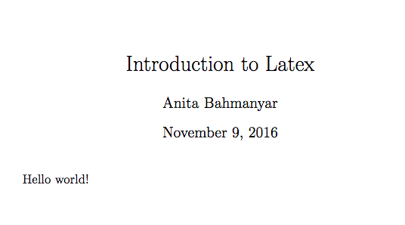
Example
\documentclass{article}
\title{Introduction to Latex}
\author{Anita Bahmanyar}
\date{November 9, 2016}
\begin{document}
\maketitle
Hello world!
\end{document}

Slide 12
Lists

Slide 13

Lists
Numeric
\begin{enumerate}
\item point 1
\item point 2
\end{enumerate}

Slide 14

Lists
Numeric
\begin{enumerate}
\item point 1
\item point 2
\end{enumerate}
Points
\begin{itemize}
\item point 1
\item point 2
\end{itemize}

Slide 15
Nested Lists
\begin{enumerate}
\item point 1
\begin{enumerate}
\item nested point 1
\begin{enumerate}
\item nested nested point 1
\end{enumerate}
\end{enumerate}
\item point 2
\end{enumerate}

Slide 16
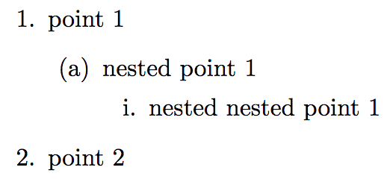
Nested Lists
\begin{enumerate}
\item point 1
\begin{enumerate}
\item nested point 1
\begin{enumerate}
\item nested nested point 1
\end{enumerate}
\end{enumerate}
\item point 2
\end{enumerate}

Slide 17
Images
\usepackage{graphicx}
\begin{figure}[H]
\centering
\includegraphics[scale=size]{filename}
\caption{}
\label{fig:label}
\end{figure}

Slide 18
Images
\usepackage{graphicx}
\begin{figure}[H]
\centering
\includegraphics[scale=size]{filename}
\caption{}
\label{fig:label}
\end{figure}
[h] : here [t] : top
[b] : bottom [p] : separate page

Slide 19

Latex is fun!
http://www.clipartkid.com/

Slide 20
Equations
\usepackage{amsmath} for math equations

Slide 21
Equations
\usepackage{amsmath} for math equations
Example:
\begin{equation}
f(x) = \frac{x^2 + 1}{5} \int x dx
\end{equation}

Slide 22
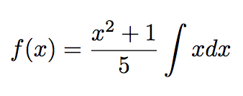
Equations
\usepackage{amsmath} for math equations
Example:
\begin{equation}
f(x) = \frac{x^2 + 1}{5} \int x dx
\end{equation}

Slide 23
Equations
Inline math mode can be inserted using $ math equation here$

Slide 24
Equations
Inline math mode can be inserted using $ math equation here$
Example:
We can use inline math such as $f(x) = 2x^3 + 5x$ in between text.

Slide 25
Equations
Inline math mode can be inserted using $ math equation here$
Example:
We can use inline math such as $f(x) = 2x^3 + 5x$ in between text.

Slide 26
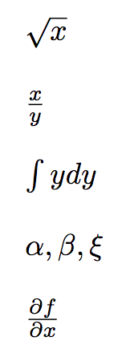
Equations
\sqrt{x}
\frac{x}{y}
\int y dy
\alpha, \beta, …
\frac{\partial f}{\partial x}

Slide 27
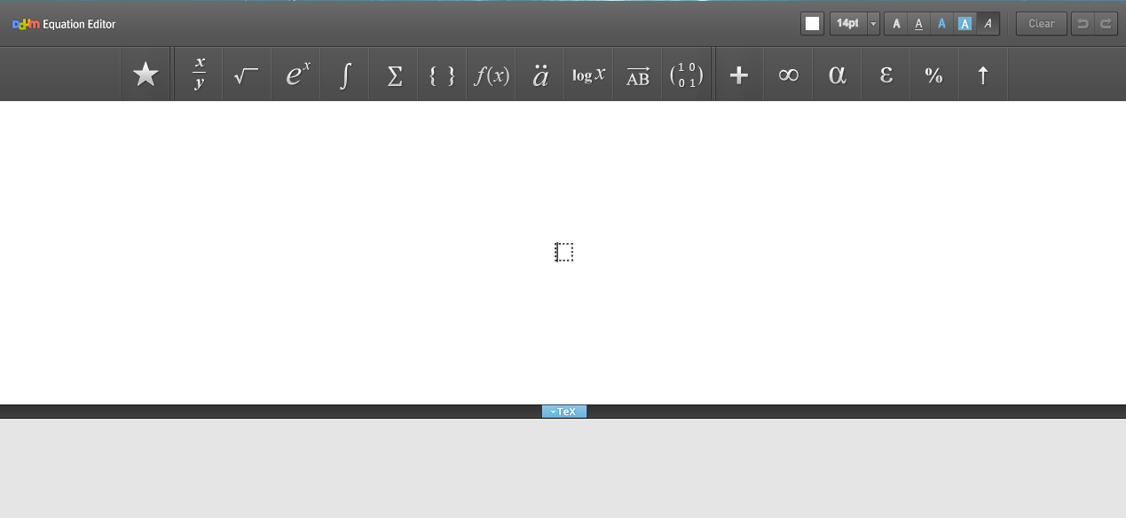
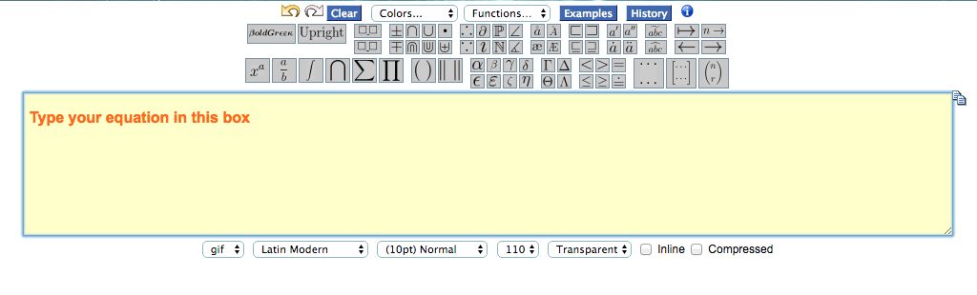
Online Equation Editors
Daum Equation Editor
Codecogs

Slide 28
Tables
\begin{tabular}{| l l l |}
\hline
Column 1 & Column 2 & Column 3 \\ \hline
A & B & C \\ \hline
D & E & F \\ \hline
\end{tabular}

Slide 29
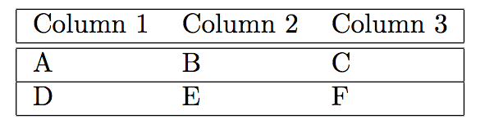
Tables
\begin{tabular}{| l l l |}
\hline
Column 1 & Column 2 & Column 3 \\ \hline
A & B & C \\ \hline
D & E & F \\ \hline
\end{tabular}

Slide 30
Bold/ Italic/ underlined

Slide 31
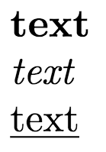
Bold/ Italic/ underlined
\textbf{text} : bold face text

Slide 32
Bold/ Italic/ underlined
\textbf{text} : bold face text
\textit{text} : italic text

Slide 33
Bold/ Italic/ underlined
\textbf{text} : bold face text
\textit{text} : italic text
\underlined{text} : underlined text

Slide 34
Cross-referencing
Use \label{} to reference figures, tables, equations, sections, etc
For reference:
\label{fig:labelname}
For calling the label:
\ref{fig:labelname}
fig, sec, eq, etc

Slide 35
Bibliography
Method 1:
Bibliography inside the file
\begin{thebibliography}{}
\bibitem{reference 1}
\bibitem{reference 2}
\end{thebibliography}
We can cite it as: \cite{reference 1}

Slide 36
Bibliography
Method 2:
Using a separate .bib file:
Inside .tex file:
\bibliographystyle{bibstyle}
\bibliography{filename}
Bibliography styles can be found at:
https://www.sharelatex.com/learn/Bibtex_bibliography_styles

Slide 37
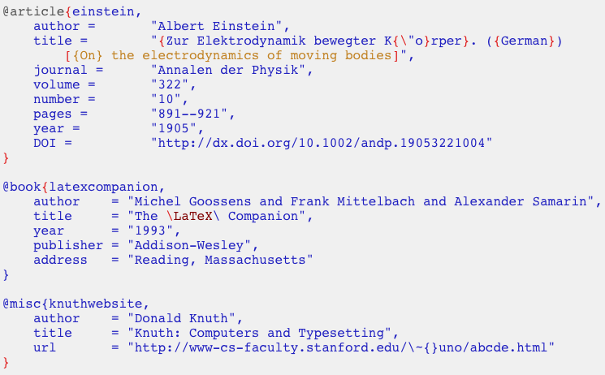
Bibliography

Slide 38
Bibliography
Entry Type

Slide 39
Bibliography
Reference name

Slide 40
Bibliography
Reference Information

Slide 41
References
https://www.sharelatex.com/learn/Bibliography_management_with_bibtex
https://www.sharelatex.com/learn/Bibtex_bibliography_styles
http://www.howtotex.com/download/FiveMinuteGuideToLaTeX.pdf

Slide 42
Questions?

Slide 43
Extra Slides

Slide 44
Tables
\begin{table}[h!]
\caption{Title} % title of Table
\centering % used for centering table
\begin{tabular}{| c | c | c | c | } % centered columns (4 columns)
\hline %inserts double horizontal lines
& Column 1 & Column 2 & Column 3 \\ [0.5ex] % inserts table
%heading
\hline % inserts single horizontal line
Row 1 & 1 & 2 & 3 \\ \hline
Row 2 & 4 & 5 & 6 \\ \hline
Ro2 3 & 7 & 8 & 9 \\%[1ex] %adds vertical space
\hline %inserts single line
\end{tabular}
\label{table:table1} % is used to refer this table in the text
\end{table}

Slide 45
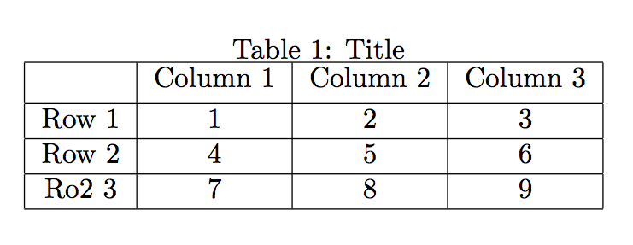
Tables

