Slide 1
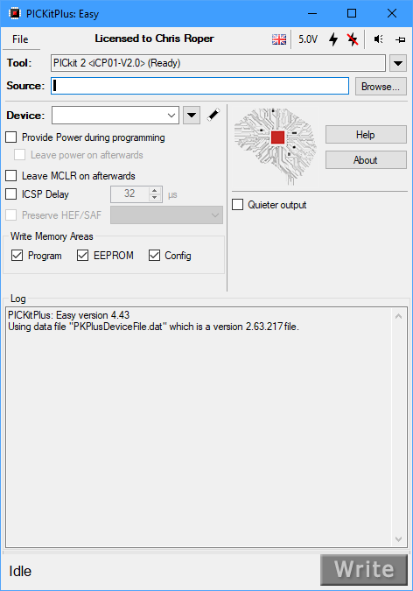
1. Programmer selection

Slide 2
2. HEX file selection

Slide 3
3. Part selection

Slide 4
3. Part selection

Slide 5
4. Magic selection

Slide 6
5. Power control

Slide 7
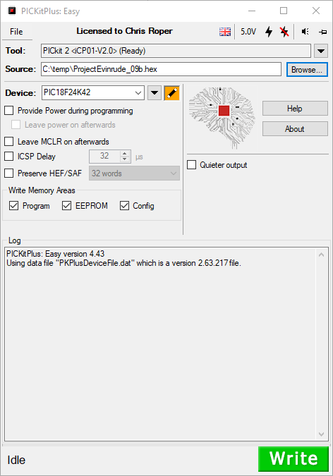
6. Write

Slide 8
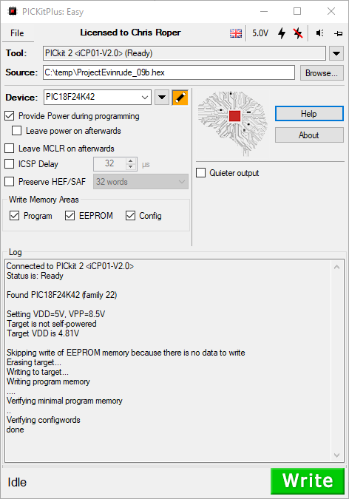
7. Completed

