Slide 1
HeapOverflow
Andronescu Alexandru
Buga Victoria
Ciobotaru Robert
Rotaru Iulian

Slide 2
Tehnologii folosite
Frontend :
HTML
CSS
JavaScript
Backend :
Java (Spring Boot framework)

Slide 3

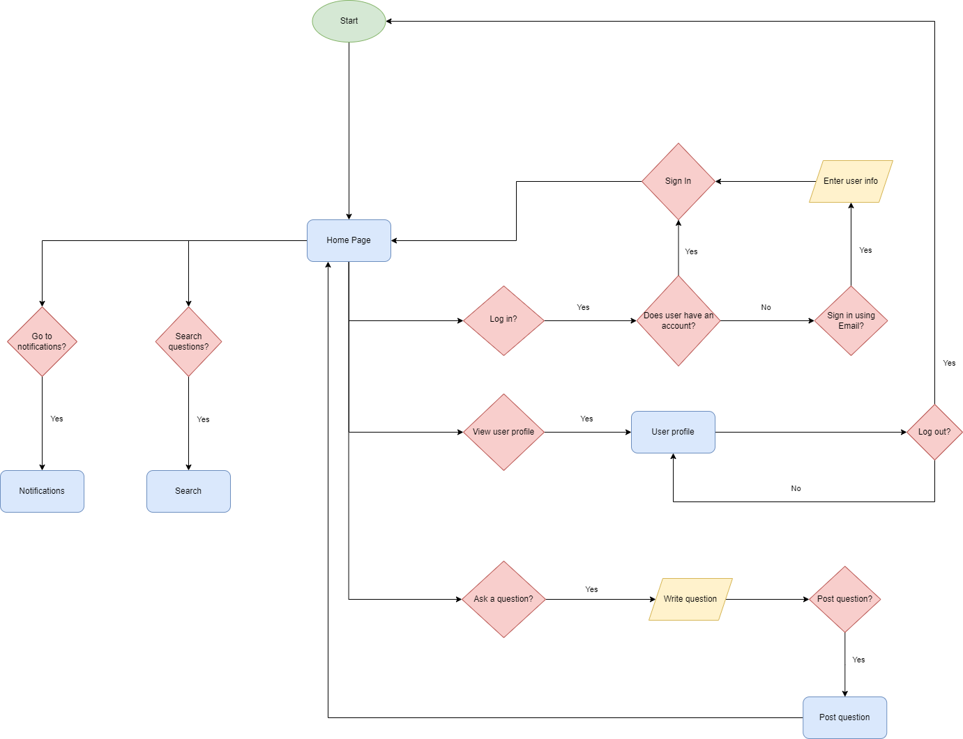
Diagrama generala

Slide 4
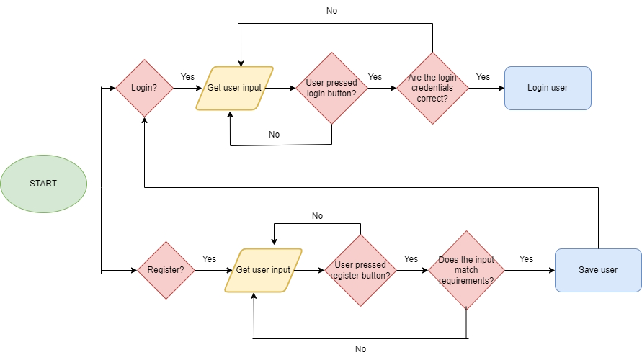
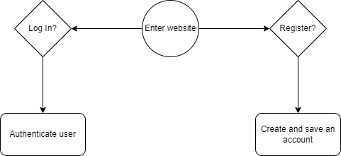
User Authentication
Diagrama de stare

Slide 5
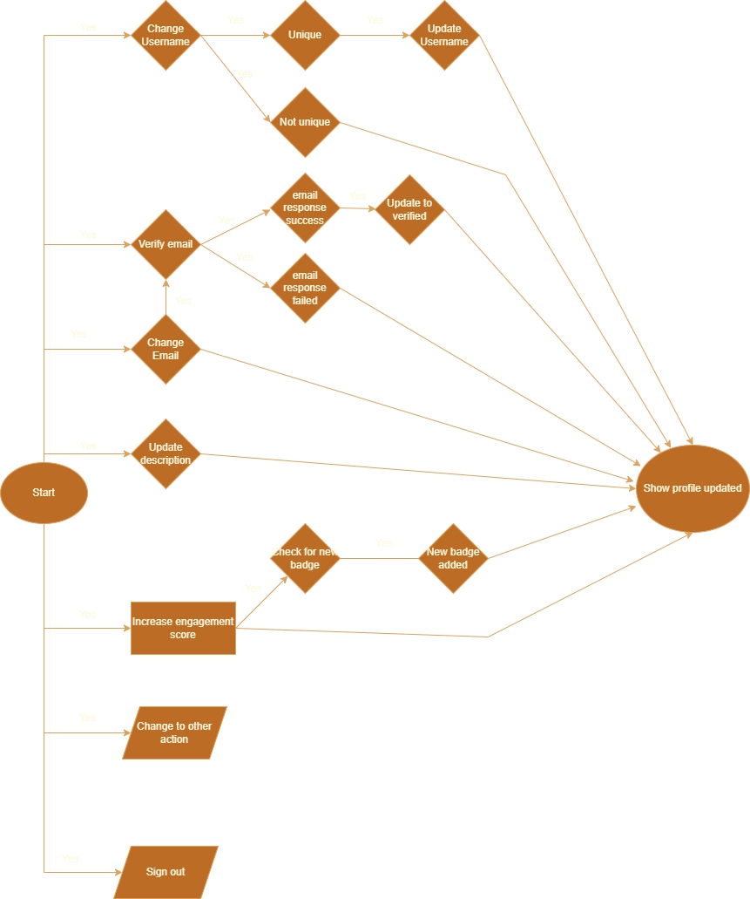
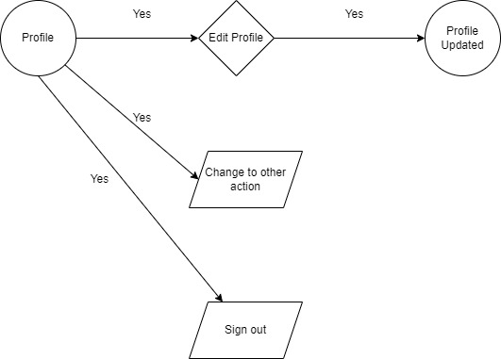
User Profile
Diagrama de stare

Slide 6
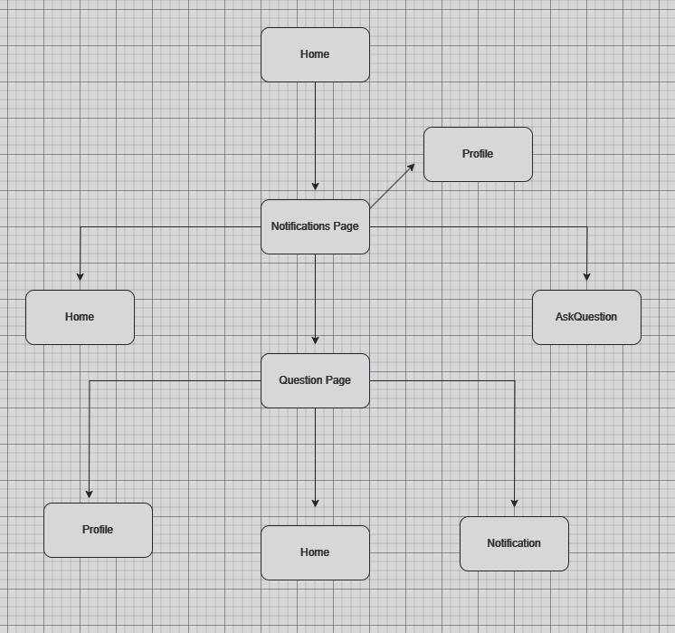
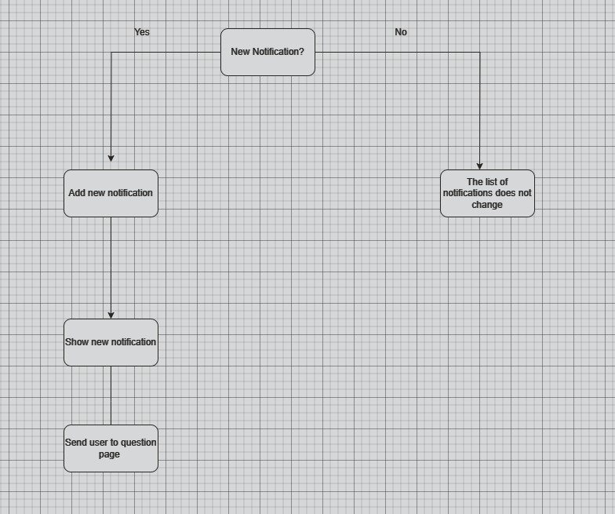
Notifications
Diagrama de stare

Slide 7
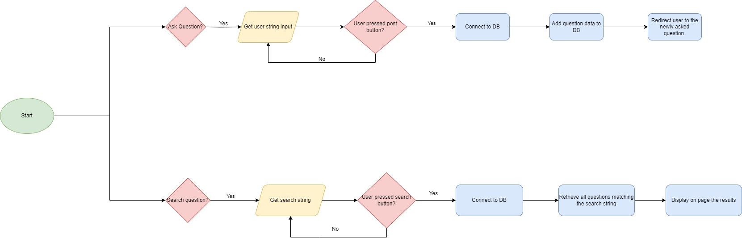
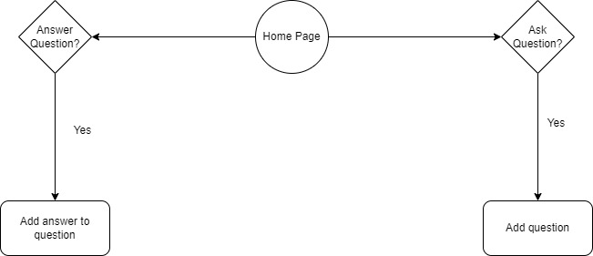
Questions&Answers
Diagrama de stare

Slide 8
Design patterns
Singleton Design Pattern Componentele Questions&Answers Componenta Notification
Observer Design Pattern Paginile Login și Register

Slide 9
Repository GitHub
https://github.com/AndronescuAlexandru/ProiectAMSS_HeapOverflow

