Slide 1

AERIAL CACTUS
IDENTIFICATION
BY: ANDRES RUBIO RAMOS

Slide 2
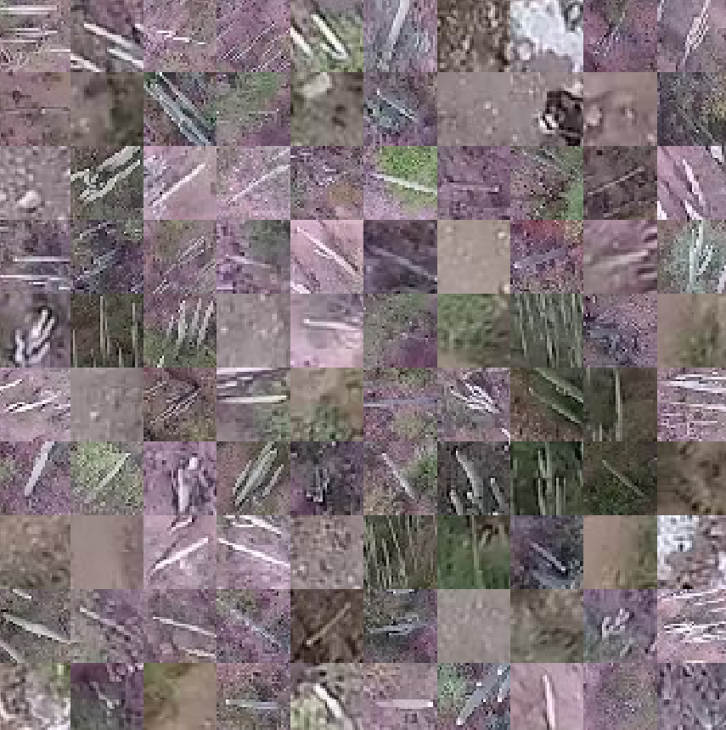
From Kaggle
Objective
This is a Kaggle competition of machine learning.
Creation of an algorithm that can distinguish cactus in aerial imagery
Dataset
Why do this?
More than 16,000 examples of a columnar cactus.
I’m interested in neural networks, image-based machine learning, experimenting with CNNs
PPT模板 http://www.1ppt.com/moban/

Slide 3

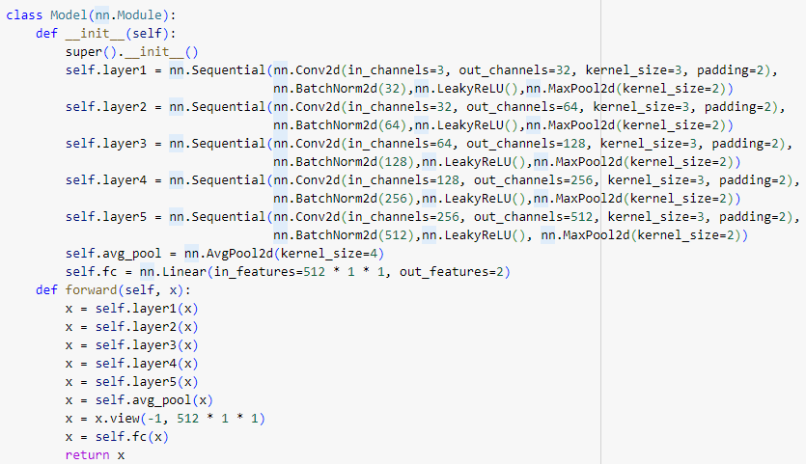


Convolutional neural network
The code defines a CNN with five convolutional layers.
Deep Architecture
Starting with 32 channels in the first layer and increasing to 512, with spatial reduction using MaxPooling.
Classification Layer
AvgPooling layer followed by FC layer for the final classification, with 2 output classes.

Slide 4










Training
Test
Final validation result of 98,18%
doing 25 epoch
Perfectly differentiates the photos shown that were not in the training

Slide 5
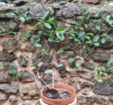
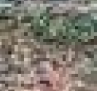
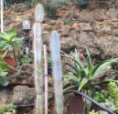
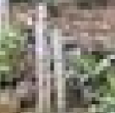
OWN PHOTOS
Real photos
Hasn’t cactus
I have taken photos of cactus, land, other plants… I have run them through the algorithm and it has been successful.
Has cactus

Slide 6
Thanks

