Slide 1
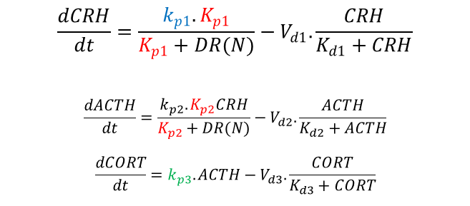
k_{p1}
Light Schedule
K_{p1}
CRH
V_{d1}/K_{d1}
DR/DR(N)
k_{p2}
K_{p2}
ACTH
IC_{50,GRm}
V_{d2}/K_{d2}
$$\frac{dCRH}{dt}=\frac{k_{p1}.K_{p1}}{K_{p1}+DR(N)}−V_{d1}.\frac{CRH}{K_{d1}+CRH}$$
$$\frac{dACTH}{dt}=\frac{k_{p2}.K_{p2}CRH}{K_{p2}+DR(N)}−V_{d2}.\frac{ACTH}{K_{d2}+ACTH}$$
$$\frac{dCORT}{dt}=k_{p3}.ACTH−V_{d3}.\frac{CORT}{K_{d3}+CORT}$$
K_{syn, GRm}
K_{syn, GR}
k_{p3}
GR mRNA
GR
K_{deg,GR}
K_{deg,GRm}
CORT
V_{d3}/K_{d3}
Induction
Elimination
Inhibition

