Slide 1
Introduction and History
Andy Wang
Operating Systems
COP 4610 / CGS 5765

Slide 2
What is an Operating System?

Slide 3
What is an Operating System?
A virtual machine
  Hides the complexity and limitations of hardware from application programmers
Applications
Virtual machine interface
Operating system
(virtual machine)
Physical machine interface
Raw machine

Slide 4
For Each OS Component
There are two major design questions:
  What is the hardware interface?
    The physical reality
  What is the application interface?
    The nicer abstraction

Slide 5
Reality vs. Abstraction
Reality | Abstraction
A single CPU | Multiple CPUs
Limited RAM capacity | Infinite capacity
Mechanical disk | Memory speed access
Insecure and unreliable networks | Reliable and secure
Many physical machines | A single machine

Slide 6
Two General OS Functions
Standard services
  Screen display
  Disk accesses
Coordination among applications
  Goals: correctness, efficiency, and fairness

Slide 7
Standard Services
Example: disk drive
Track
Sector
Cylinder

Slide 8
Disk Access
Raw disk access
  write(block, len, device, track, sector);
OS-level access
  lseek(file, file_size, SEEK_SET);
  write(file, text, len);

Slide 9
Coordination
Example: Protection
  Applications should not crash one another
    Address space: all memory addresses that an application can touch
  Applications should not crash the OS
    Dual-mode operations
      Kernel mode: anything goes
      User mode: an application can only access its own address space

Slide 10
Four Recurring Themes
OS as an illusionist
  Overcomes hardware limitations
OS as a government
  Protects users from one another
  Allocates resources efficiently and fairly
OS as a complex system
OS as a history teacher
  Learns from the past to predict the future

Slide 11
History of OS: Change!
 |  | 1980 | 2015 | Factor
Speed | CPU | 1 MIPS | 24K MIPS | 1.5 x 10⁵
 | Memory | 500 ns | 0.6 ns | 5.0 x 10³
 | Storage | 18 ms | 30 μs | 6.0 x 10³
 | Network | 300 bits/sec | 100 Gb/sec | 3.6 x 10⁸
Capacity | Memory | 64 Kbytes | 128 GB | 2.0 x 10⁶
 | Disk | 1 Mbytes | 10 TB | 4.0 x 10⁷
Cost | Per MIP | $100K/MIP | $0.0076/MIP | 1.3 x 10⁴
Other | Address bits | 8 | 64 | 8
 | Users/CPU | 10s | 0.01 | 1.0 x 10⁻³

Slide 12
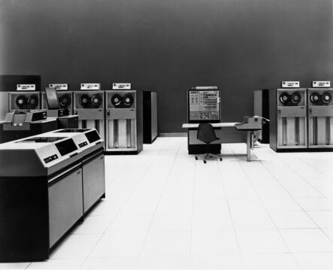
History Phase I: Hardware Expensive, Humans Cheap
Hardware: mainframes
OS: human operators
  Handle one job (a unit of processing) at a time
  Computer time
  wasted while
  operators walk
  around the
  machine room

Slide 13
OS Design Goal
Efficient use of the hardware
  Batch system: collects a batch of jobs before processing them and printing out results
    Job collection, job processing, and printing out results can occur concurrently
  Multiprogramming: multiple programs can run concurrently
    Example: I/O-bound jobs and CPU-bound jobs

Slide 14
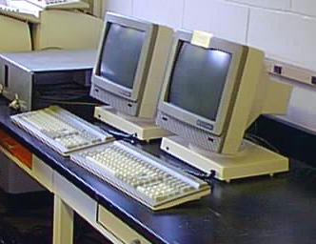
History Phase II: Hardware Cheap, Humans Expensive
Hardware: terminals
OS design goal: more efficient use of human resources
  Timesharing systems: each user can afford to own
  terminals to interact
  with machines

Slide 15
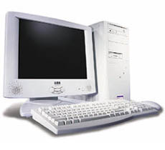
History Phase III: Hardware Very Cheap, Humans Very Expensive
Hardware: personal computers
OS design goal: allowing a user to perform many tasks at the same time
  Multitasking: the ability to run multiple programs on the same machine at the same time
  Multiprocessing: the ability
  to use multiple processors
  on the same machine

Slide 16

History Phase IV: Distributed Systems
Hardware: computers with networks
OS design goal: ease of resource sharing among machines

Slide 17
The Bottom Line
OS designs need to adapt to changing technology

Slide 18
Homework 1
Posted
Due in class next week
Xerox copy of your face
  Tell me something fun/silly that you have done
  Or your favorite quote

