Slide 1
Concurrency: Threads, Address Spaces, and Processes
Andy Wang
Operating Systems
COP 4610 / CGS 5765

Slide 2
Why Concurrency?
Allows multiple applications to run at the same time
Analogy: juggling

Slide 3
Benefits of Concurrency

Slide 4
Benefits of Concurrency
Can run multiple apps simultaneously
Better resource utilization
Resources unused by one application can be used by the others
Better average response time
No need to wait for other applications to complete

Slide 5
Benefits of Concurrency
Better performance
One application uses only the processor
One application uses only the disk drive
Completion time is shorter when running both concurrently than consecutively

Slide 6
Drawbacks of Concurrency

Slide 7
Drawbacks of Concurrency
Applications need to be protected from one another
Additional coordination mechanisms among applications
Overhead to switch among applications
Potential performance degradation when running too many applications

Slide 8
Thread
A sequential execution stream
The smallest CPU scheduling unit
Can be programmed as if it owns the entire CPU
Implication: an infinite loop within a thread won’t halt the system
Illusion of multiple CPUs on a single-CPU machine

Slide 9
Thread States
Program counter
Register values
Execution stacks

Slide 10
Thread Benefits
Simplified programming model per thread
Example: Microsoft Word
One thread for grammar check; one thread for spelling check; one thread for formatting; and so on…
Can be programmed independently
Simplifies the development of large applications

Slide 11
Address Space
Contains all states necessary to run a program
Code, data, stack
Program counter
Register values
Resources required by the program
Status of the running program

Slide 12
Process
An address space + at least one thread of execution
Address space offers protection among processes
Threads offer concurrency
A fundamental unit of computation

Slide 13
Process =? Program
Program: a collection of statements in C or any programming languages
Process: a running instance of the program, with additional states and system resources

Slide 14
Process >? Program
Two processes can run the same program
The code segment of two processes are the same program

Slide 15
Program >? Process
A program can create multiple processes
Example: gcc, chrome

Slide 16
Real-life Analogy?

Slide 17
Real-life Analogy?
Program: a recipe
Process: everything needed to cook
e.g., kitchen
Two chefs can cook the same recipe in different kitchens
One complex recipe can involve several chefs

Slide 18
Some Definitions
Uniprogramming: running one process at a time
Multiprogramming: running multiple processes on a machine

Slide 19
Some Definitions
Multithreading: having multiple threads per address space
Multiprocessing: running programs on a machine with multiple processors
Multitasking: a single user can run multiple processes

Slide 20
Classifications of OSes
 | Single address space | Multiple address spaces
Single thread | MS DOS, Macintosh | Traditional UNIX
Multiple threads | Embedded systems | Windows, iOS

Slide 21
Threads & Dispatching Loop
A thread owns a thread control block
Execution states of the thread
The status of the thread
Running or sleeping
Scheduling information of the thread
e.g., priority

Slide 22
Dispatching Loop
Threads are run from a dispatching loop
Can be thought as a per-CPU thread
LOOP
Run thread
Save states
Choose a new thread to run
Load states from a different thread
Context
switch
Scheduling

Slide 23
Simple? Not quite…
How does the dispatcher regain control after a thread starts running?
What states should a thread save?
How does the dispatcher choose the next thread?

Slide 24
How does the dispatcher regain control?
Two ways:
Internal events (“Sleeping Beauty”)
Yield—a thread gives up CPU voluntarily
A thread is waiting for I/O
A thread is waiting for some other thread
External events
Interrupts—a complete disk request
Timer—it’s like an alarm clock

Slide 25
What states should a thread save?
Anything that the next thread may trash before a context switch
Program counter
Registers
Changes in execution stack

Slide 26
How does the dispatcher choose the next thread?
The dispatcher keeps a list of threads that are ready to run
If no threads are ready
Dispatcher just loops
If one thread is ready
Easy

Slide 27
How does the dispatcher choose the next thread?
If more than one thread are ready
We choose the next thread based on the scheduling policies
Examples
FIFO (first in, first out)
LIFO (last in, first out)
Priority-based policies

Slide 28
How does the dispatcher choose the next thread?
Additional control by the dispatcher on how to share the CPU
Suppose we have three threads
Run to completion
A
B
C
Time
Timeshare the CPU
A
B
C
A
B
C
A
C
A
C
Time

Slide 29
Per-thread States
Each thread can be in one of the three states
Running: has the CPU
Blocked: waiting for I/O or another thread
Ready to run: on the ready list, waiting for the CPU

Slide 30
Per-thread State Diagram
Running
Scheduled
I/O request
Yield, timer
Ready
Blocked
I/O complete

Slide 31
For Multi-core Machines
Each core has a dispatcher loop
Decide which thread will execute next
One core has a global dispatcher loop
Decide which core to execute a thread

Slide 32
Parallelism vs. Concurrency
Parallel computations
Computations can happen at the same time on separate cores
Concurrent computations
One unit of computation does not depend on another unit of computation
Can be done in parallel on multiple cores
Can time share a single core

Slide 33
Real-life Example
Two hands are playing piano in parallel (not concurrently)
Notes from left and right hands are dependent on each other
Two separate groups singing ‘row row row your boat’ concurrently (and in parallel)

Slide 34
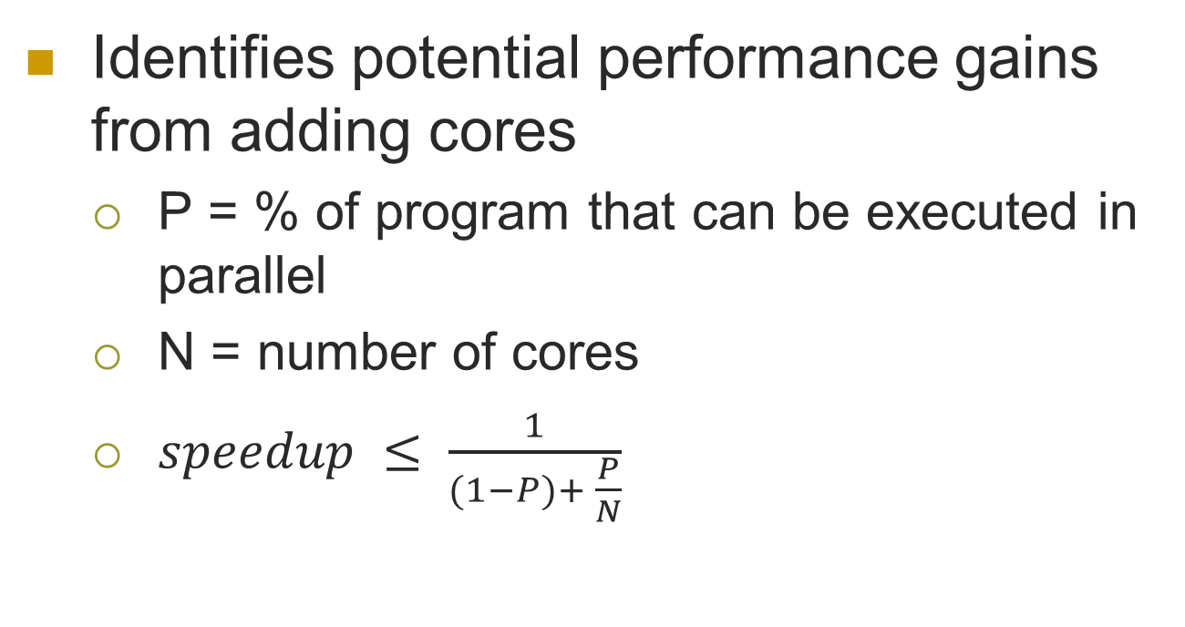
Amdahl’s Law
Identifies potential performance gains from adding cores
P = % of program that can be executed in parallel
N = number of cores
$speedup ≤ \frac{1}{(1−P)+ \frac{P}{N}}$

Slide 35
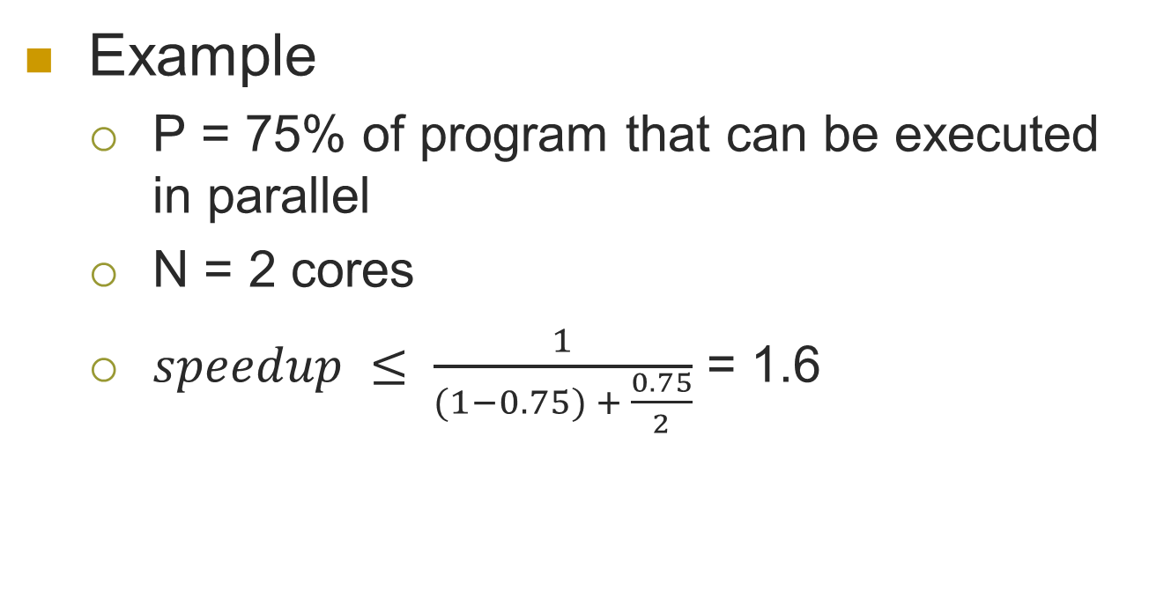
Amdahl’s Law
Example
P = 75% of program that can be executed in parallel
N = 2 cores
$speedup ≤ \frac{1}{(1−0.75) + \frac{0.75}{2}}$ = 1.6

