Slide 1
Course Information
Andy Wang
Operating Systems
COP 4610 / CGS 5765

Slide 2
Instructor
Andy Wang (awang@cs.fsu.edu)
Office: 269 LOV
Office hours:
M 4-5pm, F 4-5pm, and by appointments
Class website:
http://www.cs.fsu.edu/~awang/courses/cop4610_f2019

Slide 3
Teaching Assistants
Leah Rumancik and Christopher Draper
Email: cop4610t@cs.fsu.edu
Subject line: cop4610

Slide 4
Why Study Operating Systems?
The OS is the largest and the most complicated software running on most machines

Slide 5
Why Study Operating Systems?
The OS is the largest and the most complicated software running on most machines
  Original UNIX: 10,000 lines
  Windows: 50 million lines of code
    ~= 760K pages ~= 760 books ~= 5 bookcases
  Linux: 15 million lines of code

Slide 6
Why Study Operating Systems?
It contains many important system concepts
  Design principles
  Complexity hiding
  Performance tuning
  Resource coordination

Slide 7
Applicability of OS Skills
Software engineering
Database design and implementation
Network design and implementation
Distributed computing

Slide 8
Learning Objectives
Operating system concepts
  Process management, CPU scheduling, synchronization, caching, file systems, and so on
Programming skills
  User-level shell
  Kernel module, system call, synchronization primitives, file system

Slide 9
Prerequisites
COP 4530
  Data structures
CDA 3101
  Computer organization

Slide 10
Required Skills
Proficiency in UNIX programming and debugging environment
Proficiency in C

Slide 11

Course Material
Lecture notes (posted at the class website)
Textbook:
  Silberschatz, Galvin, Gagne,
  Operating System Concepts,
  10th Edition

Slide 12
Class Grading
Two components
  Exams (50%)
  Homework assignments and projects (50%)

Slide 13
Exams
Exam 1 (10%)
Exam 2 (10%)
Comprehensive final exam (30%)

Slide 14
More on Exams
80% based on lectures, assignments, and projects
20% based on your ability to apply various principles learned in the class

Slide 15
Assignments and Projects
Homework assignments (10%)
  Paper submissions
3 – 4 projects (10 - 15% each)

Slide 16
If you score > 35% on both components, your grade will be:
100 – 92 A
91.9 – 90 A-
89.9 – 88 B+
87.9 – 82 B
81.9 – 80 B-
79.9 – 78 C+
77.9 – 72 C
71.9 – 70 C-
69.9 – 68 D+
67.9 – 62 D
61.9 – 60 D-
59.9 – 0 F

Slide 17
If you score < 35% on one component
Say…
  30% on exams
  50% on projects and assignments
The highest grade is C-

Slide 18
Assignments
Individual homework assignments
  One bonus point for each homework assignment
    Constructive comments on lectures and recitations
    Or, a funny story of the week
    Or, ways to entertain a seven year old

Slide 19
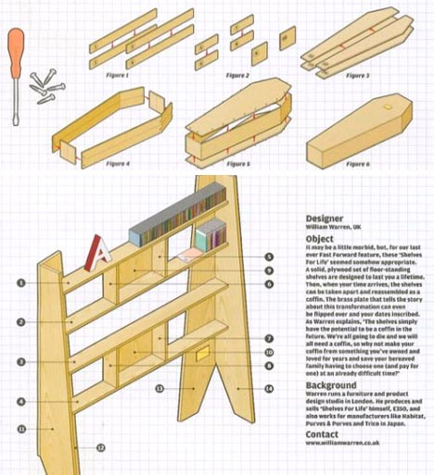
Funny Story of the Week

Slide 20
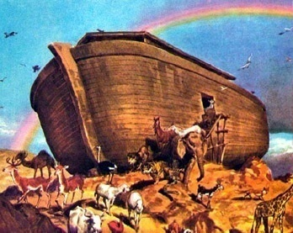
Projects…
In teams of 3 people
Increasingly difficult
  Potentially tedious compilations
  Potentially non-deterministic bugs
    Debuggers may not help
    May wipe your machine

Slide 21
Other Bonuses
Programming contest
  0.5% of your course grade + 0.5%*number of questions answered correctly
1-min video on a chosen topic
  1 per student
  Reserve your topic on Canvas
  1% of your course grade
  Mention your name and this course title
  Target non-CS people

Slide 22
Computer Accounts
Computer science account
  Various tools
    SSH, e-mail, text editor, gcc, make
my.fsu.edu account
  Receiving class emails
  Discussion board
  Grade posting

Slide 23
Your Responsibilities
Understand lecture & reading materials
Attend office hours for extra help, as needed
Uphold academic honesty
Turn in your assignments on time
Check class Web page and your garnet email account and regularly

Slide 24
Dos and Don’ts
Do share debugging experiences
Do share knowledge of tools
Do acknowledge help from others
Do acknowledge sources of information from books and web pages

Slide 25
Dos and Don’ts
Don’t cheat
Don’t copy code from others
Don’t paraphrase code from others either
  E.g., changing variable names & indentations
Don’t post code to the discussion board

Slide 26
Course Policies
Attendance mandatory
No make-up exams for missed exams…
Honor code: read your student handbook
Students with disabilities
  Report to Student Disability Resource Center
  Bring me a letter within the first week of class

Slide 27
To see or not to see me & TAs
We are not psychics
Please let us know if…
  Class is too hard
  You don’t have the background
  Class can be improved in certain ways
When in doubt, email us…

Slide 28
Survival Tips
Post messages and read the discussion board frequently
Web search engines are your good friends

