Slide 1
Project 3: FAT32 File System

Slide 2
Project Overview
FAT32 is a file system
What does that actually mean?
A storage device (ie hard drive) is simply a place to store a bunch of bytes
Given a device, how do you find a specific file in that large bunch of bytes?
File systems organize the space available on a storage device into an accessible and navigable format

Slide 3
Implementation Overview
Implemented in C
No more kernel programming
  Program will run as a normal executable
Given an image file containing raw bytes
  Open image file as a binary file (use ‘b’ flag)
  Read user input
  Manipulate image file according to input

Slide 4
Getting Started
First, explore the provided fat32 image file
2 options:
  Hexedit
  Mount

Slide 5
Hexedit
Hexedit often included in Linux distributions
Free downloads for hex viewers available online
Allow you to view raw data content of an image file
Even if you use hexedit, make sure to test your project via mounting before submission and vice versa

Slide 6
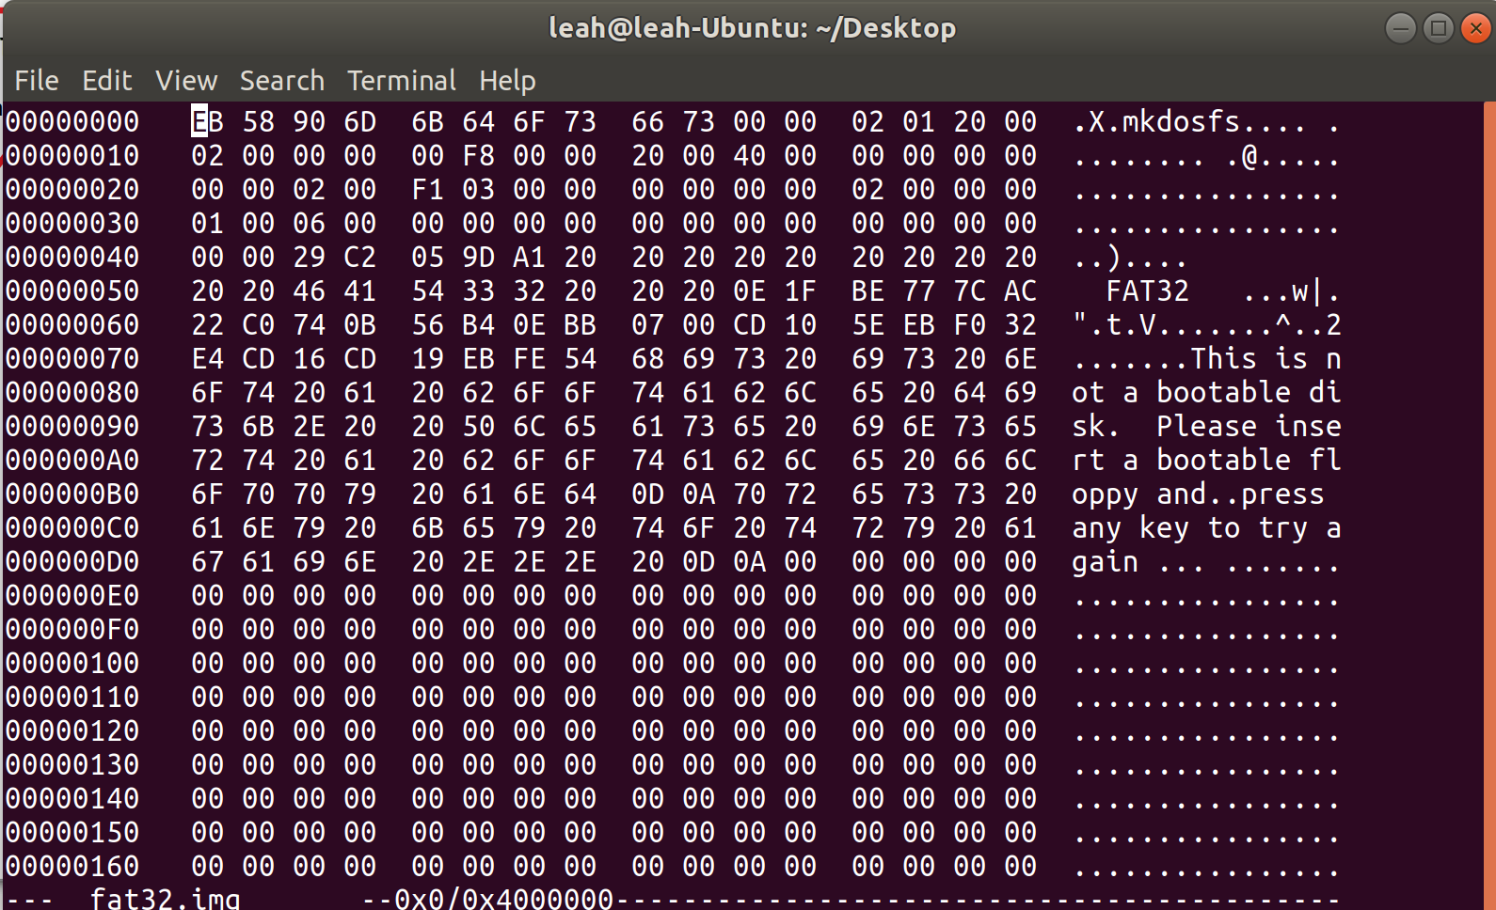
Hexedit
> hexedit fat32.img

Slide 7
Hexedit
Data and line numbers shown in hexadecimal
When possible, the ASCII representation of the data will be shown on the right

Slide 8
Hexedit
ASCII
representation
Line numbers and
data shown in hex

Slide 9
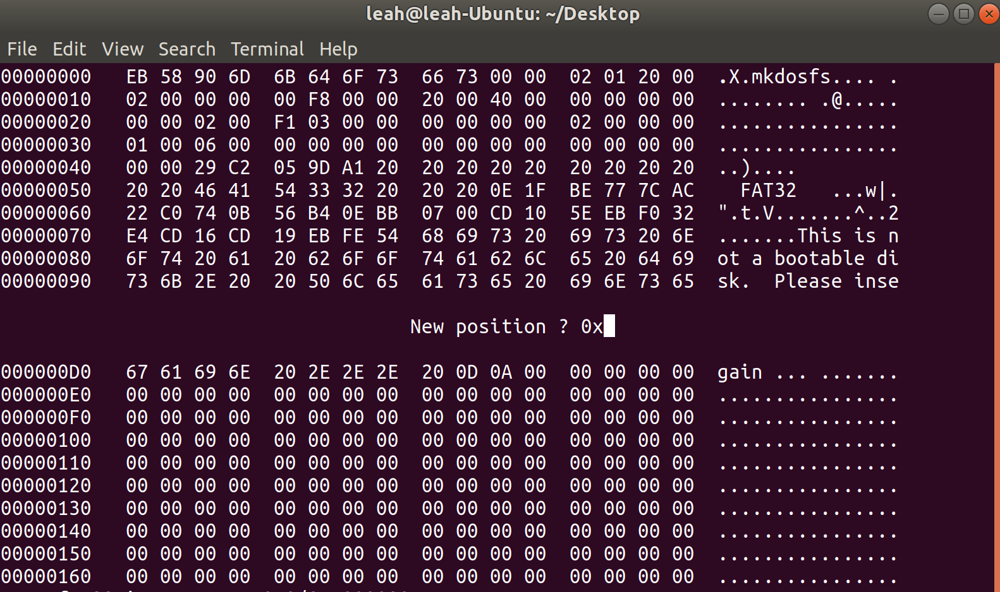
Hexedit
Use cntrl-g to jump to a new line:

Slide 10
Hexedit
To make things easier to read, set each line to 16 bytes
10_{hex} = 16_{dec} bytes

Slide 11
Hexadecimal Refresher
Represented by 0-9 A-F
Base 16: each digit ranges from 0 – 15
Binary 0000 to 1111 = 0 to 15
  Need 4 bits to represent one hexadecimal digit
  2 hexadecimal digits = 8 bits = 1 byte

Slide 12
Hexedit
One hex digit
(4 bits)
Two hex digits
(8 bits = 1 byte)
One line
(16 bytes)
4 bytes
(32 bit)

Slide 13
Mount
In a Linux environment:
  mkdir mnt_pnt
  sudo mount -o loop /path/to/image mnt_pnt
  cd mnt_pnt
Now you can access the contents of the image file through the mount point
To remove:
  sudo umount /path/to/image

Slide 14
Mount
/
mnt_pnt
/

Slide 15
Mount
/
mnt_pnt

Slide 16
Terms
Byte – 8 bits of data, the smallest addressable unit in modern processors
Sector – Smallest addressable unit on a storage device, usually this is 512 bytes
Cluster – FAT32-specific term. A group of sectors representing a chunk of data
FAT – Stands for File Allocation Table and is a map of files to data
A set of bytes make up a sector and a set of sectors make up a cluster, FAT entries are in terms of clusters

Slide 17
FAT32 Disk Layout
Reserved
Region
FAT
Region
Data
Region
• Reserved Region - Includes the boot sector, the extended boot sector, the file system information sector, and a few other reserved sectors
• FAT Region - Has the FAT: basically a map used to
traverse the data region. Contains mappings from cluster
locations to cluster locations
• Data Region - Using the addresses from the FAT region,
contains actual file/directory data

Slide 18
Reserved Region
Reserved
Region
FAT
Region
Data
Region
Contains information about the file system itself
When a FAT file system is mounted, the machine reads the reserved region to determine the type of file system and the characteristics associated with the file system
For example,
  Size of clusters
  Number of FATs
  etc

Slide 19
FAT
Reserved
Region
FAT
Region
Data
Region
Data is organized into clusters
Each cluster in the data region is allocated through the File Allocation Table (FAT)
The FAT coordinates which clusters each file/directory uses
To access a file, must know its first, starting cluster
Then, can follow find subsequent clusters using the FAT

Slide 20
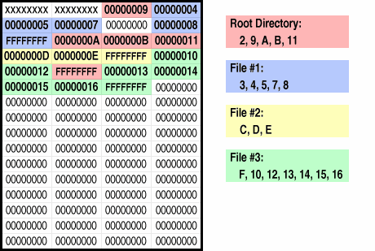
FAT
Reserved
Region
FAT
Region
Data
Region
https://www.pjrc.com/tech/8051/ide/fat32.html

Slide 21
FAT
Reserved
Region
FAT
Region
Data
Region
https://www.pjrc.com/tech/8051/ide/fat32.html

Slide 22
Data Region
Reserved
Region
FAT
Region
Data
Region
Data in the data region can be of two types: directory (folder) data or file data

Slide 23
Data Region
Reserved
Region
FAT
Region
Data
Region
Directory data:
Each directory contains directory (DIR) entries
A directory’s data in the data region is a list of DIR entries where each DIR entry represents an item in the directory (ie files and/or other directories)

Slide 24
Data Region
Reserved
Region
FAT
Region
Data
Region
Directory data:
For example,
  Directory my_dir contains files a.txt and b.txt and directory my_child_dir
  The portion of the data region corresponding to my_dir would contain DIR entries for a.txt, b.txt, and my_child_dir
Therefore, every file and directory will have a DIR entry (except for the root directory)

Slide 25
Data Region
Reserved
Region
FAT
Region
Data
Region
Directory data:
DIR entries
  Fixed sized data structures which contain fixed sized fields containing information about the entry
    Name
    Size
    First cluster number
  Check FATspec for all fields
  Read in using a struct with corresponding fields

Slide 26
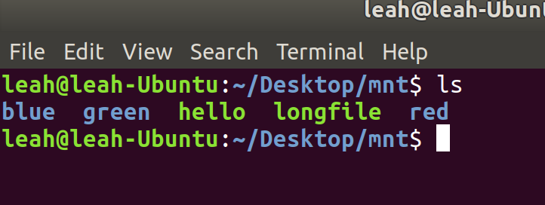
Data Region
Reserved
Region
FAT
Region
Data
Region
Directory data:
Example: Root Directory
In the data region for the root directory, there will be DIR entries for blue, green, and red folders, and hello, longfile files
1

Slide 27
Data Region
Reserved
Region
FAT
Region
Data
Region
Directory data:
All DIR entries (except for . and ..) will be preceeded by a single LDIR entry
All directories will have a “.” and “..” DIR entry except for the root directory

Slide 28
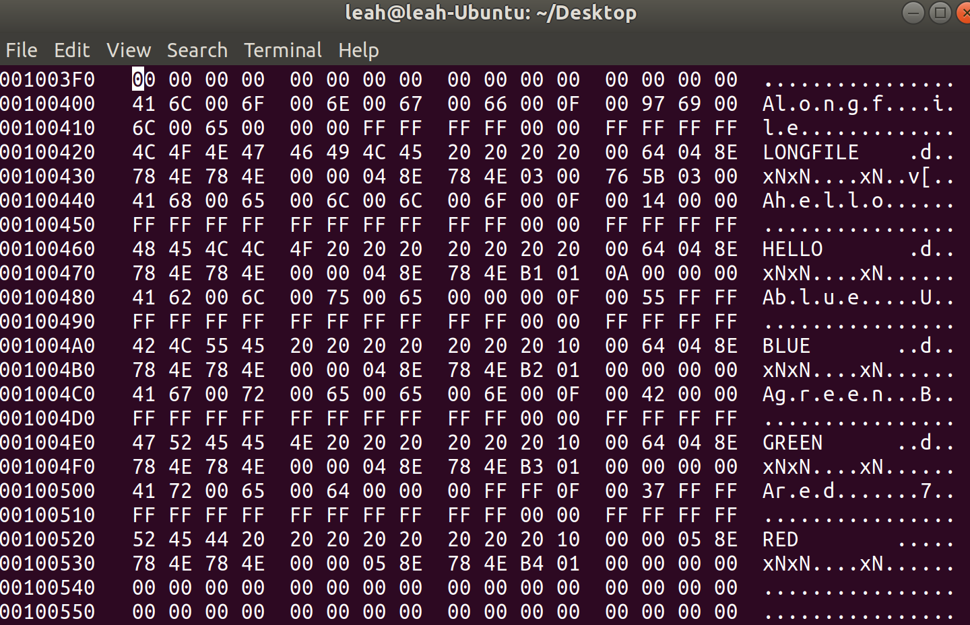
Data Region
Reserved
Region
FAT
Region
Data
Region
Directory data:
Example: Root Directory
DIR entry for
hello
Corresponding long
dir name entries
(safe to ignore)
DIR entry for
green directory

Slide 29
Data Region
Reserved
Region
FAT
Region
Data
Region
File data:
In the data region, file data is simply the content of the file
If the file is a text file, clusters in the data region allocated to the text file is simply the text contents

Slide 30
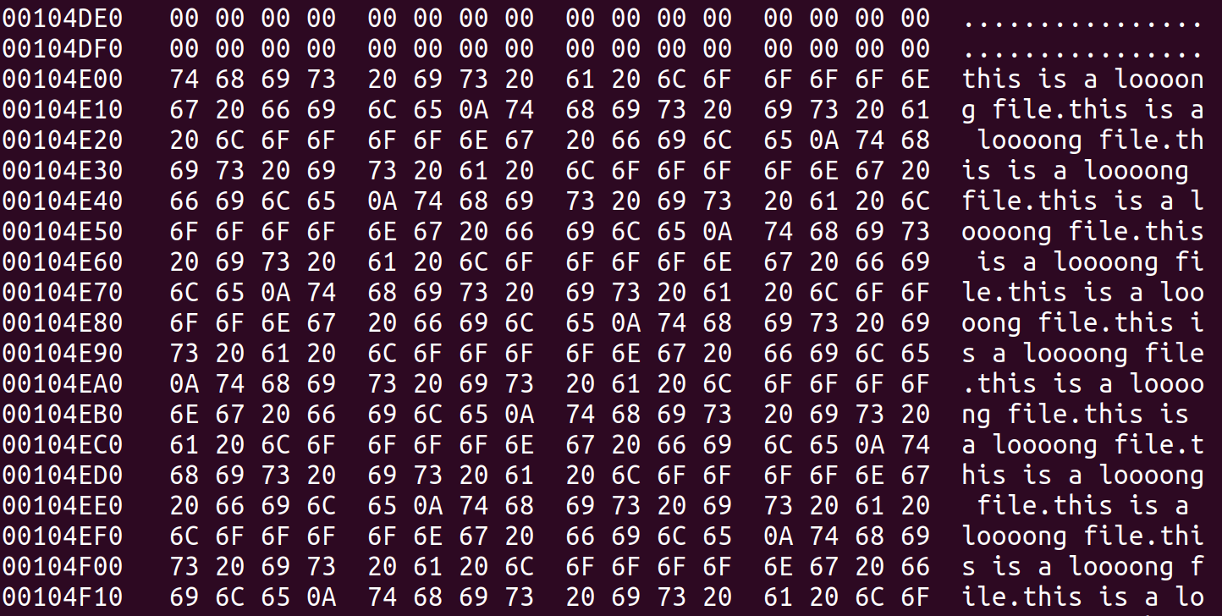
Data Region
Reserved
Region
FAT
Region
Data
Region
File data example
longfile contents:
  this is a loooong file
  this is a loooong file
  this is a loooong file
  this is a loooong file
  this is a loooong file
  ...

Slide 31
Function: exit
Close program and free up any allocated resources

Slide 32
Function: info
Boot block is the first 512 bytes ( 1st sector ) of the image disk
All the vital statistics of the image file contained here
Fields in this block can be found in the FATSpec.pdf

Slide 33
Function: info
Read all FAT32 fields into a struct – you will need these values throughout your program
Within your struct, make a corresponding variable for each field
  Make sure the byte size of the variable matches the size of the field as specified in the FATspec!
  Make sure the struct variables are listed in the same order as shown in the FATspec
Info function prints these fields
Check your values make sense
  watch out for endian issues!

Slide 34
Endianness
Endianess describes the order in which bytes are stored in memory
One hex value represents 16 bits
  Two hex values represent a byte
Given an integer 0x0A0B0C
  Big endian systems would represent integer as 0A | 0B | 0C
    Most significant byte first
  Little endian systems would represent integer as 0C | 0B | 0A
    Least significant byte first
FAT32 uses little endian
(characters are single bytes → no reordering necessary)

Slide 35
Endianness
Reading in all structs using __attribute__((packed))
  Look at documentation for syntax
  This often resolves endianness issues
  Whenever you read in a new type of value from FAT, make sure the endianness is correct

Slide 36
Function: info
ex) Finding the BPB_BytesPerSec

Slide 37
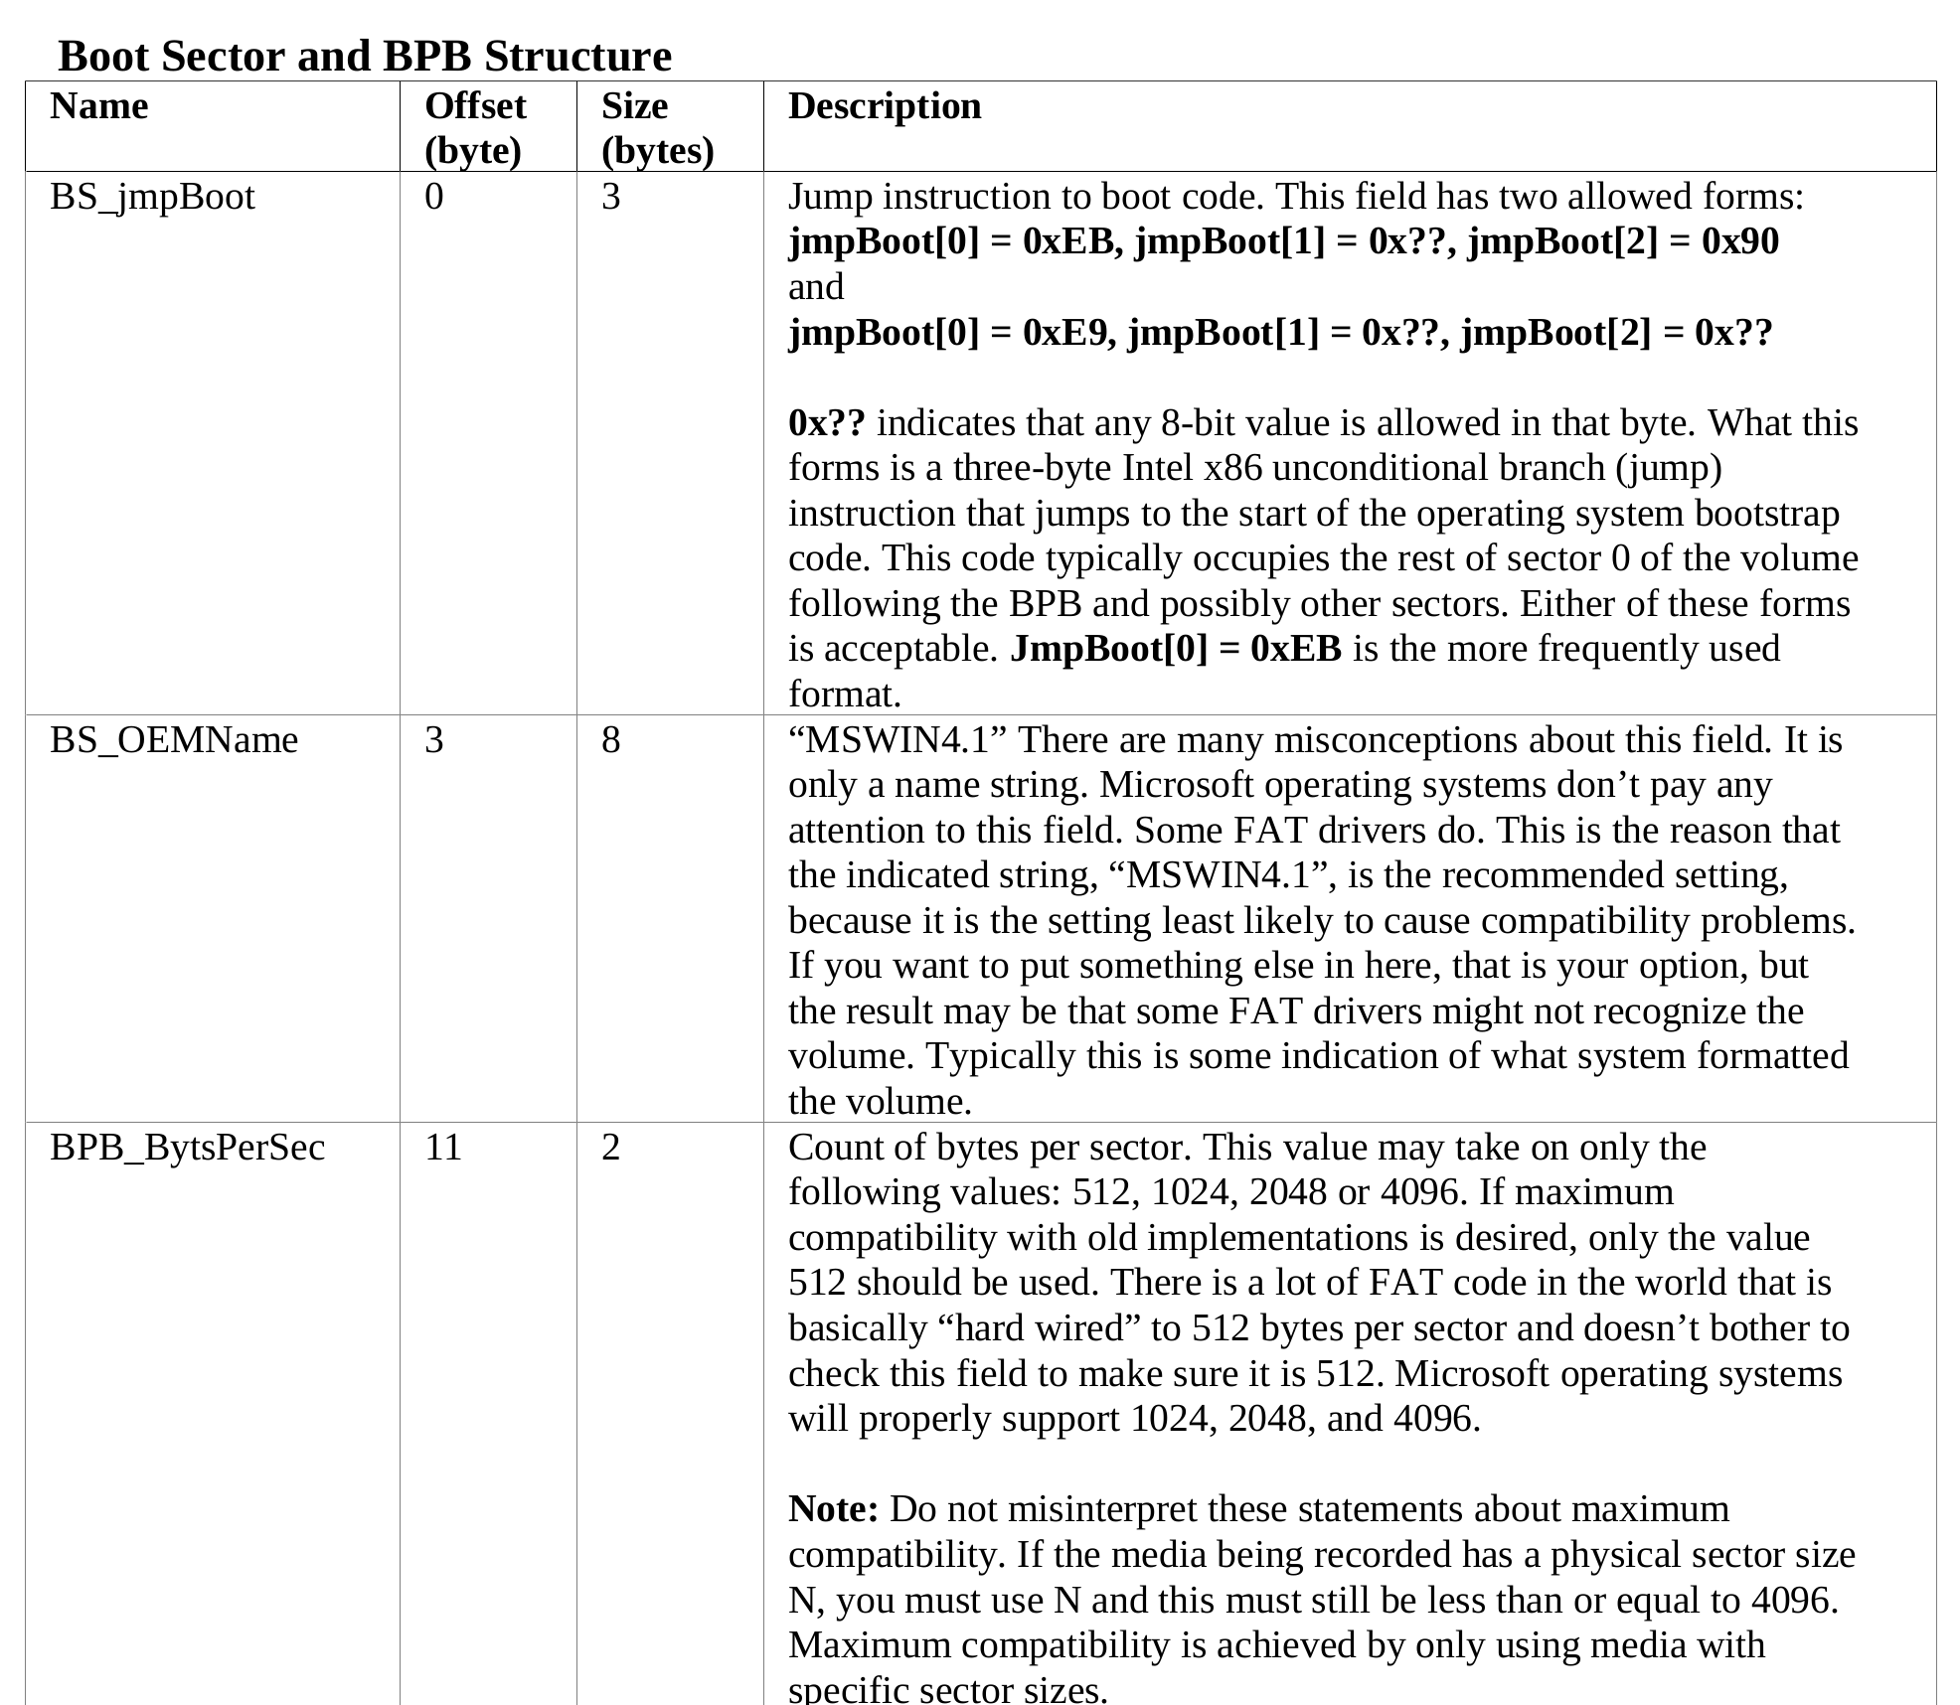
FATspec
Field Name:
BPB_BytesPerSec
Offset (byte): 11
Size (byte): 2

Slide 38
Offset = 11 Bytes
Size = 2 Bytes
00 02 little endian = 02 00 big endian
0200_{hex} = 512_{dec} → 512 bytes per sector

Slide 39
Function: ls DIRNAME
First, need to find the desired directory (DIRNAME) via file system traversal
(directories are just a special type of file with DIR_attr = 0x10)

Slide 40
Function: info
Note: one of the fields in the boot block is the BPB_RootClus
  This field tells you the cluster number of the root directory
  This field is usually = 2

Slide 41
ls DIRNAME
Let’s first try running ls at the root
Start at root directory – cluster number given in the boot sector
Index into the FAT using this cluster number
Value at this location in FAT table will either contain an end of cluster marker or a new index
FAT entries form a chain of indices for a given file

Slide 42
ls DIRNAME
Running ls on other directories is the exact same process except the starting cluster will be different
If no argument given, use current working directory’s cluster
If DIRNAME given, start at the first cluster number of DIRNAME (given in DIRNAME’s DIR entry)

Slide 43
FAT Entries
FAT[current_cluster_number] = next_cluster_number → file continues at next_cluster_number
FAT[current_cluster_number] = 0x0FFFFFF8 or 0x0FFFFFFF → end of cluster marker, current_cluster_number is the last cluster in the file
FAT[current_cluster_number] = 0 → you are at an empty cluster

Slide 44
FAT
Reserved
Region
FAT
Region
Data
Region
So, the root directory contents are located in cluster numbers 2, 9, A, B, and 11
https://www.pjrc.com/tech/8051/ide/fat32.html

Slide 45
File System Traversal
FAT table shows cluster number of file contents!
Must go to that cluster number in the data region to find the file’s actual contents

Slide 46
Finding a File’s Contents
Reserved
Region
FAT
Region
Data
Region
FirstDataSector = BPB_ResvdSectCnt + (BPB_NumFATs*BPB_FatSz32)
FirstDataSector is the Sector where data region starts (should be something around 100400 in hex)

Slide 47
Finding a File’s Contents
FirstSectorofCluster =
FirstDataSector + ((N -2)*BPB_SecPerClus)
Start of Data Region
This term is equal to the offset of the data from the beginning of the data region
Sectors per cluster * number of clusters = offset in terms of sector
(use cluster number – 2 because we start indexing clusters with N=2, remember how root started at 2?)

Slide 48
FAT32 Directories
Similar to Boot Sector, make a struct with the fields corresponding to the entries in the directory structure
  Check FATspec for details
You do not have to support long entries → directory consists of second long directory entry and short entry
  But they may exist in the image file, you can safely skip over them

Slide 49
Function: cd DIRNAME
Similar to ls, but instead of printing filenames, compare filenames to DIRNAME
If DIRNAME is found and DIR_attr = 0x10, construct DIRNAME’s location using DIR_FstClusHI and DIR_FstClusLO and set it as the present working directory (simply store it in your program, do not change environment variables)

Slide 50
Functions: size
Same as cd except you are looking for DIR_Size upon match of filename

Slide 51
When in doubt, check the FATspec!

