Slide 1
Project 3: FAT32 File System
Part 2

Slide 2
Modifying the FAT32 Image File
Whenever opening the image file, make sure to use rb+ for the mode
  b -> open file as binary file
  r+ -> allows reading and updating
  Opening with wb or wb+ will overwrite the entire image file!!
Warning: incorrectly modifying the image can corrupt it
  For instance, think about how an incorrect value for a cluster number can mess up an entire cluster chain
  But don’t panic, you can simply copy a clean image file

Slide 3
Optional Tip
While debugging, you are likely to mess up your image file which will make future tests inaccurate
To aid in development, I suggest adding a target to your makefile which reloads a clean image file (by rm’ing the old one and either untar’ing the original tar file or copying a clean version from another folder into the working directory)

Slide 4
Terminology
Reminder: in the FAT32 setting, a folder’s “directory entries” (DIR entries) refer to the entries which represent the files and subdirectories within the directory
  Distinguish between files and directories by using the DIR_Attr field
  (DIR_Attr = 0x10 means the entry refers to a directory/folder)

Slide 5
Function: creat FILENAME
To create a new file, need to find a place to put it
Iterate through FAT table and look for the 0x0 entry which marks an empty cluster -> this cluster is available for a new file
  Change entry to end of cluster marker, this means that you have allocated this space to be used and that the file is only one cluster long
(If no empty clusters, FAT is full, return an error)

Slide 6
Function: creat FILENAME
Need to create a new DIR entry in the current directory to direct users to new file location
Point the new DIR entry in the current directory to the previously found empty cluster
  Set DIR_ClusHI to the top bits of empty cluster, and DIR_ClusLO set to the bottom bits of the empty cluster
Initialize the other fields described in the FATspec
  ex) Set DIR_Size to 0

Slide 7
Function: mkdir DIRNAME
Very similar to creat
Need to set DIR_Attr = 0x10, also set the other directory related fields specified in FATspec

Slide 8
Function: mkdir DIRNAME
You need to initialize the “.” (current) and “..” (parent) directories
Go to the new directory’s cluster
Write “.” and “..” directories
  So, “.” will have DIR_Cluster = new_dir_cluster
  And “..” will have DIR_Cluster = parent directory’s cluster number

Slide 9
Function: open FILENAME MODE
You need to have some sort of record to remember which files are open and which mode they were opened with
Linked list is a good option
  Create a struct to represent an open file which contains an integer for the file’s first cluster number, and an integer or short integer to represent the write mode
  (ie mode 1 = read, 2 = write, 3 = read and write)
  Make a linked list of these struct instances
  Need global variable pointer to start of list, initialize to NULL before any files are opened

Slide 10
Function: open FILENAME MODE
First, check if FILENAME is in the current directory
Make sure FILENAME is not a directory (DIR_Attr & 0x10 == 0x00)
Check FILENAME’s permissions- is the file read-only?
  If DIR_Attr & 0x01 == 0x01, file is read-only
  You need to enforce the read-only property
  If the file is read-only and MODE is W, RW, or WR, return an error

Slide 11
Function: open FILENAME MODE
After checking for valid FILENAME and MODE arguments,
  Get FILENAME’s first_cluster_number (remember you must combine the HI and LO)
  Check if the file is open by searching through the linked list
  If first_cluster_number is in the linked list, the file is already open, return an error
  Else, create a struct entry for the file with the FILENAME’s first_cluster_number and MODE
  Add the struct to the linked list

Slide 12
Function: close FILENAME
Check if FILENAME is in the current directory, if not, print an error
Check if FILENAME’s first_cluster_number is in the linked list
  If it is, delete the entry
  If it isn’t, print an error

Slide 13
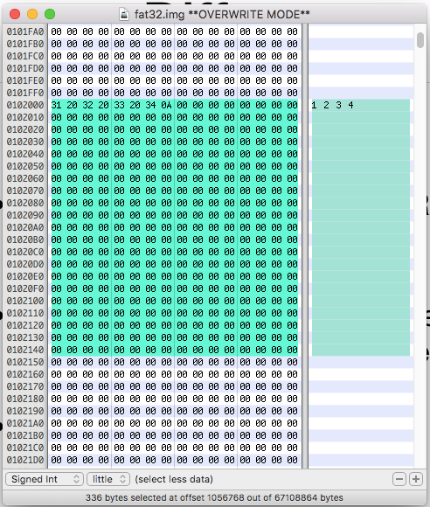
Function: read FILENAME
Remember that data stored in a file is stored in RAW format inside the FAT32 image file
This means you must print the whole data inside the file as a string
The example on the right shows a text file with the contents “1 2 3 4”

Slide 14
Function: read FILENAME
To read in the file contents,
  First, check that the read the file is open and that it was opened with MODE r, rw, or wr
Iterate through all clusters of the file printing the contents at each cluster
  Read entire cluster into char array and print contents
  You may want to use fread and puts functions

Slide 15
Function: read FILENAME OFFSET SIZE
Given a FILENAME, read SIZE bytes of the FILENAME starting at OFFSET
At each cluster, need to calculate which bytes to read based on SIZE and OFFSET!
Edge cases: OFFSET > sizeof(FILENAME)
  Print error
SIZE > sizeof(FILENAME),
  Print entire file
OFFSET + SIZE > sizeof(FILENAME)
  Prints sizeof(FILENAME) - OFFSET bytes (from offset to end of file)

Slide 16
Function: read FILENAME OFFSET SIZE
Note: OFFSET may not be perfectly divisible by sector_size (i.e. OFFSET may not be synchronized with the cluster.)
The / and % operators are your friend:
  OFFSET / bytes_per_sec = cluster offset
  OFFSET % bytes_per_sec = byte offset within cluster

Slide 17
Function: write FILENAME OFFSET SIZE STRING
Check MODE to ensure file was opened with write permissions
Initialize a char array of SIZE bytes
Need to write STRING to the file using fwrite
Once again, the file might span multiple clusters
  You may need to allocate new clusters or remove existing clusters

Slide 18
Function: write FILENAME OFFSET SIZE STRING
Edge cases:
FILENAME is a large file (say 1024 bytes), and you are supposed to write 20 bytes at OFFSET 100.
  Overwrite the 20 bytes since OFFSET 100, and then 0 out the rest of the contents of the file
  If there are clusters after the current cluster, unlink them (similar to rm and rmdir)
OFFSET > sizeof(FILENAME)
  Print error
OFFSET < sizeof(FILENAME) but OFFSET + SIZE > sizeof(FILENAME)
  Write the STRING on the (OFFSET/sector_size) cluster at OFFSET%sector_size point of the cluster, overwrite whatever is there
  This may require allocating a new cluster
Make sure to update DIR_Size appropriately for all writes!

Slide 19
Function: write FILENAME OFFSET SIZE STRING
What if the length of STRING is not equal to SIZE?
  If STRING < SIZE, pad 0s (ASCII value 0) to the rest of the char array
  If STRING > SIZE, just use the first SIZE bytes of STRING, put them in the char array and write to file

Slide 20
When in doubt, check the FATspec!

