Slide 1
Building & Unit Testing Angular JS Projects
An explanation of Angular project structure and Test/Behavioral-Driven Development
Presenter: Andy Martin
Timebox: 90 minutes including Demo and Q&A

Slide 2
Unit Testing Benefits, Concerns
Pros:
Your features will work…
Know immediately when a change affects other parts of code
Remove and prevent loose code
Green test coverage reports make everyone happy!
Cons:
Setting up the test environment can be daunting
Maintaining test-first discipline is challenging
Carpal tunnel syndrome…?

Slide 3
Test Environment Setup
Use npm to install karma, jasmine, and other dependencies
npm install --save-dev <package>
Multiple packages can be installed with a single command
npm install --save-dev karma jasmine karma-phantomjslauncher
Run karma init in the folder where you want the config file
The root folder of your application is a good place, or ./test/
Inside karma.conf.js-
Include necessary scripts (Angular, jQuery, project files, etc.)
Any JavaScript files included in index.html should be here
Set up reporters, browsers, etc.
Reporters I like: ‘dots’, ‘coverage’ (we’ll talk about coverage soon)
Browser of choice: PhantomJS (headless webkit browser)
Advanced: plugins like json-mocks can allow us to add functionality

Slide 4
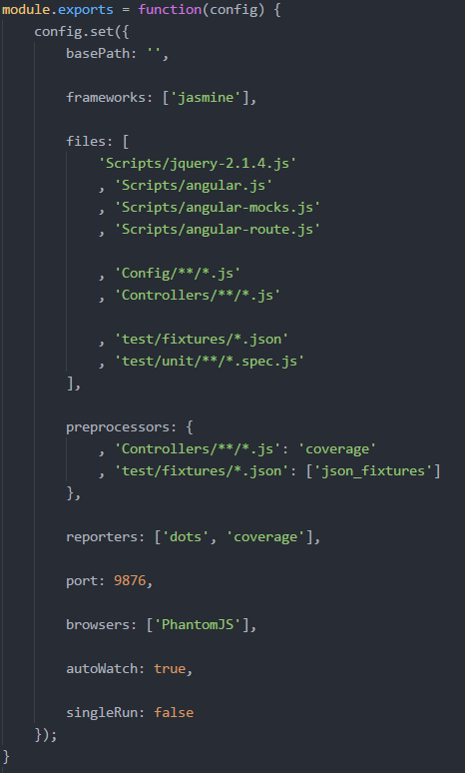
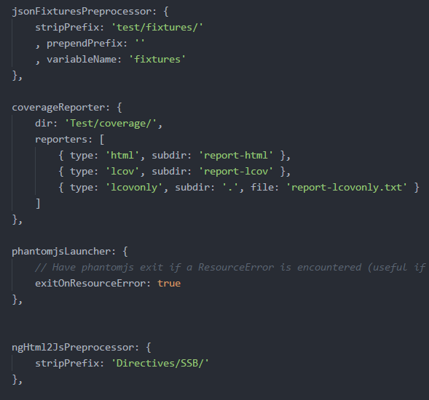
What does karma.conf.js look like?
Notes:
(left)
File listing
Wildcards are allowed in file/folder names
Make sure libraries, project files, and test spec files are included here
Choose appropriate pre-processors, reporters, browsers, and watch settings
(Right)
pre-processor and plugin options

Slide 5
Let’s write some unit tests!

Slide 6
Best Practices For Writing Unit Tests
Have a test suite setup section (beforeEach)
Mock/Stub any required dependencies
If the testing framework allows, use nesting where applicable
In the case of Jasmine, nesting allows us to cascade setups
Keep test descriptions relatively loose (but still precise)
Think “it should denote that a user is valid”
Not “it should set user.valid to true”
Write comprehensive test suites
Each test should handle a single unit of work
Coverage should be high (100% or near)
Write testable code
Mock/Stub dependent method calls
Pass variables through function arguments

